Slide 1
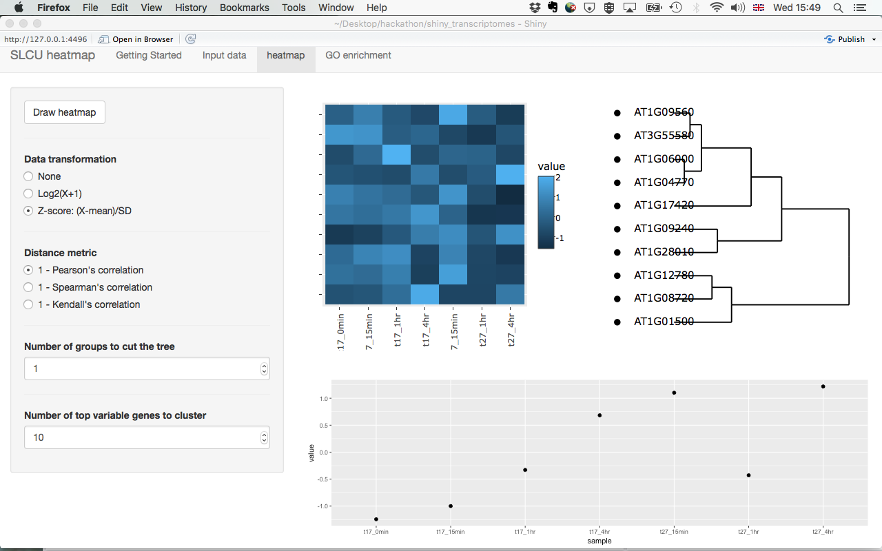
Shiny app for interactive visualization of expression data
Cambridge Bioinformatics Hackathon 25-27 September 2017
https://github.com/gogleva/shiny_transcriptomes
Anna Gogleva, Hugo Tavares, Sandra Cortijo

