Slide 1

Identifying Unknown Malware Intrusion by Supercomputing
Taosha Wang
Ronny Ko

Slide 2
Limitation of All Security Software
cyber attacks and cyber security are in endless arms race
Software attack → software protection → smarter attacks → smarter
protections → ...... (never ends)
Smart Cars: even a single security breach can take away the driver’s life!
Is there a protection scheme with a guarantee that no software attacks can
possibly break...?
Tamper-proof security hardware

Slide 3
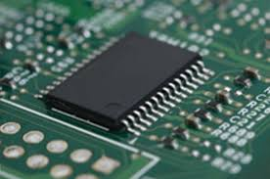
Malware Detection & Identification by Tamper-proof Hardware
TPM (Trusted Platform Module): Tamper-proof security chip
TPM is an independent chip from CPU
TPM has its own registers and RSA private key burned at manufacture stage,
which never gets revealed outside the TPM
CPU communicates with TPM to leverage TPM’s security services
TPM is mainly used for:
- Integrity Measurement for launched software binaries
- Remote Attestation

Slide 4
TPM Chip’s Security Features
Contains special registers, called PCR
[TPM’s PCR update rule]
PCR_{n+1} = SHA1(PCR_{n} | hash_{n+1})
→ PCR accumulates & stores the 20-byte hash signature of the system’s all
loaded binaries, modules, shared libraries since the computer’s boot-time
→ SHA1() is a non-invertible cryptographic hash function
→ can’t intentionally update PCR to some expected value

Slide 5
System Integrity Measurement
[System Boot-up Sequence]
BIOS → bootloader (GRUB2)
→ OS kernel image (Linux, iOS, windows)
startup executables, scripts, modules, shared libraries
additional binaries
[TPM’s PCR update rule]
PCR_{n+1} = SHA1(PCR_{n} | hash_{n+1})
......
User-space executables, scripts,
kernel modules, shared libraries
n=4,5,6...
......
n=3
Kernel image (Linux)
n=2
Bootloader (GRUB2)
n=1
BIOS
[System Boot-up Software Stack]

Slide 6
System Integrity Measurement
[System Boot-up Sequence]
BIOS → bootloader (GRUB2)
→ OS kernel image (Linux, iOS, windows)
startup executables, scripts, modules, shared libraries
additional binaries
[TPM’s PCR update rule]
PCR_{n+1} = SHA1(PCR_{n} | hash_{n+1})
......
Malware!!!
......
User-space executables, scripts,
kernel modules, shared libraries
n=4,5,6...
......
n=3
Kernel image (Linux)
n=2
Bootloader (GRUB2)
n=1
BIOS
[System Boot-up Software Stack]

Slide 7
Malware Identification
void Recursive_Malware_Select (int depth) {
1. Continue recursion to generate every possible malware combination
---------------- CUDA / OpenACC section ---------------------------------------
2. for-loop: insert each malware selected in step 1 into every possible position
in the expected boot-up software stack log 3. Simulate & compute the PCR value.
4. Check if step 3’s result is the same as the TPM-signed PCR value
(if yes, break the for-loop / if not, go back to step 2)
--------------------------------------------------------------------------------------
}
[Malware Identification Pseudo Code]

Slide 8
Remote Attestation
Server Client
{r: random number}
{PCR | r} {Sign_{RSA}(PCR | r, privateKey_{TPM}) }
Verify_{RSA}(PCR | r, publicKey_{TPM})
(step 1)
(step 2)
(step 3)

Slide 9
Experiments

Slide 10
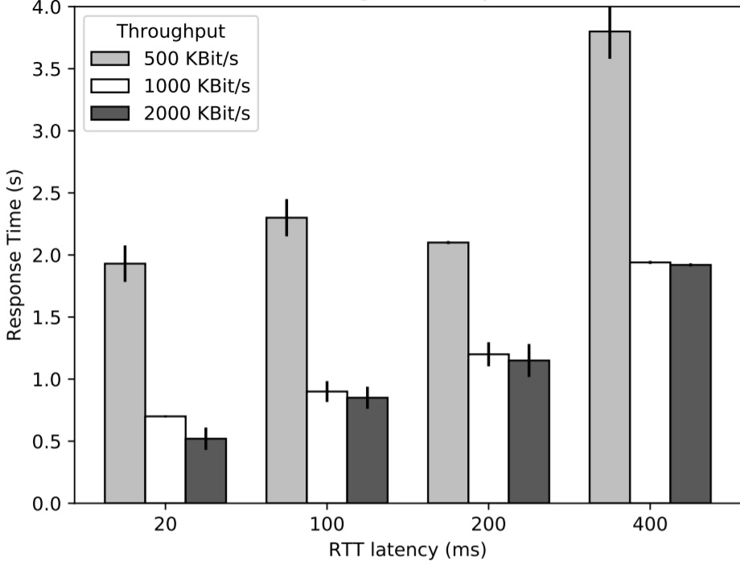
Remote Attestation
- 200 binary files loaded during boot-up
- The attestation delay becomes higher with the increasing network latency, but decreases with the increasing bandwidth.

Slide 11
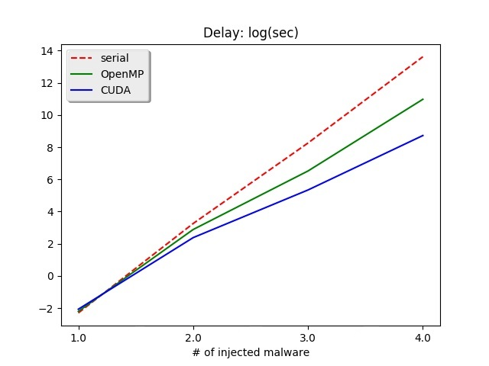
Malware Identification with Parallel-computing
Measuring execution time for multiple SHA1 computations (200, 200², 200³, 200⁴)
OpenACC: upto 10x speedup
CUDA: upto 100x speedup
- Practical enough up to the scenario of 4 malware injection

Slide 12
Conclusion
Leveraging parallel computing enables identifying a reasonable number of concurrently intruding malware even without the launch log file.
Future research:
- How to identify self-modifying malware?
- How to handle multi-core CPU’s non-deterministic binary launch sequence?

