Slide 1
Onset Detection with Spiking Neural Network
Huang-Yu, Yao
Institude of Systems Neuroscience
2019/06/18

Slide 2
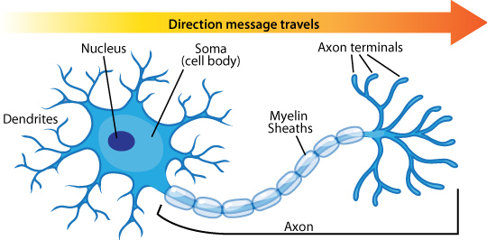
Biological neuron
https://askabiologist.asu.edu/neuron-anatomy

Slide 3
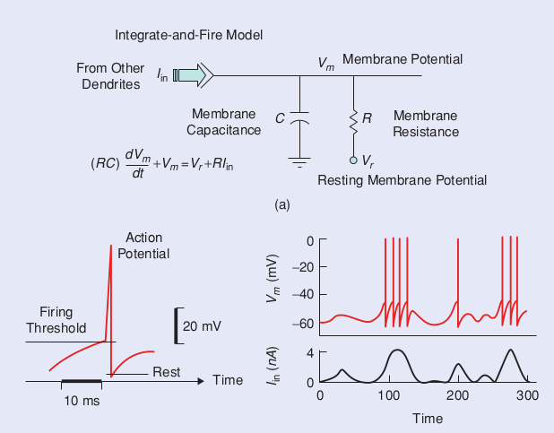
Spiking neural model
R. Munkong and B. Juang, "Auditory perception and cognition," in IEEE Signal Processing Magazine, vol. 25, no. 3, pp. 98-117, May 2008.

Slide 4
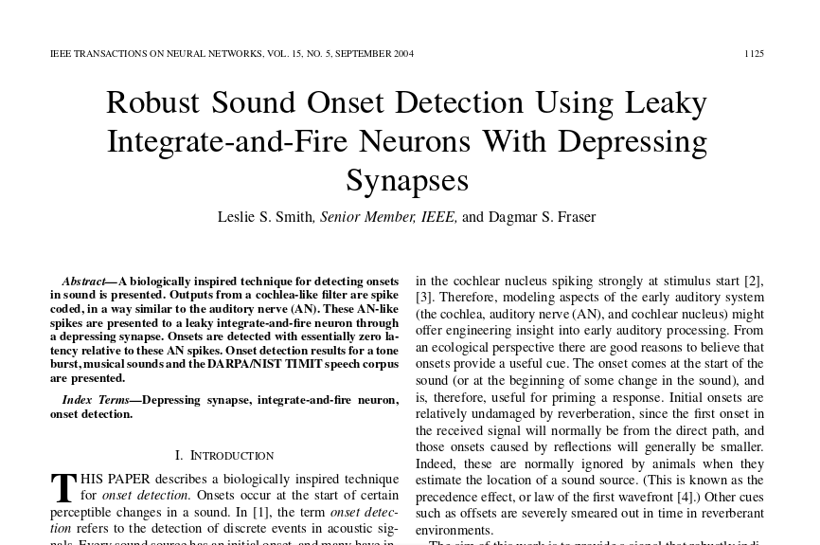
Previous work

Slide 5



Tools
Gammatone filter – cochlea and auditory nerve fiber
SNN simulator – higher level neural circuit

Slide 6
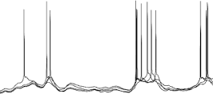
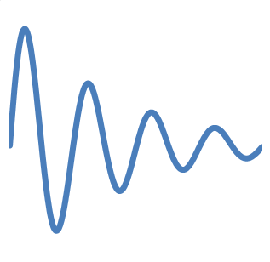
Network
Gammatone filterbank
Onset spikes
Signal

Slide 7
Dataset
ODB (onset detection database)
  19 real recordings in wav format and their onset positions in text format.

Slide 8
Evaluation
We consider an onset to be correctly matched if a detected onset is reported within 50 ms of the ground truth onset time.
c: number of correct detections, FP: false positive, FN: false negative
Merged rate, doubled rate and mean deviation are also provided.

Slide 9
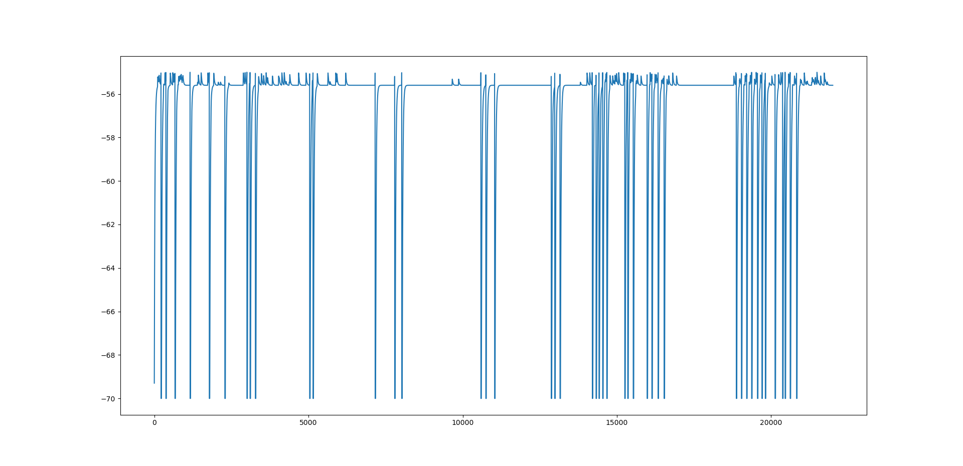
Brief result

Slide 10
Future works
Network fine-tuning
Full dataset evaluation

Slide 11
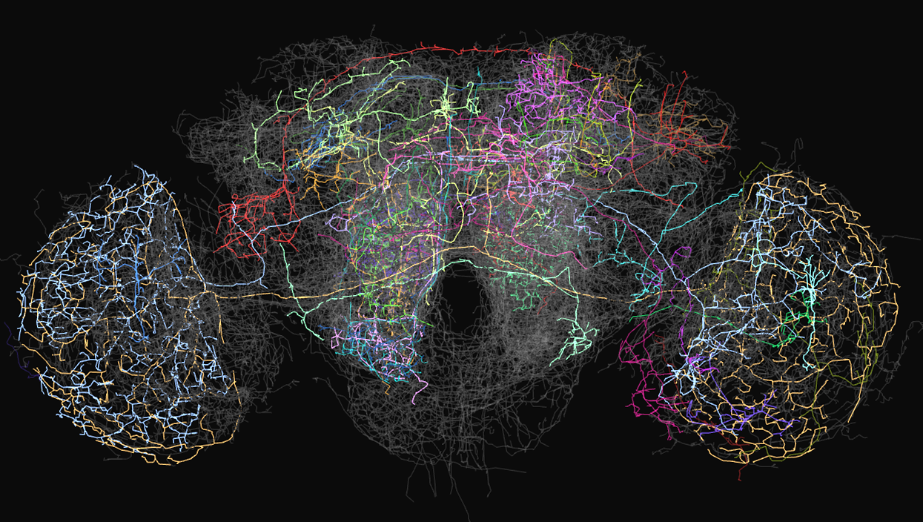
Thanks for your attention!

Slide 12
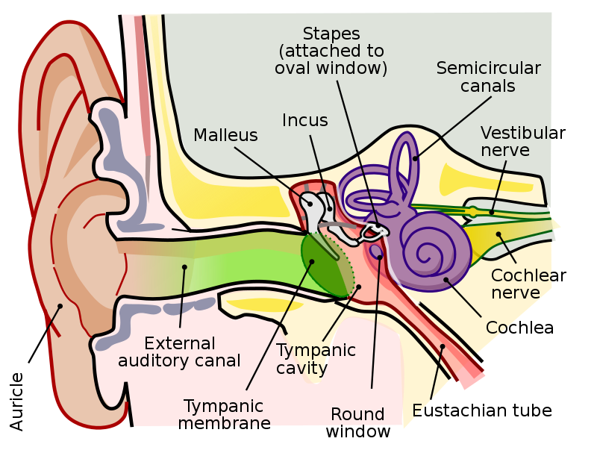
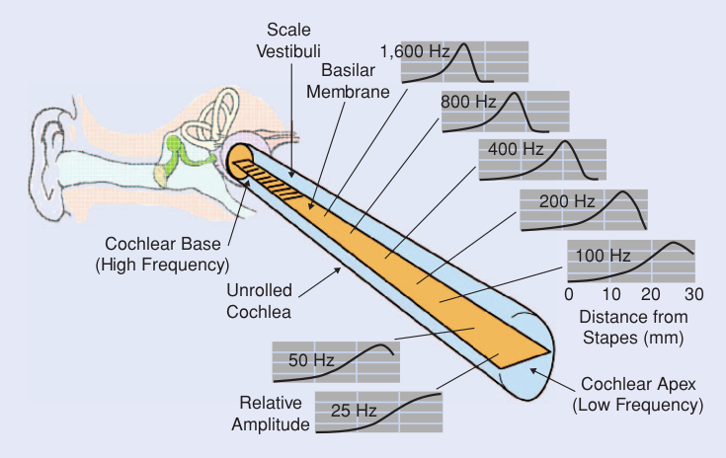
Auditory periphery
https://en.wikipedia.org/wiki/Auditory_system

