Slide 1

GenerativeAI and Its Applications
Unit 1
(UE23CS342BA4)
Tokenization and Ngrams
Dr. Pooja Agarwal
Dept. of CSE, PES University, Bangalore

Slide 2

Generative AI and its Applications
Tokenization and Ngrams

Slide 3
GenerativeAI and Its Applications
Acknowledgement
The slides are prepared from various resources from the Universities from abroad and India. Also, some material is taken from reliable resources from internet throughout this course.

Slide 4
GenerativeAI and Its Applications
Content and Function Words
We may divide parts of speech into two major groups:
Content words are words that have meaning.
They are words we would look up in a dictionary,
such as "lamp," "computer," "drove.“
New content words are constantly added to the English
language; old content words constantly leave the language as they become obsolete.
Therefore, we refer to content words as an "open" class.
Nouns, verbs, adjectives, and adverbs are content parts of speech.
Content Words Function Words

Slide 5
GenerativeAI and Its Applications
Content and Function Words
Function words are words that exist to explain or create grammatical or structural relationships into which the content words may fit.
Words like "of," "the," "to," they have little meaning on
their own.
They are much fewer in number and generally do not change as English adds and omits content words.
Therefore, we refer to function words as a "closed" class.
Pronouns, prepositions, conjunctions, determiners qualifiers/intensifiers and interrogatives are some function parts of speech.

Slide 6
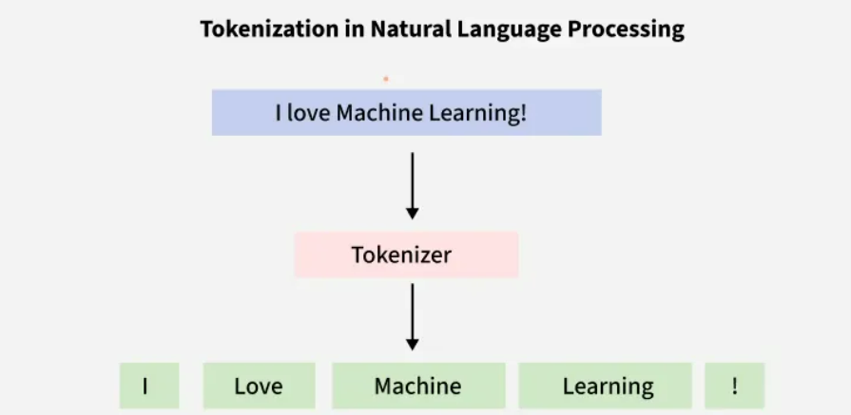
GenerativeAI and Its Applications
Tokenization
Tokenization is a fundamental step in Natural Language Processing (NLP). It involves dividing a Textual input into smaller units known as tokens.

Slide 7
GenerativeAI and Its Applications
Tokenization
How about
They picnicked by the pool, then lay back on the grass and looked at the stars.
18 tokens (again counting punctuation)
But we might also note that “the” is used 3 times, so there are only 16 unique types (as opposed to tokens).
In going forward, we’ll have occasion to focus on counting both types and tokens of both words and N-grams.
Prof. ABC
Dr. John
I saw a dog yesterday in the courtyard

Slide 8
GenerativeAI and Its Applications
Tokenization
Tokenization is the process of
breaking up the sequence of characters in a text by locating the word boundaries, the points where one word ends and another begins.
The words thus identified are frequently referred to as tokens.
In written languages ( like Chinese, Japanese, Turkish) where no word boundaries are explicitly marked in the writing system, tokenization is also known as word segmentation, and this term is frequently used synonymously with tokenization.
In addition to word segmentation, sentence segmentation is a crucial first step in text processing.

Slide 9
GenerativeAI and Its Applications
What a great day
Great work
Text Normalization
Once tokenization of the text is done,
Is it necessary to distinguish great, Great, and GREAT?
Sentence-initial capitalization may be irrelevant to the classification task.
Also the complete elimination of case distinctions will result in a smaller vocabulary, and thus smaller feature vectors.

Slide 10
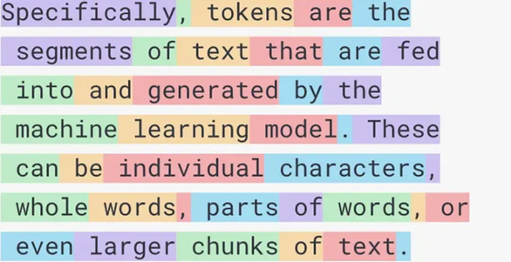
GenerativeAI and Its Applications
Tokenization
Tokenization is a foundational preprocessing step in natural language processing (NLP) that bridges the gap between raw text and machine learning models. It involves breaking down text into smaller units, called tokens, which are then converted into numerical IDs.
These IDs serve as the input to large language models (LLMs), where they are mapped to embeddings — vector representations that capture semantic meaning. The choice of tokenization method plays a vital role in determining the performance and efficiency of LLMs.

Slide 11
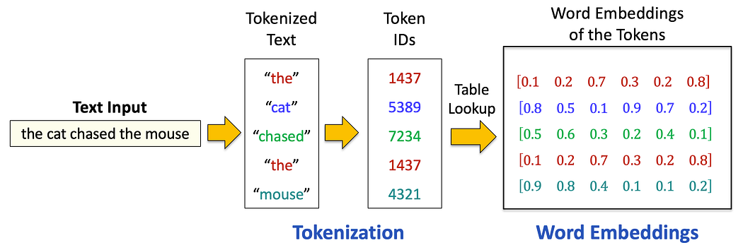
GenerativeAI and Its Applications
Tokenization
Tokenization is the process of transforming unstructured text into a structured format that machine learning models can understand. At its core, it involves segmenting a piece of text — whether a sentence, paragraph, or document — into smaller, manageable units called tokens.
These tokens can be words, subwords, or even individual characters, depending on the tokenization strategy employed.
Once tokenized, each token is assigned a numerical ID from a predefined vocabulary, converting text into a sequence of numbers.

Slide 12
GenerativeAI and Its Applications
Tokenization
Next, a table lookup retrieves word embeddings — dense vector representations — for each token ID from a pre-trained embedding matrix. These embeddings capture semantic meaning, enabling models to understand relationships between words, like the similarity between "cat" and "kitten".
This process is foundational for NLP tasks, allowing models to process and generate human language.

Slide 13
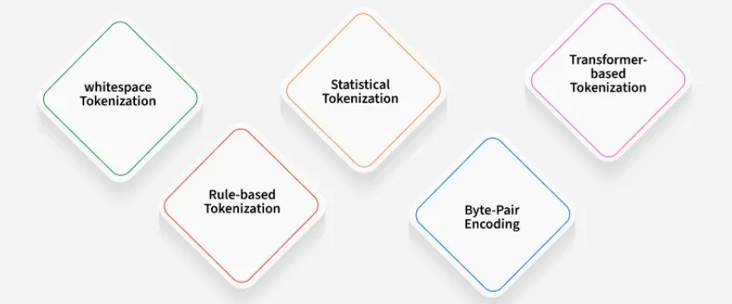
GenerativeAI and Its Applications
Popular Approaches of Tokenization
Tokenizer is designed specifically for transformer models.
Common Methods:
Uses spaces as delimiters
No linguistic or statistical knowledge
Learns that “machine learning” occurs often together
WordPiece (BERT)
BPE (GPT)
Unigram LM (SentencePiece)
Separate punctuation
Keep abbreviations together (e.g., “Dr.”)
Handle contractions (“don’t” → “do + n't”)
Break words into frequently occurring subwords.
Start with characters
Repeatedly merge most frequent character pairs
Build a subword vocabulary
Example: “unhappiness” → ["un", "happi", "ness"]

Slide 14
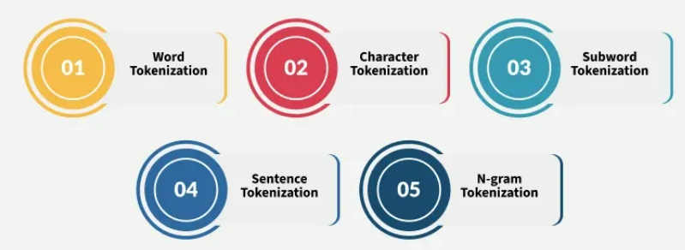
GenerativeAI and Its Applications
Types of Tokenization
Word Tokenization(It works well for languages with clear word boundaries, like English.)
Input before tokenization: ["Machine Learning is fascinating"]
Output when tokenized by words: ["Machine", "learning", "is", "fascinating"]

Slide 15
GenerativeAI and Its Applications
Types of Tokenization
Character Tokenization (This is useful for tasks like spelling correction or for tasks with unclear boundaries.
Input before tokenization: ["You are helpful"]
Output when tokenized by characters: ["Y", "o", "u", " ", "a", "r", "e", " ", "h", "e", "l", "p", "f", "u", "l"]

Slide 16
GenerativeAI and Its Applications
Types of Tokenization
Sentence Tokenization (This is useful for tasks requiring individual sentence analysis or processing.)
Input before tokenization:["Artificial Intelligence is an emerging technology. Machine learning is fascinating. Computer Vision handles images. "]
Output when tokenized by characters:["Artificial Intelligence is an emerging technology.", "Machine learning is fascinating.", "Computer Vision handles images."]

Slide 17
GenerativeAI and Its Applications
Types of Tokenization
N-gram Tokenization (splits words into fixed-sized chunks (size = n) of data.)
Input before tokenization: ["Machine learning is powerful"]
Output when tokenized by characters: [('Machine', 'learning'), ('learning', 'is'), ('is', 'powerful')]

Slide 18
GenerativeAI and Its Applications
Types of Tokenization
Subword Tokenization (This is important in GenAI because it allows models to represent rare or unseen words more efficiently. Instead of increasing the vocabulary, subword tokenization enables models to work with a smaller vocabulary while generating more flexible outputs.
Input before tokenization:“fascination”
Output when tokenized by characters:[‘fas’, ‘cina’, ‘tion’]
["Time", "table"] , ["Rain", "coat"] , ["Grace", "fully"] , ["Run", "way"]

Slide 19

GenerativeAI and Its Applications
Subword Level Tokenization
Subword-level tokenization strikes a balance between character and word-level approaches by splitting words into smaller units, such as prefixes, suffixes, or other meaningful subword components.
The subword-level tokenization of the sentence "low lower lowest" would be ["low", "low", "er", "low", "e", "s", "t"]. The sub-word "low" is reused across all three words, reducing vocabulary size compared to word-level tokenization.
There are three popular subword tokenization algorithms: Byte Pair Encoding (BPE), WordPiece, and SentencePiece. Each algorithm employs a distinct approach to segmenting text into tokens

Slide 20
GenerativeAI and Its Applications
Subword Level Tokenization (Byte Pair Encoding (BPE))
BPE is a subword tokenization algorithm that builds a vocabulary by iteratively merging the most frequent pairs of characters or subwords.
This approach balances tokenization by keeping common words as whole tokens while breaking rare words into subword tokens, enabling models to handle unknown words efficiently without inflating the token count.
First introduced for data compression, BPE was adapted for NLP by OpenAI for models like GPT.
A key advantage of BPE is its ability to minimize or avoid UNK (unknown) tokens, which are detrimental to model performance.

Slide 21
GenerativeAI and Its Applications
Subword Level Tokenization (Byte Pair Encoding (BPE))
UNK tokens occur when a word isn’t in the model’s vocabulary, leading to:
Loss of Information: The model discards all context and meaning associated with the unknown word.
Inefficient Language Representation: Excessive UNK tokens distort the model’s understanding of the input.
Poor Generalization: Models struggle to generalize to unseen text when UNK tokens are prevalent.
Degraded Downstream Performance: Tasks like translation or summarization suffer due to misinterpretations.

Slide 22
GenerativeAI and Its Applications
Subword Level Tokenization (How BPE works)
Pre-Tokenization: first pre-tokenized into smaller units. "applied deep learning" might be split into ["applied", "deep", "learning"].
Initial Vocabulary: initial vocabulary consists of all individual characters found in the pre-tokenized words, often with a special end-of-word marker (e.g., </w>).
"deep" would initially be considered ["d", "e", "e", "p", "</w>"]
Iterative Merging: iteratively identifies and merges the most frequent adjacent pairs of characters or tokens. , if the pair ("e", "e") is the most frequent, it would be merged into a single token "ee". This new token is then added to the vocabulary.
Vocabulary Update: The merging process continues until a predefined vocabulary size is reached or no more frequent pairs can be found. Each merge operation creates a new token, which expands the vocabulary.
Final Tokenization: Once the vocabulary is finalized, the text is tokenized using the learned subword units, breaking down words into the largest possible subword tokens present in the vocabulary.

Slide 23
GenerativeAI and Its Applications
Subword Level Tokenization (How BPE works - Example)
Input text: "low lower lowest”
Pre-Tokenization (with end-of-word markers) : Initial Vocabulary: ["l", "o", "w", "</w>", "l", "o", "w", "e", "r", "</w>", "l", "o", "w", "e", "s", "t", "</w>"] (conceptual representation)
Iterative Merging: Count character pair frequencies across all words
("l", "o"): 3 occurrences (from “low”, “lower”, “lowest”)
("o", "w"): 3 occurrences
("e", "r"): 1 occurrence
("e", "s"): 1 occurrence
…and so on.
Most frequent pair: ("l", "o") (3 occurrences)
Vocabulary Update: Step 3: Merge most frequent pair New token: "lo" Current tokens:
["lo", "w", "</w>", "lo", "w", "e", "r", "</w>", "lo", "w", "e", "s", "t", "</w>"]
Step 4: Count pair frequencies again Most frequent pair: ("lo", "w") (3 occurrences)
Step 5: Merge most frequent pair New token: "low" Current tokens:
["low", "</w>", "low", "e", "r", "</w>", "low", "e", "s", "t", "</w>"]
Step 6: Count pair frequencies again
("e", "r"): 1 occurrence
("e", "s"): 1 occurrence
… (assuming no other pair is more frequent)
Let’s choose ("e", "r") arbitrarily (or based on global frequency if it were tied with other pairs across all words).
Step 7: Merge chosen pair New token: "er" Current tokens:
["low", "</w>", "low", "er", "</w>", "low", "e", "s", "t", "</w>"]
Final Tokenization: The actual tokens generated
["low</w>", "low", "er</w>", "low", "e", "s", "t</w>"]

Slide 24
GenerativeAI and Its Applications
Strengths of BPE
Handles OOV Words: Effectively breaks down rare or unknown words into known subword units.
Adaptive Vocabulary: The vocabulary is learned directly from the training data, adapting to different languages and domains.
Variable Token Length: Creates tokens of varying lengths, balancing between character and word units.
Limitations of BPE
Requires Pre-tokenization: Relies on initial splitting into “words” (e.g., by spaces), which can be challenging for languages without clear word boundaries (e.g., Chinese or Japanese).
Greedy Merging: The greedy nature of merging the most frequent pairs might not always lead to the most semantically optimal subword units.

Slide 25
GenerativeAI and Its Applications
Subword Level Tokenization (Wordpiece Tokenization)
WordPiece is a subword tokenization algorithm similar to BPE, but it distinguishes itself by how it selects token pairs for merging. Instead of merging the most frequent pairs, WordPiece merges pairs that maximize the likelihood of the training data.
This makes it particularly effective for models like BERT and is widely used by Google.
How Wordpiece Works
WordPiece is a subword tokenization algorithm similar to BPE, but it distinguishes itself by how it selects token pairs for merging. Instead of merging the most frequent pairs, WordPiece merges pairs that maximize the likelihood of the training data.
This makes it particularly effective for models like BERT and is widely used by Google.

Slide 26


GenerativeAI and Its Applications
How Wordpiece works
Initial Vocabulary: Like BPE, WordPiece starts with a vocabulary of individual characters or pre-tokenized words, often marked with a special prefix (e.g., ## for subword units that are not at the beginning of a word).
Likelihood Maximization: WordPiece selects the pair of tokens that, when merged, maximizes the likelihood of the training data.
This is typically done by calculating the score of a potential merge as
where P represents the probability of a token or sequence of tokens appearing in the training corpus. The pair with the highest likelihood gain is merged.

Slide 27
GenerativeAI and Its Applications
How Wordpiece works
Iterative Merging: The selected pair is merged, added to the vocabulary, and the process repeats until the desired vocabulary size is reached.
Final Tokenization: The text is tokenized using the learned subword units, prioritizing longer, more frequent units. Subword units that are not the start of a word are often prefixed with ## (e.g., [“un”, “##believ”, “##able”]).
WordPiece : “If I merge these two tokens, does the probability of the corpus increase?”

Slide 28
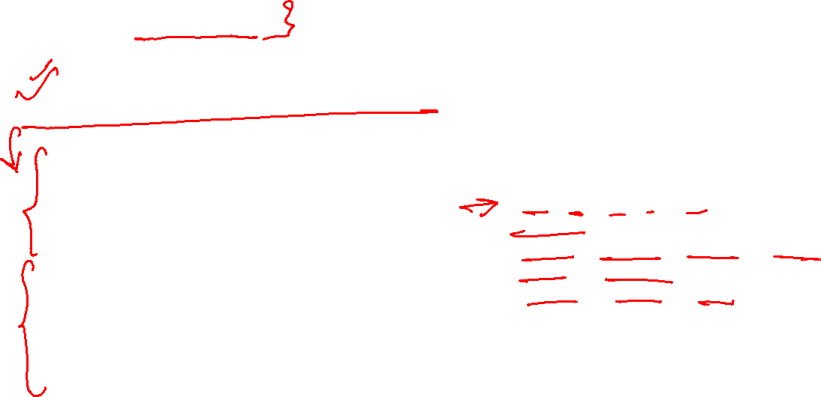
GenerativeAI and Its Applications
How Wordpiece works
Input text: "low lower lowest”
Pre-Tokenization (with end-of-word markers) : Initial Vocabulary: ["l", "o", "w", "</w>", "l", "o", "w", "e", "r", "</w>", "l", "o", "w", "e", "s", "t", "</w>"] (conceptual representation)
Likelihood-favorable merges: High-value merges
low (very frequent)
est (appears in newest, widest)
new
wid
er
Vocabulary learned
low
new
wid
est
er
Tokenizing the corpus
low → low
lower → low + er
newest → new + est
widest → wid + est
Final WordPiece Tokens
[ low , low , low , low , low ,
low , er ,
new , est , new , est , new , est , new , est , new , est , new , est ,
wid , est , wid , est , wid , est ]

Slide 29
GenerativeAI and Its Applications
Strengths of Wordpiece
Meaningful Subwords: By maximizing likelihood, WordPiece often generates more linguistically meaningful subword units.
Effective for BERT: Its design is particularly well-suited for masked language modeling tasks, as seen in BERT.
Handles OOV Words: Similar to BPE, it effectively breaks down unknown words into known subwords.
Limitations of Wordpiece
Requires Pre-tokenization: Like BPE, it typically relies on an initial word split (e.g., by spaces), which can be problematic for certain languages that lack clear word boundaries.
Prefix Markings: The ## prefix for internal subwords can sometimes be less intuitive for human interpretation.

Slide 30
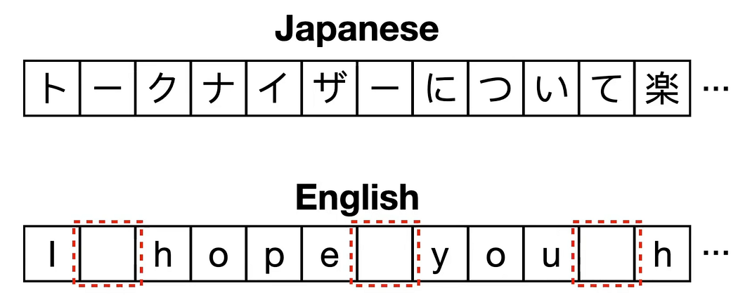

GenerativeAI and Its Applications
Subword Level Tokenization (Sentencepiece Tokenization)
SentencePiece treats the input text as a raw stream of characters, including spaces, eliminating the need for an initial word split.
This approach allows SentencePiece to handle languages with ambiguous word boundaries (like Chinese, Japanese, and Korean) seamlessly, making it a versatile choice for multilingual and non-space-delimited languages.
SentencePiece processes the input text as a continuous stream of characters, including spaces.

Slide 31
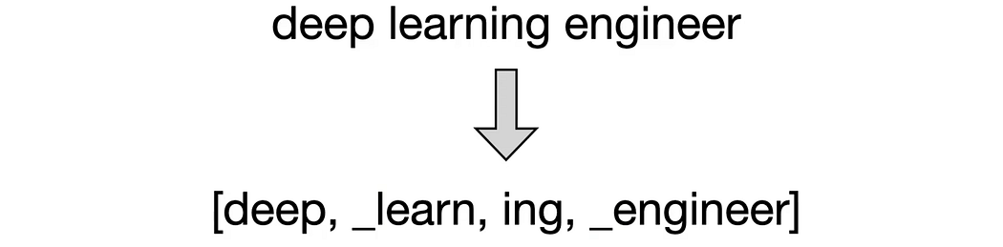

GenerativeAI and Its Applications
How Sentencepiece WOrks
Input as Character Stream: SentencePiece considers the entire input text as a continuous sequence of characters, including spaces. It replaces spaces with a special placeholder character (typically _).
Merging Algorithm: It can employ either a BPE-like merging algorithm (merging most frequent pairs) or a Unigram Language Model tokenizer.
BPE-like merging: It iteratively merges the most frequent character/subword pairs to build the vocabulary.
Unigram tokenizer: This method works in reverse. It initializes its vocabulary to a very large number of potential tokens and then iteratively prunes (removes) tokens that reduce the likelihood of the training data the least, until the desired vocabulary size is achieved.
Space Handling: SentencePiece explicitly learns how to handle spaces by treating them as regular characters during training. When tokenizing, it uses an underscore (_) as a placeholder for spaces to ensure the original text can be perfectly reconstructed.
Reconstructing Sentences: The original sentence can be perfectly
reconstructed by concatenating the tokens and replacing the
underscores with spaces.

Slide 32

GenerativeAI and Its Applications
How Sentencepiece WOrks
Input Text : “low low low low low lower lower newest newest newest newest newest newest widest widest widest”
Raw text (no preprocessing!)
SentencePiece keeps whitespace using ▁:
▁low ▁low ▁low ▁low ▁low ▁lower ▁lower ▁newest ▁newest ▁newest ▁newest ▁newest ▁newest ▁widest ▁widest ▁widest
Initial large vocabulary (examples)
▁low
▁new
▁wid
est
er
▁lower
▁newest
▁widest
Unigram probability pruning
SentencePiece removes tokens that reduce likelihood least.
Final preferred tokens:
▁low
▁new
▁wid
est
er
Tokenization
▁low
▁lower → ▁low + er
▁newest → ▁new + est
▁widest → ▁wid + est
Final SentencePiece Tokens
▁low
▁low er
▁new est
▁wid est

Slide 33

GenerativeAI and Its Applications
Strengths of Sentencepiece
Language Agnostic: Handles a wide range of languages, especially those without explicit word boundaries, by treating input as a raw character stream.
No Pre-tokenization: Eliminates the need for language-specific pre-tokenizers, simplifying multilingual pipelines.
Perfect Reconstruction: Guarantees that the original text can be perfectly reconstructed from its tokens due to explicit space handling.
Flexible Algorithms: Can use both BPE and Unigram LM approaches for vocabulary learning.

Slide 34
GenerativeAI and Its Applications
Limitation of Sentencepiece
Less Intuitive Tokens: The use of _ for spaces can make the tokenized output less intuitive for human reading or debugging compared to word-level tokens.
Increased Vocabulary for Spaces: Explicitly learning spaces might slightly increase the effective vocabulary or sequence length compared to methods that implicitly handle spaces.

Slide 35
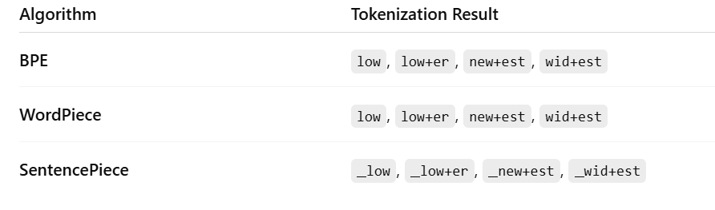
GenerativeAI and Its Applications
Final Side by Side Comparison
All three may produce similar outputs, but they arrive there using completely different principles.
BPE: frequency
WordPiece: likelihood
SentencePiece: probabilistic pruning + whitespace modeling

Slide 36
generativeAI and Its Applications
Types of Ambiguities in Words

Slide 37
GenerativeAI and Its Applications
Ambiguity
Sarah is wearing a pink t-shirt or her dog????
Sarah gave a bath to her dog wearing a pink t-shirt.
I have never tasted a cake quite like that one before!
Is the cake good or bad??

Slide 38
GenerativeAI and Its Applications
Types of Ambiguities
Ambiguities
Anaphoric
Lexical
Syntactic
Semantic

Slide 39
GenerativeAI and Its Applications
Lexical Ambiguity
Lexical Ambiguity:
Related to words.
This type of ambiguity represents words that can have multiple assertions.
For instance, in English, the word “back” can be a noun ( backstage), an adjective (back door), or an adverb (back away).
Words have multiple meanings. "I saw a bat." bat = flying mammal / wooden club/ Sports equipment? saw = past tense of "see" / present tense of "saw" (to cut with a saw.)backstage

Slide 40
GenerativeAI and Its Applications
Syntactic Ambiguities
Syntactic Ambiguity:
This type of ambiguity represents sentences that how a particular sentence can be parsed in multiple syntactical forms.
In multiple Structural representation which one needs to be selected.
Eg.
“ I heard his cell phone ring in my office”.
The propositional phrase “in my office” can be parsed in a way
that modifies the noun or
another way that modifies the verb.

Slide 41
GenerativeAI and Its Applications
Syntactic Ambiguities
Syntactic Ambiguity:
This type of ambiguity represents sentences that how a particular sentence can be parsed in multiple syntactical forms.
In multiple Structural representation which one needs to be selected.
Eg.
“ I heard his cell phone ring in my office”.
The propositional phrase “in my office” can be parsed in a way
that modifies the noun or
another way that modifies the verb.
verb
noun

Slide 42

GenerativeAI and Its Applications
Syntactic Ambiguity
Another Example:
Mary ate a salad with spinach from California for lunch on Tuesday.“
"with spinach" can attach to "salad" or "ate“,
"from California" can attach to "spinach", "salad", or "ate".
"for lunch" can attach to "California", "spinach", "salad", or "ate"
and "on Tuesday" can attach to "lunch", "California", "spinach", "salad" or "ate".
Nonetheless there are 42 possible different parse trees for this sentence.

Slide 43
GenerativeAI and Its Applications
Semantic Ambiguity
Semantic Ambiguity: Related to the interpretation of sentence. OR
How you interpret the meaning of entire senetence.
Eg.,
I heard his cell phone ring in my office can be interpreted as if “I was physically present in the office” or as if “the cell phone was in the office”.
Lucy owns a parrot (existentially quantified) that is larger than a cat (either universally quantified or means "typical cats")
Another Example
"The dog is chasing the cat." vs. "The dog has been domesticated for 10,000 years."
In the first sentence, "The dog" means to a particular dog;
In the second, it means the species "dog".

Slide 44
GenerativeAI and Its Applications
Anaphoric Ambiguity
Anaphoric ambiguity
A phrase or word refers to something previously mentioned, but there is more than one possibility for machine to understand that word.
Eg.
"Margaret invited Susan for a visit, and she gave her a good lunch." (she = Margaret; her = Susan)
"Margaret invited Susan for a visit, but she told her she had to go to work" (she = Susan; her = Margaret.)
"On the train to Boston, George chatted with another passenger. The man turned out to be a professional hockey player."
(The man = another passenger).

Slide 45
GenerativeAI and Its Applications
Metonymy Ambiguity
Metonymy:
The most difficult type of ambiguity, metonymy deals with phrases in which the literal meaning is different from the figurative assertion.
Eg.,
Samsung is screaming for new management.
Here screaming doesn’t literally mean yelling.
Looking for a better management

Slide 46

GenerativeAI and Its Applications
Examples
Find the different types of ambiguities in the following sentence.
“Elsa tried to reach her aunt on the phone, but she didn't answer”.
1. Lexical ambiguity:
The word "tried" means "attempted" not "held a court proceedings", or "test" (as in "Elsa tried the lemonade"). The word "reach" means "establish communication" not "physically arrive at" (as in "the boat reached the shore").
Syntactic ambiguity:
The phrase "on the phone" attaches to "reach" and thus means "using the phone" not to "aunt" which would mean "her aunt who was physically on top of the phone" (compare "her aunt in Seattle").
Anaphoric ambiguity:
"she" means the aunt, not Elsa.

Slide 47
Thank You

