Slide 1

GenerativeAI and Its Applications
Unit 1
(UE23CS342BA4)
Language Models and Ngrams
Dr. Pooja Agarwal
Dept. of CSE, PES University, Bangalore

Slide 2

Generative AI and its Applications
Ngrams

Slide 3
GenerativeAI and Its Applications
Language Modelling
I am very ……….
Language modeling (LM) is the use of various statistical and probabilistic techniques to determine the probability of a given sequence of words occurring in a sentence.
Language models analyze body of text data to provide a basis for their word predictions.
They are used in natural language processing (NLP) applications, particularly ones that generate text as an output.
Eg, in Machine Translation and Question Answering systems.

Slide 4
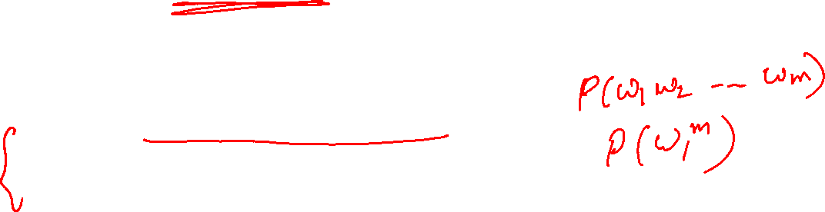
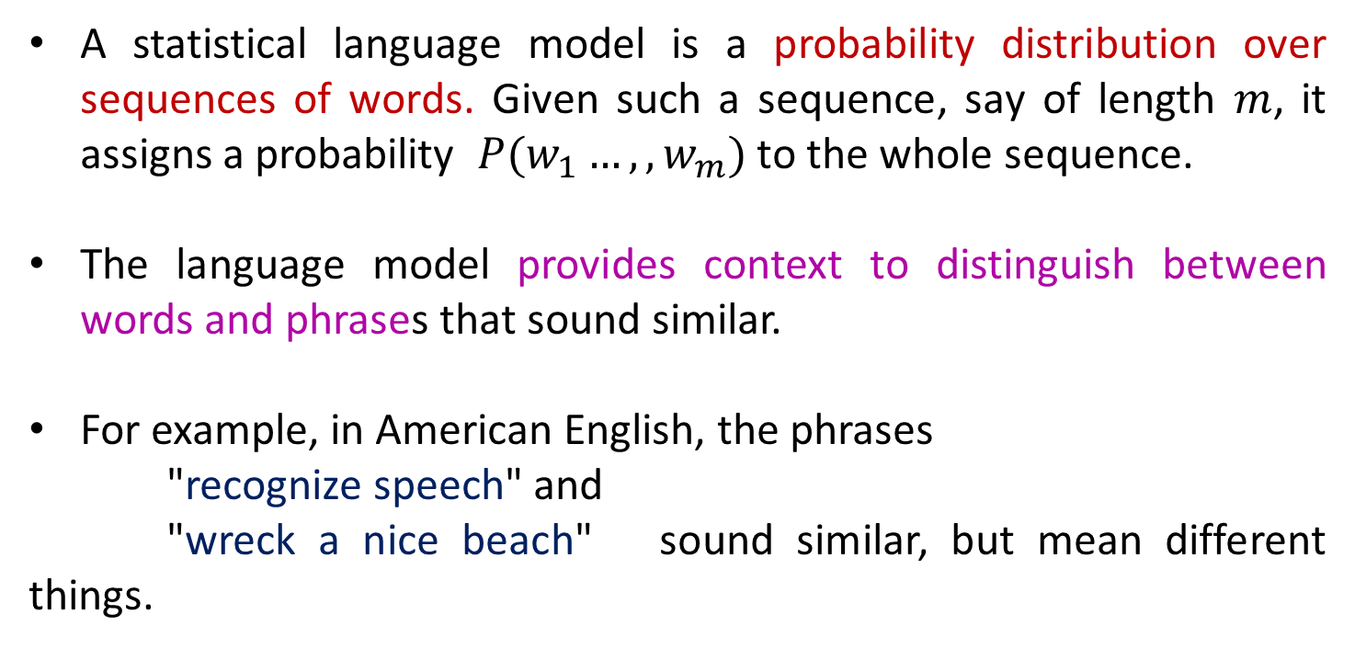
GenerativeAI and Its Applications
Language Modelling
A statistical language model is a probability distribution over sequences of words. Given such a sequence, say of length $m$, it assigns a probability $P(w_{1}…, ,w_{m})$ to the whole sequence.
The language model provides context to distinguish between words and phrases that sound similar.
For example, in American English, the phrases
"recognize speech" and
"wreck a nice beach" sound similar, but mean different things.

Slide 5
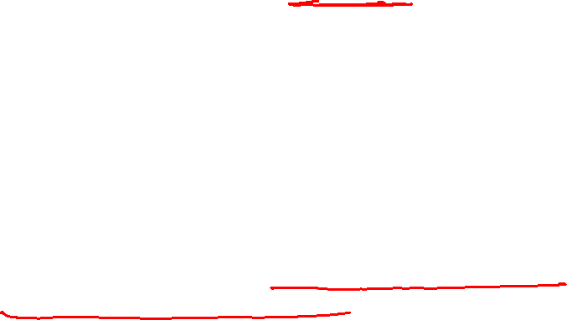
GenerativeAI and Its Applications
How language modeling works
Language models determine word probability by analyzing text data.
They interpret this data by feeding it through an algorithm that establishes rules for context in natural language.
The data is educated by the language model, and they feed it through an algorithm
It finds the rules for context in the natural language and this way, the model applies these rules in different type of language tasks to accurately predict the new sentences.

Slide 6
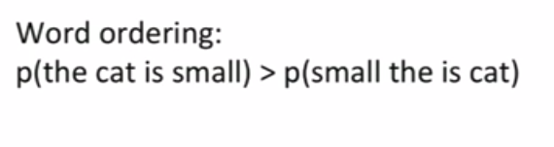
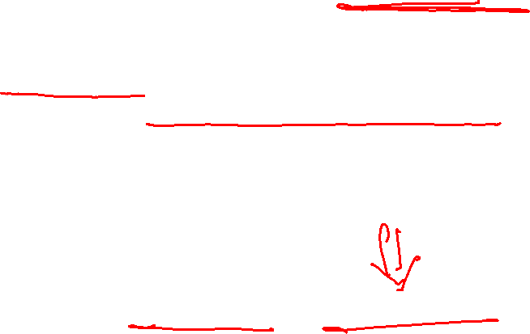
GenerativeAI and Its Applications
Why Probability of words?
A language model learns to predict the probability of a sequence of words.
But why do we need to learn the probability of words? Let’s understand that with an example.
I am reading a book
Eg. In Machine Translation, a bunch of words are taken from a language and convert these words into another language.
There can be many potential translations, so compute the probability of each of these translations to understand which one is the most accurate.

Slide 7
GenerativeAI and Its Applications
This ability to model the rules of a language as a probability gives great power for NLP related tasks.
Language models are used in
speech recognition,
machine translation,
part-of-speech tagging,
parsing,
Optical Character Recognition,
handwriting recognition,
information retrieval, and many other daily tasks.

Slide 8
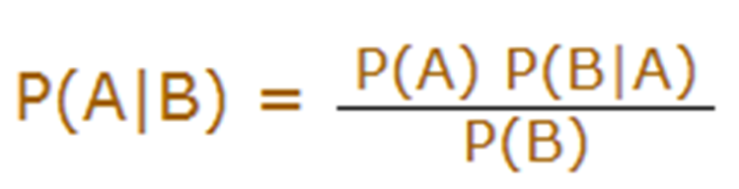
GenerativeAI and Its Applications
RECAP: Bayes’ theorem
The formula is:
Which tells us: Probability of event A occurring at a particular place given event B, written P(A|B),
Say A is the “predicted word” and B is the “another word that appears before A”.
When we know:
how often B happens given that A happens, written P(B|A) and
how likely A is on its own, written P(A) and
how likely B is on its own, written P(B)

Slide 9
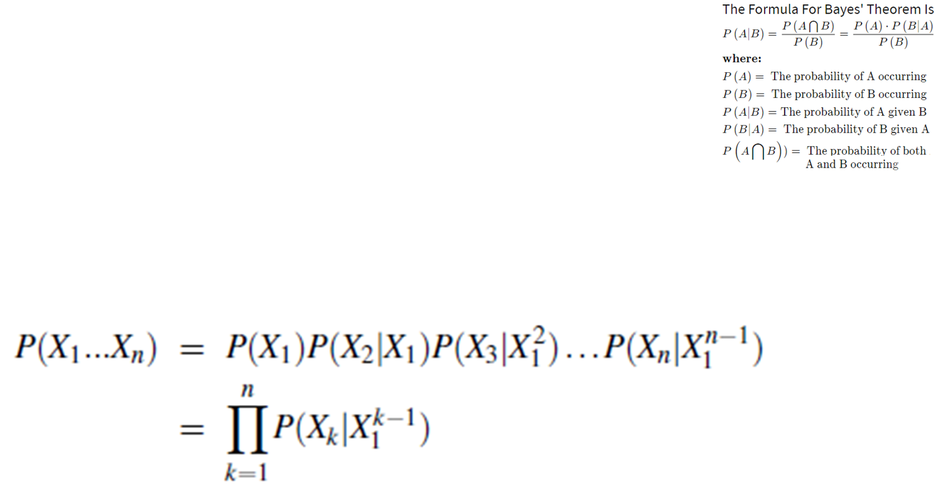
GenerativeAI and Its Applications
RECAP : Chain rule of probability
We can rearrange the formula for conditional probability to get the so-called product rule:
P(A,B) = p(A) p(B|A)
We can extend this for three variables:
P(A,B,C) = P(A) P(B|A) P(C|A,B)
and in general to n variables:
P(X1, X2, ..., Xn) =P(X1) P(X2| X1) P(X3|X1,X2), ..., P(Xn|X₁^{n-1})

Slide 10
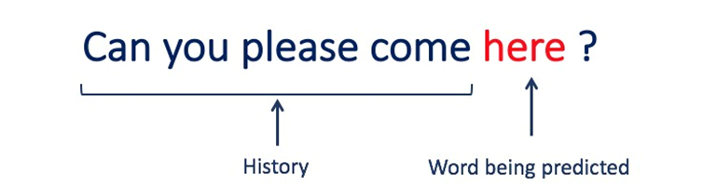
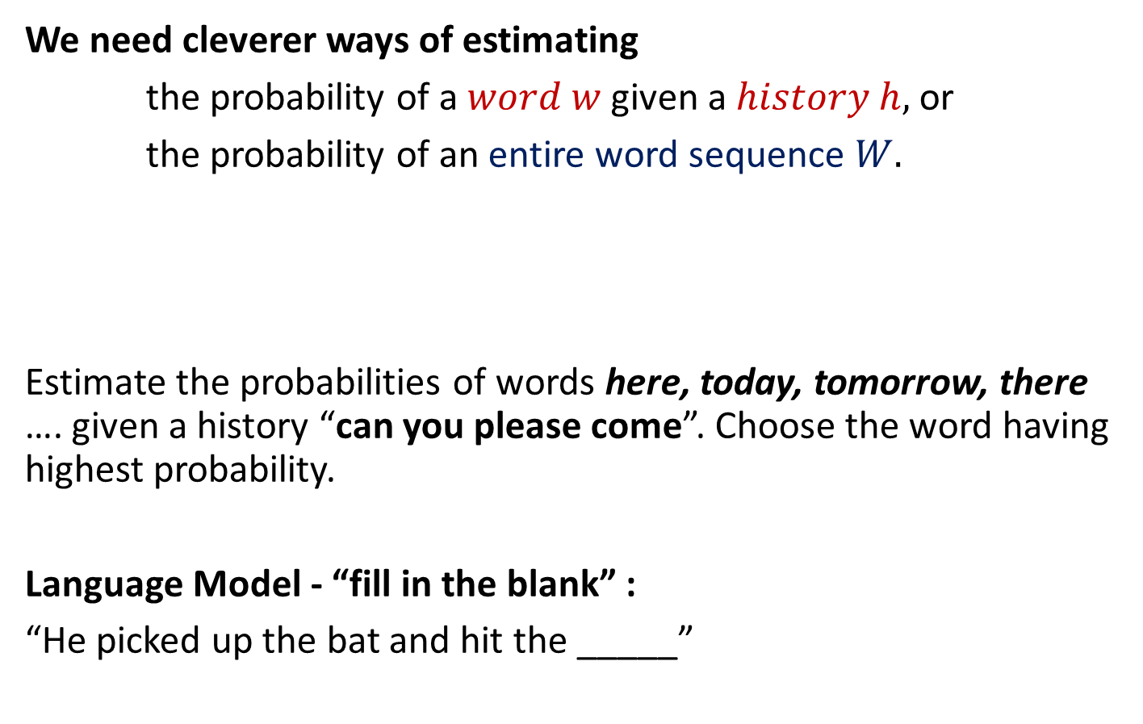
GenerativeAI and Its Applications
Defining Probabilistic Language Modeling
I am reading …………
We need cleverer ways of estimating
the probability of a $word$ $w$ given a $history h,$ or
the probability of an entire word sequence $W.$
Estimate the probabilities of words here, today, tomorrow, there …. given a history “can you please come”. Choose the word having highest probability.
Language Model - “fill in the blank” :
“He picked up the bat and hit the _____”
i.e. P(w|h) or P(word|history)

Slide 11
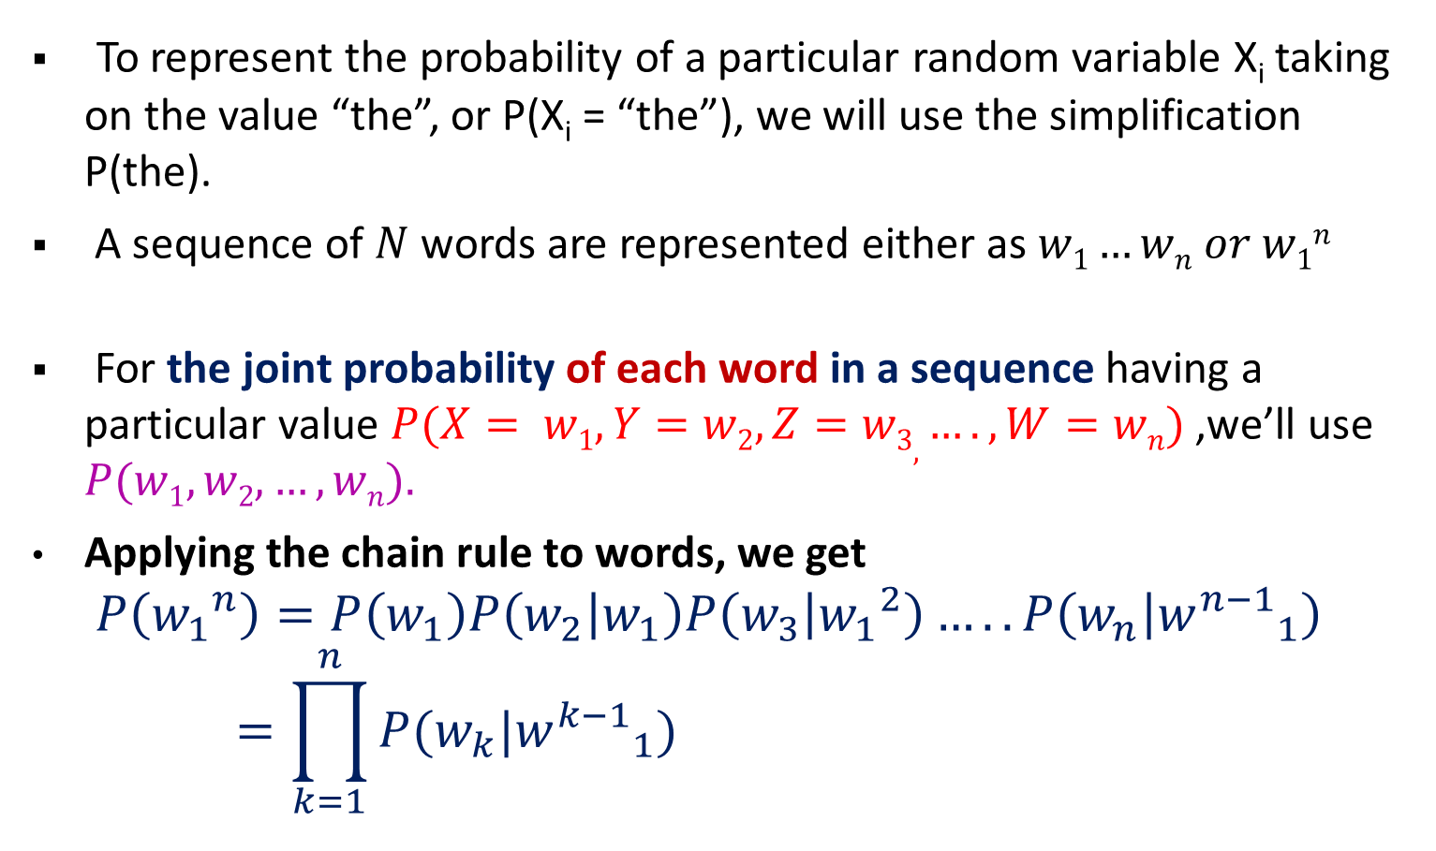
GenerativeAI and Its Applications
Defining Probabilistic Language Modeling
To represent the probability of a particular random variable X_{i} taking on the value “the”, or P(X_{i} = “the”), we will use the simplification P(the).
A sequence of $N$words are represented either as $w1…wn or w1n$
For the joint probability of each word in a sequence having a particular value $P(X= w1,Y=w2,Z=w3, ….,W=wn)$ ,we’ll use $P(w1,w2,…,wn).$
Applying the chain rule to words, we get
$$P\left({w_{1}}^{n}\right)=P\left(w_{1}\right)P\left(w_{2} | w_{1}\right)P\left(w_{3} | {w_{1}}^{2}\right)…..P\left(w_{n} | {w^{n−1}}_{1}\right)=\prod_{k=1}^{n}{P(w_{k}|{w^{k−1}}_{1})}$$

Slide 12
GenerativeAI and Its Applications
DEFINING Probabilistic Language Modelling
Compute the probability of a sentence or sequence of words:
P(W) = P(w₁,w₂,w₃,w₄,w₅…w_{n})
Related task: Say if I have four words (w₁,w₂,w₃,w₄) then probability of an upcoming word w₅ :
P(w₅|w₁,w₂,w₃,w₄)
Definition : A model that computes either of these:
P(W) OR P(w_{n}|w₁,w₂…w_{n-1}) is called a language model.

Slide 13
GenerativeAI and Its Applications
What are N-grams?
What are N-grams (unigram, bigram, trigrams)?
An N-gram is a sequence of N tokens (or words).

Slide 14
GenerativeAI and Its Applications
What are N-grams?
Example: Consider the following sentence:
“I love working with students on different research ideas.”
A 1-gram (or unigram) is a one-word sequence. For the above sentence, the unigrams would simply be: “I”, “love”, “working”, “with”, “students”, “on”, “different”, “ project”, “ideas”.
A 2-gram (or bigram) is a two-word sequence of words, like “I love”, “love working ”, “working with ” ….
A 3-gram (or trigram) is a three-word sequence of words like “I love working ”, “love working with ”, ……..

Slide 15

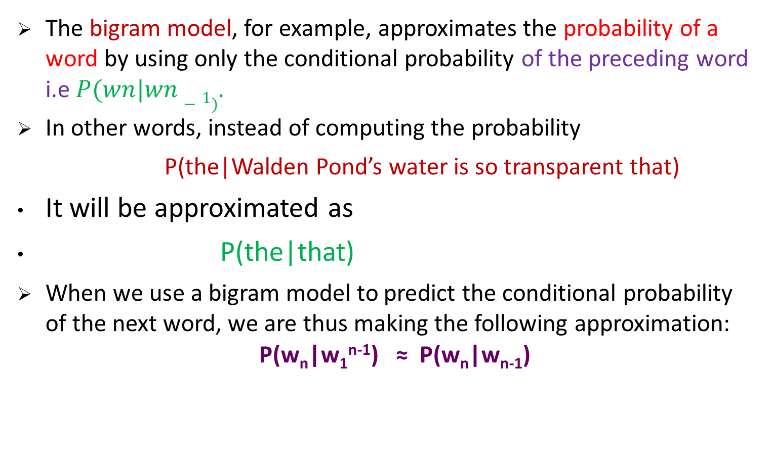
GenerativeAI and Its Applications
Bi-gram Model
The bigram model, for example, approximates the probability of a word by using only the conditional probability of the preceding word i.e $P(wn|wn−1)$.
In other words, instead of computing the probability
P(the|Walden Pond’s water is so transparent that)
It will be approximated as
P(the|that)
When we use a bigram model to predict the conditional probability of the next word, we are thus making the following approximation:
P(w_{n}|w₁^{n-1}) ≈ P(w_{n}|w_{n-1})

Slide 16
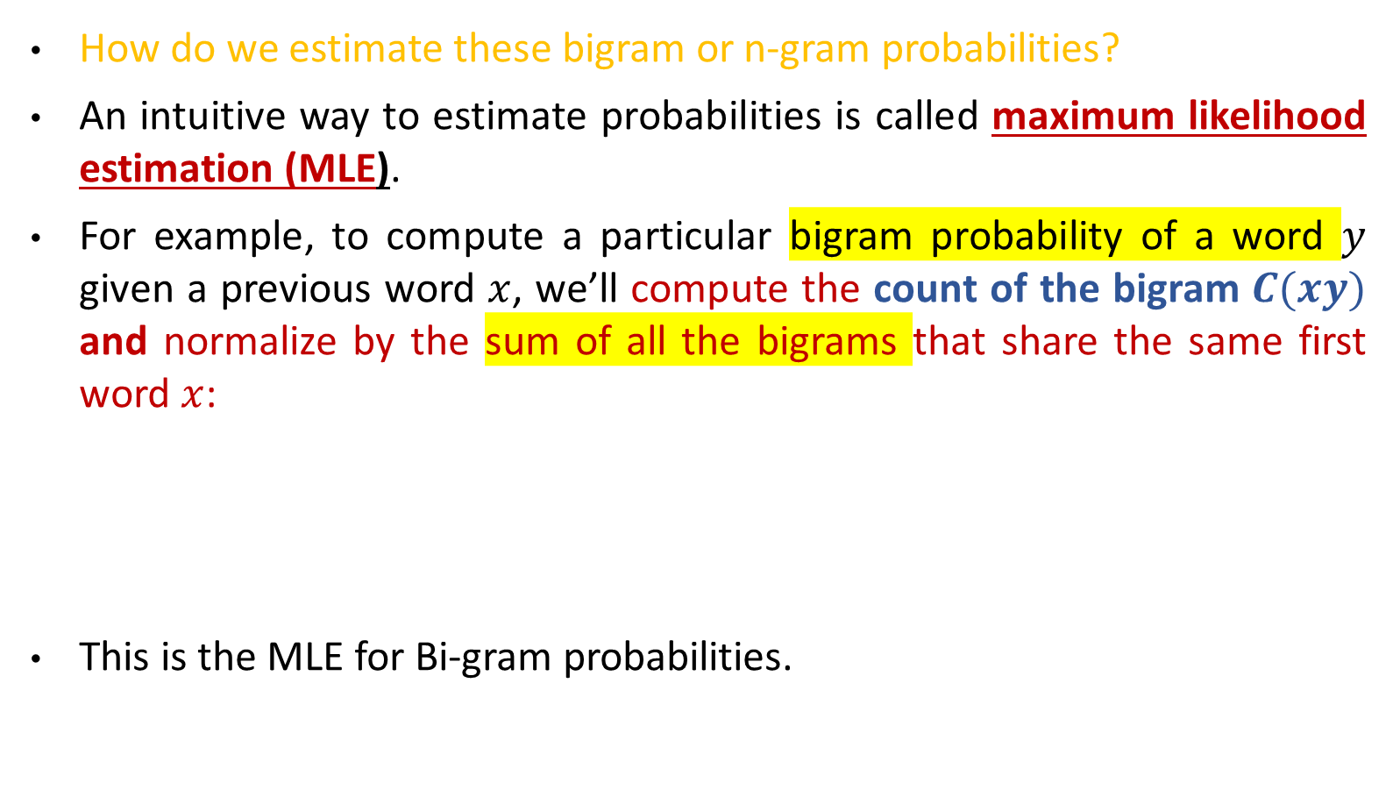
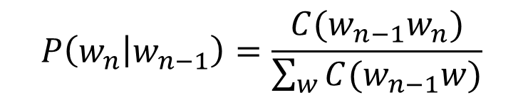
GenerativeAI and Its Applications
Bigram - maximum likelihood estimate (MLE)
How do we estimate these bigram or n-gram probabilities?
An intuitive way to estimate probabilities is called maximum likelihood estimation (MLE).
For example, to compute a particular bigram probability of a word $y$ given a previous word $x$, we’ll compute the count of the bigram $C(xy)$ and normalize by the sum of all the bigrams that share the same first word $x$:
This is the MLE for Bi-gram probabilities.
$$P\left(w_{n} | w_{n−1}\right)=\frac{C(w_{n−1}w_{n})}{\sum_{w}{C(w_{n−1}w)}}$$

Slide 17
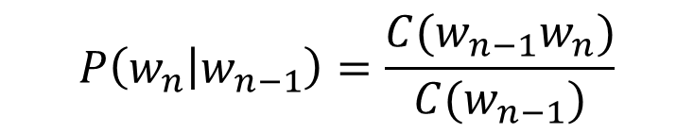
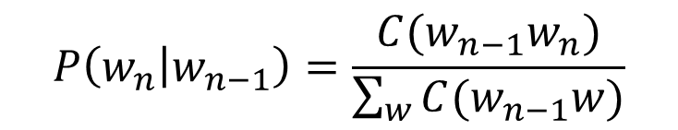
GenerativeAI and Its Applications
Bigram - Maximum Likelihood Estimate (MLE)
How do we estimate these bigram or n-gram probabilities?
Simplifying, since the sum of all bigram counts that start with a given word w_{n-1} must be equal to the unigram count for that word w_{n-1}
$$P\left(w_{n} | w_{n−1}\right)=\frac{C(w_{n−1}w_{n})}{\sum_{w}{C(w_{n−1}w)}}$$
$$P\left(w_{n} | w_{n−1}\right)=\frac{C(w_{n−1}w_{n})}{C(w_{n−1})}$$

Slide 18
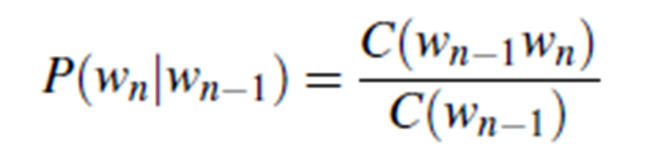
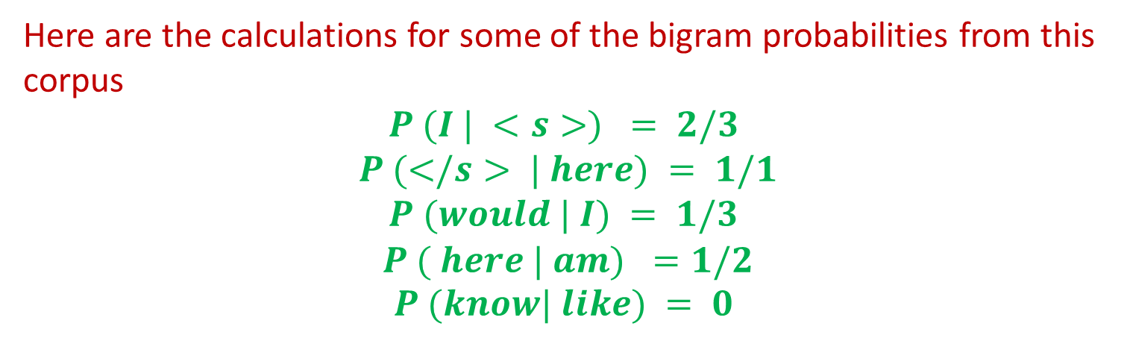
GenerativeAI and Its Applications
An example of bigram model
Example: A mini-corpus of three sentences
<s> I am here </s>
<s> Who am I </s>
<s> I would like to know </s>
Here are the calculations for some of the bigram probabilities from this corpus
$$P (I | <s>) = 2/3$$
$$P (</s> | here) = 1/1$$
$$P (would | I) = 1/3$$
$$P ( here | am) =1/2$$
$$P (know| like) = 0$$

Slide 19
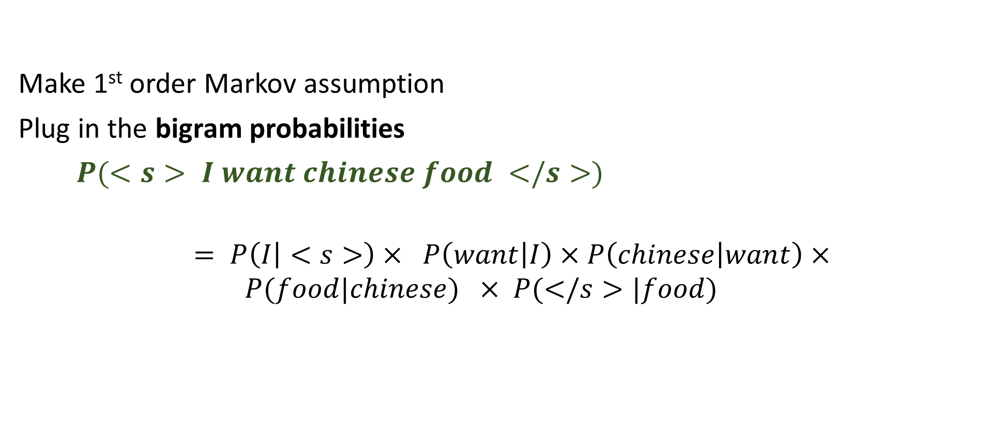
GenerativeAI and Its Applications
Bigram estimates of sentence probabilities
Make 1st order Markov assumption
Plug in the bigram probabilities
$P(<s> I want chinese food </s>)$
$$= P\left(I | <s>\right)× P\left(want | I\right)×P\left(chinese | want\right)×$$
$$P(food|chinese) × P(</s>|food)$$

Slide 20
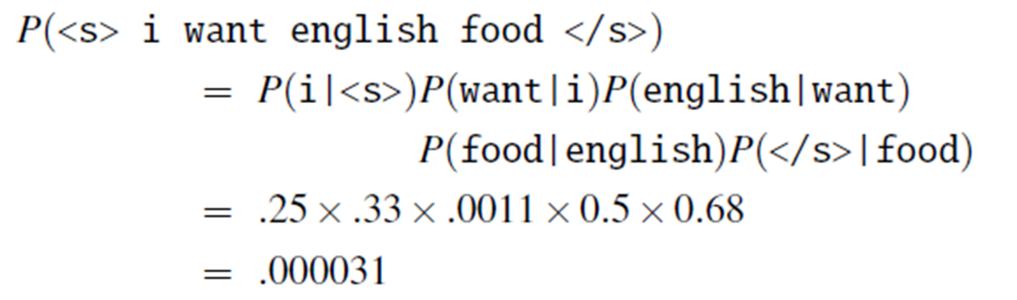
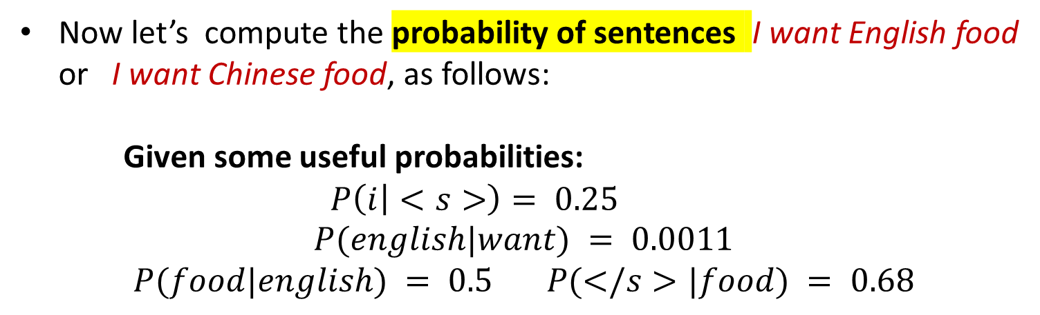
GenerativeAI and Its Applications
Raw bigram probabilities
Now let’s compute the probability of sentences I want English food or I want Chinese food, as follows:
Given some useful probabilities:
$$P\left(i | <s>\right)= 0.25$$
$$P(english|want) = 0.0011$$
$$P(food|english) = 0.5 P(</s>|food) = 0.68$$

Slide 21
GenerativeAI and Its Applications
Limitations of N-gram approach to Language Modeling
N-gram based language models do have a few drawbacks:
The higher the N, the better is the model usually. But this leads to lots of computation overhead that requires large computation power in terms of RAM
N-grams are a sparse representation of language. This is because we build the model based on the probability of words co-occurring. It will give zero probability to all the words that are not present in the training corpus.

Slide 22
Thank You

