Slide 1

GenerativeAI and Its Applications
Unit 1
(UE23CS342BA4)
Word Embeddings
Dr. Pooja Agarwal
Dept. of CSE, PES University, Bangalore

Slide 2

Generative AI and its Applications
Word Embeddings

Slide 3
GenerativeAI and Its Applications
Acknowledgement
The slides are prepared from various resources from the Universities from abroad and India. Also, some material is taken from reliable resources from internet throughout this course.

Slide 4
generativeAI and Its Applications
Sequence to be followed:
One hot Encoding
Bag of Words
Ngrams
TF-IDF
Word Embedding- Word2Vec, SkipGram, CBOW, Glove
POS
NER
Text Classification

Slide 5
GenerativeAI and Its Applications
One-Hot Encoding
Word vectors are vectors of weights. Say there are some dimensions and these vectors are defining those words in these n dimensions.
In a simple 1-of-N (or one-hot) encoding every element in the vector is associated with a word in the vocabulary
To train embeddings, words need to be converted to one-hot encodings so that they can be used as input to a neural network
Amongst all the dimensions, only one dimension is 1 and all other dimensions are 0 and this dimension may correspond to the index of the word
With this encoding, computing semantic similarity is difficult.
Sim(hotel, motel)=0
Hotel [0 0 0 0 1 0 0 0 0 0 0 0 0 0 0 ]
Motel[0 0 0 0 0 0 0 0 1 0 0 0 0 0 0 ]

Slide 6
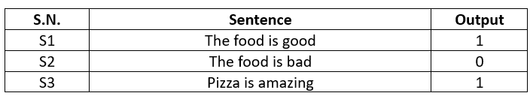
GenerativeAI and Its Applications
One-Hot Encoding
One Hot Encoding is a method for converting categorical variables into a binary format. It creates new columns for each category where 1 means the category is present and 0 means it is not.
Create Vocabulary
We first build a fixed vocabulary from the dataset.
Vocabulary (Size = 7) = [The, food, is, good, bad, pizza, amazing]
One hot Representation of the words:
The: [1 0 0 0 0 0 0], food: [0 1 0 0 0 0 0], is: [0 0 1 0 0 0 0], good: [0 0 0 1 0 0 0], bad: [0 0 0 0 1 0 0], pizza: [0 0 0 0 0 1 0] , amazing : [0 0 0 0 0 0 1]

Slide 7
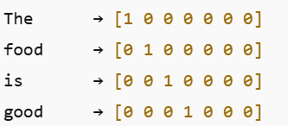
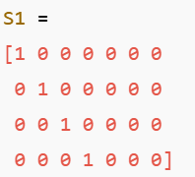
GenerativeAI and Its Applications
One-Hot Encodings
Sentence Level Encoding
Sentence S1: “The food is good”
Number of words = 4, Vocabulary size = 7, Sentence Matrix Size = 4 × 7
Sentence S2: “The food is bad”
Matrix Size = 4 × 7
Sentence S3: “Pizza is amazing”
Number of words = 3
Matrix Size = 3 × 7

Slide 8
GenerativeAI and Its Applications
Limitations of One-Hot Encoding
Sparse Matrix
Mostly zeros
High-dimensional vectors
Leads to overfitting, especially with limited data
No Semantic Meaning Captured
“good” and “amazing” are equally distant
Model cannot learn similarity between words
distance(food good) = distance(food not good)
Variable Sentence Length Problem
S1 → 4×7 matrix
S3 → 3×7 matrix
ML algorithms expect fixed-size inputs
Out-of-Vocabulary (OOV) Problem
New Sentence:
“Berger is bad”
Word “Berger” not in vocabulary
Cannot be encoded using existing one-hot vectors

Slide 9
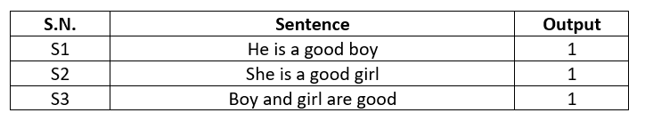
GenerativeAI and Its Applications
Bag Of Words (BOW)
BOW is used to convert text into a numerical format that machine learning algorithms can process.
It represents a document as an unordered collection ("bag") of the words it contains, keeping track of word frequencies while entirely disregarding grammar and word order.
Let’s first perform the Text preprocessing:
1. lower the word cases
2. Removal of stop words

Slide 10
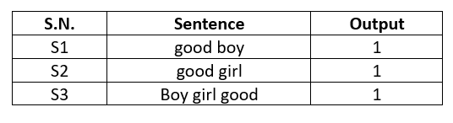
GenerativeAI and Its Applications
Bag Of Words (BOW) (BOW and Binary BOW)
After preprocessing we get
Vocabulary: {good, boy, girl}
Count the Frequency of each word in the vocabulary
good: 3
boy: 2
girl: 2
Sentence 4: girl good good
BOW: [2, 0, 1]
Binary BOW: [1, 0, 1]
BoW Vector format – based on the descending order of the word frequency [good, boy, girl]
BOW: represents the frequency of the word in the sentence
Sentence 1: [1, 1, 0]
Sentence 2: [1, 0, 1]
Sentence 3: [1, 1, 1]
Binary BOW: represents the existence of the word in the sentence
Sentence 1: [1, 1, 0]
Sentence 2: [1, 0, 1]
Sentence 3: [1, 1, 1]

Slide 11
GenerativeAI and Its Applications
Advantages and Limitations of BOW
Advantages of Bag Of Words
Simple and Intuitive
Fixed Size Input (Based on Vocabulary)
Limitations of Bag Of Words
Sparse Matrix
Ordering of words is getting changed
Out-of-Vocabulary (OOV) Problem - If the word is not the part of vocabulary
Semantic meaning not getting Captured –
Say there are two sentences. S1 – “The food is good” and vector for this is [1, 1, 1, 0, 1]
S2 – “The food is not good” and vector for this is [1, 1, 1, 1, 1]
Plot these two vector as points, they will be very near to each other and will not represent that they are complete opposite to each other in semantics.

Slide 12
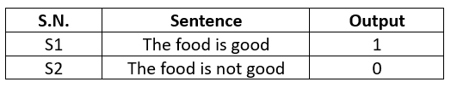
GenerativeAI and Its Applications
N-grams can be used for the Embedding
N gram can be used for the Word embedding. Say there are two sentences
Remove the stop words
Vocabulary = [food, not, good]
Convert these sentences to vectors
S1 = [1 0 1]
S2 = [1 1 1]
These vectors if plotted will be very near to each other and hence represent that these two sentences are very similar to each other.

Slide 13
GenerativeAI and Its Applications
N-grams can be used for the Embedding (Using Bigram)
Let’s use bi-grams ( combination of two words)
Vocabulary = [food, not, good, food good, food not, not good]
Convert these sentences to vectors
S1 = [1 0 1 1 0 0]
S2 = [1 1 1 0 1 1]
These vectors if plotted will be little far from each other in comparison to the previous vectors and hence better embedding.

Slide 14
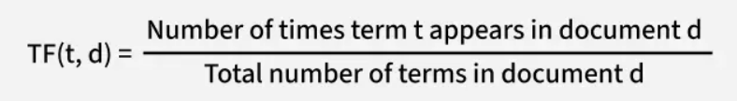
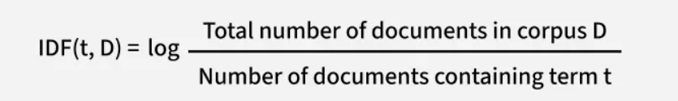
GenerativeAI and Its Applications
TF-IDF (Term frequency- Inverse Document Frequency)
TF-IDF (Term Frequency–Inverse Document Frequency) is a statistical method used in natural language processing and information retrieval to evaluate how important a word is to a document in relation to a larger collection of documents.
TF-IDF combines two components:
Term Frequency (TF): Measures how often a word appears in a document. A higher frequency suggests greater importance. If a term appears frequently in a document, it is likely relevant to the document’s content.
Inverse Document Frequency (IDF): Reduces the weight of common words across multiple documents while increasing the weight of rare words. If a term appears in fewer documents, it is more likely to be meaningful and specific.

Slide 15
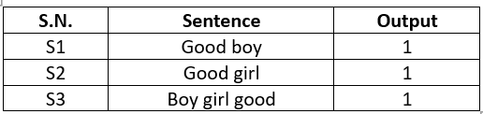
GenerativeAI and Its Applications
TF-IDF (Term frequency- Inverse Document Frequency)
Let’s consider the dataset is
Vocab = { good, boy, girl }
Total number of sentences (N) = 3
Let’s do the calculation of vector embedding using TF-IDF now

Slide 16
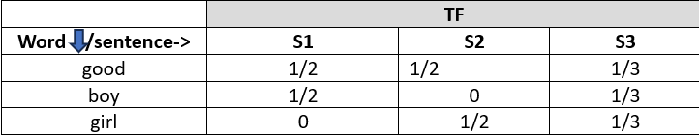
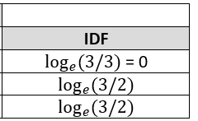
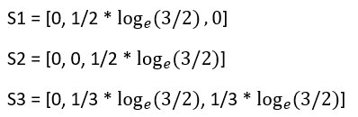
GenerativeAI and Its Applications
TF-IDF (Term frequency- Inverse Document Frequency)
The dataset is
Vocab = { good, boy, girl }
Total number of sentences (N) = 3
Calculation of TF and IDF
Vector embedding using TF-IDF now

Slide 17
GenerativeAI and Its Applications
Advantages and Limitations of TF-IDF
Advantages of TF-IDF
Simple and Intuitive
Fixed Size Input (Based on Vocabulary)
Word importance is given – Semantic meaning is getting captured
like “good” is not distinguishing. But sentence 1 has “boy” very important that’s why there is some value. Similarly in sentence 2 “girl” is important, so some value is getting captured. And in sentence 3 both are playing major role.
Limitations of TF- IDF
Sparsity still exist
Out of vocabulary problem exist
To get rid of this we start talking about word embedding

Slide 18
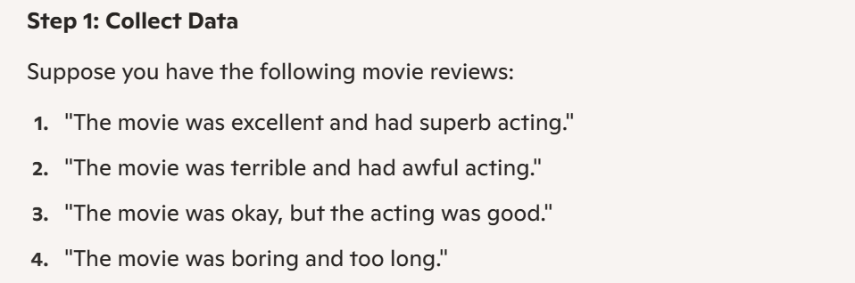
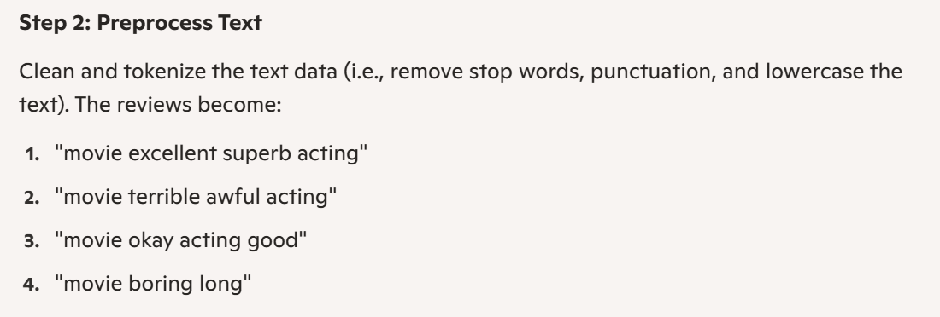
GenerativeAI and Its Applications
TF-IDF (Term frequency- Inverse Document Frequency) (Example)

Slide 19
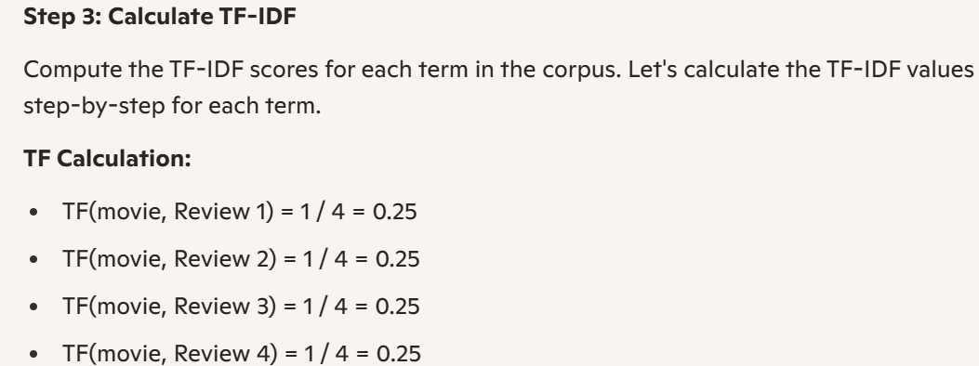
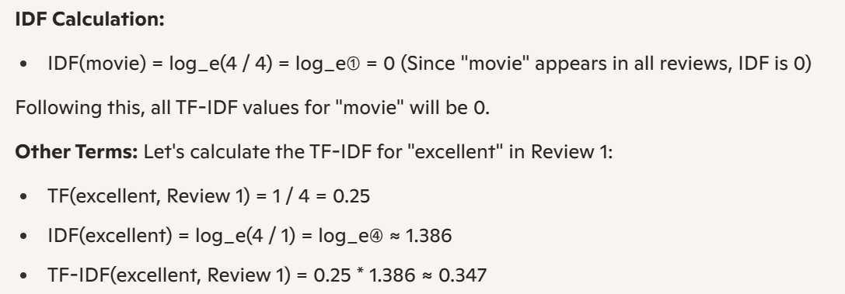
GenerativeAI and Its Applications
TF-IDF (Term frequency- Inverse Document Frequency) (Example)

Slide 20
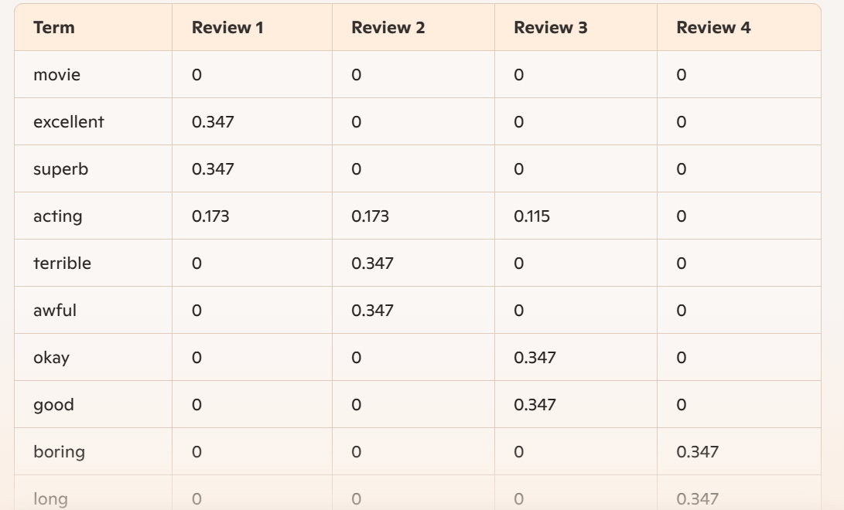
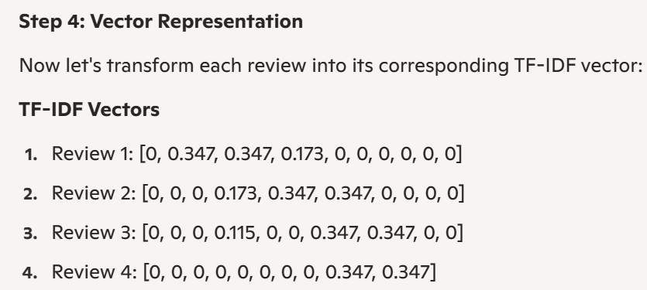
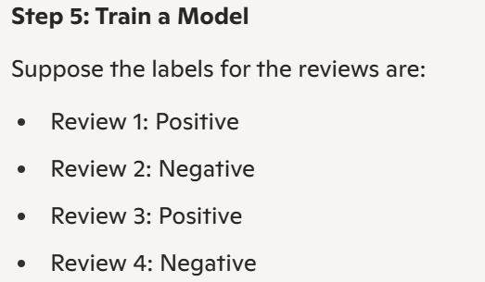
GenerativeAI and Its Applications
TF-IDF (Term frequency- Inverse Document Frequency) (Example)

Slide 21
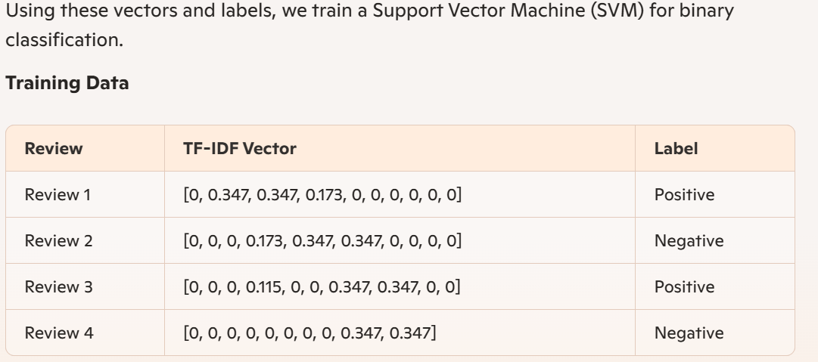
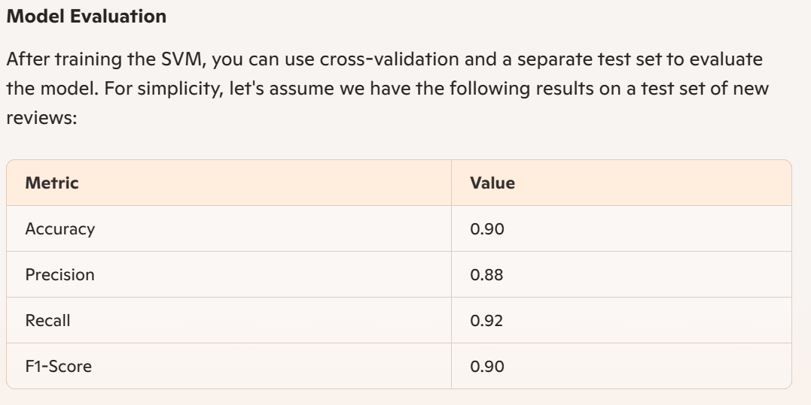
GenerativeAI and Its Applications
TF-IDF (Term frequency- Inverse Document Frequency) (Example)

Slide 22
GenerativeAI and Its Applications
Distributional Representation of words
Dense Vectors are good at capturing synonyms and semantic similarity.
When we talk about word embeddings( word vector) being d-dimensional, which may vary from 50-1000. These d-dimensions don’t have very clear interpretation.
Dense vectors work better for almost all NLP tasks.
Consider King, Queen, Man, Woman, Child as 5 words in a vocabulary and now say Queen can represented as a1-hot encoding and king as
Lets consider the 5-dimensions as Royalty, Masculine, Feminine, Age, Height etc and define some words based on it:
King. Queen. Man
But with this representation we can’t establish semantic similarity between King and queen
0 | 1 | 0 | 0 | 0
1 | 0 | 0 | 0 | 0
0.92
0.98
0.02
0.5
0.6
0.95
0.04
0.98
0.4
0.4
0.01
0.98
0.03
0.5
0.4
The dense vectors are also capable of capturing the synonymy.

Slide 23
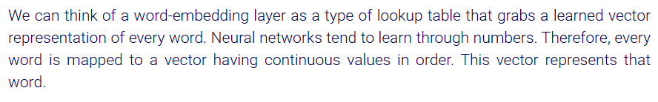
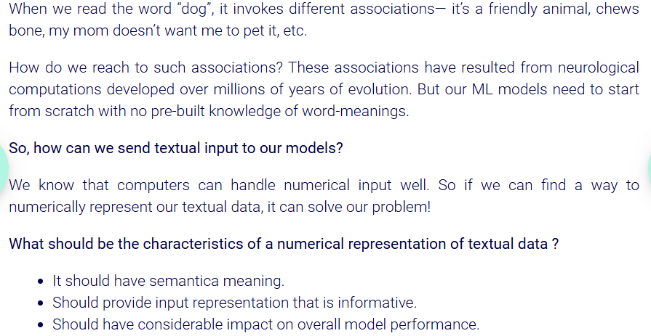

GenerativeAI and Its Applications
Input Embedding

Slide 24
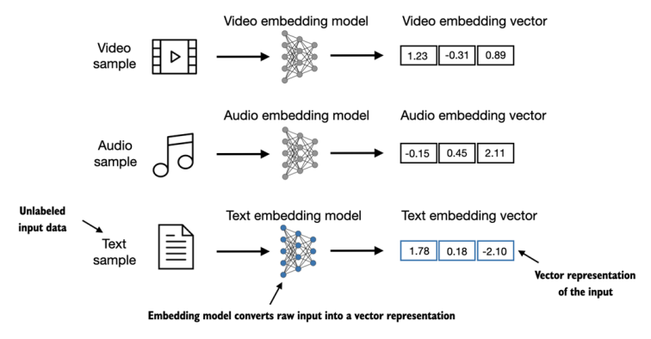
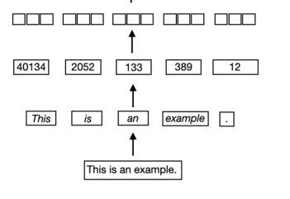
GenerativeAI and Its Applications
Word Embeddings
What are Word Embeddings? Word embeddings are numerical representations of text that convert words into vectors that machines can understand and process. Think of them as translating human language into a mathematical language that AI models can work with.
Why Do We Need Them?
Neural networks can't process raw text directly (Input is generally vectors)
Text needs to be converted to continuous-valued vectors (Array of Numbers)
Enables mathematical operations required for neural networks
Captures semantic relationships between words
A good embedding should preserve the meaning of the token that should adapt well to the context in which it is used
References:
Book: Build a Large Language Model (From Scratch)

Slide 25
GenerativeAI and Its Applications
Word Embeddings
Definition
Real-valued and sub-symbolic representations of words as dense numeric vectors. So word embeddings are dense numeric vectors.
Distributed representation of word meanings (not count-based on frequency of word)
usually learned with neural networks.
Specific dimensions of the resulting vectors cannot bet directly mapped to symbolic representation
Models that seek to predict between a center word and context words (predict models)
Key elements of deep learning models.

Slide 26
GenerativeAI and Its Applications
Neural Word embeddings
Framework for learning word embeddings;
Takes words from a very large corpus of text as input (unsupervised)
Learn a vector representation for each word to predict relation between every word and its context
Fully connected feed-forward neural network with one hidden layer
Two main algorithms:
Skip-gram: predicts context taking the center/target word as input
Continuous Bag of Words (CBOW): predicts center/target/focus word from the given context (sum of surrounding words vectors)

Slide 27
GenerativeAI and Its Applications
Word2vec
Word2vec is not a single algorithm but a combination of two techniques –
CBOW(Continuous bag of words) and Skip-gram model.
Both of these are not Deep neural networks, they are shallow neural networks which map word(s) to the target variable which is also a word(s).
Both of these techniques learn weights which act as word vector representations.

Slide 28
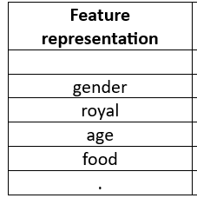
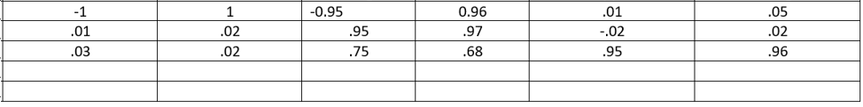
GenerativeAI and Its Applications
Word2vec (Vector representation of the words)
Vocabulary is the combination of unique words in the document and that becomes the corpus.
Suppose the words in vocabulary are
[boy girl king queen apple mango]
Suppose the vector for king, man, queen and girl in 2 feature rep
King [.95. .96] , man [.95, .98]
Queeen [ -.96, .95], girl [-.99, -.96]
Apply king – man + Queen = girl

Slide 29
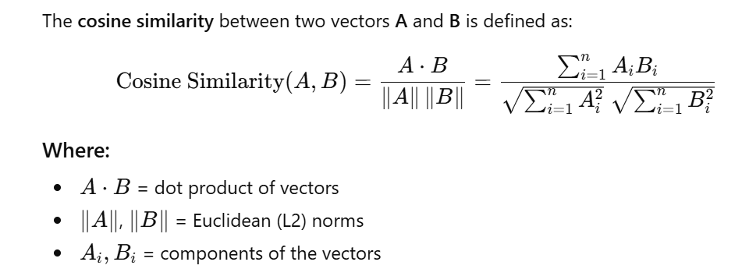
GenerativeAI and Its Applications
Word2vec (Vector representation of the words)
Using Cosine Similarity
If we plot the vector of king and man as points and calculate the distance, using distance = 1-cosine similarity
cosine simi = Cos 45 = 0.707
distance = .29,
since distance is very near to zero that indicates that both the words are very similar.

Slide 30
GenerativeAI and Its Applications
Word2vec (Training of Word2vec)
Word2Vec model gets trained with the help of
CBOW and Skipgram
Word2Vec and GloVe are word embedding techniques;
Skip-Gram and CBOW are the two training architectures used within Word2Vec.

Slide 31
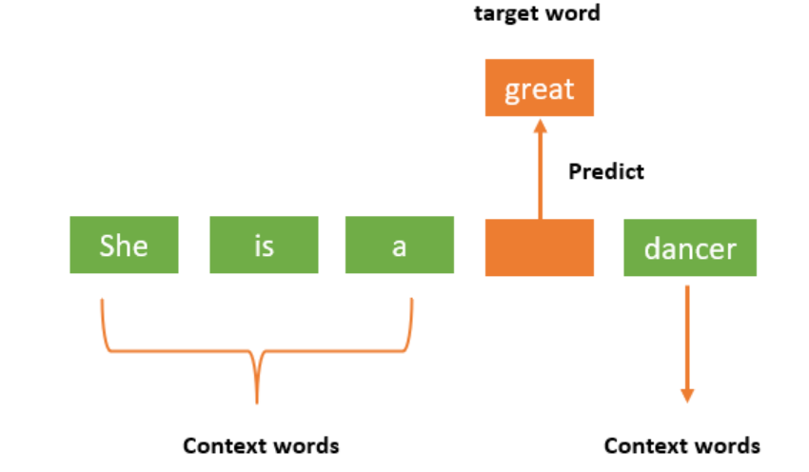
GenerativeAI and Its Applications
CBOW (Continuous BagOfWords)
Continuous Bag of Words (CBOW) is a NLP technique used to generate word embeddings. CBOW is a neural network-based algorithm that predicts a target word given its surrounding context words.
It can learn from unlabeled data, and it is often used to pre-train word embeddings that can be used for various NLP tasks such as sentiment analysis, text classification.

Slide 32
GenerativeAI and Its Applications
Comparison between BOW and CBOW
The BoW model represents text as a collection of words and their frequency in a given document or corpus. It does not consider the order or context in which the words appear, and therefore, it may not capture the full meaning of the text.
CBOW model is a neural network-based approach that captures the context of words. It learns to predict the target word based on the words that appear before and after it in a given context window.

Slide 33
GenerativeAI and Its Applications
Architecture of CBOW Model
Example "She is a great dancer.“
CBOW model converts this phrase into pairs of context words and target words.

Slide 34
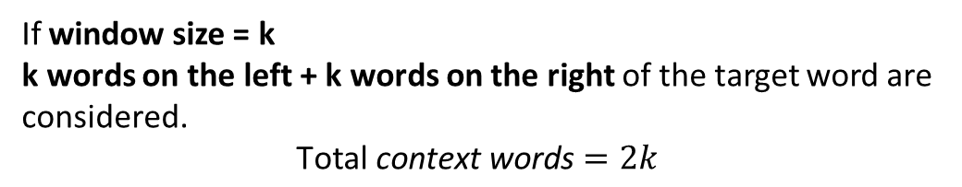
GenerativeAI and Its Applications
Architecture of CBOW Model
Example "She is a great dancer.“
CBOW model converts this phrase into pairs of context words and target words.
The word pairings for window size=1 would appear like this
([she, a], is), ([is, great], a) ([a, dancer], great)
The model considers the context words and tries to predict the target term.
Four 1∗W input vectors passed to the input layer (if have four words as context words)
Objective is to predict one target word
Hidden layer will receive the input vectors and then multiply them by a W∗N matrix.
1∗N output from the hidden layer finally enters the sum layer
Where the vectors are element-wise summed before a final activation is carried out and the output is obtained from the output layer.
If window size = k k words on the left + k words on the right of the target word are considered.
$$\text{Total} \text{context} \text{words}=2k$$

Slide 35
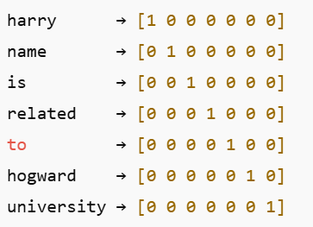
GenerativeAI and Its Applications
CBOW Example
Dataset : Harry name is related to hogward university
Vocabulary size = 7
{ harry, name, is, related, to, hogward, university }
Each word is initially represented using One-Hot Encoding as a 7 dimensional vector
These are inputs to the CBOW network (not the final embeddings.)
Let Window Size = 5
Input (Context Words)
[ harry, name, related, to ]
Target (Output Word)
is
So CBOW learns:
(harry + name + related + to) → is
Weight Matrix
Shape of W₁ = 7 × 5
7 → vocabulary size
5 → number of neurons in the hidden layer

Slide 36
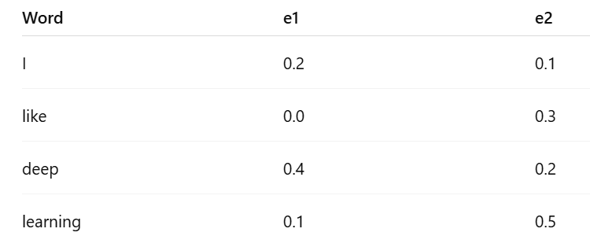
GenerativeAI and Its Applications
CBOW Model (Example)
Sentence
I like deep learning
Target word
deep
Window size
1
So,
Context words = [like, learning]
Vocabulary:
[I, like, deep, learning]
|V| = 4
One-hot vectors:
I → [1 0 0 0]
like → [0 1 0 0]
deep → [0 0 1 0]
learning → [0 0 0 1]
Embedding size, N = 2
Initial weight matrices (randomly initialized)
W₁ (Input → Hidden) (4 × 2)

Slide 37
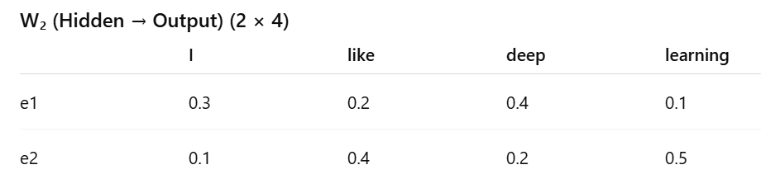
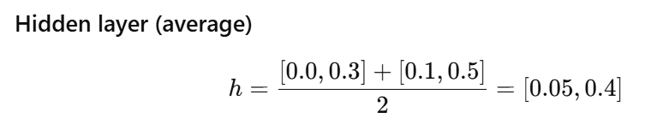
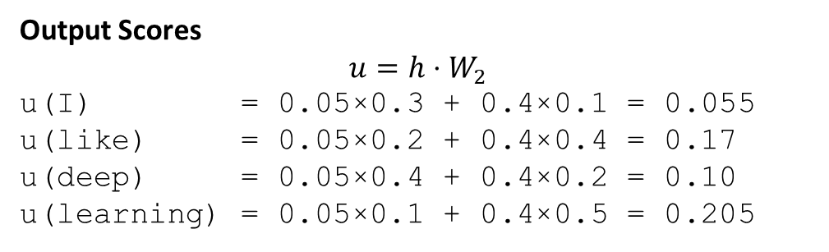
GenerativeAI and Its Applications
CBOW Model (Example)
STEP 3: Forward Pass (Iteration 1)
Context embeddings
Embedding(like) = [0.0, 0.3]
Embedding(learning) = [0.1, 0.5]
Output Scores
$$u=h⋅W_{2}$$
u(I) = 0.05×0.3 + 0.4×0.1 = 0.055
u(like) = 0.05×0.2 + 0.4×0.4 = 0.17
u(deep) = 0.05×0.4 + 0.4×0.2 = 0.10
u(learning) = 0.05×0.1 + 0.4×0.5 = 0.205

Slide 38
GenerativeAI and Its Applications
CBOW Model (Example)
STEP 7: Backpropagation (Conceptual but Complete)
Error signal at output
error(word) = predicted − actual
For target deep:
error(deep) = 0.25 − 1 = −0.75
For others (example):
error(learning) = 0.29 − 0 = +0.29
STEP 8: Weight Updates
Update W₂ (Hidden → Output)
Reduce weights leading to learning
Increase weights leading to deep
After update (conceptually):
W₂(deep) weights ↑
W₂(learning) weights ↓
STEP 5: Softmax Probabilities
Approximate softmax:
P(I) ≈ 0.23
P(like) ≈ 0.27
P(deep) ≈ 0.25 ← target
P(learning) ≈ 0.29 ← highest (wrong)
Model prediction is learning, not deep WRONG
STEP 6: Loss Computation
Using cross-entropy loss:
Loss is high, so learning must happen.

Slide 39
GenerativeAI and Its Applications
CBOW Model (Example)
Update W₁ (Input → Hidden)
Only context words are updated:
like, learning
Their embeddings move closer to deep.
STEP 9: Forward Pass (Iteration 2)
After weight update, recompute:
New context embeddings
New hidden vector
New output probabilities
Now probabilities look like:
P(deep) ≈ 0.55
P(learning) ≈ 0.20
Loss decreases:
Loss ≈ 0.60
The Process Repeats

Slide 40
GenerativeAI and Its Applications
SkipGram
Skip-Gram predicts surrounding (context) words given a target (center) word.
It is the reverse of CBOW.
Example Sentence
I like deep learning
Let the target word be:
deep
Identify Context Words
Context words = [like, learning]
Skip-Gram Training Pairs
Skip-Gram creates multiple input–output pairs from one target word.
How Skip-Gram Learns
Input word (deep) is converted to one-hot vector
Passed through a neural network
Model predicts probabilities of context words
Errors are backpropagated
Weights are updated
Over training:
Words appearing in similar contexts get similar embeddings

Slide 41
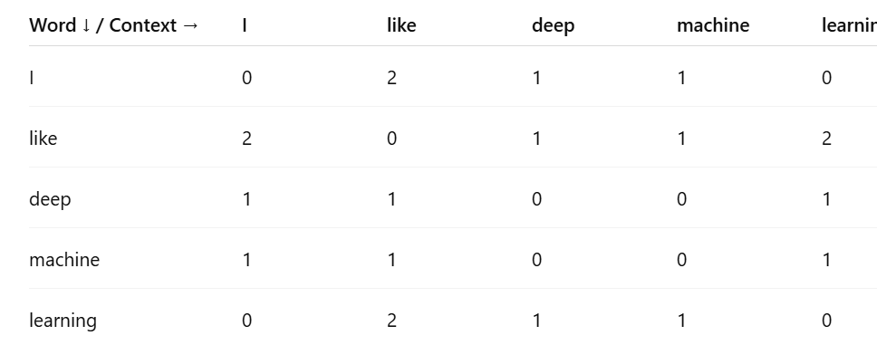
GenerativeAI and Its Applications
Glove(Global Vectors for Word Representation)
GloVe learns word embeddings using global word co-occurrence statistics from the entire corpus.
Unlike CBOW/Skip-Gram (which use local context), GloVe looks at the whole dataset at once.
One Simple Example
Corpus (2 sentences)
S1: I like deep learning
S2: I like machine learning
Build Vocabulary
Vocabulary = { I, like, deep, machine, learning }
Build Co-Occurrence Matrix
We count how often two words appear together in a fixed window.
Observation
deep and machine never appear together
Both appear with learning
Hence they will get similar vectors

Slide 42

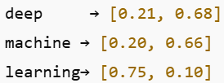
GenerativeAI and Its Applications
Glove(Global Vectors for Word Representation)
What GloVe Learns
GloVe factorizes this matrix to learn dense vectors such that:
So it learns embeddings like:
deep ≈ machine because their global usage pattern is similar.
Key Intuition (Very Important)
Words with similar global co-occurrence patterns get similar embeddings.

Slide 43
Thank You

