Slide 1

GenerativeAI and Its Applications
Unit 1
(UE23CS342BA4)
Text Classification
Naïve Bayes and Its Application
Dr. Pooja Agarwal
Dept. of CSE, PES University, Bangalore

Slide 2

GenerativeAI and Its Applications
Acknowledgement
The slides are prepared from various resources from the Universities from abroad and India. Also, some material is taken from reliable resources from internet throughout this course.

Slide 3
GenerativeAI and Its Applications
Text Classification
Naïve Bayes and Its Application

Slide 4

GenerativeAI and Its Applications
Naive Bayes Classifier
Highly practical Bayesian Learning method
Comparable performance with neural network and decision tree learning.
Naive Bayes classifier applies to learning task where each instance x is classified by the conjunction of attribute value and where the target function f(x) can take any value from finite set V.
A set of training examples of the target function is provided and a new instance is presented in tuple of attribute values (a1,a2,a3,a4,........an)
The learner/classifier is asked to predict the target value or the classification of the new instance.
In this section, we will look at the Bayesian approach to classify a new instance Xnew.

Slide 5
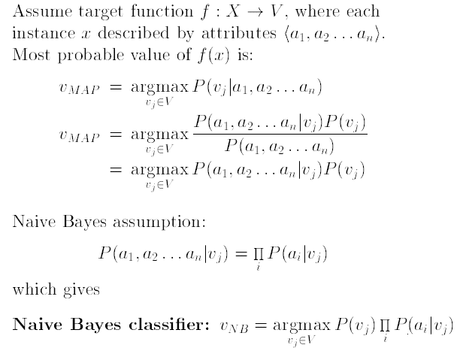
GenerativeAI and Its Applications
Naive Bayes Classifier
The Bayesian approach is to classify the new instance is to assign the class label that is the most probable value, V_{MAP} , given attribute values (a1.....an) that describe the instance is

Slide 6
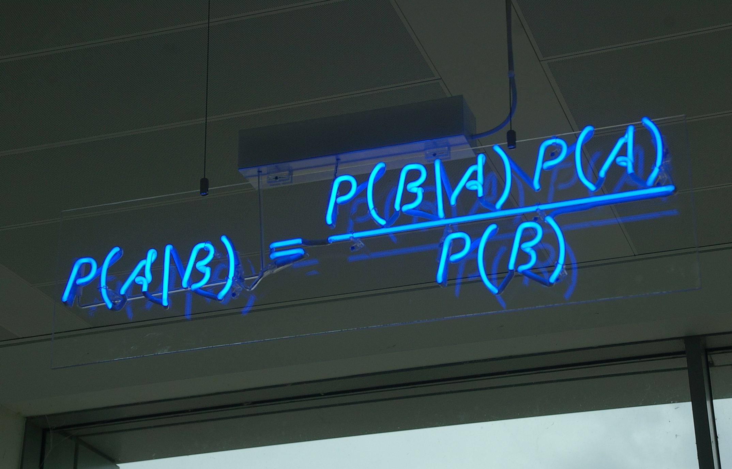
GenerativeAI and Its Applications
Naive Bayes Classifier
Apply Baye’s theorem
using this
It is easy to estimate P(V_{j}):

Slide 7
GenerativeAI and Its Applications
Naive Bayes Classifier
V_{MAP}
----------------------(1)
Naive Bayes Classifier is based on simplifying assumption that the attribute values (i.e. a1, a2, a3, …, an)are conditionally independent given the target value
i.e the assumption is that given the target value of the instance, the probability of observing the conjunction a1,a2,a3,.....an is just the product of the probabilities for the individual attributes
Using this in our V_{MAP} equation 1, we get
V _{MAP} =

Slide 8
GenerativeAI and Its Applications
Naive Bayes Classifier
Lets note few things
Number of distinct P(a_{i}|V_{j}) terms that must be estimated from the training set:'D' is equal to the number of distinct attribute value times the number of distinct target values
Based on the frequencies over the training set
whenever NB assumption of conditional independence is satisfied, this NB classification=MAP classification

Slide 9
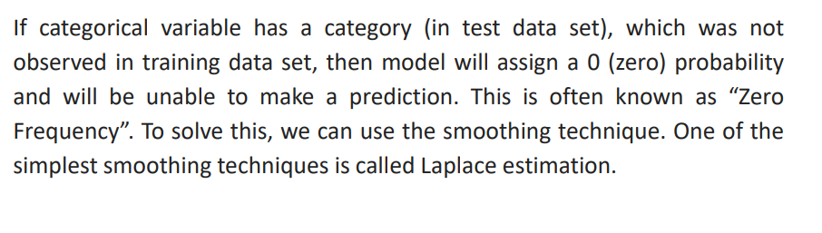
GenerativeAI and Its Applications
Naïve Bayes Classifier- Zero Frequency Problem
Laplace Estimation

Slide 10
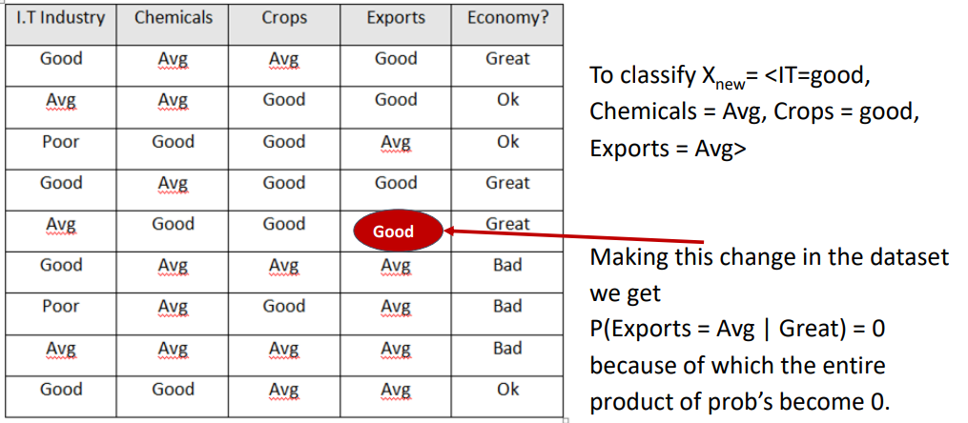
GenerativeAI and Its Applications
Naïve Bayes Classifier

Slide 11
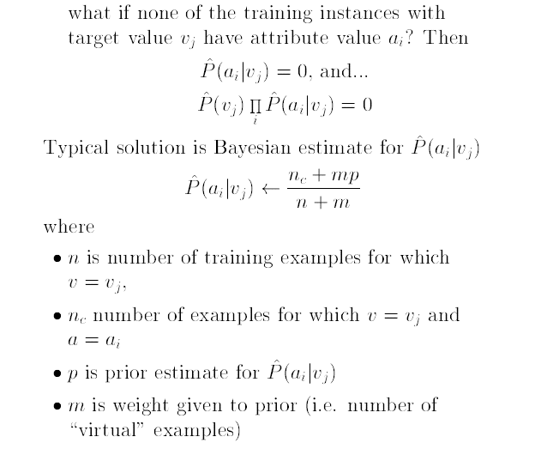
GenerativeAI and Its Applications
Special Case( M-estimate of Conditional Probability)

Slide 12
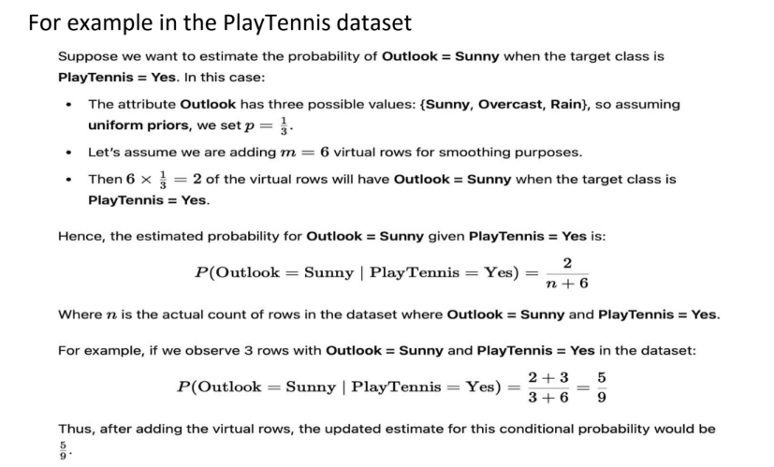
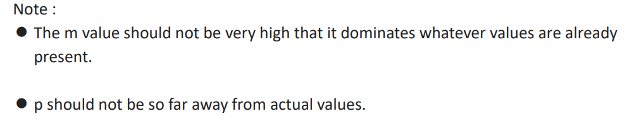
GenerativeAI and Its Applications
Special Case( M-estimate of Conditional Probability)

Slide 13
GenerativeAI and Its Applications
Example 1-Text Classification

Slide 14
GenerativeAI and Its Applications
Example (Text Classification)
consider the given data set AND the task is to classify the sentence
“A very close game” as sports or not sports
In this data set we do not have numbers but we have only text
We need to convert all this text into numbers that we can use for calculation. HOW?????
One solution is to use frequency of words
Ignore word order and sentence construction
Treat every document as a set of words it contains.
Now the feature used in this case is the counts of words i.e(words frequency)
It’s a simplistic approach, but works surprisingly well
sentence | class
A great game | sports
The election is over | Not sports
very clean match | sports
a clean but forgettable game | sports
it was a close election | not sports

Slide 15
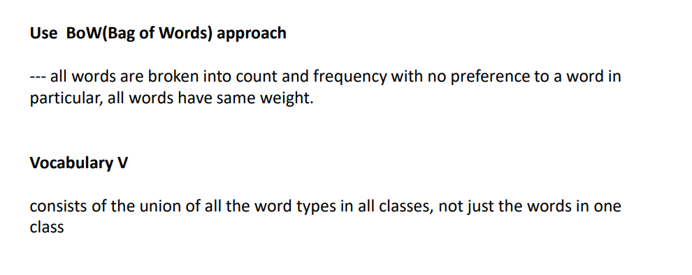
GenerativeAI and Its Applications
Example- (Text Classification)

Slide 16
GenerativeAI and Its Applications
Example-Text Classification
Now, we need to transform the probability we want to calculate into something that can be calculated using word frequencies.
Bayes Theorem for example:
since in our classier ,we are just trying to find out which category has bigger probability we can discard the divisor
This is same for both the categories
we can compare
P(A very close game/sports) x P(sports)
with
P(A very close game/not sports) x P(not sports)
sentence | class
A great game | sports
The election is over | Not sports
very clean match | sports
a clean but forgettable game | sports
it was a close election | not sports

Slide 17
sentence | class
A great game | sports
The election is over | Not sports
very clean match | sports
a clean but forgettable game | sports
it was a close election | not sports

Slide 18
GenerativeAI and Its Applications
Example -Text Classification
sentence | class
A great game | sports
The election is over | Not sports
very clean match | sports
a clean but forgettable game | sports
it was a close election | not sports
The probabilities can be calculated:
count how many times the sentence
'A very close game' appears in sports category
Divide by the total
obtain P(a very close game|sports)
PROBLEM: we do not have the 'sentence' in the training set
=>probability is zero
unless every sentence appears in the training set, what we want to classify, the model won’t classify

Slide 19
GenerativeAI and Its Applications
Example -Text Classification
we assume that every word in a sentence is independent of the other ones
no longer we will look for entire sentences, but for only words(individual)
i,e for a sentence “This was a funny party” is same as “funny is party was this” is same as “party funny this was a”
we can write this as:
P(a very close game)=P(a)xP(very)xP(close)xP(game)
This enables to make the model work well, Now lets apply,
P(a very close game|sports)= P(a|sports)xP(very|sports)xP(close|sports)xP(game|sports)
all these individual words actually show up several times in our training set,we can do our calculations
sentence | class
A great game | sports
The election is over | Not sports
very clean match | sports
a clean but forgettable game | sports
it was a close election | not sports

Slide 20
GenerativeAI and Its Applications
Example-Text Classification
CALCULATING PROBABILITIES
The final step is just to calculate every probability and see which one turns to be larger
First: calculate a priori probability for each category,i.e for the sentence given in the training set
P(sports)=3/5=0.6
P(not sports)=2/5=0.4
calculate P(game/sports) : counting number of times the word game appears in the sports sample, divided by the total no of words in sports
i.e it appears twice for 11 words. P(game/sports)=2/11=0.18181
A problem again
the word close does not appear in any sports ,and would lead us 0 when multiplied with other probability
sentence | class
A great game | sports
The election is over | Not sports
very clean match | sports
a clean but forgettable game | sports
it was a close election | not sports

Slide 21
GenerativeAI and Its Applications
Example -Text Classification
CALCULATING PROBABILITIES
The final step is just to calculate every probability and see which one turns to be larger
First: calculate a priori probability for each category,i.e for the sentence given in the training set
P(sports)=
P(not sports)=
calculate P(game/sports) : counting number of times the word game appears in the sports sample, divided by the total no of words in sports
i.e it appears twice for 11 words.
P(game/sports)=
P(close/sports)= , P(a/sports)= , P(very/sports)=
P(game/not sports)=
P(close/ not sports)= , P(a/ not sports)= , P(very/ not sports)=
A problem again
the word close does not appear in any sports ,and would lead us 0 when multiplied with other probability
sentence | class
A great game | sports
The election is over | Not sports
very clean match | sports
a clean but forgettable game | sports
it was a close election | not sports

Slide 22
GenerativeAI and Its Applications
Example -Text Classification
sentence | class
A great game | sports
The election is over | Not sports
very clean match | sports
a clean but forgettable game | sports
it was a close election | not sports
To resolve this we do something called Laplace smoothing
Add 1 to every count so its never zero
To balance it again, add no of possible words to divisor,
in our case the possible words are:
{a, great, game, the election, is, over,.......}= 15
Applying smoothing we get:-
WORD | P(word/sports) | P(word/Not sports)
a
very
close
game

Slide 23
GenerativeAI and Its Applications
Example-Text Classification
sentence | class
A great game | sports
The election is over | Not sports
very clean match | sports
a clean but forgettable game | sports
it was a close election | not sports
To resolve this we do something called Laplace smoothing
Add 1 to every count so its never zero
To balance it again, add no of possible words to divisor,
in our case the possible words are:
{a, great, game, the election, is, over,.......election}= 15
Applying smoothing we get:-
WORD | P(word/sports) | P(word/Not sports)
a | (2+1)/(15+11)=3/26 | (1+1)/(9+15)=2/24
very | (1+1)/(15+11)=2/26 | (0+1)/(9+15)=1/24
close | (0+1)/(15+11)=1/26 | (1+1)/(9+15)=2/24
game | (2+1)/(15+11)=3/26 | (0+1)/(9+15)=1/24

Slide 24
GenerativeAI and Its Applications
Example -Text Classification
WORD | P(word/sports) | P(word/Not sports)
a | (2+1)/(15+11)=3/26 | (1+1)/(9+15)=2/24
very | (1+1)/(15+11)=2/26 | (0+1)/(9+15)=1/24
close | (0+1)/(15+11)=1/26 | (1+1)/(9+15)=2/24
game | (2+1)/(15+11)=3/26 | (0+1)/(9+15)=1/24
sentence | class
A great game | sports
The election is over | Not sports
very clean match | sports
a clean but forgettable game | sports
it was a close election | not sports
Now find if it belongs to sports or not sports class using naïve bayes:-
P(a/sports)xP(very/sports)xP(close/sports)xP(game/sports) P(Sports) =
P(a/not sports)xP(very/not sports)xP(close/not sports)xP(game/not sports) P(Not Sports) =
By this, we successfully classify it as “ category”

Slide 25
GenerativeAI and Its Applications
Example 2-Text Classification

Slide 26
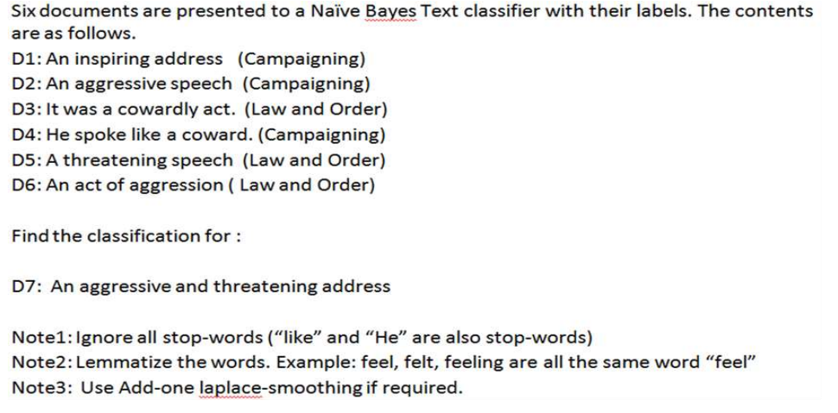
GenerativeAI and Its Applications
Example-Text Classification

Slide 27
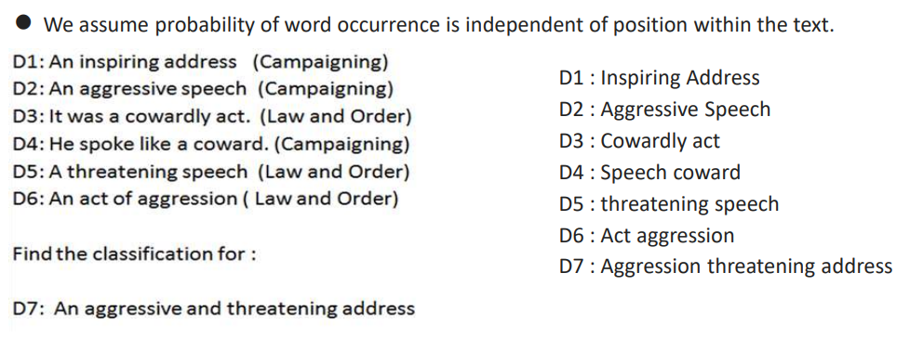
GenerativeAI and Its Applications
Example-Text Classification

Slide 28
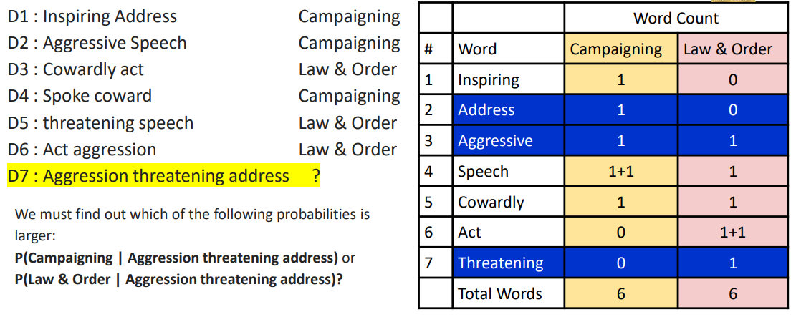
GenerativeAI and Its Applications
Example-Text Classification

Slide 29
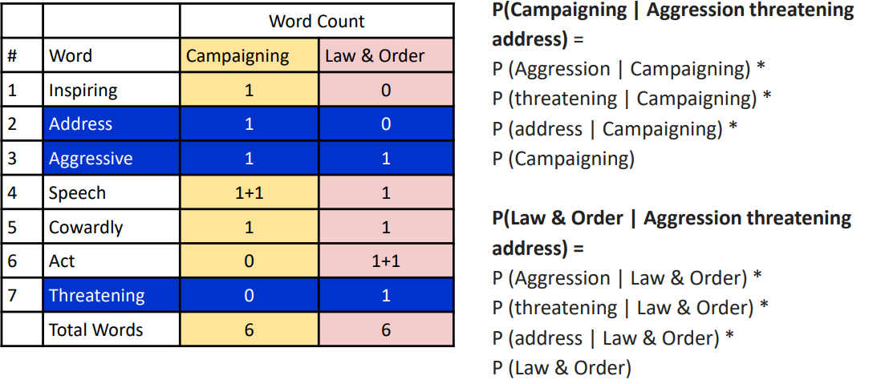
GenerativeAI and Its Applications
Example-Text Classification

Slide 30
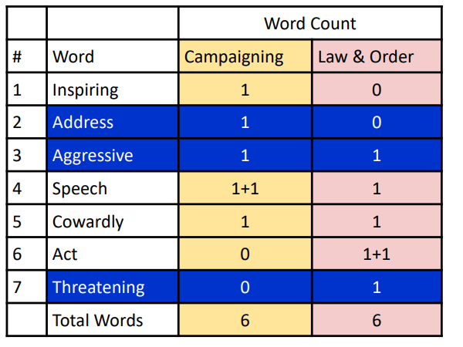
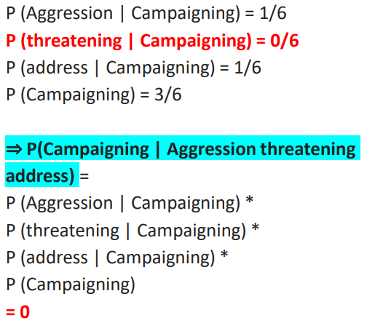
GenerativeAI and Its Applications
Example-Text Classification

Slide 31
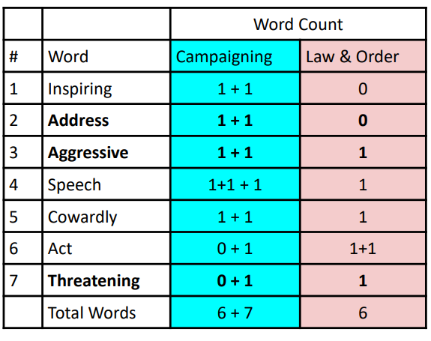
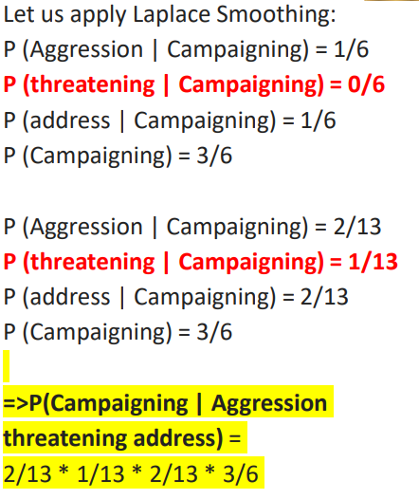
GenerativeAI and Its Applications
Example-Text Classification

Slide 32
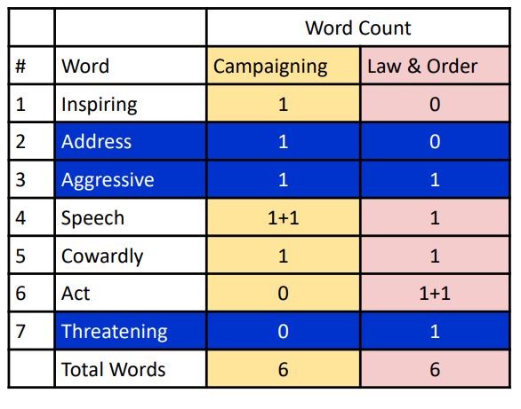
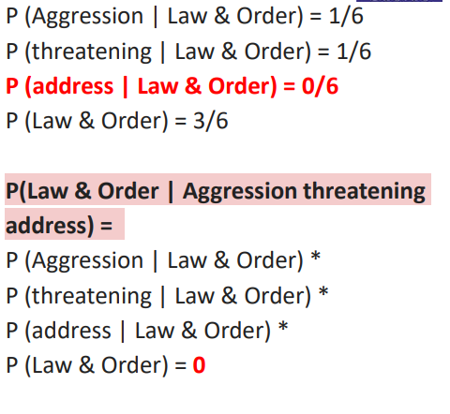
GenerativeAI and Its Applications
Example-Text Classification

Slide 33
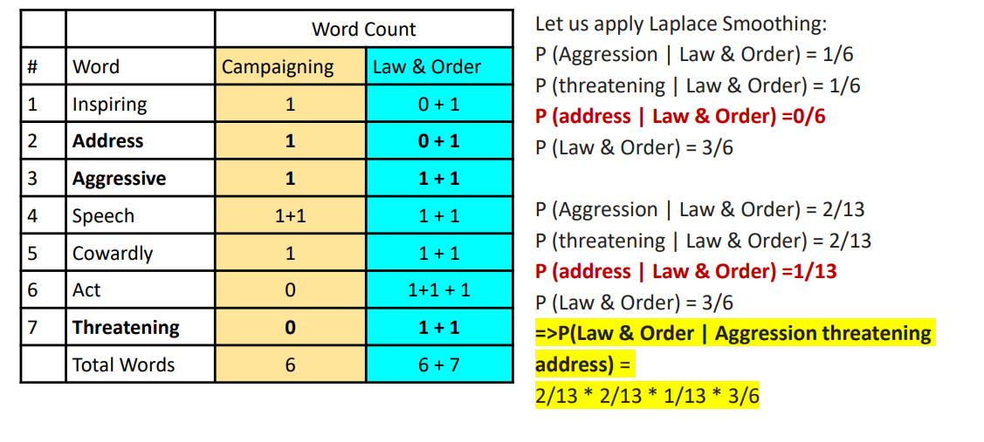
GenerativeAI and Its Applications
Example-Text Classification

Slide 34
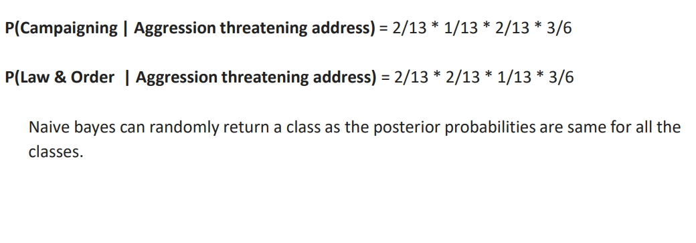
GenerativeAI and Its Applications
Example-Text Classification

Slide 35
Thank You

