Slide 1
E-Commerce Sales
Performance Analysis
An End-to-End Data Analysis of Kaggle E-Commerce Dataset
Dec 2010 – Dec 2011 | 541,909 Transactions
Presented by: Gogo Harrison

Slide 2
Problem Statement & Objectives
Business Context
Core Objectives
An online retailer requires executive-level insight into: • Sales trajectory and seasonality
• Which customers generate the most value
• Product performance and portfolio health
• Customer retention and churn risk
The analysis covers 397,884 valid transactions across 37 countries, 4,338 customers and 3,665 SKUs.
1
Understand Revenue Patterns
Identify trends, seasonality, and geographic concentration
2
Analyse Customer Behaviour
Segment customers by value; measure retention
3
Evaluate Product Portfolio
Surface top performers and underperforming SKUs
4
Deliver Actionable Insight
Translate findings into concrete business strategies

Slide 3
Dataset Overview
541,909
397,884
4,338
Raw Transactions
Valid Transactions
Unique Customers
3,665
37
£8.9M
Unique SKUs
Countries Served
Total Revenue
Data Quality Notes: 135K rows removed (missing CustomerID) · Cancellations excluded · Zero/negative values filtered

Slide 4
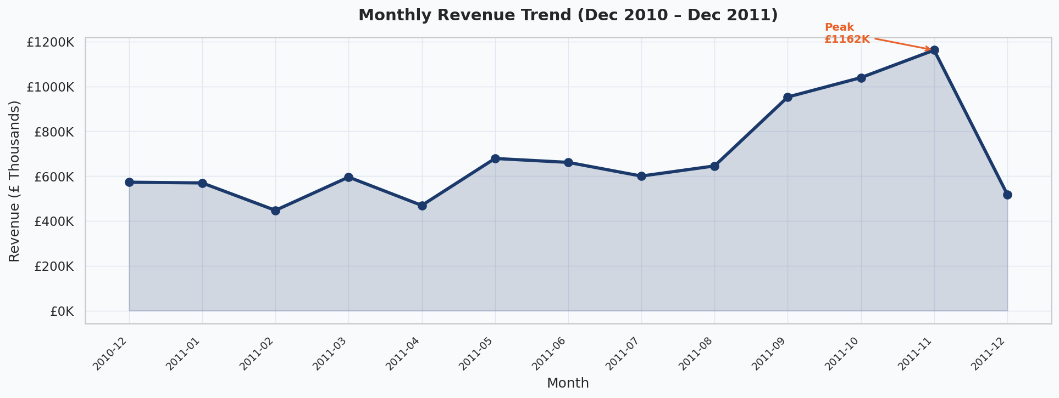
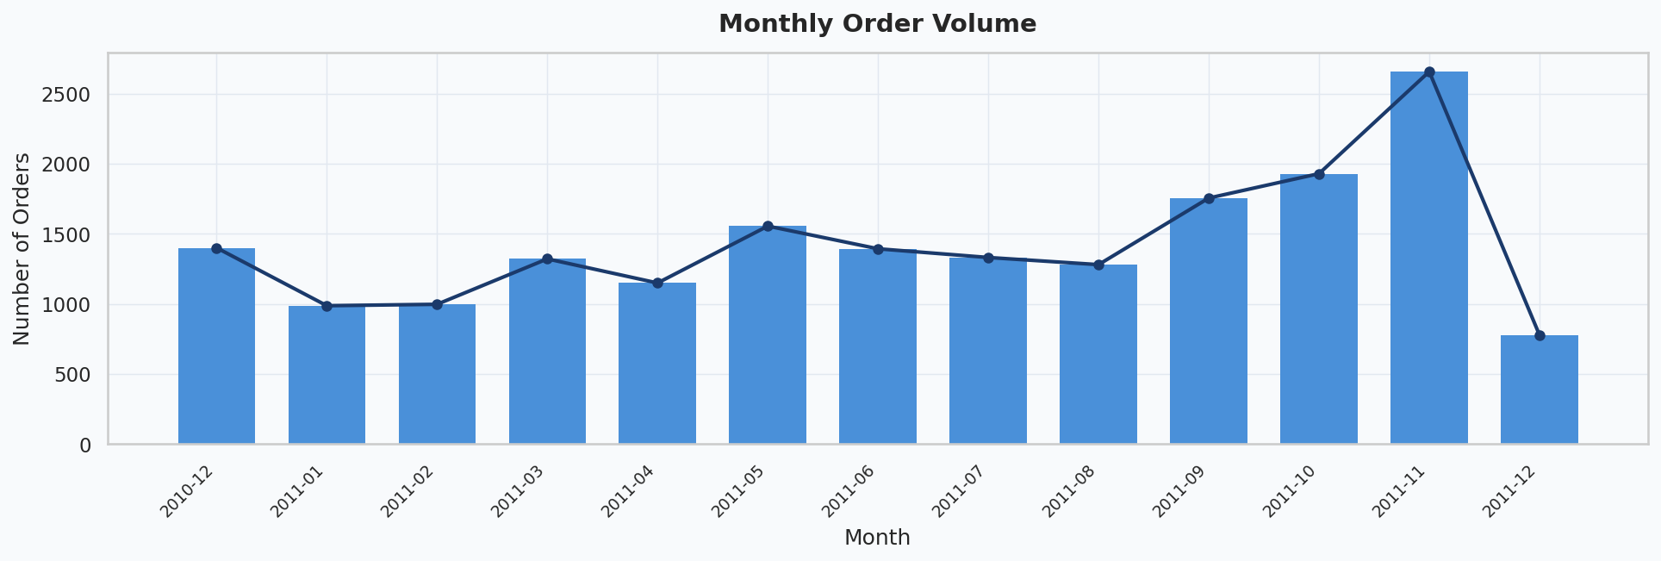
Revenue Trend & Order Volume
Key Insights
📈 Revenue grew consistently from Dec 2010
🎄 November 2011 was the peak month — Christmas demand surge
📦 Order volume tracks revenue closely, confirming volume-driven growth
⚠️ December 2011 data is partial (dataset ends 9 Dec)
💡 Q4 is critical — invest in inventory & marketing by September

Slide 5
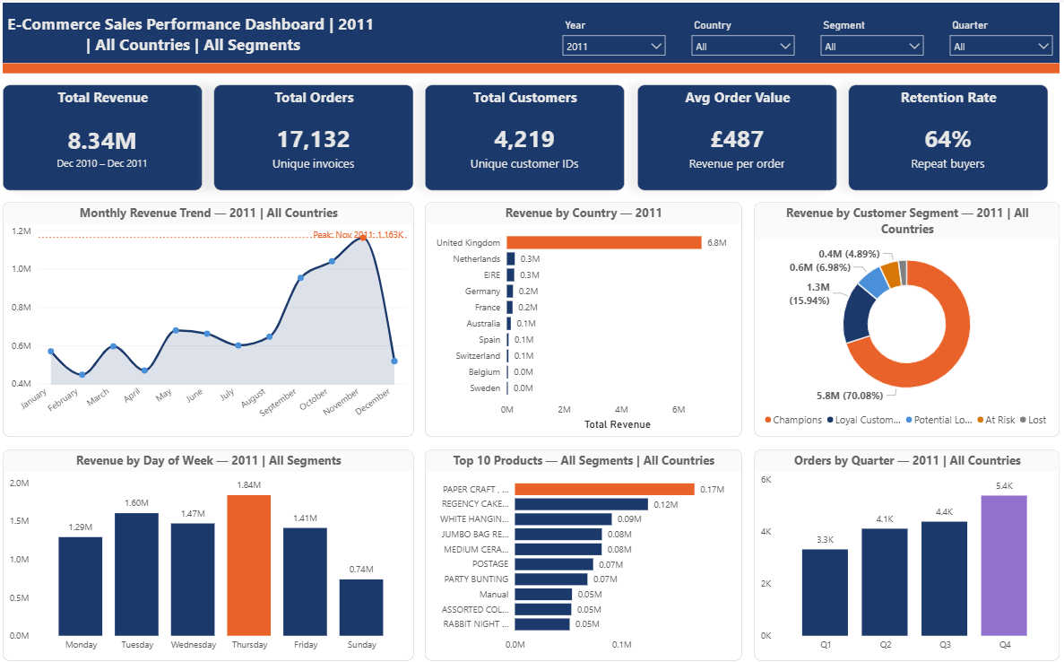
RFM Customer Segmentation
Champions
Loyal
At Risk
Lost
934 customers
£6.3M
800 customers
£430K
883 customers
£203K
Full dashboard available as an interactive Power BI file with dynamic filtering by Year, Country, Customer Segment, and Quarter. Download the .pbix file from the project repository to explore.

Slide 6
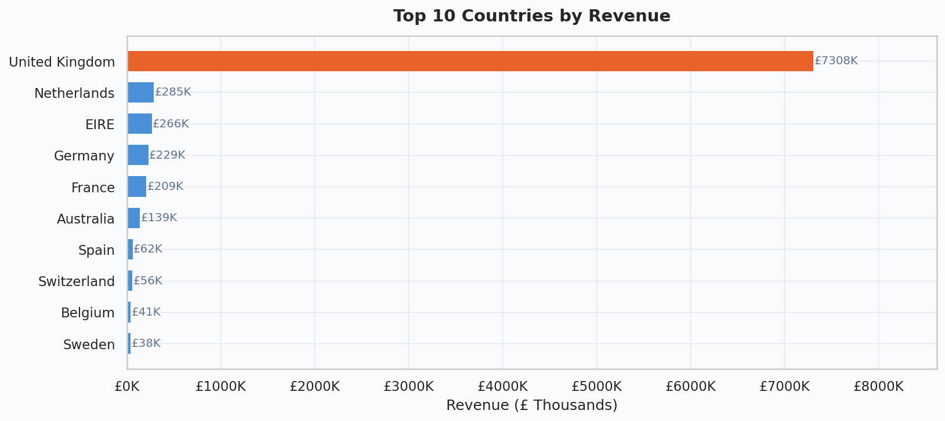
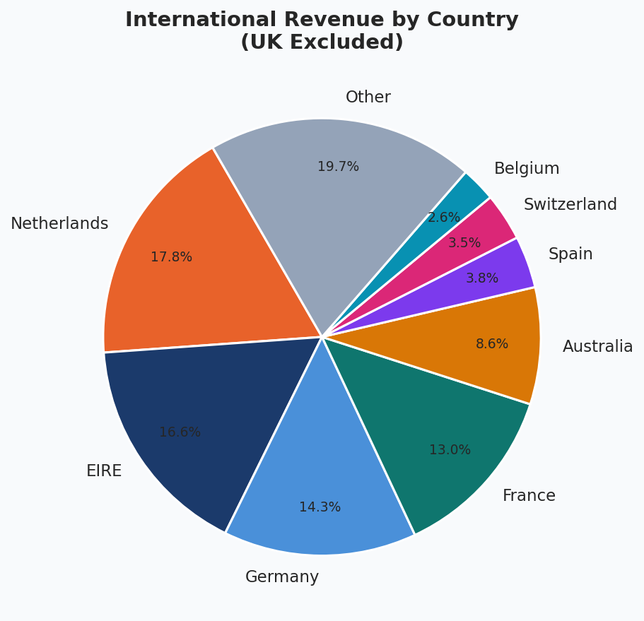
Geographic Revenue Performance
Key Insights
🇬🇧 UK = 83% of revenue — significant concentration risk
🇳🇱 Netherlands is the #2 market internationally
🇩🇪🇫🇷 Germany and France growing steadily
🌍 Top 5 intl. markets represent a £1.5M+ expansion opportunity
💡 Build localised experiences and EU fulfilment hubs to scale internationally

Slide 7
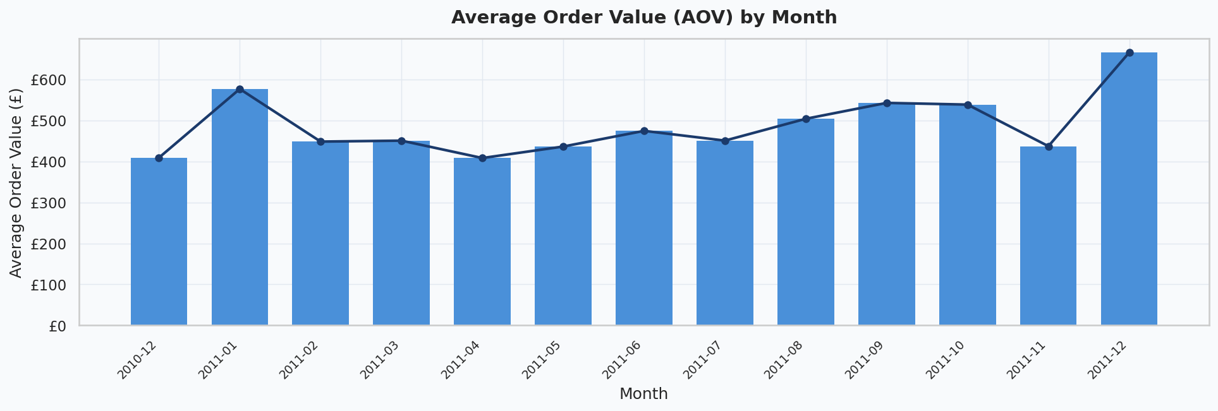
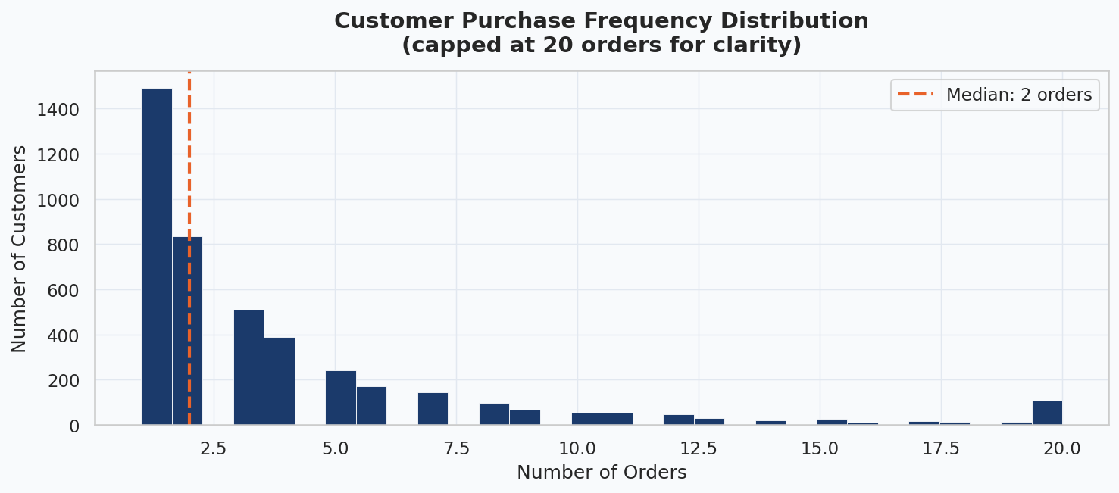
Customer Behaviour Analysis
Key Insights
💰 Overall AOV: £369 (mean); £230 (median)
📅 AOV spikes in Q4 — customers buy more per order for gifting
🔁 ~65% of customers are repeat buyers
👤 Median customer places 2 orders; max is 209
💡 Post-purchase nurture sequences can convert one-time buyers to repeat buyers

Slide 8
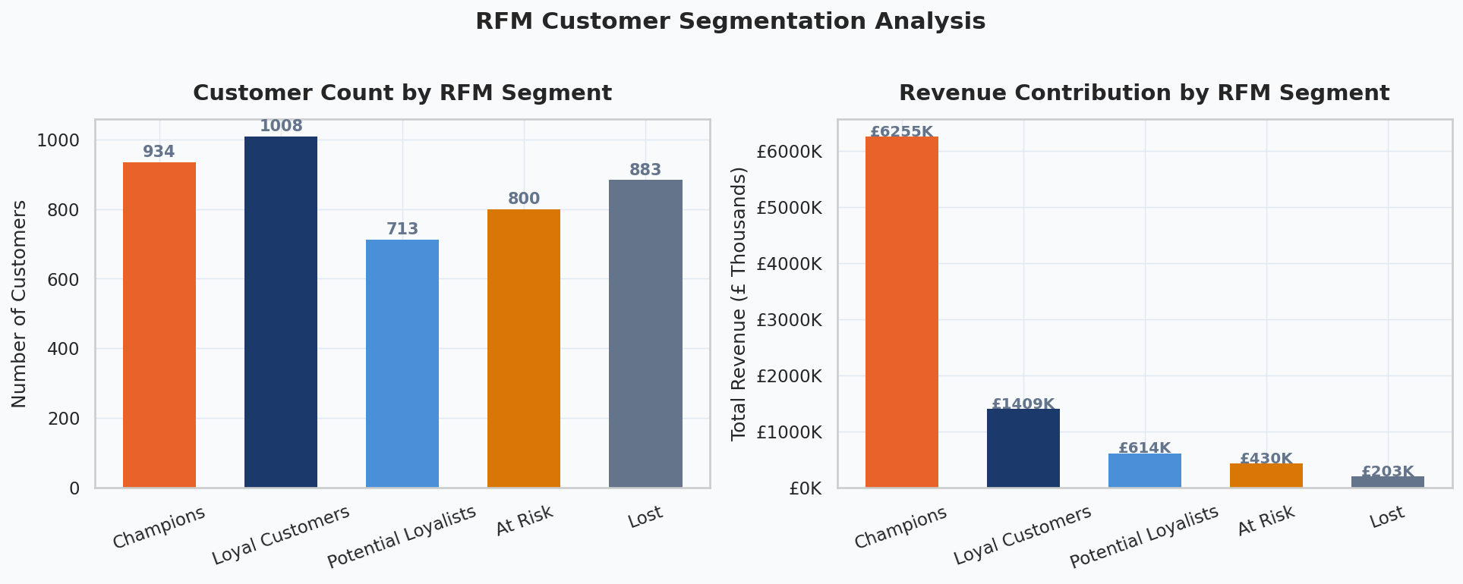
RFM Customer Segmentation
Champions
Loyal
At Risk
Lost
934 customers
£6.3M
1,008 customers
£1.4M
800 customers
£430K
883 customers
£203K
VIP loyalty tier, personal outreach
Rewards programme, early access
Win-back campaign, discount trigger
Re-engagement or remove from list

Slide 9
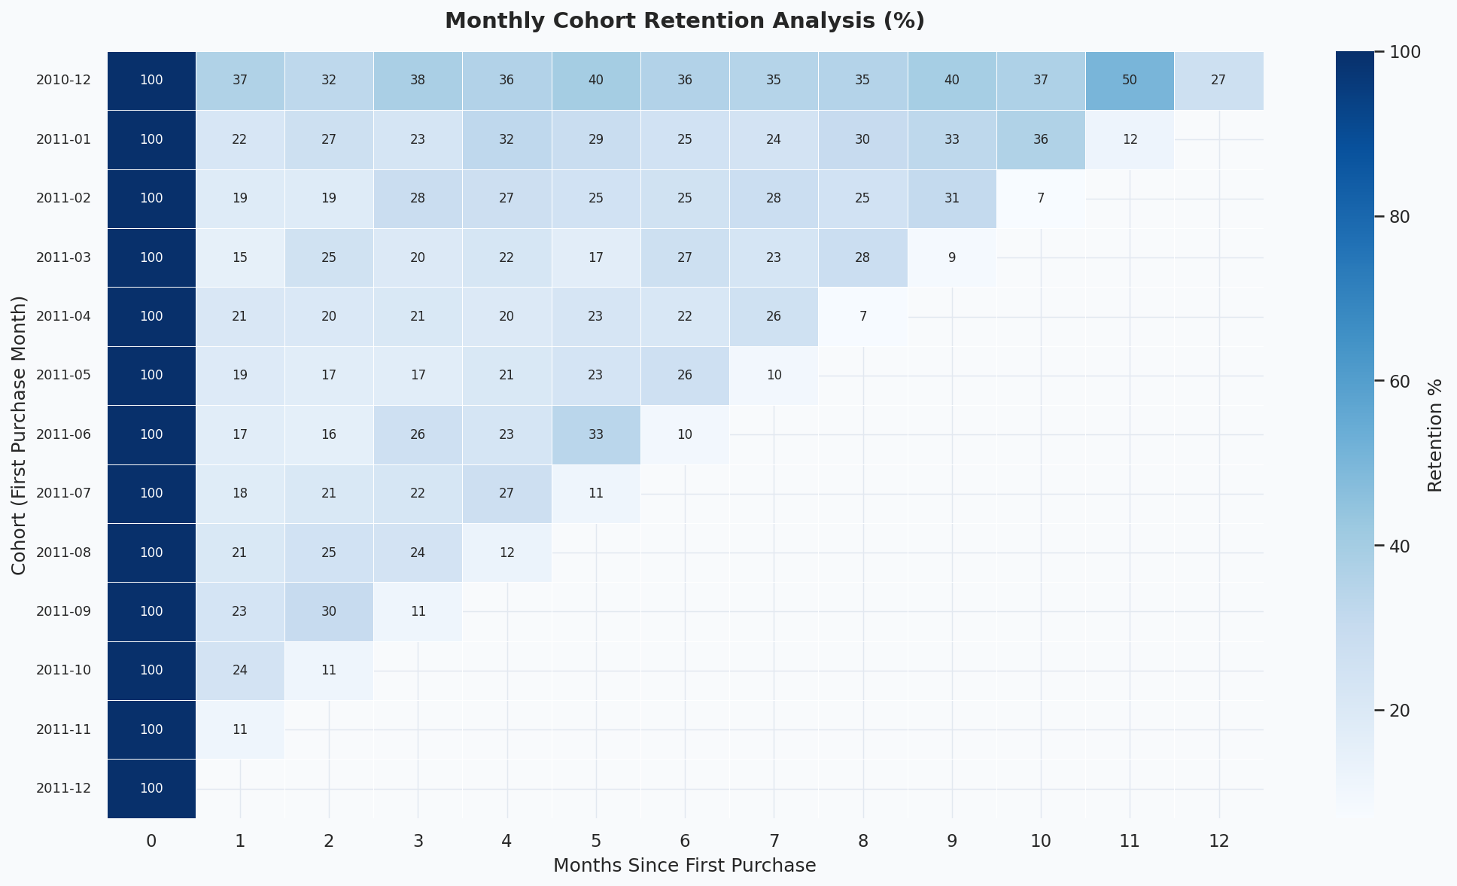
Cohort Retention Analysis
Key Insights
• Month-1 retention averages ~20-25%
• Dec 2010 cohort shows strongest long-term retention
• Retention drops sharply after month 1
• Holiday-acquired customers retain better
• 💡 Focus onboarding on first 30 days post-purchase — this is the critical retention window

Slide 10
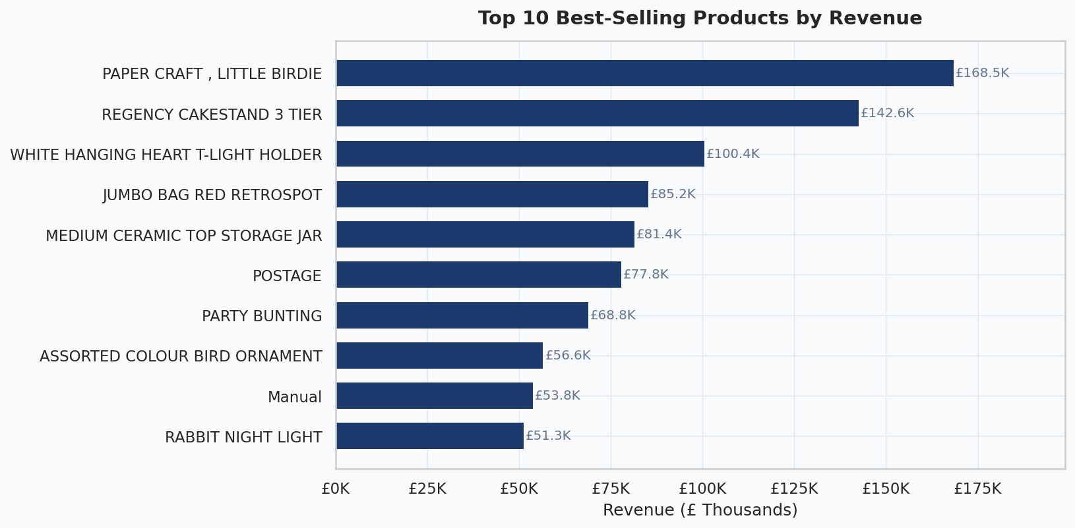
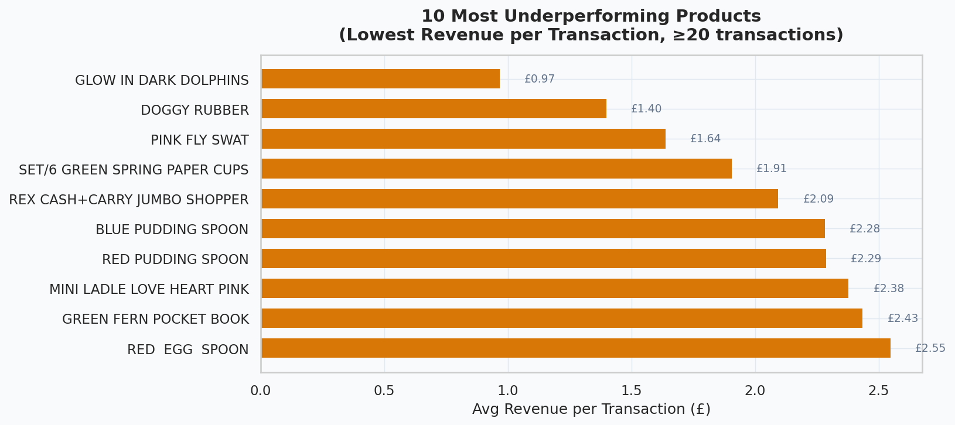
Product Performance Insights
Key Insights
🏆 Top 10 products generate disproportionate revenue
🕯️ Decorative / gift items dominate top sellers
⚠️ Many SKUs have <£2 avg revenue per transaction
📦 Bundling low-value items can boost basket size
💡 Apply 80/20 rule: focus marketing budget on top 20% of SKUs
🗑️ Consider discontinuing or repricing the bottom 50 SKUs

Slide 11
Strategic Recommendations
🏆 Protect Champions
🔄 Win Back At-Risk
🌍 Expand Internationally
Launch VIP tier with early access, free delivery & dedicated account support for top 100 CLV customers.
Deploy 3-step email win-back sequence with escalating discount. Target 800 at-risk customers (£430K revenue at stake).
Build localised landing pages & EU fulfilment hub for NL, DE, FR. Reduce geographic revenue concentration from 83%.
🎄 Maximise Q4 Seasonality
📧 Nurture One-Time Buyers
📅 Optimise Campaign Timing
Pre-stock top SKUs by September. Launch Q4 campaigns by late Sep. Create gift bundles at £25/£50/£75 price points.
Trigger post-purchase email flow at 14, 30, 60 days. Offer 10% off second order. Convert ~35% one-time buyers.
Schedule email & paid ads on Tuesdays and Thursdays (peak revenue days). Run weekend flash sales to lift Saturday revenue.

Slide 12
Conclusion
01 Revenue grew 60%+ over the analysis period with clear Q4 seasonal peaks
02 Champions (934 customers) generate 70% of revenue — protection is paramount
03 Month-1 retention of ~20-25% represents the single largest growth lever
04 Geographic concentration in UK (83%) poses strategic risk — international expansion warranted
05 Product portfolio can be optimised: reinvest in top 20% SKUs, rationalise the tail
Thank you

