Slide 1

Message Passing Programming
//Advanced Use of Collectives

Slide 2
// The Problem
Given a MxN matrix, we want to calculate the sum of each row and each column
Results are M values (row sums) and N values (column sums)

Slide 3
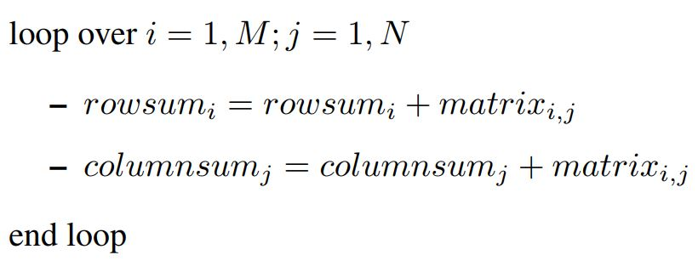
// Pseudocode

Slide 4
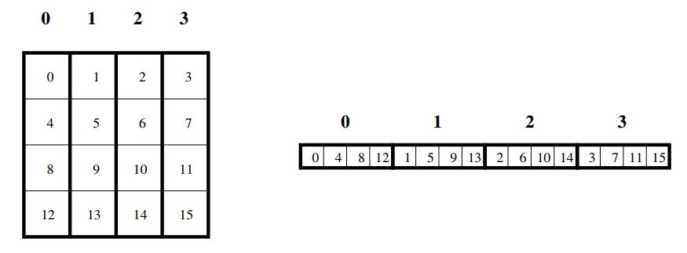
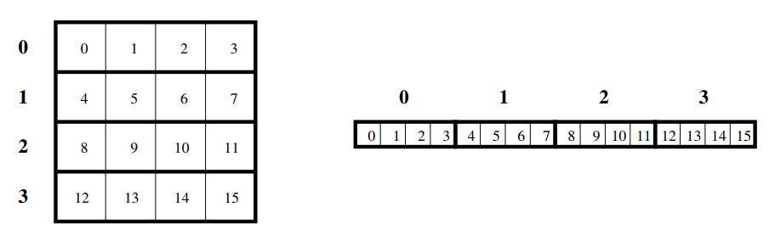
// MPI Implementation
Matrix is decomposed across procs over one of its dims (Scenario A)
Matrix is decomposed across procs over both of its dims (Scenario B)

Slide 5
// Scenario A approach (meh)
Create Communicator across all processes (root)
Scatter data based on decomposition (row-wise or column-wise)
Each process calculates sum locally (row or column)
Root gathers sums
Root Reduces on every array position

Slide 6

// Scenario B approach ( )
Create Communicator across all processes (root)
Scatter array decomposed on first of two dims
Each process calculates the sum locally
Root collects sums
Communicator scatters array decomposed on second dim
Each process calculates the sum locally
Root gathers sums

Slide 7
Fin

