Slide 1
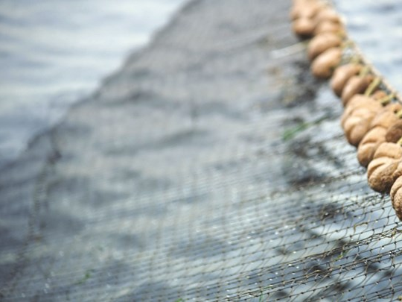
Fish Classification
Convolutional Neural Networks and Deep Learning
Athens University of Economics & Business
Master of Science: Business Analytics
Course : Big Data Content Analytics
Professor: Mr. Harris Papageorgiou
Assistant: Mr. Dimitris Pappas
Authors:
Katsaris Christos,Polyzogopoulos Pavlos,Rapanou Argyro,Souliou Georgia

Slide 2
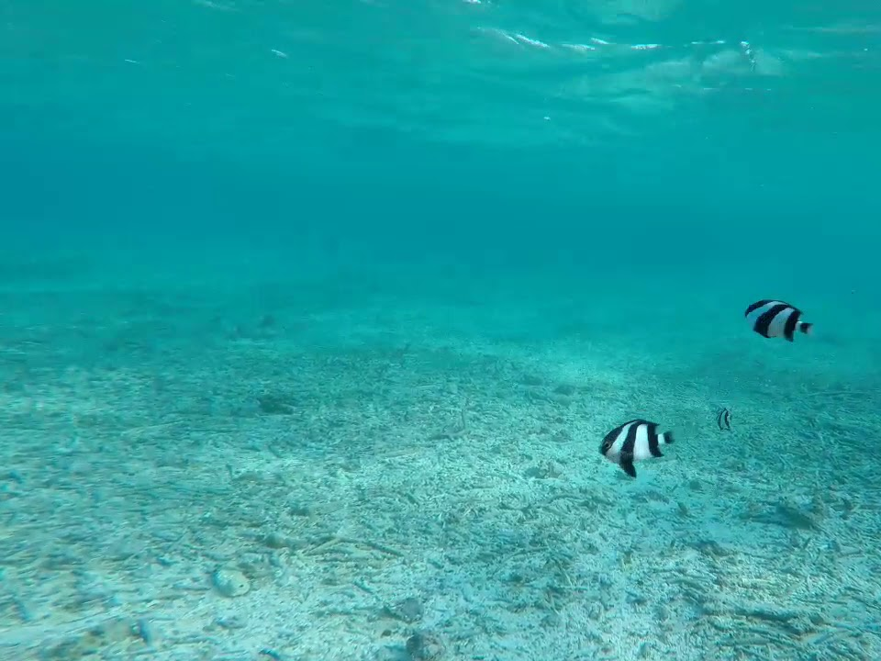
A little stats to begin with..
17% of fish stocks are partial overexploited
52% fully exploited
7% depleted
90% of large predatory fish are already gone
Total harvesting of wild fish from the world’s oceans stands at approximately to 90 million tons

Slide 3
The major issues vs Solutions
Monitoring fish
Obtaining data and records
Counting fish population
Automatic fish species classification in underwater image monitoring using CNN
(Convolutional Neural Networks).

Slide 4
Our business goal!
Create a gadget composed of a software and an underwater camera.
Fish species recognition, capturing underwater footage.
Useful in fishery and underwater experiences like scuba diving and snorkeling.

Slide 5
The dataset
Fish Recognition Ground-Truth Data
Fish Dataset
Labeled Fish in the Wild
Fish Net
41464 Images
31 Classes
Train (90 %)
Test (10 %)
Notes:
Only four available open datasets for CNN were found. We used only three except Fish Dataset. The core of the data comes from Fish Recognition Ground Truth data and Fish Net. And labeled fish in the Wild was used for no fish classification. The images are all underwater from seas and rivers . Reference to numbers, Manual split in 90 and 10 percent. Each class is stored in subfolders in two main folders for test and train.

Slide 6
Fish with no chips..
Data is acquired from live underwater videos
27.370 sea, 14.094 river
Varying size and number
Identify images based on the background of the picture rather than the fish itself. (water etc.)
Notes:
Some folders of classes, had very few images. Identifying based on the background also was a concern that we had to deal with because our model had to learn from the fish itself and not the background. For example , water. So, data augmentation was used too solve these issues. The three techniques were used.
random shifts, zoom and flip and finally data normalization.

Slide 7
The Methodology of CNNs
Convolutional Neural Network (CNN) for image recognition and processing pixel data.
Create a simple model (two layer) and after some experiments, end up with pre-trained model.
VGG16 model.
Notes:
CNN is a type of artificial neural network used in image recognition and processing that is specifically designed to process pixel data.

Slide 8
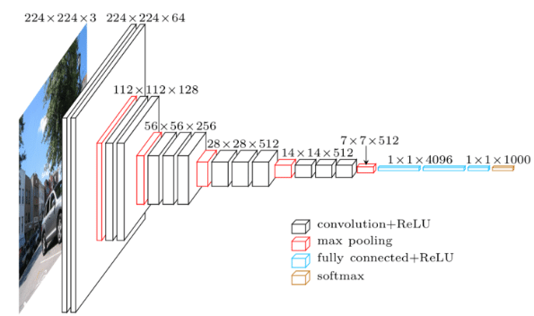
The architecture of VGG16 model
Introduced by the VGGT in the ILSVRS 2014 Competition
16-layer network
138 million parameters
Implementation in Keras
Notes:
So this is how the VGG16 model looks like. It was first introduced by VGG team Oxford University. In 2014 for ImageNet competition. The 16 stands for 16 layers or particularly has 13 convolutional layers and 3 dense layers.
### DESCRIBE MODEL ARCHITECTURE
16-layer networks were considered very deep (although we now have the ResNet architecture which can be successfully trained at depths of 50-200 for ImageNet and over 1,000 for CIFAR-10). Compared to other famous models VGG16 is preferred for its simplicity. On the contrary
It is painfully slow to train and second the network architecture weights themselves are quite large (over 138 million)

Slide 9
VGG16 Fine Tuned - Parameters
13 convolutional layers and 1 dense layer of 128 units
Input size 64x64
Multiple 3x3 kernel sized filters
Convolution stride = 1 pixel and padding = 1
Activation function ReLu
Softmax classifier with 31 channels
2x2 MaxPooling with stride of 2 pixels
No Dropout
14,7 million total number of weights / 63.512 trainable
Training time 3 days
Notes:
Of course we had to find tune our model in order to meets the goal of this project.
the last two dense layers were removed and replaced with one of 128 units
There 31 classes, so the last layer contains 31 channels. the input image size was resized to 64x64. Unfortunately it was too computationally expensive to increase these parameters.
The rest of the parameters kept as in the original VGG16 model.
Every Convolutional layer has MULTIPLE 3x3 filters with stride and padding equal to 1. The Max-Pooling layers are 2x2 with stride 2.
So, the final model has only 14,9 million parameters in total and 262.271 of them are trainable. It took more than 3 days to train.

Slide 10
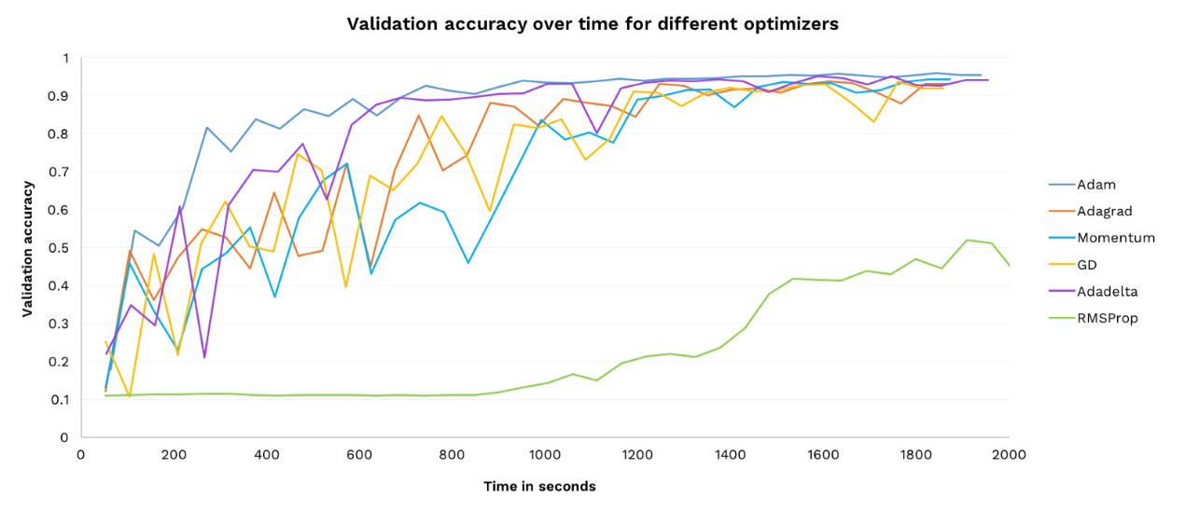
VGG16 Fine Tuned – Hyper Parameters
Categorical cross entropy loss
Adam optimizer algorithm with Learning Rate = 0.001
10 epochs / batch size = 200
Adam is the best
Notes:
As hyperparameters we used categorical crossentropy loss function with Adam optimizer algorithm and a learning rate of 0.001.
The model was trained for 10 epochs with batch size of 200. Steps per training and validation were set to 5000 and 1500 respectively

Slide 11
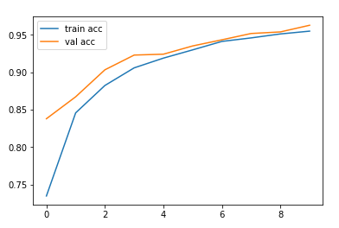
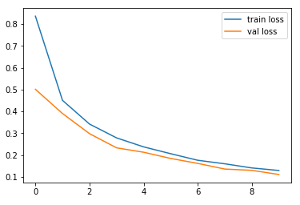
Model Evaluation in a glance
Validation Accuracy
95.80% - 3837/4006 images
Training Accuracy
93.3% - 35137/37458 images
Validation Loss
0.1308
0.1368
Training Loss
Notes:
So, we did really well. As you can see in the first figure, Training accuracy gradually increased and reached a peak of 95.8%. And Validation Accuracy was 93.3%
In addition, validation loss reaches 0.1308 and training loss the value of 0.1368 respectively. There is no sign of overfitting. On the contrary, both validation accuracy and loss were smaller than trainings’.

Slide 12
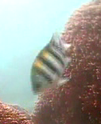
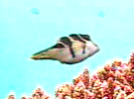
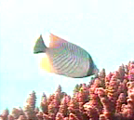

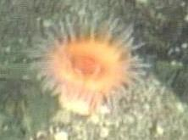
Best Accuracy Per Class
Abudefduf Vaigiensis : 100 %
10/10 images
Canthigaster valentini : 100 %
17/17 images
Chaetodon trifascialis : 100 %
28/28 images
Scaridae : 100 %
6/6 images
no_fish : 96%
29/31 images
Notes:
Our model managed to correctly classify 3837 out of 4006 images. In most cases, accuracy per class was greater than 90%. As you can see in the figures, in some cases the accuracy reached 100 %.It was very satisfying that the no fish class accuracy was 96%. Recall that these images do not show any fish, which means that our model learned to classify fish from their mask.

Slide 13
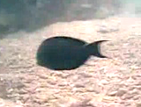
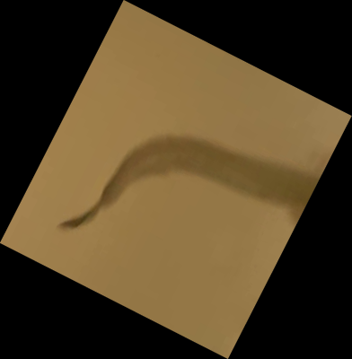
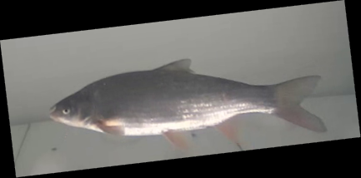

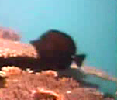
Worst Accuracy Per Class
Acanthurus nigrofuscus : 55 %
11/20 images
Burbot : 53.6 %
30/56 images
Nase : 76 %
133/175 images
Neoglyphidodon nigroris : 50 %
2/4 images
Zebrasoma scopas: 58.3%
7/12 images
Notes:
On the contrary, the accuracy in some classes was very poor. This maybe happened because of the fact that there were very few images for these classes in the validation set..
Another clue that for our model learned to classify fish based on their image rather than the background , was that it misclassified fishes coming from different origins (sea/river).
It is possible that the training and validation accuracy could have been even better if this model was trained for more than 10 epochs or the input image size was increased. In any case the success of transfer learning in this study is promising for the prospect of training Convolutional Neural Networks for other imaging tasks.

Slide 14
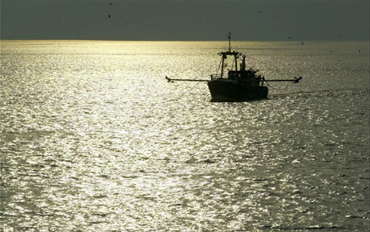
THANK YOU !!!!
Our project is available on https://github.com/gogosouliou

