Slide 1
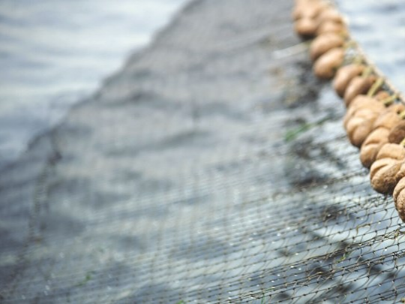
Fish Classification
Convolutional Neural Networks and Deep Learning
Athens University of Economics & Business
Master of Science: Business Analytics
Course : Big Data Content Analytics
Professor: Mr. Harris Papageorgiou
Assistant: Mr. Dimitris Pappas
Authors:
Katsaris Christos,Polyzogopoulos Pavlos,Rapanou Argyro,Souliou Georgia

Slide 2
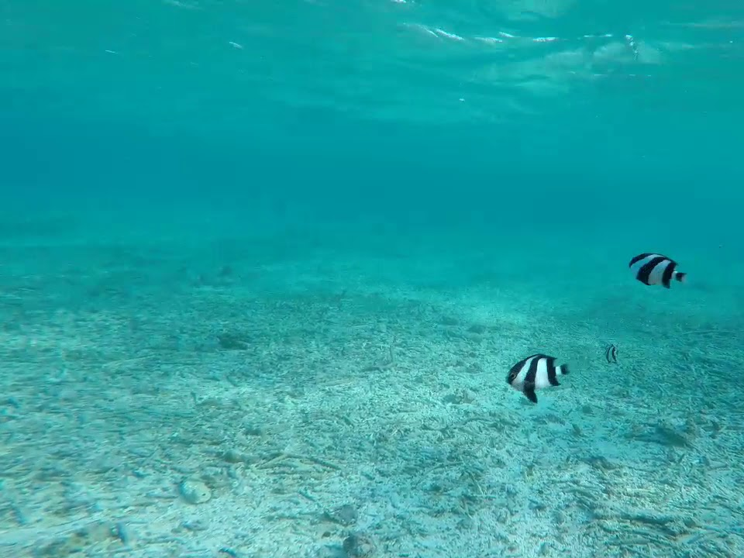
A little stats to begin with..
17% of fish stocks are partial overexploited
52% fully exploited
7% depleted
90% of large predatory fish are already gone
Total harvesting of wild fish from the world’s oceans stands at approximately to 90 million tons

Slide 3
The major issues vs Solutions
Monitoring fish
Obtaining data and records
Counting fish population
Automatic fish species classification in underwater image monitoring using CNN
(Convolutional Neural Networks).

Slide 4
Our business goal!
Create a gadget composed of a software and an underwater camera.
Fish species recognition, capturing underwater footage.
Useful in fishery and underwater experiences like scuba diving and snorkeling.

Slide 5
The dataset
Fish Recognition Ground-Truth Data
Fish Dataset
Labeled Fish in the Wild
Fish Net
41464 Images
31 Classes
Train (90 %)
Test (10 %)

Slide 6
Fish with no chips..
Data is acquired from live underwater videos
27.370 sea, 14.094 river
Varying size and number
Identify images based on the background of the picture rather than the fish itself. (water etc.)

Slide 7
The Methodology of CNNs
Convolutional Neural Network (CNN) for image recognition and processing pixel data.
Create a simple model (two layer) and after some experiments, end up with pre-trained model.
VGG16 model.

Slide 8
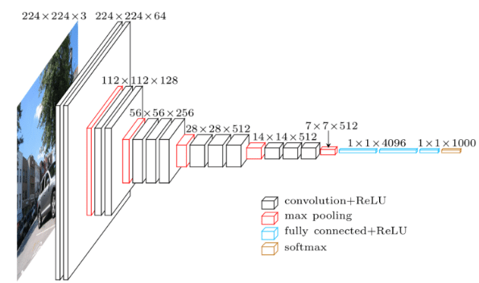
The architecture of VGG16 model
Introduced by the VGGT in the ILSVRS 2014 Competition
16-layer network
138 million parameters
Implementation in Keras

Slide 9
VGG16 Fine Tuned - Parameters
13 convolutional layers and 1 dense layer of 128 units
Input size 64x64
Multiple 3x3 kernel sized filters starting at 64 and increasing by a factor of 2 after every pooling layer
Convolution stride = 1 pixel and padding = 1
Activation function ReLu
Softmax classifier with 31 channels
2x2 MaxPooling with stride of 2 pixels
No Dropout
14,7 million total number of weights / 63.512 trainable
Training time 3 days

Slide 10
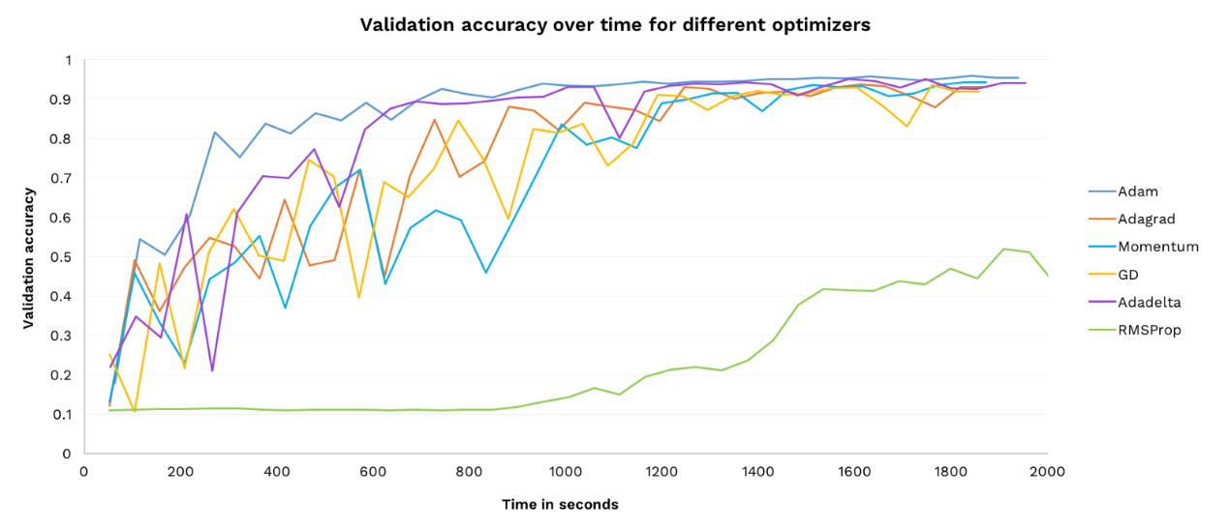
VGG16 Fine Tuned – Hyper Parameters
Categorical cross entropy loss
Adam optimizer algorithm with Learning Rate = 0.001
10 epochs / batch size = 200
Adam is the best

Slide 11
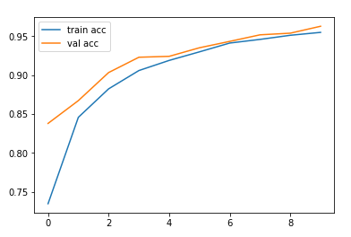
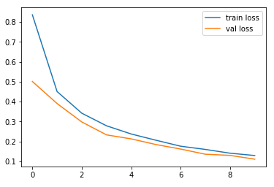
Model Evaluation in a glance
Validation Accuracy
95.80% - 3837/4006 images
Training Accuracy
93.3% - 35137/37458 images
Validation Loss
Training Loss
0.1308% - 5/4006 images
0.1368% - 51/37458 images

Slide 12
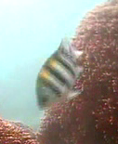
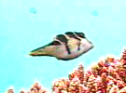
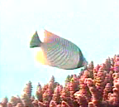

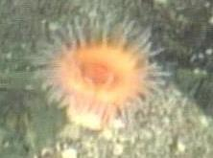
Best Accuracy Per Class
Abudefduf Vaigiensis : 100 %
10/10 images
Canthigaster valentini : 100 %
17/17 images
Chaetodon trifascialis : 100 %
28/28 images
Scaridae : 100 %
6/6 images
no_fish : 96%
29/31 images

Slide 13
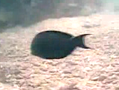
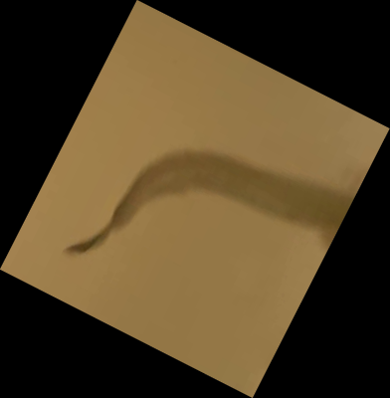
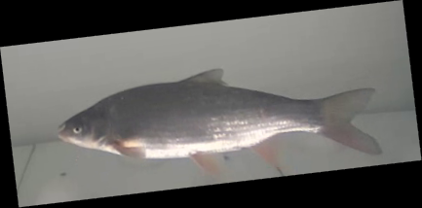

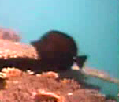
Worst Accuracy Per Class
Acanthurus nigrofuscus : 55 %
11/20 images
Burbot : 53.6 %
30/56 images
Nase : 76 %
133/175 images
Neoglyphidodon nigroris : 50 %
2/4 images
Zebrasoma scopas: 58.3%
7/12 images

Slide 14
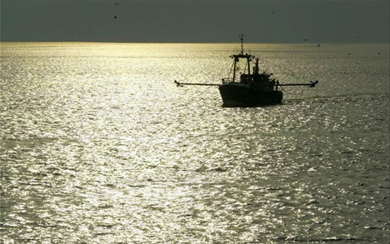
THANK YOU !!!!
Our project is available on https://github.com/gogosouliou

