Slide 1

Observer Pattern

Slide 2
What is Observer Pattern?
Allow objects to listen to events of the subject.
Allow subjects to broadcast events to any number of objects.
Also called “event driven software development“, particularly in UI development.
Allow a kind of a reverse of method call.
  When an object uses a class (subject), oftentime it’s the object calling methods of the class. i.e. object pulls data from the subject.
  However, with observer pattern, subject can ask the object to do something through previously received listener. i.e. subject pushes the data to the object.

Slide 3
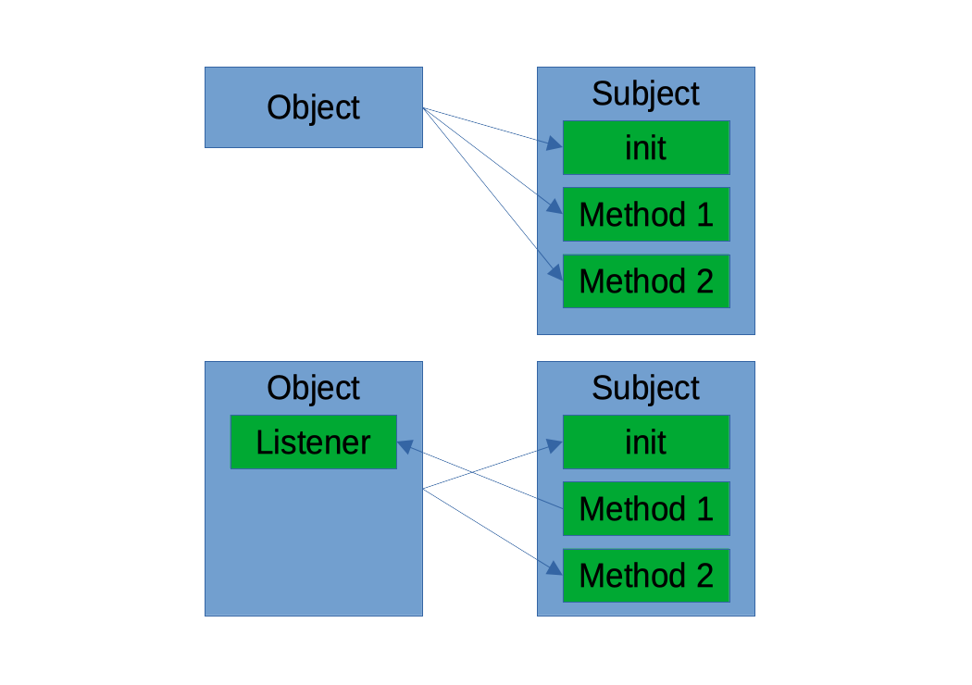
Pull vs. Push

Slide 4
Why Observer Pattern?
Enable loose coupling between subjects and objects.
  Subjects no need to know what the observers are.
  Objects no need to know how the subject is implemented.
Allow scaling observers easily.
Allow calling observers asynchronously easily.
Particularly useful when data come in an indeterminate time in the future.
  User input e.g. clicks, presses, taps, drags etc
  Disk I/O, Network I/O

Slide 5
Implementations
Java UI listener
RxJava Observable
Swift ObservableObject
Kotlin Flow
Dart Stream
Many of these APIs are advanced that you can compose multiple listeners to form new listeners, and be called asynchronously.

Slide 6
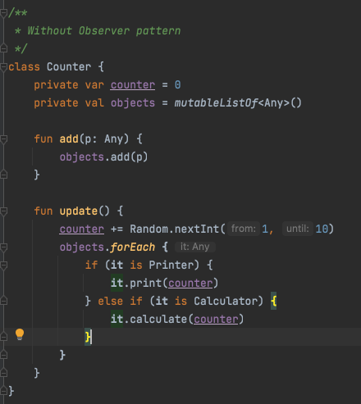

What if we don’t use observers.

Slide 7
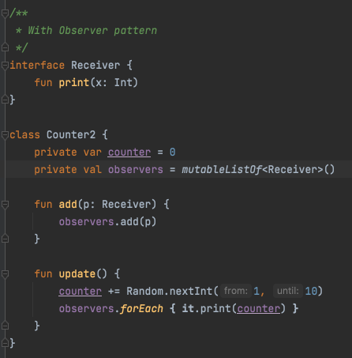

When we use observers.

Slide 8
Q&A

