Slide 1
SEQ CPU Implementation

Slide 2
Outline
SEQ Stage Implementation
Suggested Reading 4.3.4

Slide 3
PC
Write back
valM
Memory
Data memory
addrs,data
valE
CC
Cnd
CC
ALU
Execute
CC
aluA,aluB
valA, valB
Decode
srcA, srcB
A B
Register File
M
E
M
Register
icode:ifun, rA:rB
valC
dstE,dstM
valE,
valM
valP
Instruction memory
Fetch
Instruction
PC increment
PC
PC
PC
newPC

Slide 4
newPC
PC
New PC
data out
valM
read
Memory
Mem Control
Data memory
write
Addr
Data
Bch
valE
Execute
CC
ALU
ALU fun
ALUA
ALUB
valA
valB
dstE
dstM
srcA
srcB
Decode
dstE
dstM
srcA
srcB
A
B
M
Register file
E
Write Back
icode
ifun
rA
rB
valC
valP
Instruction Memory
PC increment
Fetch
PC

Slide 5
SEQ Hardware
Blue boxes: predesigned hardware blocks
  e.g., memories, ALU
Gray boxes: control logic
  Describe in HCL
White ovals: labels for signals
Thick lines: 64-bit word values
Thin lines: 4-8 bit values
Dotted lines: 1-bit values
Notes:
这个图中有些控制信号没有标出来。
似乎PC也应该是蓝色的。

Slide 6
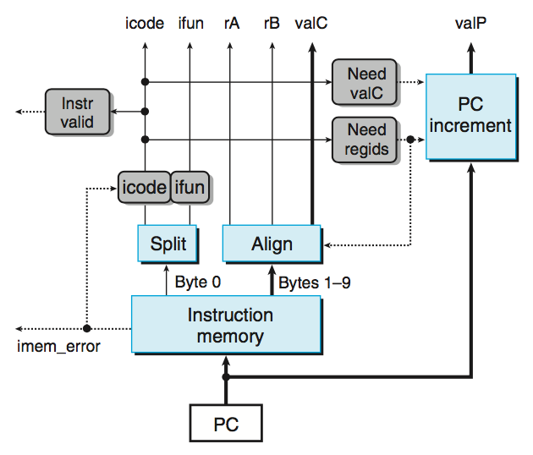
Fetch Logic
Notes:
事实上，不管需要几个字节，读入都是10个字节。
Split实际上是非常简单的。因为读出的一个字节就是8根信号线，只要将他们分为两股就可以了。
一个问题：Align没有使用Need valC信号，因为如果这条指令没有带常数，那么valC不管产生什么内容都无所谓。但valC到底是1-8字节还是2-9字节却要根据Need regids信号来确定。所以Need regids必须要，而Need valC可以不需要。
这也是一种常用的硬件设计方法：如果我们说一个信号在某种情况下用不到，那么它就可以是任意值。这样通过对它赋予某种赋值可以将他与其他信号合并或者其他简化。这里就是一个例子，valC并不是如果不需要的话，就为0。

Slide 7
Fetch Logic
Predefined Blocks
  PC: Register containing PC
  Instruction memory: Read 10 bytes (PC to PC+9)
  Split: Divide instruction byte into icode and ifun
  Align: Get fields for rA, rB, and valC
  PC increment: increases PC to valP

Slide 8
Fetch Logic
Control Blocks
  Instr. Valid: Is this instruction valid?
  Need regids: Does this instruction have a register bytes?
  Need valC: Does this instruction have a constant word?
  icode|ifun: Set to “nop” if imem_error

Slide 9
Some Macros
Name | Value | Meaning
IHALT | 0 | Code for halt instruction
INOP | 1 | Code for nop instruction
IRRMOVQ | 2 | Code for rrmovq instruction
IIRMOVQ | 3 | Code for irmovq instruction
IRMMOVQ | 4 | Code for rmmovq instruction
IMRMOVQ | 5 | Code for mrmovq instruction
IOPQ | 6 | Code for integer op instructions
IJXX | 7 | Code for jump instructions
………… | …… | ……………………………
IPOPQ | B | Code for popq instruction
Notes:
用在HCL中表示指令、寄存器、操作符类型

Slide 10
Some Macros
Name | Value | Meaning
RRSP | 4 | Register ID for %rsp
FNONE | 0 | Default Function Code
RNONE | F | Indicates no register file access
ALUADD | 0 | Function for addition operation
SAOK | 1 | Status code for normal operations
SADR | 2 | Status code for address exception
SINS | 3 | Status code for illegal instruction Exception
SHLT | 4 | Status code for halt
Notes:
用在HCL中表示指令、寄存器、操作符类型

Slide 11
nop
0
0
0
nop
0
halt
0
0
0
0
halt
1
1
1
1
0
0
0
halt
0
nop
rA
rB
rA
rA
rB
rB
rA
rA
rB
rB
rA
rA
rB
2
rB
2
0
0
2
2
0
rrmovl
,
0
rrmovl
rrmovq
,
,
V
rB
V
V
rB
rB
rB
rB
rB
rB
V
V
3
V
3
3
3
0
0
0
0
8
8
8
irmovl
8
irmovl
irmovq
,
,
,
rA
rA
rA
D
D
D
rB
rB
rB
rA
rA
rB
rB
D
rA
rA
rB
rB
D
4
D
4
0
0
4
4
0
rmmovl
0
rmmovl
rmmovq
,
,
,
(
(
(
)
)
)
D
rB
rA
D
D
rB
rB
rA
rA
rA
rA
rB
rB
D
rA
rA
rB
rB
D
5
D
0
5
5
5
0
0
mrmovl
0
mrmovl
mrmovq
(
(
(
),
),
),
rA
rB
rA
rA
rB
rB
fn
fn
rA
rA
rB
fn
rB
fn
rA
rA
rB
6
rB
6
6
OPl
,
6
OPl
OPq
,
,
Dest
Dest
Dest
fn
fn
Dest
fn
fn
Dest
7
Dest
7
7
jXX
7
jXX
jXX
Dest
Dest
Dest
Dest
Dest
8
Dest
8
0
0
8
8
0
call
0
call
call
ret
9
9
0
ret
0
ret
9
9
0
0
rA
rA
rA
rA
rA
rA
A
rA
A
0
0
8
A
8
A
0
0
8
pushl
8
pushl
pushq
rA
rA
rA
rA
rA
rA
B
rA
B
B
B
0
0
0
0
8
8
8
popl
8
popl
popq
need_regids

Slide 12
Fetch Control Logic
bool need_regids = icode in
{ IRRMOVQ, IIRMOVQ, IRMMOVQ, IMRMOVQ, IOPQ, IPUSHQ, IPOPQ };
bool instr_valid = icode in
{ IHALT, INOP, IRRMOVQ, IIRMOVQ, IRMMOVQ, IMRMOVQ, IOPQ, IJXX, ICALL, IRET, IPUSHQ, IPOPQ };

Slide 13
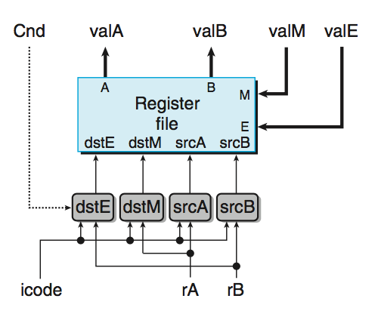
Decode & Write-Back Logic
Notes:
因为Decode阶段和Write Back阶段都主要是在操作register file，所以我们把他们合在一起讲。
写口E是用来写Execute阶段来的结果的，写口M是用来写Memory阶段来的结果的。
这里主要是要处理4个读写信号的地址。
当dstE和dstM相同时（这发生在popl %esp时），根据语义，应该是使用valM的值。

Slide 14
Decode &
Write Back Logic
Predefined Blocks
  Registers File
    Read ports A, B & Write ports E, M
    Addresses are register IDs or F (no access)

Slide 15
Decode &
Write Back Logic
Control Logic
  srcA: read port address for valA {rA, %rsp}
  srcB: read port address for valB {rB, %rsp}
  dstE: write port address for valE {rB, %rsp}
  dstM: write port address for valM {rA}
  Cnd: used to decide whether set valE (cmovXX)

Slide 16
A Source
opq rA, rB
Decode
valA ← R[rA]
Read operand A
rmmovq rA, D(rB)
Decode
valA ← R[rA]
Read operand A
popq rA
Decode
valA ← R[%rsp]
Read stack pointer
jXX Dest
Decode
No operand
call Dest
Decode
No operand
ret
Decode
valA ← R[%rsp]
Read stack pointer
Notes:
具体的表见P283-284

Slide 17
A Source
int srcA = [
icode in { IRRMOVQ, IRMMOVQ, IOPL, IPUSHQ } : rA;
icode in { IPOPQ, IRET } : RRSP;
1 : RNONE; # Don't need register
];
Notes:
具体的表见P283-284

Slide 18
E Destination
opq rA, rB
Write-back
R[rB] ← valE
Write back result
rmmovq rA, D(rB)
Write-back
None
popq rA
Write-back
R[%rsp] ← valE
Update stack pointer
jXX Dest
Write-back
None
call Dest
Write-back
R[%rsp] ← valE
Update stack pointer
ret
Write-back
R[%rsp] ← valE
Update stack pointer

Slide 19
E Destination
int dstE = [
icode in { IRRMOVQ, IIRMOVQ,
IOPQ} : rB;
icode in { IPUSHQ, IPOPQ, ICALL,
IRET }: RRSP;
1 : RNONE; # Don't need register
];
// cmovXX is not considered

Slide 20
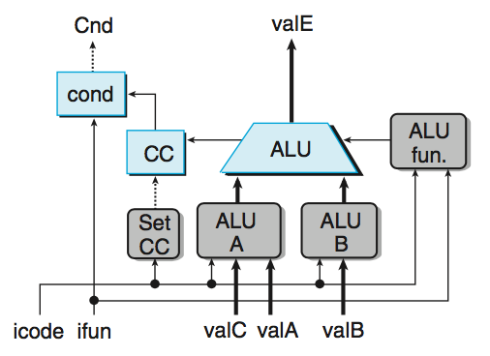
Execute Logic
Notes:
Set CC信号表示CC寄存器是否需要被更新。

Slide 21
Execute Logic
Predefined Blocks
  ALU: implements 4 required functions and
  generate condition code values
  CC: register with 3 condition code bits
  cond: computes condition flag

Slide 22
Execute Logic
Control Logical
  Set CC: Should condition code register be loaded?
  ALU A: Input A to ALU {valA, valC, +8, -8}
  ALU B: Input B to ALU {valB, 0}
  ALU fun: What function should ALU compute?

Slide 23
ALU A Input
opq rA, rB
Execute
valE ← valB OP valA
Perform ALU operation
rmmovq rA, D(rB)
Execute
valE ← valB + valC
Compute effective address
popq rA
Execute
valE ← valB + 8
Increment stack pointer
jXX Dest
Execute
No operation
call Dest
Execute
valE ← valB + –8
Decrement stack pointer
ret
Execute
valE ← valB + 8
Increment stack pointer

Slide 24
ALU A Input
int aluA = [
icode in { IRRMOVQ, IOPQ } : valA;
icode in { IIRMOVQ, IRMMOVQ,IMRMOVQ} : valC;
icode in { ICALL, IPUSHQ } : -8;
icode in { IRET, IPOPQ } : 8;
# Other instructions don't need ALU
];

Slide 25
ALU Operation
opq rA, rB
Execute
valE ← valB OP valA
Perform ALU operation
rmmovq rA, D(rB)
Execute
valE ← valB + valC
Compute effective address
popq rA
Execute
valE ← valB + (-8)
Increment stack pointer
jXX Dest
Execute
No operation
call Dest
Execute
valE ← valB + (-8)
Decrement stack pointer
ret
Execute
valE ← valB + 8
Increment stack pointer

Slide 26
ALU Operation / Condition Set
int alufun = [
icode == IOPQ : ifun;
1 : ALUADD;
];
Bool set_cc = icode in { IOPQ };

Slide 27
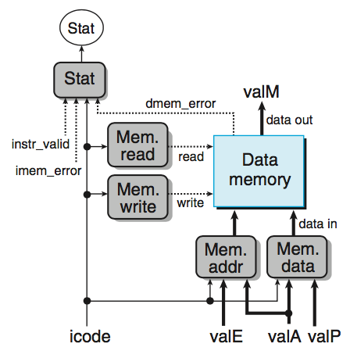
Memory Logic
Notes:
Mem read信号和Mem write信号不会同时为1。

Slide 28
Memory Logic
Predefined Blocks
  Memory: Reads or writes memory word

Slide 29
Memory Logic
Control Logical
  Mem. read: should word be read?
  Mem. write: should word be written?
  Mem. addr.: Select address {valA, valE}
  Mem. data.: Select data {valA, valP}

Slide 30
Memory Address
opq rA, rB
Memory
No operation
rmmovq rA, D(rB)
Memory
M₈[valE] ← valA
Write value to memory
popq rA
Memory
valM ← M₈[valA]
Read from stack
jXX Dest
Memory
No operation
call Dest
Memory
M₈[valE] ← valP
Write return value on stack
ret
Memory
valM ← M₈[valA]
Read return address

Slide 31
Memory Address
int mem_addr = [
icode in { IRMMOVQ, IPUSHQ, ICALL, IMRMOVQ } : valE;
icode in { IPOPL, IRET } : valA;
# Other instructions don't need address
];

Slide 32
Memory Read
opq rA, rB
Memory
No operation
rmmovq rA, D(rB)
Memory
M₈[valE] ← valA
Write value to memory
popq rA
Memory
valM ← M₈[valA]
Read from stack
jXX Dest
Memory
No operation
call Dest
Memory
M₈[valE] ← valP
Write return value on stack
ret
Memory
valM ← M₈[valA]
Read return address

Slide 33
Memory Read/Write
bool mem_read = icode in { IMRMOVQ, IPOPQ, IRET };
bool mem_write = icode in { IRMMOVQ, IPUSHQ, ICALL };

Slide 34
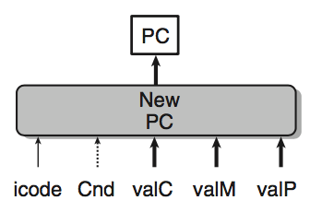
PC Update Logic
New PC
  Select next value of PC

Slide 35
PC Update
opq rA, rB
PC update
PC ← valP
Update PC
rmmovq rA, D(rB)
PC update
PC ← valP
Update PC
popq rA
PC update
PC ← valP
Update PC
jXX Dest
PC update
PC ← Cnd ? valC : valP
Update PC
call Dest
PC update
PC ← valC
Set PC to destination
ret
PC update
PC ← valM
Set PC to return address

Slide 36
PC Update
int new_pc = [
icode == ICALL : valC;
icode == IJXX && Cnd : valC;
icode == IRET : valM;
1 : valP;
];

Slide 37
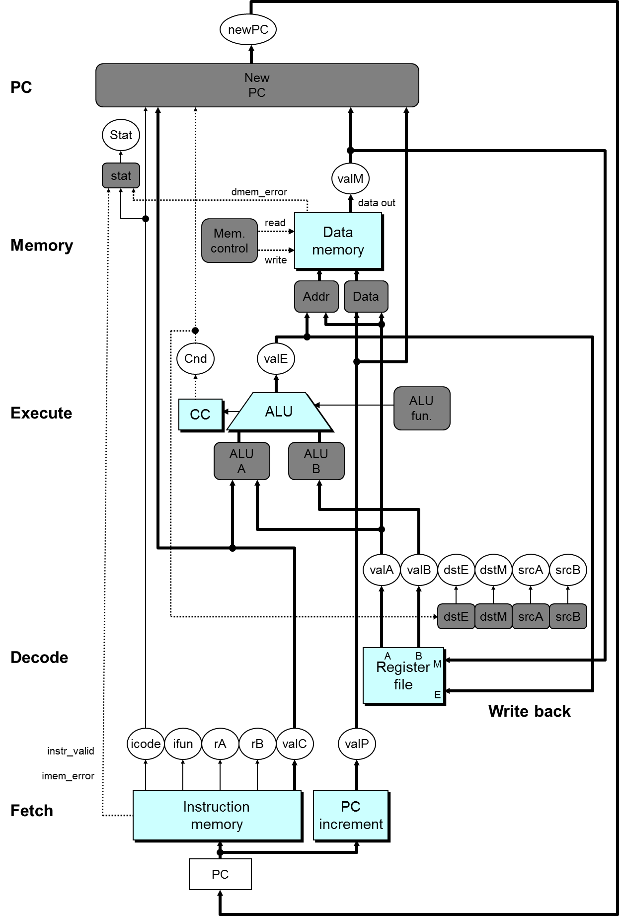

Slide 38
SEQ Summary
Implementation
  Express every instruction as series of simple steps
  Follow same general flow for each instruction type
  Assemble registers, memories, predesigned combinational blocks
  Connect with control logic

Slide 39
Limitations of SEQ
Too slow to be practical
  Too many tasks needed to finish in one clock cycle
    instruction memory, register file, ALU, and data memory
  Signals need long time to propagate through all of the stages
  The clock must run slowly enough
Does not make good use of hardware units
  Every unit is active for part of the total clock cycle

Slide 40
Principles of Pipeline

Slide 41
Outline
General Principles of Pipelining
  Goal
  Difficulties
Suggested Reading 4.4

Slide 42


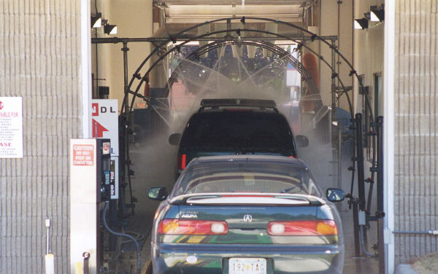
Real-World Pipelines: Car Washes
Sequential
Parallel
Idea
  Divide process into independent stages
  Move objects through stages in sequence
  At any given times, multiple objects being processed
Pipelined

Slide 43
Computational Example
300 ps
20 ps
Combinational
logic
R
e
g
Delay = 320 ps
Throughput = 3.12 GOPS
Clock
System
  Computation requires total of 300 picoseconds
  Additional 20 picoseconds to save result in register
  Can must have clock cycle of at least 320 ps
Notes:
Clock Cycle是320ps

Slide 44
3-Way Pipelined Version
100 ps
20 ps
100 ps
20 ps
100 ps
20 ps
Comb.
logic
A
R
e
g
Comb.
logic
B
R
e
g
Comb.
logic
C
R
e
g
Delay = 360 ps
Throughput =
8.33 GOPS
Clock
System
  Divide combinational logic into 3 blocks of 100 ps each
  Can begin new operation as soon as previous one passes through stage A.
    Begin new operation every 120 ps
  Overall latency increases
    360 ps from start to finish
Notes:
Clock Cycle是120ps。
之所以要增加阶段寄存器是因为B要用A的结果，原来B和A执行的是同一条指令，所以内容都是属于同一条指令的。
现在B和A在一个clock cycle里执行的是两条指令的内容，而B所需要的A的内容是上个周期中A产生的。所以必须保留下来给B用。所以要增加阶段间的寄存器。用以存放中间结果。

Slide 45
Pipeline Diagrams
Unpipelined
  Cannot start new operation until previous one completes
3-Way Pipelined
  Up to 3 operations in process simultaneously
OP1
OP2
OP3
Time
OP1
A
B
C
OP2
A
B
C
OP3
A
B
C
Time
Notes:
这就是时空图。
OP表示一条指令。
原来Unpipelined时候一条指令执行完了，才能执行另外一条指令。现在几条指令可以overlap。

Slide 46
Limitations: Nonuniform Delays
50 ps
20 ps
150 ps
20 ps
100 ps
20 ps
Comb.
logic
A
R
e
g
Comb.
logic
B
R
e
g
Comb.
logic
C
R
e
g
Delay = 510 ps
Throughput
= 5.88 GOPS
Clock
OP1
A
B
C
OP2
A
B
C
OP3
A
B
C
Time
Notes:
Clock cycle是170ps

Slide 47
Limitations: Nonuniform Delays
Throughput limited by slowest stage
Other stages sit idle for much of the time
Challenging to partition system into balanced stages
Notes:
Clock cycle是170ps

Slide 48
Limitations: Register Overhead
50 ps
20 ps
50 ps
20 ps
50 ps
20 ps
50 ps
20 ps
50 ps
20 ps
50 ps
20 ps
Comb.
logic
R
e
g
Comb.
logic
R
e
g
Comb.
logic
R
e
g
Comb.
logic
R
e
g
Comb.
logic
R
e
g
Comb.
logic
R
e
g
Clock
Delay = 420 ps,
Throughput = 14.29 GOPS
Notes:
时钟周期70ps。

Slide 49
Limitations: Register Overhead
As try to deepen pipeline, overhead of loading registers becomes more significant
Percentage of clock cycle spent loading register:
  1-stage pipeline: 6.25%
  3-stage pipeline: 16.67%
  6-stage pipeline: 28.57%
High speeds of modern processor designs obtained through very deep pipelining
Notes:
时钟周期70ps。

Slide 50
Data Dependencies
Combinational
logic
R
e
g
Clock
OP1
OP2
OP3
Time
System
  Each operation depends on result from preceding one

Slide 51
Data Hazards
Comb.
logic
A
R
e
g
Comb.
logic
B
R
e
g
Comb.
logic
C
R
e
g
Clock
OP1
A
B
C
OP2
A
B
C
OP3
A
B
C
OP4
A
B
C
Time
Notes:
dependency存在是没有问题的。
但当这种问题解决不了的时候，她就变成了一种hazard。

Slide 52
Data Hazards
Result does not feed back around in time for next operation
Pipelining has changed behavior of system
1 irmovq $50, %rax
2 addq %rax , %rbx
3 mrmovq 100(%rbx),%rdx
Notes:
dependency存在是没有问题的。
但当这种问题解决不了的时候，她就变成了一种hazard。

Slide 53
Pipeline Implemetation

Slide 54
Outline
SEQ+ Implementations
Naïve PIPE Implementation
Instruction Stalling
Data Forwarding
Suggested Reading 4.5.1 ~ 4.5.5, 4.5.7~4.5.8

Slide 55
SEQ Hardware vs. SEQ+ Hardware
SEQ Hardware
  Stages occur in sequence
  One operation in process at a time
SEQ+ Hardware
  Still sequential implementation
  Reorder PC stage to put at beginning

Slide 56
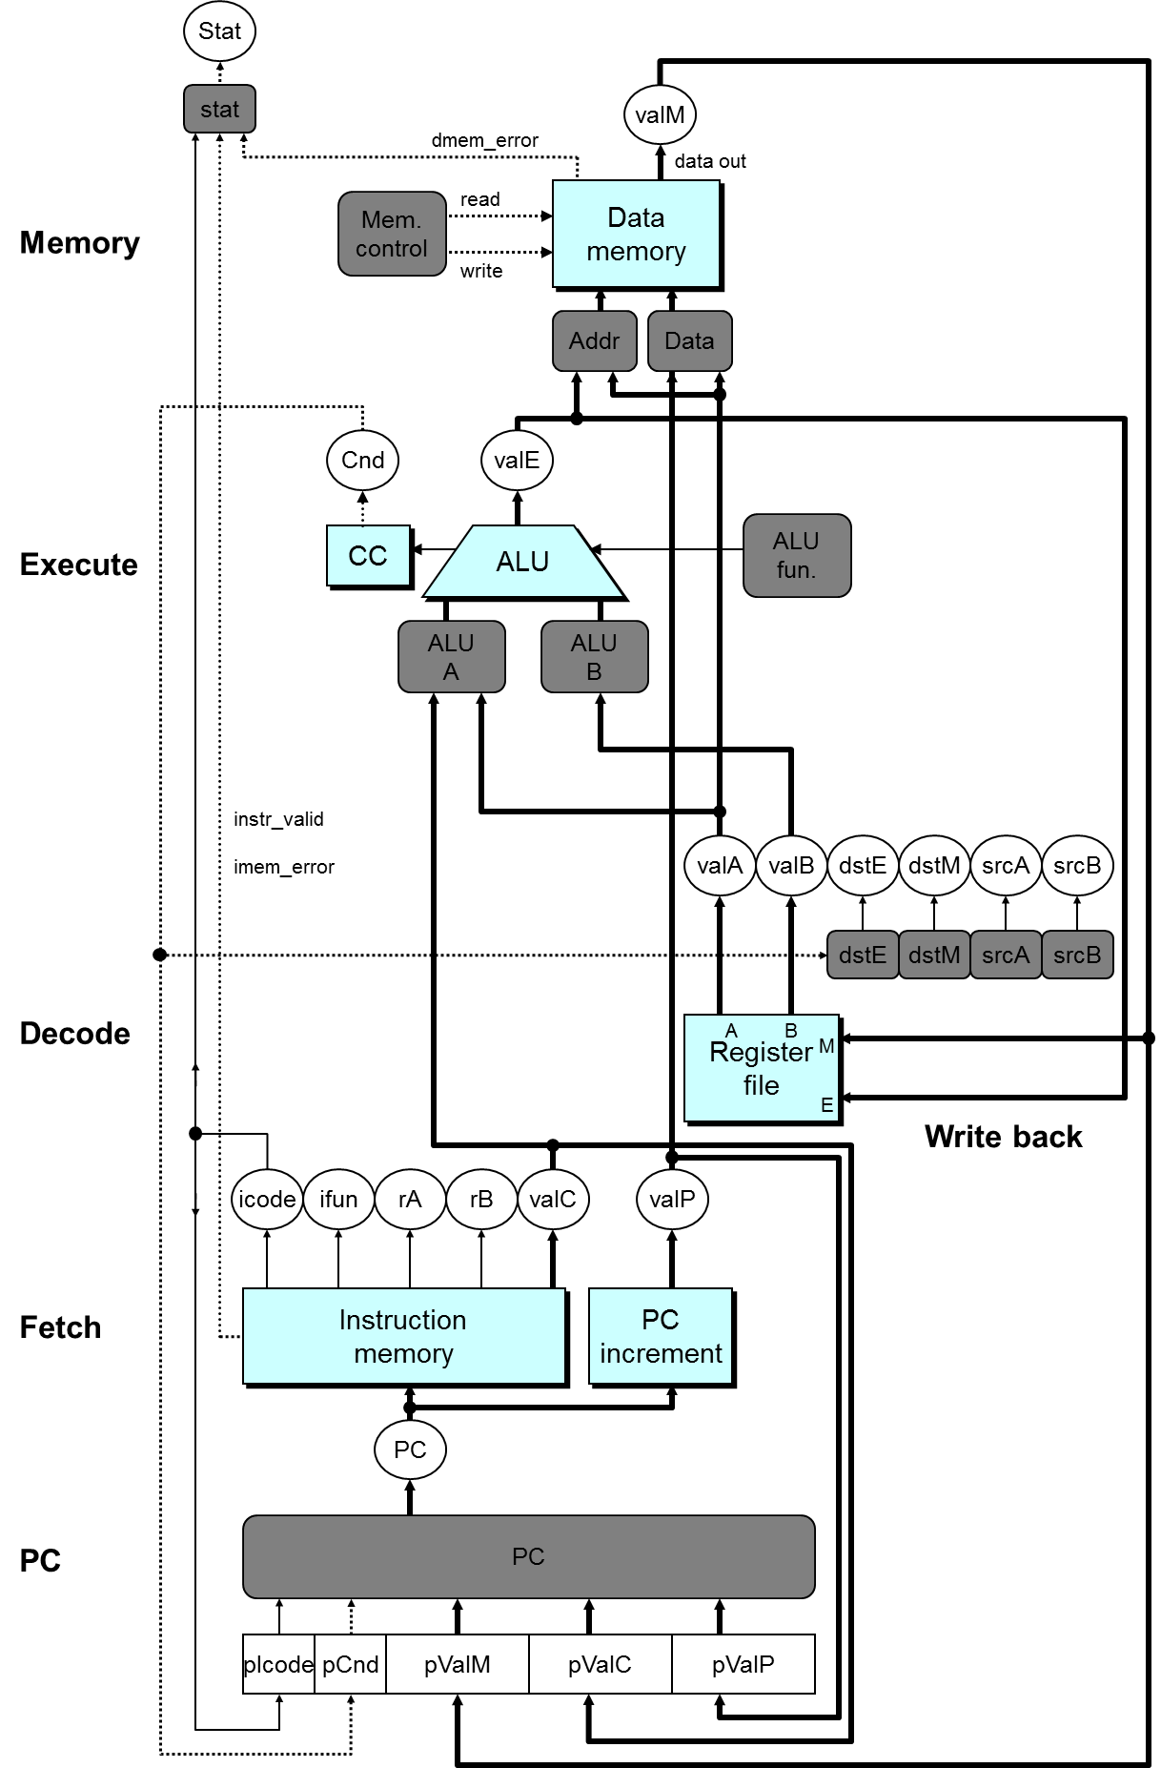

Slide 57
SEQ+ Hardware
PC Stage
  Task is to select PC for current instruction
  Based on results computed by previous instruction
Processor State
  PC is no longer stored in register
  But, can determine PC based on other stored information
Notes:
可能初看上去非常古怪。明明计算下条指令地址PC应该是在本指令快结束时才能进行的。为什么放到了指令的开始呢。
因为我们把计算下条指令地址变成了计算本条指令地址。也就是说算出来的PC(圆圈中的那个)不是下条指令的地址，而是本条指令的地址。
相当于对时序进行切分时向前移动了一点。
在这种情况下，虽然lSA说存在一个PC寄存器。但实际上并不存在这个寄存器。相反，存在其他几个寄存器pIcode, pBch, pValM, pValC, pValP。（但程序员不可见）
另外，这种变换也没有引起问题。例如相对跳转(PC-relative寻址)(虽然Y86不存在这种寻址方式)，这种寻址方式实际上是在Execute阶段将valP的值+偏移量。所以没有使用PC的值，即使用了在Fetch之前新的PC也已经有了，所以对于其后的各个阶段来说PC和SEQ中的是一样的。
这种变换的主要目的是要说明ISA和实现之间并不需要一一对应，只要语义一致就可以了。
这种变换也方便了我们下面要实现的PIPE。因为PIPE的地址预测是在fetch阶段就做的。

Slide 58
PC Computation
int pc= [
picode == ICALL : pValC;
picode == IJXX && pBch : pValC;
Picode == IRET : pValM;
1 : pValP;
];

Slide 60
Pipeline Stages
Fetch
  Select current PC
  Read instruction
  Compute incremented PC
Decode
  Read program registers
Execute
  Operate ALU
Memory
  Read or write data memory
Write Back
  Update register file
Notes:
我们希望能够设计一个每条指令只用一个周期完成的Pipleline CPU

Slide 61
PIPE- Hardware
Pipeline registers hold intermediate values from instruction execution
Forward (Upward) Paths
  Values passed from one stage to next
  Cannot jump past stages
    e.g., valC passes through decode
Notes:
整个硬件框图。实际上大部分内容与SEQ+相比，是相当类似或者说相同的。
变化有：
信号的重新组织与命名。在原有输入信号前面加上流水线寄存器名称（大写）以区分各自用到的信号。因为例如icode就在Decode、Execute、Memory和Write back阶段都存在，而且这些信号的内容还不同(因为属于不同的指令)，所以用流水线寄存器来加以区分。D_icode, E_icode, M_icode, and W_icode.
如果这些信号是某一阶段产生的，则以小写字母作前缀。例如valE是由Execute阶段产生的，所以在Execute阶段，他的名字叫e_valE.
2. 在Fetch阶段增加了Predict PC部件来预测下一条指令的地址。
3. 将valP和valA在Decode阶段合并为一个信号，所以多了一个Select A部件。书上P321。主要用处是减少控制信号和寄存器的数目。因为只有call指令会在memory阶段用到valP，
只有jump指令会在execute阶段用到valP。这两种指令都不需要用到寄存器A。所以我们可以将这两个控制信号合并。这样，SEQ中的data部件就不需要了。
因为在Fetch阶段本身就有Predict PC部件。这样valP在其他场合也不需要传播到Fetch阶段之外的场合去。

Slide 62
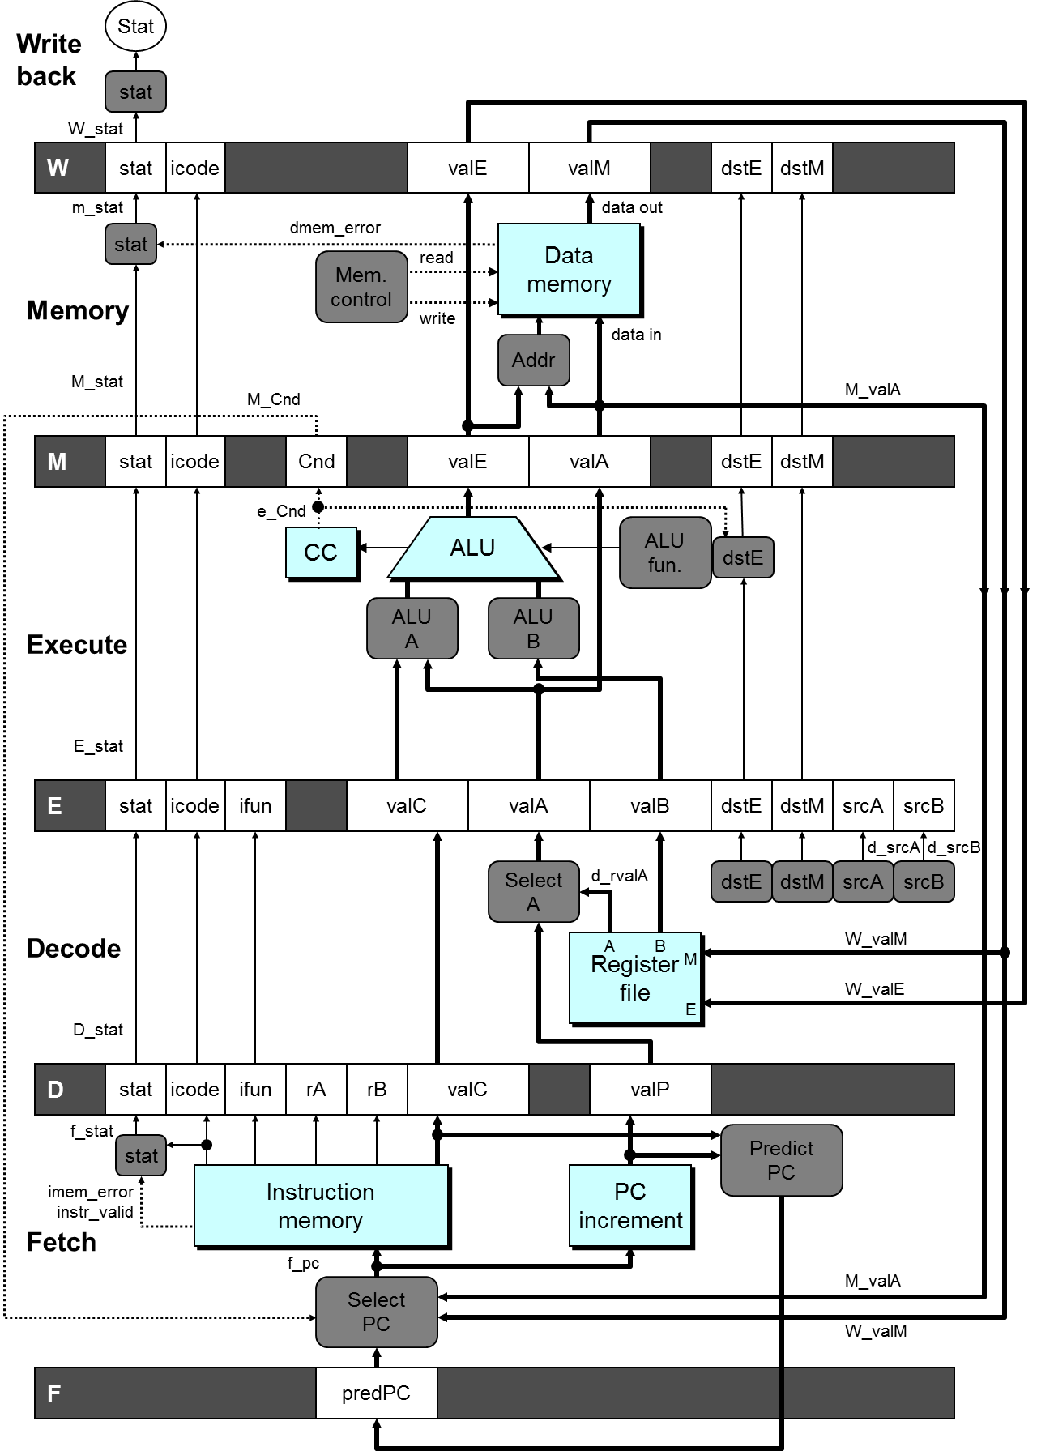
Notes:
整个硬件框图。实际上大部分内容与SEQ+相比，是相当类似或者说相同的。
变化有：
信号的重新组织与命名。在原有输入信号前面加上流水线寄存器名称（大写）以区分各自用到的信号。因为例如icode就在Decode、Execute、Memory和Write back阶段都存在，而且这些信号的内容还不同(因为属于不同的指令)，所以用流水线寄存器来加以区分。D_icode, E_icode, M_icode, and W_icode.
如果这些信号是某一阶段产生的，则以小写字母作前缀。例如valE是由Execute阶段产生的，所以在Execute阶段，他的名字叫e_valE.
2. 在Fetch阶段增加了Predict PC部件来预测下一条指令的地址。
3. 将valP和valA在Decode阶段合并为一个信号，所以多了一个Select A部件。书上P321。主要用处是减少控制信号和寄存器的数目。因为只有call指令会在memory阶段用到valP，
只有jump指令会在execute阶段用到valP。这两种指令都不需要用到寄存器A。所以我们可以将这两个控制信号合并。这样，SEQ中的data部件就不需要了。
因为在Fetch阶段本身就有Predict PC部件。这样valP在其他场合也不需要传播到Fetch阶段之外的场合去。

Slide 63
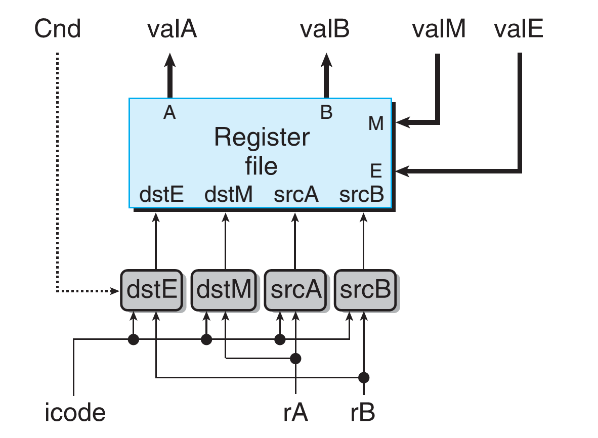
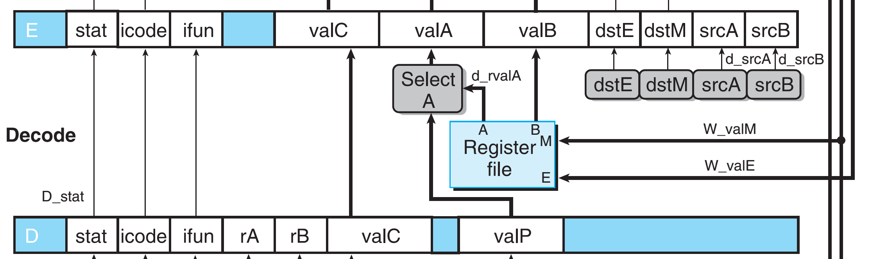
Generate Signals

Slide 64
Generate Signals
#code from SEQ
int srcA = [
icode in {IRRMOVL, IRMMOVL,
IOPL, IPUSHL} : rA;
icode in {IPOPL, IRET} : RRSP;
1: RNONE; #Don’t need register
];
#code from PIPE
int d_srcA = [
D_icode in {IRRMOVL, IRMMOVL,
IOPL, IPUSHL} : D_rA;
D_icode in {IPOPL, IRET} : RRSP;
1: RNONE; #Don’t need register
];

Slide 65
Feedback Paths
Predicted PC
  Guess value of next PC
  Branch information
    Jump taken/not-taken
    Fall-through or target address
  Return point
    Read from memory
Register updates
    To register file write ports
Notes:
这个CPU中的反馈回路。就是方向从上到下的信号。包括：
预测PC到F。
跳转与否（不是预测）信号到PC选择。
读内存结果到PC选择（这出现在ret指令的场合）和寄存器存储。
计算结果到寄存器存储。

Slide 67
Predicting the PC
Start fetch of new instruction after current one has completed fetch stage
  Not enough time to reliably determine next instruction
Guess which instruction will follow
  Recover if prediction was incorrect
Notes:
之所以要Predict PC是因为我们在有些时候没有办法在指令刚完成fetch就知道他的下一条指令在哪里。
这种情况出现在我们碰到条件跳转和ret指令时。条件跳转必须到execute阶段执行完才能知道是否跳转。Ret必须等到memory阶段完成才能知道下一条指令的地址。
其他情况，我们可以在fetch阶段结束时就知道下一条指令的地址。对于call和jmp来说，下一条地址就是valC。对于其他指令来说，就是valP。
但我们又希望每个周期处理一条指令，所以就必须在下一条指令地址还没能完全确定的时候就进行取指令。所以需要对下一条指令的地址进行猜测。
具体的实现在Section 5.12. 这里先不介绍。
因为Predict PC只是根据前一条指令预测下一条指令的地址，所以它只需要从fetch阶段取得信号就可以了。

Slide 68
Our Prediction Strategy
Instructions that Don’t Transfer Control
  Predict next PC to be valP
  Always reliable
Call and Unconditional Jumps
  Predict next PC to be valC (destination)
  Always reliable
Notes:
对于conditional jump，我们总是预测他会跳转。
对于ret, 可能的情况太多，所以我们就不预测。 （实际上有些策略可以解决）
对于预测，我们必须保留它另一个分支的地址。因为预测不一定准确，所以我们需要在预测错误时恢复到另一个入口执行。

Slide 69
Our Prediction Strategy
Conditional Jumps
  Predict next PC to be valC (destination)
  Only correct if branch is taken
    Typically right 60% of time
    Recovery: M_Cnd and M_valA (valP: next PC)
Return Instruction
  Don’t try to predict
Notes:
对于conditional jump，我们总是预测他会跳转。
对于ret, 可能的情况太多，所以我们就不预测。 （实际上有些策略可以解决）
对于预测，我们必须保留它另一个分支的地址。因为预测不一定准确，所以我们需要在预测错误时恢复到另一个入口执行。

Slide 70
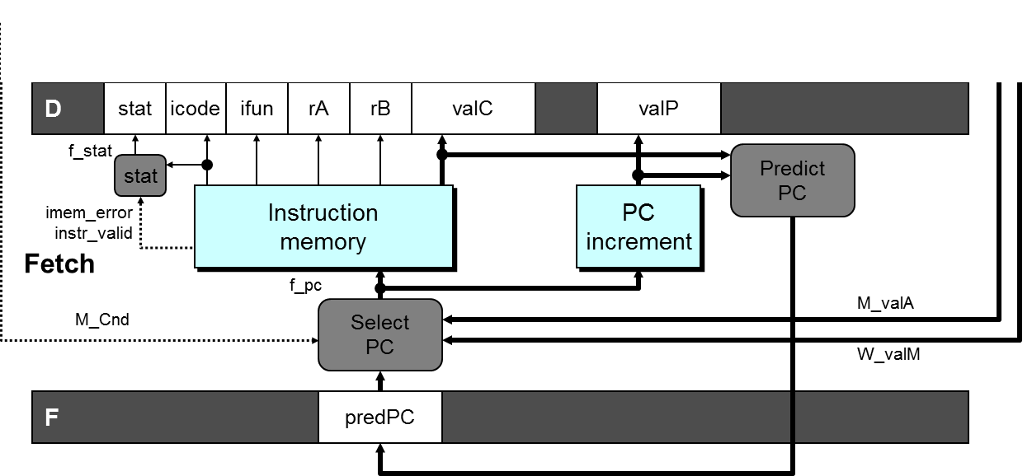
Select PC
Int F_predPC = [
f_icode in {IJXX, ICALL} : f_valC;
1: f_valP;
];

Slide 71
Recovering from PC Misprediction
Mispredicted Jump
  Will see branch flag once instruction reaches Memory stage
  Can get fall-through PC from valA (valP)
Return Instruction
  Will get return PC when ret reaches write-back stage
Notes:
预测分为两步：
分支的预测
预测错误时的恢复。

Slide 72
Recovering the PC
M_valP
Notes:
之所以要Predict PC是因为我们在有些时候没有办法在指令刚完成fetch就知道他的下一条指令在哪里。
这种情况出现在我们碰到条件跳转和ret指令时。条件跳转必须到execute阶段执行完才能知道是否跳转。Ret必须等到memory阶段完成才能知道下一条指令的地址。
其他情况，我们可以在fetch阶段结束时就知道下一条指令的地址。对于call和jmp来说，下一条地址就是valC。对于其他指令来说，就是valP。
但我们又希望每个周期处理一条指令，所以就必须在下一条指令地址还没能完全确定的时候就进行取指令。所以需要对下一条指令的地址进行猜测。
具体的实现在Section 5.12. 这里先不介绍。
因为Predict PC只是根据前一条指令预测下一条指令的地址，所以它只需要从fetch阶段取得信号就可以了。

Slide 73
Select PC
int f_PC = [
#mispredicted branch. Fetch at incremented PC
M_icode == IJXX && !M_Cnd : M_valA;
#completion of RET instruciton
W_icode == IRET : W_valM;
#default: Use predicted value of PC
1: F_predPC
];
Notes:
对于mispredicted的情况，因为默认是跳转，所以这时该执行的指令地址是branch指令的下一条指令。这条指令的地址已经被放在valA中传递到了
Memory阶段，所以要从M_valA中恢复。
在实际中要根据预测的方法来确定new_F_predPC和f_PC的计算方法。关键的一点是预测时必须保证另一个出口地址被妥善的保存好。

Slide 74
Pipeline Demonstration
1
2
3
4
5
6
7
8
9
irmovq $1,%rax #I1
irmovq $2,%rcx #I2
irmovq $3,%rdx #I3
irmovq $4,%rbx #I4
halt #I5
F
D
E
M
W
F
D
E
M
W
F
D
E
M
W
F
D
E
M
W
F
D
E
M
W
Cycle 5
W
I1
M
I2
E
I3
D
I4
F
I5

