Slide 1
Introducing to Y86

Slide 2
Topics
Y86 instruction set architecture
Why do we need to study CPU design
RISC vs. CISC
Suggested Reading: 4.1

Slide 3
Goal
Understanding the instruction encodings
Preparing for designing your
  assembler
  simulator
  computer

Slide 4
Y86 Processor State
Program Registers
  Same 15 as with IA64. Each 64 bits
Program Counter
  Indicates address of instruction
PC
Program registers
%rax
%rsi
%r8
%r12
%rcx
%rdi
%r9
%r13
%rdx
%rsp
%r10
%r14
%rbx
%rbp
%r11

Slide 5
Y86 Processor State
Condition Codes
  Single-bit flags set by arithmetic or logical instructions
    OF: Overflow ZF: Zero SF: Negative
Status code
  Program is running normally
  Or some special event has occured
Memory
  Byte-addressable storage array
  Words stored in little-endian byte order
Condition codes
OF
ZF
SF
Program status
Memory

Slide 6
Y86 Instructions
Format
  1--10 bytes of information read from memory
    Can determine instruction length from first byte
    Not as many instruction types, and simpler encoding than with IA64
  Each accesses and modifies some part(s) of the program state

Slide 7
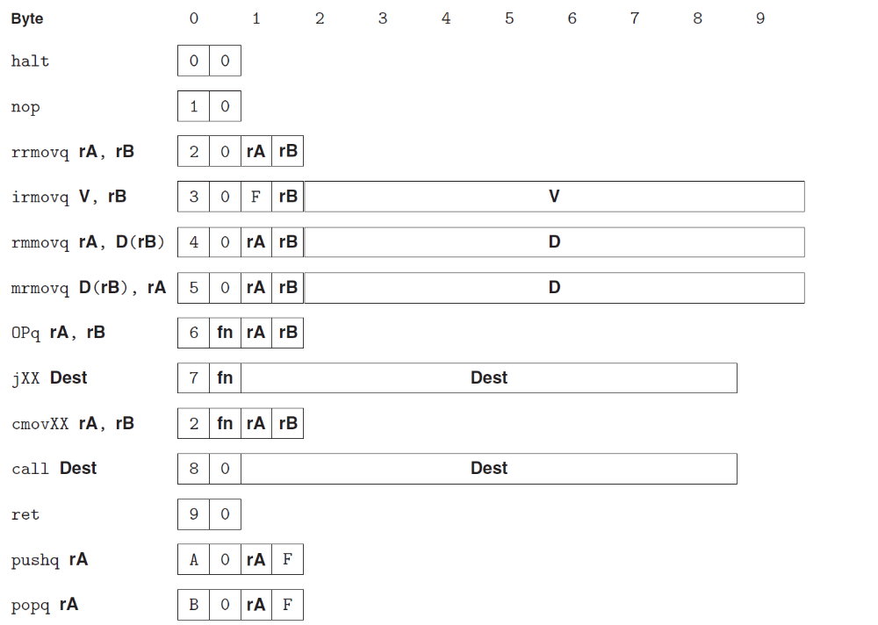
Y86 Instructions

Slide 8
Encoding Registers
1
Each register has 4-bit ID
  Same encoding as in IA64, except %r15
Register ID F indicates “no register”
  Will use this in our hardware design in multiple places
%rax
0
%rsi
6
%r8
8
%r12
C
%rcx
1
%rdi
7
%r9
9
%r13
D
%rdx
2
%rsp
4
%r10
A
%r14
E
%rbx
3
%rbp
5
%r11
B
None
F

Slide 9
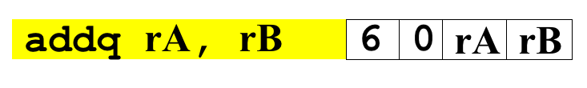
Instruction Example
Addition Instruction
  Add value in register rA to that in register rB
    Store result in register rB
    Note that Y86 only allows addition to be applied to register data
  Set condition codes based on result
Generic Form
Encoded Representation

Slide 10
Instruction Example
Addition Instruction
  e.g., addq %rax,%rsi Encoding: 60 06
  Two-byte encoding
    First indicates instruction type
    Second gives source and destination registers
Generic Form
Encoded Representation

Slide 11
Arithmetic and Logical Operations
Instruction Code
Function Code
Add
  Refer to generically as “OPl”
  Encodings differ only by “function code”
    Low-order 4 bites in first instruction word
  Set condition codes as side effect
  Notice: no multiply or divide operation
addq rA, rB
6
0
rA
rB
Subtract (rA from rB)
subq rA, rB
6
1
rA
rB
And
andq rA, rB
6
2
rA
rB
Exclusive-Or
xorq rA, rB
6
3
rA
rB

Slide 12
Move Operations
rrmovq rA,rB
2
0
rA
rB
Register → Register
irmovq V,rB
3
0
F
rB
V
Immediate → Register
rmmovq rA,D(rB)
4
0
rA
rB
D
Register → Memory
mrmovq D(rB),rA
5
0
rA
rB
D
Memory → Register
Like the IA64 movq instruction
Simpler format for memory addresses
Give different names to keep them distinct

Slide 13
Move Instruction Examples
IA64
Y86
movq $0xabcd, %rdx
irmovq $0xabcd, %rdx
movq %rsp, %rbx
rrmovq %rsp, %rbx
movq -12(%rbp),%rcx
mrmovq -12(%rbp),%rcx
movq %rsp,0x12345(%rdx)
rmmovq %rsp,0x12345c(%rdx)
movq $0xabcd, (%rax)
—
movl %rax, 12(%rax,%rdx)
—
movl (%rbp,%rax,8),%rcx
—

Slide 14
Move Instruction Examples
Y86
Encoding
irmovq $0xabcd, %rdx
30 F2 cd ab 00 00 00 00 00 00
rrmovq %rsp, %rbx
20 43
mrmovq -12(%rbp),%rcx
50 15 f4 ff ff ff ff ff ff ff
rmmovq %rsp,0x12345(%rdx)
40 42 45 23 01 00 00 00 00 00

Slide 15
Conditional Move Operations
Refer to generically as “cmovXX”
  Share the same “instruction code” with rrmovl
Encodings differ only by “function code”
cmovle rA, rB
2
1
rA
rB
cmovl rA, rB
2
2
rA
rB
cmove rA, rB
2
3
rA
rB
cmovne rA, rB
2
4
rA
rB
cmovge rA, rB
2
5
rA
rB
cmovg rA, rB
2
6
rA
rB
Based on values of condition codes
Same as IA64 counterparts

Slide 16
Jump Instructions
Jump Unconditionally
  Refer to generically as “jXX”
  Encodings differ only by “function code”
  Based on values of condition codes
  Same as IA64 counterparts
  Encode full destination address
    Unlike PC-relative addressing seen in IA64
jmp Dest
7
0
Dest
Jump When Less or Equal
jle Dest
7
1
Dest
Jump When Less
jl Dest
7
2
Dest
Jump When Equal
je Dest
7
3
Dest
Jump When Not Equal
jne Dest
7
4
Dest
Jump When Greater or Equal
jge Dest
7
5
Dest
Jump When Greater
jg Dest
7
6
Dest

Slide 17
Y86 Program Stack
Stack Bottom
Region of memory holding program data
Used in Y86 (and IA64) for supporting procedure calls
Stack top indicated by %rsp
  Address of top stack element
Stack grows toward lower addresses
  Top element is at lowest address in the stack
•
•
•
Increasing
Addresses
%rsp
Stack Top

Slide 18
Stack Operations
pushq rA
a
0
rA
F
Decrement %rsp by 8
Store word from rA to memory at %rsp
Like IA64 (pushq %rsp → save old %rsp)
Read word from memory at %rsp
Save in rA
Increment %rsp by 8
Like IA64 (popq %rsp → movq (%rsp) %rsp)
popq rA
b
0
rA
F

Slide 19
Subroutine Call and Return
call Dest
8
0
Dest
Push address of next instruction onto stack
Start executing instructions at Dest
Like IA64
Pop value from stack
Use as address for next instruction
Like IA64
ret
9
0

Slide 20
Miscellaneous Instructions
nop
1
0
Don’t do anything
Stop executing instructions
IA64 has comparable instruction, but can’t execute it in user mode
We will use it to stop the simulator
halt
0
0

Slide 21
Y86 Instructions

Slide 22
Y86 Programs
int Sum(int *Start, int Count)
{
int sum = 0;
while (Count) {
sum += *Start;
Start++;
Count--;
}
return sum;
}

Slide 23
Y86 Assembly
IA64 code
1 sum:
2 movl $0, %eax
3 jmp .L2
4 .L3:
5 addq (%rdi), %rax
6 addq $8, %rdi
7 subq $1, %rsi
8 .L2:
9 testq %rsi, %rsi
10 jne .L3
11 rep; ret
Y86 code
int Sum(int *Start, int Count)
1 sum:
2 irmovq $8,%r8
3 irmovq $1,%r9
4 xorq %rax,%rax
5 andq %rsi,%rsi
6 jmp test
7 loop:
8 mrmovq (%rdi),%r10
9 addq %r10,%rax
10 addq %r8,%rdi
11 subq %r9,%rsi
12 test:
13 jne loop
14 ret

Slide 24
Y86 Object Program
1 # Execution begins at address 0
2 .pos 0
3 irmovq stack, %rsp # Set up stack pointer
4 call main # Execute main program
5 halt # Terminate program
6
Init part of program generated automatically
Assembler directives
  .pos 0, .pos 0x200
  .align
Symbolic Name

Slide 25
Y86 Object Program
7 # Array of 4 elements
8 .align 8
9 array:
10 .quad 0x000d000d000d
11 .quad 0x00c000c000c0
12 .quad 0x0b000b000b00
13 .quad 0xa000a000a000
14
Data area
  array denotes the start of an array
  Aligned on 8-byte boundary

Slide 26
Y86 Object Program
15 main:
16 irmovq array,%rdi
17 irmovq $4,%rsi
18 call sum # sum(array, 4)
19 ret
20

Slide 27
Y86 Object Program
21 # long sum(long *start, long count)
22 # start in %rdi, count in %rsi
23 sum:
24 irmovq $8,%r8 # Constant 8
25 irmovq $1,%r9 # Constant 1
26 xorq %rax,%rax # sum = 0
27 andq %rsi,%rsi # Set CC
28 jmp test # Goto test

Slide 28
Y86 Object Program
29 loop:
30 mrmovq (%rdi),%r10 # Get *start
31 addq %r10,%rax # Add to sum
32 addq %r8,%rdi # start++
33 subq %r9,%rsi # count--. Set CC
34 test:
35 jne loop # Stop when 0
36 ret # Return
37
38 # Stack starts here and grows to lower addresses
39 .pos 0x200
40 stack:

Slide 29
Y86 Object Program
38 # Stack starts here and grows to lower addresses
39 .pos 0x200
40 stack:
Programmers must write assembly codes themselves
  including manage the memory
    such as allocate memory for array and stack
    as well as avoid the memory overwritting
Symbolic Name

Slide 30
Assembling Y86 Program
  unix> yas eg.ys
Generates “object code” file eg.yo
  Actually looks like disassembler output

Slide 31
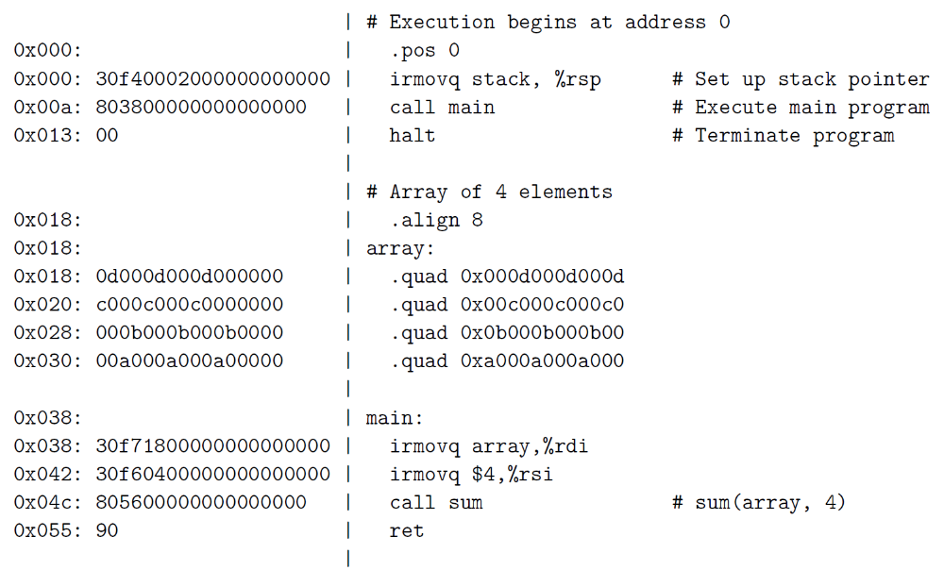

Slide 32
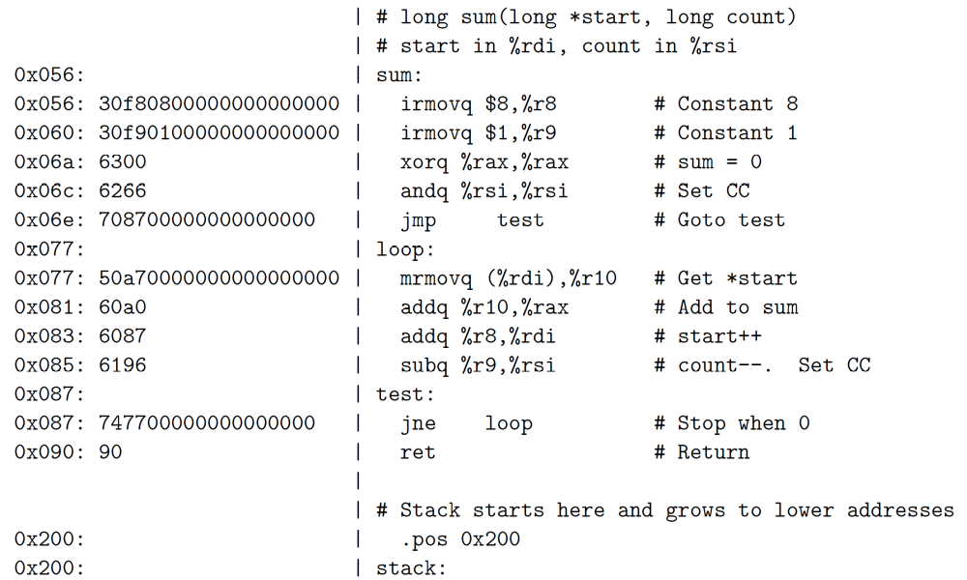

Slide 33
Simulating Y86 Program
  unix> yis eg.yo
Instruction set simulator
  Computes effect of each instruction on processor state
  Prints changes in state from original

Slide 34
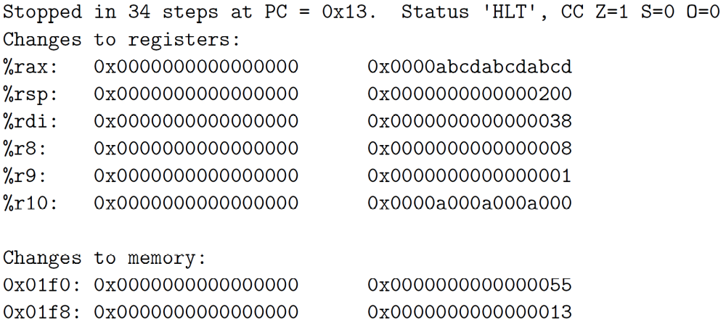
Simulating Y86 Program

Slide 35
Why do We Study the CPU Design?
Understand basic computer organization
  Instruction set architecture
Deeply explore the CPU working mechanism
  How the instruction is executed
Help you programming
  Fully understand how computer is organized and works will help you write more stable and efficient code

Slide 36
Instruction Set Architecture #1
What is ISA ?
  Assemble Language Abstraction
    assembly supported by a processor
  Machine Language Abstraction
    Byte-level representation
What does it provide?
  An abstraction of the real computer, hide the details of implementation
    The syntax of computer instructions
    The semantics of instructions
    The execution model
    Programmer-visible computer status

Slide 37
Instruction Set Architecture #2
Assembly Language View
  Processor state
    Registers, memory, …
  Instructions
    addq, movq, leaq, …
    How instructions are encoded as bytes
Layer of Abstraction
  Above: how to program machine
    Processor executes instructions in a sequence
  Below: what needs to be built
    Use tricks to make it run fast
    E.g., execute multiple instructions simultaneously
Application
Program
Compiler
OS
ISA
CPU
Design
Circuit
Design
Chip
Layout

Slide 38
Instruction Set Architecture #3
ISA define the processor family
  Two main kind: RISC and CISC
    RISC: SPARC, MIPS, PowerPC, ARM
    CISC: X86 (or called IA32)
Under same ISA, there are many different processors
  From different manufacturers
    X86 from Intel, AMD and VIA
  Different models
    8086, 80386, Pentium, atom, core i7
Notes:
This is the modern division. There are other kinds besides superscalar, VLIW and EPIC, e.g. vector machine, stack machine (example is X87)
We will cover some of these topics in the last lesson of cpu design.

Slide 39
RISC vs. CISC
ISA
  Instruction set architecture
    Instructions supported by a particular processor
    Their byte-level encodings
CISC
  Complex instruction set computer
RISC
  Reduced instruction set computer

Slide 40
CISC
Involved from the earliest computers
Mainframe and Minicomputers
  By the early 1980s
  their instruction sets had grown quite large
    Manipulating circular buffers
    performing decimal arithmetic
    evaluating polynomials
Microcomputer
  Appeared in 1970s, had limited instruction sets
    constrained by number of transistors on a single chip
  By the early 1980s, followed the path to increase their instruction sets

Slide 41



RISC
Developed in the early 1980s
  philosophy
    One are able to generate efficient code for a simpler form of instruction set
    Complex instructions are hard to generated with a compiler and seldom used
John Cocke (1925-2002)
  1987 ACM Turing Award
David Patterson(UC Berkeley), John Hennessy (Stanford U)
  2017 ACM Turing Award

Slide 42
RISC
IBM | Power
IBM and Motorola | PowerPC
Sun Microsystems | SPARC
Digital Equipment Corporation | Alpha
Hewlett Pack | Pa-risc
MIPS Technologies | MIPS
Acorn Computers Ltd | ARM(Acorn RISC Machine)

Slide 43
RISC vs. CISC
CICS | Early RISC
A large number of instructions | Many fewer instructions (<100)
Some instructions with long execution times | No instruction with a long execution time
Variable-length encodings. (x86-64 1~15 bytes) | Fixed-length encodings
Multiple formats for specifying operands | Simple addressing formats
Arithmetic and logical operations can be applied to both memory and register operands | Arithmetic and logical operations only use register operands. load/store Architecture

Slide 44
RISC vs. CISC
CICS | Early RISC
Implementation artifacts hidden from machine level programs | Implementation artifacts exposed to machine level programs
Condition codes | explicit test instructions store the test results in normal registers for use in conditional evaluation
Stack-intensive procedure linkage | Registers are used for procedure arguments and return addresses

Slide 45
RISC
Cons for early RISC
  More instructions
  Not multiple cycles
  Exposing implementation artifacts to machine level programs
Pros for RISC
  Well suited for pipeline (high efficient implementation)

Slide 46
Y86-64
The Y86-64 instruction set
  Includes attributes of both CISC and RISC
  Can be viewed as taking a CISC instruction set (x86-64) and simplifying it by applying some of the principles of RISC
On the CISC side
  condition codes, variable-length instructions
  uses the stack to store return addresses.
On the RISC side,
  a load/store architecture
  a regular instruction encoding
  passes procedure arguments through registers

Slide 47
RISC vs. CISC
In the early 1990s, the debate diminished
  neither RISC nor CISC in their purest forms are better than designs that incorporated the best ideas of both

Slide 48
RISC
Evolved and introduced more instructions
  many of which take multiple cycles to execute
  Have hundreds of instructions
Exposing implementation artifacts to machine-level programs
  proved to be shortsighted
  As new processor models were developed
    using more advanced hardware structures,
    many of these artifacts became irrelevant,
    but they still remained part of the instruction set

Slide 49
CISC
The core of RISC design
  is well suited to execution on a pipelined machine
X86 incorporates RISC features
  Dynamic translating CISC instructions to RISC-like ops and taking pipeline architectures
  X86-64 introduces more RISC features

Slide 50
CISC
Marketing issues determine the success of the ISAs
  X86 wins in high-end server, desktop, laptop machines
  RISC win in market of embedded processors and the smart phone

Slide 51
CISC
Intel made it easy to keep moving from one generation of processor to the next
  By maintaining compatibility with its existing processors
As integrated-circuit technology improved
  x86 processor manufacturers could overcome the inefficiencies created by the original 8086 instruction set design
  using RISC techniques to produce performance comparable to the best RISC machines.

Slide 52
CISC
RISC processors have done very well in the market for embedded processors
In these applications, saving on cost and power is more important than maintaining backward compatibility
  In terms of the number of processors sold
this is a very large and growing market

Slide 53
Logical Design & HCL

Slide 54
Topics
Logic design
Hardware Control Language HCL
Suggested Reading: 4.2

Slide 55
Logic Design
Digital circuit
  What is digital circuit?
  Know what a CPU will base on?
Hardware Control Language (HCL)
  A simple and functional language to describe our CPU implementation
  Syntax like C

Slide 56
Category of Circuit
Analog Circuit
  Use all the range of Signal
  Most part is amplifier
  Hard to model and automatic design
  Use transistor and capacitance as basis
  We will not discuss it here

Slide 57
Category of Circuit
Digital Circuit
  Has only two values, 0 and 1
  Easy to model and design
  Use true table and other tools to analyze
  Use gate as the basis
  The voltage of 1 is differ in different kind circuit.
    E.g. TTL circuit using 5 voltage as 1

Slide 58
Digital Signals
0
1
0
Voltage
Time
  Use voltage thresholds to extract discrete values from continuous signal
  Simplest version: 1-bit signal
    Either high range (1) or low range (0)
    With guard range between them
  Not strongly affected by noise or low quality circuit elements
    Can make circuits simple, small, and fast

Slide 59
Overview of Logic Design
Fundamental Hardware Requirements
  Communication
    How to get values from one place to another
  Computation
  Storage (Memory)
  Clock Signal
    A periodic signal
Clock

Slide 60
Overview of Logic Design
Bits are Our Friends
  Everything expressed in terms of values 0 and 1
  Communication
    Low or high voltage on wire
  Computation
    Compute Boolean functions
  Storage
  Clock Signal

Slide 61
Category of Digital Circuit
Combinational Circuit
  Without memory. So the circuit can’t have state. Any same input will get the same output at any time.
  Needn’t clock signal
  Typical application: ALU

Slide 62
Category of Digital Circuit
Sequential Circuit
  = Combinational circuit + memory and clock signal
  Have state. Two same inputs may not generate the same output.
  Use clock signal to control the run of circuit.
  Typical application: CPU

Slide 63
Computing with Logic Gates
And
Or
Not
a
a
out
b
out
a
out
b
out = a && b
out = a || b
out = !a
  Outputs are Boolean functions of inputs
  Not an assignment operation, just give the circuit a name
  Respond continuously to changes in inputs
    With some, small delay
Rising Delay
Falling Delay
a && b
b
Voltage
a
Time

Slide 64
Combinational Circuits

Slide 65



Combinational Circuits
Acyclic Network
Inputs
Outputs
Acyclic Network of Logic Gates
  Continuously responds to changes on inputs
  Outputs become (after some delay) Boolean functions of inputs

Slide 66
Bit Equality
Bit equal
a
eq
HCL Expression
b
bool eq = (a&&b)||(!a&&!b)
  Generate 1 if a and b are equal
Hardware Control Language (HCL)
  Very simple hardware description language
    Boolean operations have syntax similar to C logical operations
  We’ll use it to describe control logic for processors

Slide 67
Word Equality
Word-Level Representation
b₆₃
Bit equal
eq₆₃
B
=
a₆₃
eq
b₆₂
Bit equal
eq₆₂
A
a₆₂
HCL Representation
eq
bool Eq = (A == B)
b₁
Bit equal
eq₁
  64-bit word size
  HCL representation
    Equality operation
    Generates Boolean value
a₁
b₀
Bit equal
eq₀
a₀

Slide 68
Bit-Level Multiplexor
s
Bit MUX
HCL Expression
bool out = (s&&a)||(!s&&b)
b
out
a
  Control signal s
  Data signals a and b
  Output a when s=1, b when s=0
  Its name: MUX
  Usage: Select one signal from a couple of signals

Slide 69
Word Multiplexor
s
Word-Level Representation
s
b₆₃
MUX
out₆₃
B
Out
a₆₃
A
b₆₂
out₆₂
a₆₂
HCL Representation ?
b₀
out₀
a₀

Slide 70
Word Multiplexor
HCL Representation
  Select input word A or B depending on control signal s
  HCL representation
    Case expression
    Series of test : value pairs (Don’t require mutually)
    Output value for first successful test
Out = [
s : A;
1 : B;
];
default case

Slide 71
HCL Word-Level Examples
Minimum of 3 Words
HCL Representation
C
MIN3
word Min3 = [
A < B && A < C : A;
B < A && B < C : B;
1 : C;
];
B
Min3
A
Find minimum of three input words
HCL case expression
Final case guarantees match
Notes:
好像这个Min可以简化的。求B时，条件可以为：B<C

Slide 72
HCL Word-Level Examples
4-Way Multiplexor
HCL Representation
s1
s0
word Out4 = [
!s1&&!s0: D0;
!s1 : D1;
!s0 : D2;
1 : D3;
];
D0
MUX4
D1
Out4
D2
D3
Select one of 4 inputs based on two control bits
HCL case expression
Simplify tests by assuming sequential matching
Notes:
好像这个Min可以简化的。求B时，条件可以为：B<C

Slide 73
Arithmetic Logic Unit
0
1
2
3
Y
A
Y
A
Y
A
Y
A
A
L
U
A
L
U
A
L
U
A
L
U
X + Y
X - Y
X & Y
X ^ Y
X
B
OF
X
B
OF
X
B
OF
X
B
OF
ZF
ZF
ZF
ZF
SF
SF
SF
SF
Combinational logic
  Continuously responding to inputs
Control signal selects function computed
  Corresponding to 4 arithmetic/logical operations in Y86
Also computes values for condition codes
We will use it as a basic component for our CPU

Slide 74
Storage

Slide 75
Storage
Clocked Registers
  e.g. Program Counter(PC), Condition Codes(CC)
  Hold single words or bits
  Loaded as clock rises
  Not “program registers”
Clock
  A periodic signal that determines when new values are to be loaded into the devices
I
O
Clock
Clock
Rising
edge
falling
edge

Slide 76
Register Operation
State = x
Rising
clock
State = y
Input = y
x
Output = x
y
Output = y
Stores data bits
For most of time acts as barrier between input and output
As clock rises, loads input

Slide 77
State Machine Example
0
Comb. Logic
0
A
L
U
MUX
0
Out
In
1
Load
Clock

Slide 78
State Machine Example
0
Comb. Logic
0
?
A
L
U
MUX
0
Out
X₀
?
X₀
In
1
Load
1
Clock
Clock
Load
In
X₀
Out

Slide 79
State Machine Example
0
Comb. Logic
0
X₀
A
L
U
MUX
0
Out
X₀+X₀
X₀
X₀
In
1
Load
0
Clock
Clock
Load
In
X₀
Out
X₀

Slide 80
State Machine Example
0
Comb. Logic
0
X₀
A
L
U
MUX
0
Out
X₀+X₁
X₀
X₁
In
1
Load
0
Clock
Clock
Load
In
X₀
X₁
Out
X₀

Slide 81
State Machine Example
0
Comb. Logic
0
X₀+X₁
A
L
U
MUX
0
Out
X₀+X₁+X₁
X₀+X₁
X₁
In
1
Load
0
Clock
Clock
Load
In
X₀
X₁
Out
X₀
X₀+X₁

Slide 82
State Machine Example
0
Comb. Logic
0
X₀+X₁
A
L
U
MUX
0
Out
X₀+X₁+X₂
X₀+X₁
X₂
In
1
Load
0
Clock
Clock
Load
In
X₀
X₁
X₂
Out
X₀
X₀+X₁

Slide 83
State Machine Example
0
Comb. Logic
0
X₀…X₂
A
L
U
MUX
0
Out
X₀…X₂
X₀…X₂
X₂
In
1
Load
0
Clock
Clock
Load
In
X₀
X₁
X₂
Out
X₀
X₀+X₁
X₀…X₂

Slide 84
State Machine Example
0
Comb. Logic
0
X₀…X₂
A
L
U
MUX
0
Out
X₃
X₀…X₂
X₃
In
1
Load
1
Clock
Clock
Load
In
X₀
X₁
X₂
X₃
Out
X₀
X₀+X₁
X₀…X₂

Slide 85
State Machine Example
0
Comb. Logic
0
X₃
A
L
U
MUX
0
Out
X₃
X₃
X₃
In
1
Load
1
Clock
Clock
Load
In
X₀
X₁
X₂
X₃
Out
X₀
X₀+X₁
X₀…X₂
X₃

Slide 86
State Machine Example
0
Comb. Logic
Accumulator circuit
Load or accumulate on each cycle
0
A
L
U
MUX
0
Out
In
1
Load
Clock
Clock
Load
In
X₀
X₁
X₂
X₃
X₄
X₅
Out
X₀
X₀+X₁
X₀…X₂
X₃
X₃+X₄
X₃…X₅

Slide 87
Storage
Random-access memories
  e.g. Register File, Memory
  Hold multiple words
    Address input specifies which word to read or write
  Possible multiple read or write ports
  Read word when address input changes
  Write word as clock rises

Slide 88
Register File
valA
Register
file
srcA
A
valW
Read ports
W
dstW
Write port
valB
srcB
B
Clock
Register file
  Holds values of program registers
  %rax, %rsp, etc.
  Register identifier serves as address
    ID “F” implies no read or write performed
Multiple Ports
  Can read and/or write multiple words in one cycle
    Each has separate address and data input/output

Slide 89
Register File Timing
Reading
  Like combinational logic
  Output data generated based on input address (After some delay)
Writing
  Like register
  Update only as clock rises
valA
2
Register
file
A
x
srcA
x
valB
srcB
B
2
Register
file
Register
file
2
2
x
y
valW
y
Rising clock
valW
W
dstW
W
dstW
2
Clock
Clock

Slide 90
Memory
error
data out
read
Data
Memory
write
Clock
address
data in
Memory
  Holds program data and instructions
Ports
  A single address input
  A data input for writing, and a data output for reading
  Error signal means invalid address

Slide 91
Summary
Storage
  Clocked Registers
    Hold single words (e.g., PC, CC)
    Loaded as clock rises
  Random-access memories
    Hold multiple words (e.g., Register File, Memory)
    Possible multiple read or write ports
    Read word when address input changes
    Write word as clock rises

