Slide 1
Tkit
All about Tkit

Slide 2
技术方案
开发
React + Typescript
Redux + Redux-saga + Redux-actions + Reselect
React-router
Custom Antd
工具
Swagger-codegen
Tslint + Husky + pretty-quick
测试
Jest
enzyme
构建
Webpack 4

Slide 3
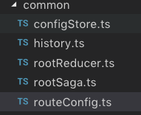
目录结构
./
src
assets
common
features
utils
locales
styles
config
scripts
common
service
others
redux
selectors
public
assets
kit.js
gen-service.sh
tests
home
Notes:
./: typescript tsconfig.json配置、代码规范校验配置、代码自动格式化prettier配置、编辑器配置
config: webpack相关各种配置， 比如loader、externals
public: umd静态资源及inde.html
Script: 1.脚手架代码，组件、action模板 2.swagger2service工具
Tests: 测试
Src: 源码
assets: 普通资源，图片、字体、css等；
styles：antd定制 less，以及全局配置及minxins
service: api及api参数，与数据类型定义
utils: 工具函数，时间格式化、ajax请求、国际化函数
common: history、store、saga、route配置
features: 页面、store、actions已feature划分模块，进行组织
： redux，selectors
common: 公用组件、actions、store及页面
home: 布局组件

Slide 4
页面路由-config/routeConfig.ts
const routes = [
{
path: '/internal',
component: App, // 布局
childRoutes: [
{
path: ‘403',
name: 'Page403Page',
component: Page403Page
},
…
]
},
{
path: '*',
redirect: '/official/index/'
}
]
App
Page403Page

Slide 5
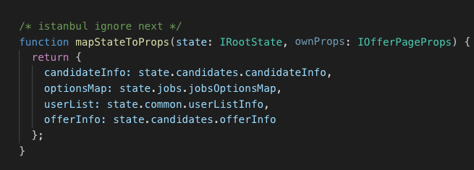
store: IRootState
actionAState= {
count: 0,
price: 100
}
featureStore: {
…[actionsAState],
…[actionsBState],
…[actionsCState],
}
IRootState: {
[feature1]: {
…
},
[feature2]: {
…
},
[feature3]: {
…
},
}
actionBState= {
name: null,
age: null
}

Slide 6
Usage - Base
node ./scripts/kit.js add
action feature/actionName
-a: 是否异步，异步创建 saga
component feature/componentName
presenter feature/presenterName
-p: PureComponent
-u: 页面
-c: connect to store

Slide 7
action
Action: doAction: xxxx
ActionState: {
count: 0,
price: 100
}
Saga middleware: call service and fetch data
Reducer:applyAction: xxxx
applyAction: (state: ActionState, action: Action<any>): ActionState => {
…
}

Slide 8
component
export interface IIndexPageProps {} export interface IIndexPageState {} type StateProps = ReturnType<typeof mapStateToProps>;
type DispatchProps = ReturnType<typeof mapDispatchToProps>; type Props =RouteComponentProps && StateProps & DispatchProps & IIndexPageProps;
export class IndexPage extends React.Component<Props, IIndexPageState> {}
function mapStateToProps(state: IRootState, ownProps: IIndexPageProps) {}
function mapDispatchToProps(dispatch: Dispatch, ownProps: IIndexPageProps) {}
export default connect<StateProps, DispatchProps, IIndexPageProps>(
mapStateToProps,
mapDispatchToProps
)(IndexPage);

Slide 9
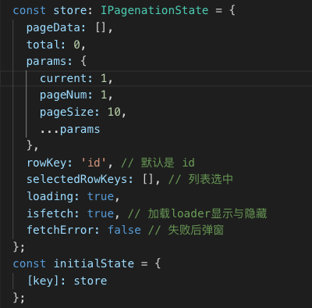
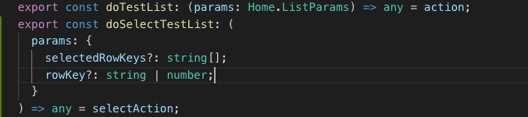
Usage – ADV:List
node ./scripts/kit.js add
list feature/testList - key

Slide 10
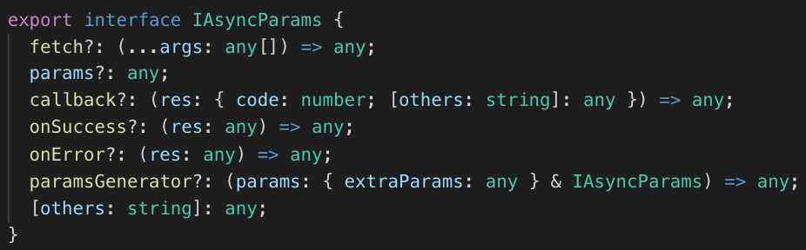
Usage – ADV:doAsync
src/features/common/redux/async.ts – 单线异步操作
old
doAsync
doAsyncConfirmed
new
doNewAsync
doNewAsyncConfirmed

Slide 11
Q&A

