Slide 1

Final Project- Credit Card Fraud Detection using Amazon SageMaker
Paladugu Suman
CSCI E-63 Big Data Analytics, Spring 2021
Harvard University Extension School
Prof. Zoran B. Djordjević

Slide 2
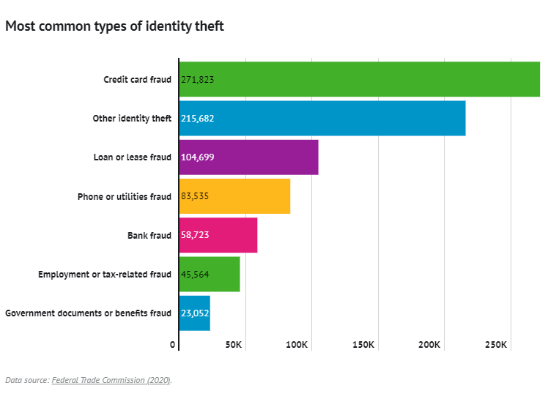
Introduction
FTC report shows that credit card fraud continues to be one of the fastest growing forms of Identity theft. Using funds recovered in fraud cases, the FTC returned $483 million to victims of fraud and identity theft in 2020, an increase of 108% from 2019’s $232.2 million

Slide 3




Problem Statement
It is very important for the financial institutions to be able to recognize the fraudulent transactions and avoid any recurring charges against their customers. This project is to build a model for identifying fraudulent credit card transactions using machine learning algorithms with the help of Amazon SageMaker
Technology Overview
Hardware | Software
Windows 10 HP Zbook Studio G3 Intel® Core™ i7-6820HQ CPU 32 GB X64 bit processor

Slide 4
Project Overview
Setup Amazon SageMaker
Import Data
Exploratory and Design Analysis
Build various models with imbalance data
Balance data using SMOTE
Build various models with balanced data
Evaluate and compare the models

Slide 5
Amazon SageMaker
Amazon SageMaker is a fully managed machine learning service
Easy to build, train and deploy models to production-ready hosted environment
It also provides common machine learning algorithms that are optimized to run efficiently against large dataset within a distributed environment
To get started with SageMaker:
Sign-up for AWS account
Create IAM administrator group and user
Request Trial access to SageMaker
Create S3 bucket
Create Jupyter Notebook instance
Select appropriate Kernel from the list

Slide 6
Identity Access Management and S3
IAM:
Create separate IAM account and do not use AWS account
Add them to Administrators user group
Create policy for consistent access among all accounts
You can attach policies to IAM user accounts
Amazon S3:
S3 means Simple Storage Service
Used for storage and to retrieve any amount of data
Stores data as objects
Standard interfaces
Buckets are containers for objects

Slide 7
About Dataset
The dataset for this project is taken from Kaggle
File specifications:
Filename: creditcard.csv
File size: 143 MB File
Format: Comma separated values
Has total of 284,000 transactions
31 features altogether
The data has the column ‘Class’ in which it specifies whether the record is fraudulent or not.
Class 0 – Valid Transaction
Class 1 – Fraud Transaction
V1, V2,V3…… V28 columns are PCA transformed data
Amount – Transactional amount in USD
Time – Transaction time of the day in seconds

Slide 8

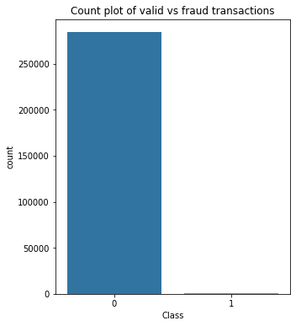

Data Pre-processing & analysis
Importing packages
Importing data
Check nulls
Check duplicates
Check if data is balanced
Number of fraud transactions: 0.17%
Number of valid transactions: 99.83%

Slide 9
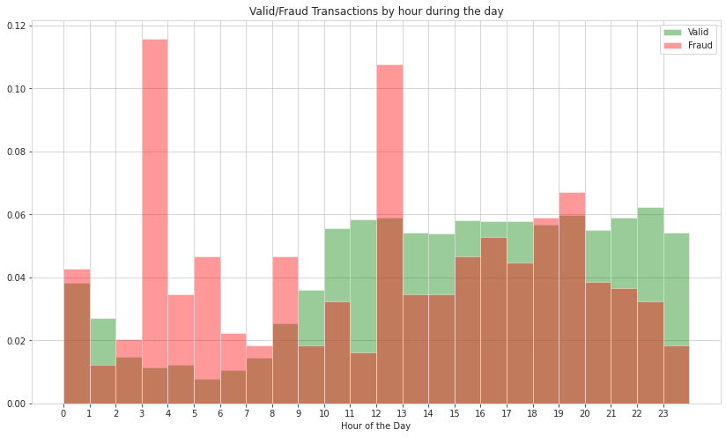
Data Visualization
Histogram plot of valid transactions vs fraud transactions by hour

Slide 10
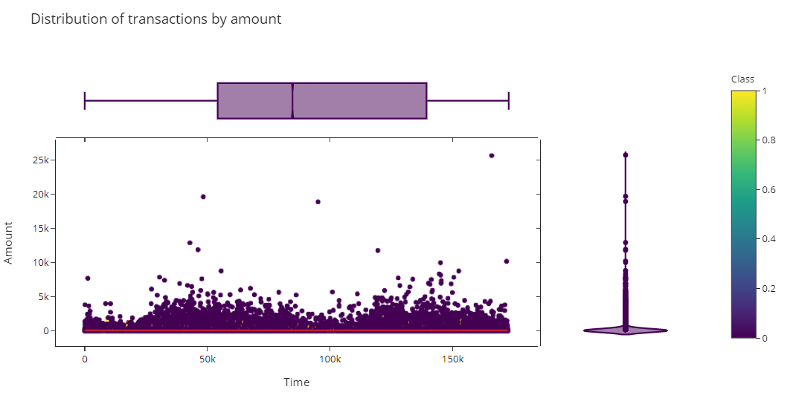
Data Visualization
Scattered plot of distribution of transactions by amount

Slide 11
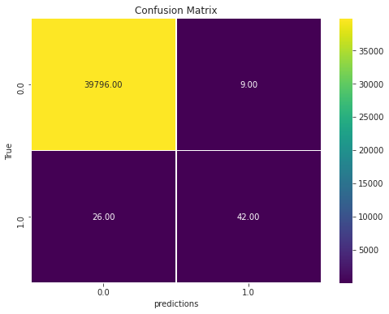
Model 1- SageMaker LinearLearner
The Amazon SageMaker linear learner algorithm provides a solution for both classification and regression problems.
Since ours is binary classification problem, the label must be either 0 or 1.
Accuracy | 99.91%
Precision | 82.35%
Recall | 61.76%

Slide 12
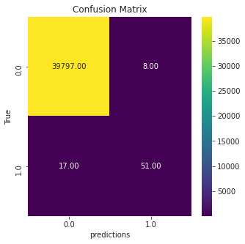
Model 2- SageMaker LinearLearner 'positive_example_weight_mult' parameter
To account for class imbalance during training of a binary classifier, LinearLearner offers the hyperparameter, positive_example_weight_mult
Accuracy | 99.94%
Precision | 86.44%
Recall | 75%

Slide 13
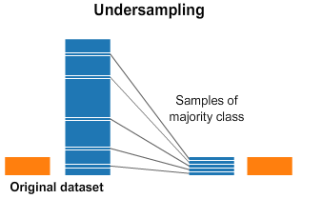
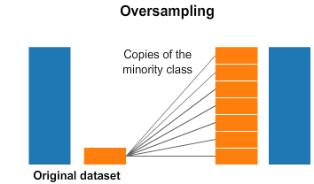
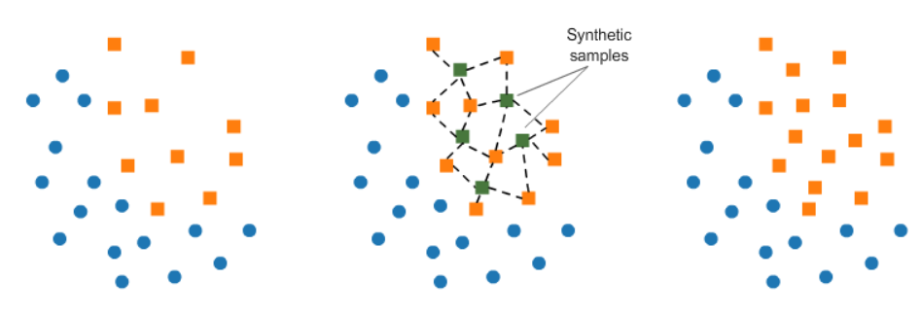
Balancing Dataset
Under Sampling
Valuable information may be lost
Over Sampling
Overfit the model
Synthetic Minority Oversampling Technique (SMOTE)
Reduce the risk of overfitting the model
Information is not lost
Image credits: https://www.kaggle.com/rafjaa/resampling-strategies-for-imbalanced-datasets

Slide 14
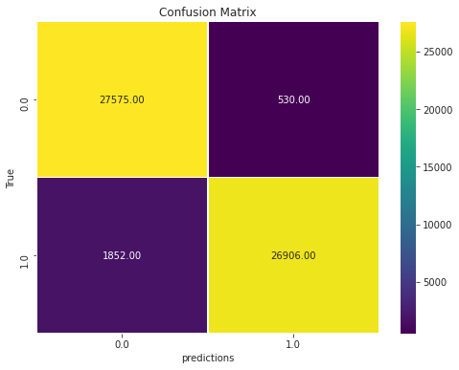
Model 3: LinearLearner using SMOTE balanced data
Precision, Recall has been improved along with decent accuracy compared
to the previous models
Accuracy | 95.81%
Precision | 98.07%
Recall | 93.56%

Slide 15
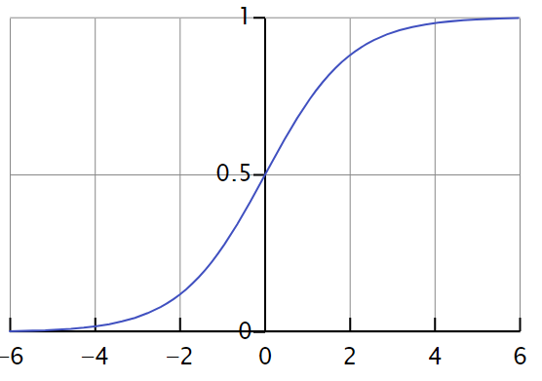
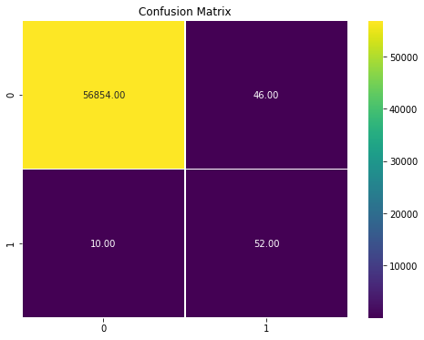
Model 4: Logistic Regression
Logistic Regression is primarily used when the target variable is dichotomous i.e., binary. This regression is built based on logistic function which is from the field of statistics. The logistic function is a S-shaped curve which can take any real number as input and maps to range of values between 0 and 1.
Credits: Wikipedia
Accuracy | 99.90%
Precision | 53.06%
Recall | 83.87%

Slide 16
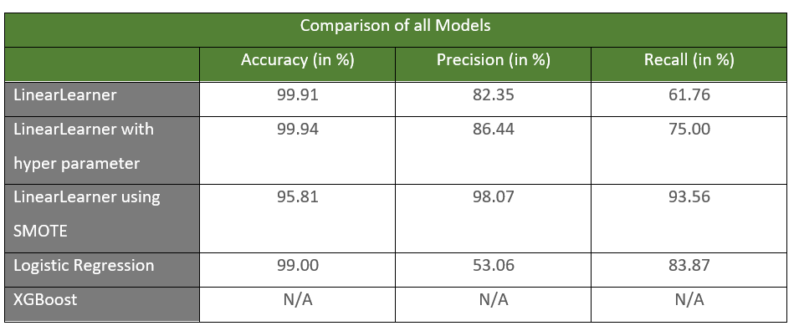
Comparison of Models at glance

Slide 17
Conclusion
When compared all the models based on all the scores, the first two models are very much biased and predicted Class 0, so the accuracy rate is higher. But if you look precision and recall, those models did not do well.
LinearLearner with the SMOTE achieved the best model when compared to other models.
Amazon SageMaker has lot of inbuilt algorithms, but I felt documentation wise it still needs more improvement
References
https://algorithmia.com/blog/evaluating-machine-learning-models-with-a-confusion-matrix
AWS Amazon SageMaker- Multi Class classifiers
Github link for credit card fraud detection
Dataset from Kaggle
Short Video: https://youtu.be/SaS4EnTs7ek
Long Video: https://youtu.be/KbuZGUIwwXg

Slide 18
THANK YOU

