Slide 1
Chapter 3
PIC18F Programming Model and Its Instruction Set
Updated: 2/10/2019

Slide 2
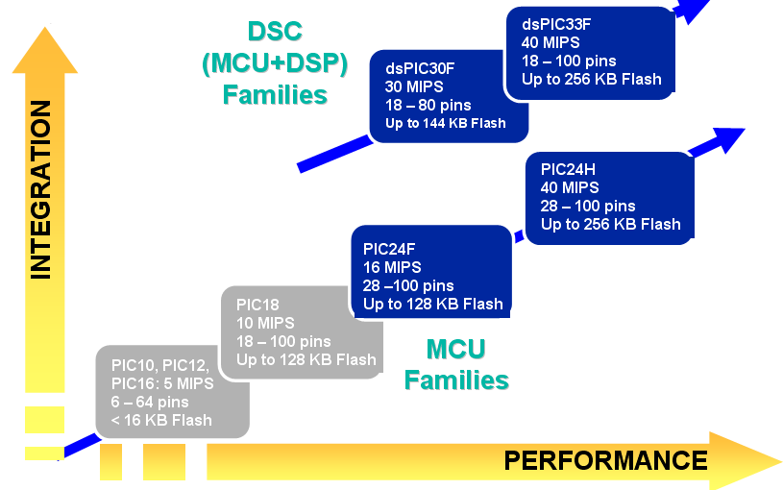

Slide 3


















Data Memory
4k bytes Data Memory
000h
07Fh
080h
0FFh
Organization
a-bit
a = 0 access bank a = 1 use BSR
100h
1FFh
200h
Decoded Instruction
from Program
Memory:
Opcode
d a Address
2FFh
Arithmetic/Logic Function to be Performed
Address of Second Source Operand
Result Destination
D00h
Instruction Examples:
DFFh
E00h
MOVLW MOVWF
0x23
0xF3
EFFh
F00h F7Fh
F80h FFFh
MOVWF MOVWF
0xF2
0x200

Slide 4
Data Memory
4k bytes Data Memory
000h
07Fh
080h
0FFh
Organization
a-bit
a = 0 access bank a = 1 use BSR
100h
1FFh
200h
Decoded Instruction
from Program
Memory:
Opcode
d a Address
2FFh
Arithmetic/Logic Function to be Performed
Address of Second Source Operand
Result Destination
D00h
Instruction Examples:
DFFh
E00h
MOVLW MOVWF
0x23
0xF3
EFFh
F00h F7Fh
F80h FFFh
MOVWF MOVWF
0xF2
0x200
0x200 Does not fit in Operand Field; 0x200 is large than ACCESS Bank

Slide 5




















Data Memory
4k bytes Data Memory
000h
07Fh
080h
0FFh
Access RAM
Organization
Bank 0 GPR
100h
Bank 1 GPR
0 x 2 00
1FFh
200h
Bank 2 GPR
2FFh
BSR
D00h
Bank 13 GPR
DFFh
E00h
Bank 14 GPR
Opcode
d a Address
8 bit operand
EFFh
F00h F7Fh
F80h FFFh
Bank 15 GPR
Access SFR

Slide 6
Data Memory
4k bytes Data Memory
000h
07Fh
080h
0FFh
Access RAM
Organization
Bank 0 GPR
a-bit
a = 0 access bank a = 1 use BSR
100h
Bank 1 GPR
1FFh
200h
Decoded Instruction
from Program
Memory:
Opcode
d a Address
Bank 2 GPR
2FFh
Arithmetic/Logic Function to be Performed
Address of Second Source Operand
Result Destination
D00h
Bank 13 GPR
Instruction Examples:
DFFh
E00h
Bank 14 GPR
MOVLW MOVWF
0x23
0xF3
EFFh
F00h F7Fh
F80h FFFh
MOVWF MOLB MOVWF
0xF2
0x02
0x20,1
Bank 15 GPR
Loading BSR
Access SFR

Slide 7
















Data Memory
4k bytes Data Memory
Organization
000h
07Fh
080h
0FFh
Access RAM
PIC16F8F2520/4520
Register File Map
Bank 0 GPR
Remember:
100h
Bank 1 GPR
Data Memory up to 4k bytes
Divided into 256 byte banks
Half of bank 0 and half of bank 15 form a virtual bank
1FFh
200h
Virtual bank:
Access Bank
Bank 2 GPR
2FFh
Access RAM
00h
7Fh
80h FFh
that is accessible no matter which bank is selected
Access SFR
D00h
Bank 13 GPR
256 Bytes
DFFh
E00h
Bank 14 GPR
EFFh
F00h F7Fh
F80h FFFh
Bank 15 GPR
Access SFR

Slide 8

































Register File Concept
Data Memory (Register File)
w
f
07h □ Register File Concept: All of data memory is part of the register file, so any location in data memory may be operated on directly
All peripherals are mapped into data memory as a series of registers
□ Orthogonal Instruction Set: ALL instructions can operate on ANY data
ALU
08h
09h
Data Bus
0Ah
d
0 1
0Bh
w
f
0Ch
0Dh
□
0Eh
0Fh
WREG
10h
memory location
Decoded Instruction
Opcode
d a Address
from Program
Memory:
Arithmetic/Logic Function to be Performed
a-bit
a = 0 access bank a = 1 use BSR
Address of Second Source Operand
Result Destination

Slide 9
PIC18F Programming Model (1 of 2)
The representation of the internal architecture of a microprocessor, necessary to write assembly language programs
Programming Model
Two Groups of Registers in PIC16 8-bit Programming Model (all in SRAM)
ALU Arithmetic Logic Unit (ALU)
Special Function Registers (SFRs)

Slide 10
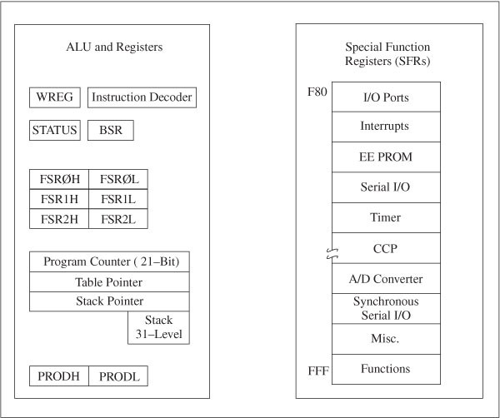
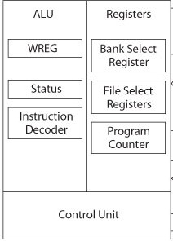
PIC18F Programming Model (2 of 2)
Register Size: 8
Register Size: 16
Register Size: 8
Two Groups of Registers in PIC16 8-bit Programming Model

Slide 11
Registers
WREG
8-bit Working Register (equivalent to an accumulator)
Used for arithmetic and logic operations
BSR: Bank Select Register (0 to F)
4-bit Register
□ Only low-order four bits are used to provide MSB four bits of a12-bit address of data memory.

Slide 12
























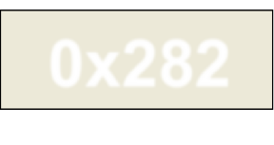
































































































































Register Direct Addressing
BSR (Bank Select Register) 4-bits from BSR Register
'f’ Operand
8-bits Encoded in Instruction
12-bit Effective Address (Use this when coding)
'a’ Bit from Instruction
0 0 1 0 1 0 0 0 0 0 1 0
0x282
a bit = 1
Bank0
Bank1
Bank2
Bank13
Bank14
Bank15
00
01
02
03
7D
7E
7F
80
81
82
FC FD FE FF

Slide 13
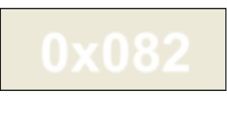
Register Direct Addressing
BSR (Bank Select Register) 4-bits from BSR Register
'f’ Operand
8-bits Encoded in Instruction
12-bit Effective Address (Use this when coding)
'a’ Bit from Instruction
0 0 1 0 1 0 0 0 0 0 1 0
0x082
a bit = 0
Bank0
Bank1
Bank2
Bank13
Bank14
Bank15
00
01
02
03
7D
7E
7F
80
81
82
FC FD FE FF

Slide 14
Register Direct Addressing
BSR (Bank Select Register) 4-bits from BSR Register
'f’ Operand
8-bits Encoded in Instruction
12-bit Effective Address (Use this when coding)
'a’ Bit from Instruction
0 0 0 0 1 0 0 0 0 0 1 0
0x082
a bit = 1
Bank0
Bank1
Bank2
Bank13
Bank14
Bank15
00
01
02
03
7D
7E
7F
80
81
82
FC FD FE FF

Slide 15
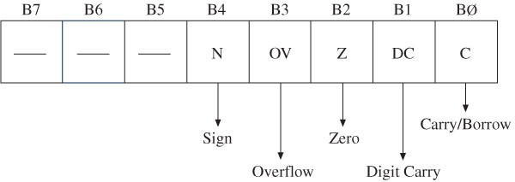
STATUS: Flag Register
Flags in Status Register
Remember:
NOVember iZ Damn Cold in Canada
C (Carry/Borrow Flag): set when an addition generates a carry and a subtraction generates a borrow
DC (Digit Carry Flag): also called Half Carry flag; set when carry generated from Bit3 to Bit4 in an arithmetic operation
Used for BCD representation
Z (Zero Flag): set when result of an operation is zero
OV (Overflow Flag): set when result of an operation of signed numbers goes beyond seven bits – if the results fall outside 127 (0x7F) and -128 (0x80)
N (Negative Flag): set when bit B7 is one

Slide 16
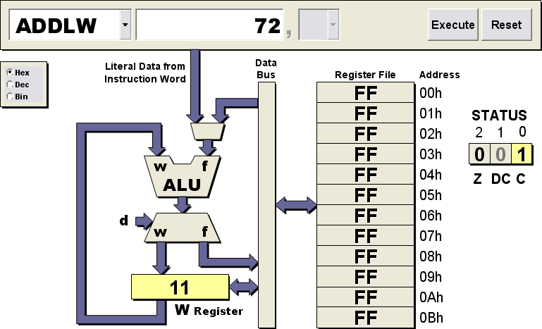




Example:
PIC18 Visual Interpreter
ADD: WREG=9F and L=72. Which flags will be set?
1001 1111 N=0
0111 0010 OV=0 // not signed numbers
------------- Z=0 0001 0001 DC=1
=0x11 C= 1
1
WREG=9F
0111 0010
1001 1111
------------- 0001 0001
=0x11

Slide 17
Example:
PIC18 Visual Interpreter
ADD: WREG=9F and L=72. Which flags will be set?
1001 1111 N=0
0111 0010 OV=0 // not signed numbers
------------- Z=0 0001 0001 DC=1
=0x11 C= 1
1
WREG=0x11
The results will be directed back to WREG since d=0 Note that for ADDLW instruction the d bit is always ZERO!
0111 0010
1001 1111
------------- 0001 0001
=0x11

Slide 18

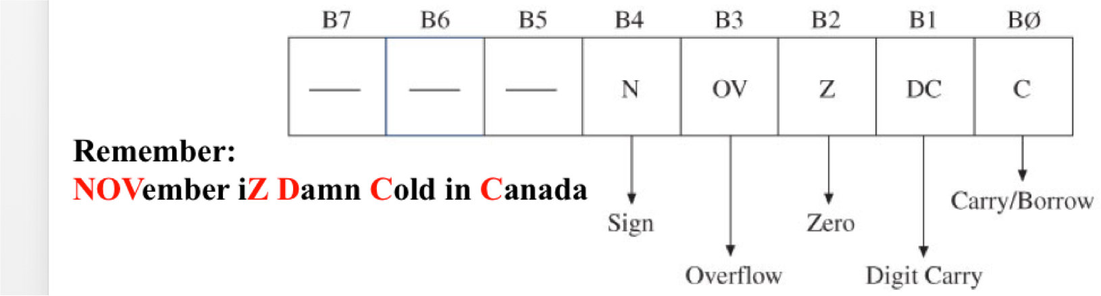


Example:
PIC18 Visual Interpreter
ADD: Literal=0x9F and WREG=0x52. Which flags will be set?
0x9F
1
1001 1111
0101 0010
------------- 1111 0001
= 0xF1
N=1 OV=0 Z=0 DC=1 C=0
WREG=0x52
0xF1

Slide 19
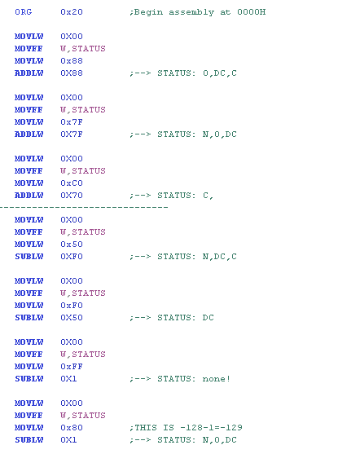
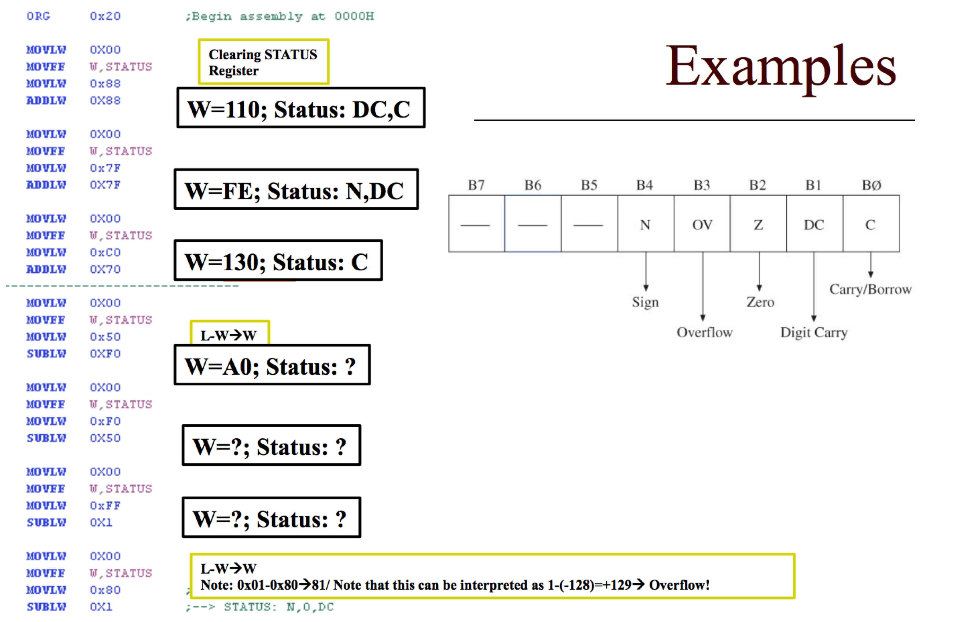
Examples
Clearing STATUS Register
DC,C,OV
Practice These Instructions!!
DC,N,OV
L-W→W
L-W→W
Note: 0x01-0x80→81/ Note that this can be interpreted as 1-(-128)=+129→ Overflow!

Slide 20
How OV Is Calculated
□ Read this for a very good description as to how OV works:
■
http://teaching.idallen.com/dat2343/10f/notes/040_overflow.txt
□ We compare carry into 7th bit and carry out of the 7th bit; if they are EQUAL then no overflow, else there is an overflow. Basic steps:
■
■
When ADDING just add the two numbers; THEN check Carry-IN and Carry-OUT
When SUBTRACTING (X-Y); FIRST convert Y to 2’s complement THEN calculate X+Y_2’sComp FINALLY check Carry-IN and Carry-OUT
□ Try the following (assuming all numbers are in HEX):
■
■
■
■
■
■
■
0xFF-0x12 ; no overflow because 0xFF+0xEE→ Carry into bit 7=Carry out from 7th bit 0x12-0xFF ; no overflow because 0x12+0x1 → Carry into bit 7=Carry out
0x80-0xFF : Carry into bit 7=Carry out → no overflow 0xFF-0x81; Carry into bit 7 = Carry out → No overflow 0xA-0x81: Carry into bit 7 NOT = Carry out → overflow 0x1-0xFA: Carry into bit 7 = Carry out → No overflow
0xEF-FB: Carry into bit 7 = Carry out from 7th bit→ No overflow

Slide 21
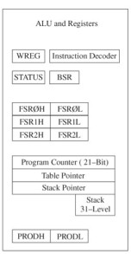
File Select Registers (FSR)
Three registers holding 12-bit address of data registers
FSR0, FSR1, and FSR2
File Select Registers composed of two 8-bit registers (FSRH and FSRL)
Used as pointers for data registers for indirect addressing
Find FSR0-FSR2 in Special Function Register –
What are the File addresses
for each? / How many INDF do you find?
Associated with index (INDF) registers

Slide 22
File Select Registers (FSR) –
Indirect Addressing
The main application of FSR is Indirect Addressing
FSRs will be pointing at the address of the data file and they can be incremented
This is much easier than using direct addressing
1A
2D
3D
4D
0x1F34
FSR0=0x1F34
Data Memory
FSR0H=0x1F
FSR0L=0x34

Slide 23
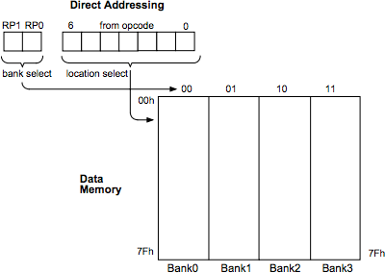
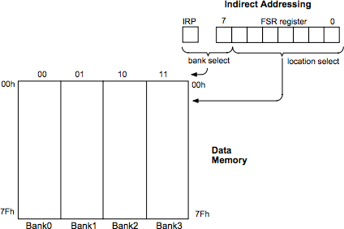
Direct and Indirect Addressing
BSF
BSF Register – Two Bytes
Remember: We are taking about DATA MEMORY!
WE WILL DISCUSS THIS IN MORE DETAILS WHEN WE LEARN MORE AOUT COMMANDS!
http://ww1.microchip.com/downloads/en/DeviceDoc/31006a.pdf

Slide 24
Stack and Table Pointers
Table Pointer
21-bit register used as a memory pointer to copy bytes between program memory and data registers
Stack Pointer (SP)
Stack is a group of 31 word-size registers used for temporary storage of memory address during execution
Used to store the return address
Requires 5-bit address
Saved in STKPTR in SFR
Used primarily for saving PC for next program address prior to entering subroutine

Slide 25
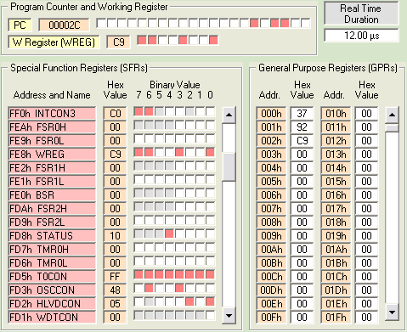
FSR
Don’t confuse SFRs and FSRs (file Select Registers)

Slide 26




























Program Counter
21-bit register functions as a pointer to program memory during program execution
PCU PCH
21 20 19 18 17 16 15 14 13 12 11 10 9 8
PCL
7 6 5 4 3 2 1 0
0
0
0
0
0
0
0
0
0
0
0
0
0
0
0
0
0
0
0
0
0
0
Program Counter
21-bit PC can access up to 2²¹ = 2MB (1MWord)
22nd bit used to access configuration memory at program time or via table reads & writes
Contains address of NEXT instruction (pipelining)
Lower byte accessible in data memory as PCL
Upper bytes indirectly accessible via PCLATH/PCLATU
Bit 0 of PC is always '0’ except when reading or writing program memory via table read/write mechanism
PCL
PCLATH | PCLATL | PCL

Slide 27
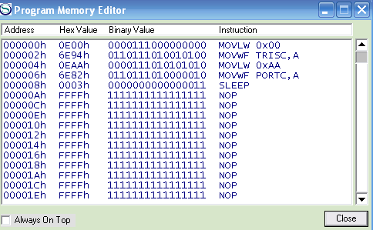
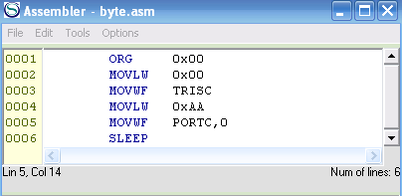

21-Bit PC Example & Program Memory
Leave space

Slide 28
















Program Memory is Byte Addressable
Low byte has even address, high byte has odd address
Addresses of instructions are always even
16-bit wide program memory is byte addressable
All program instructions will start at an even address
So if we are jumping 4 instructions ahead, we are actually jumping 8-bytes (or 8 word addresses) ahead
Word Address
16-bit Program Memory
High Byte Address Low Byte Address
_{0x000001} 0 0 0 0 0 0 0 0 0 0 0 0 0 0 0 0 _{0x000000}
0 0 0 0 0 0 0 0 0 0 0 0 0 0 0 0
PC
0x000003 0x000002
_{0x000005} 0 0 0 0 0 0 0 0 0 0 0 0 0 0 0 0 _{0x000004}
0 0 0 0 0 0 0 0 0 0 0 0 0 0 0 0
0x000007 0x000006
_{0x000009} 0 0 0 0 0 0 0 0 0 0 0 0 0 0 0 0 _{0x000008}
0 0 0 0 0 0 0 0 0 0 0 0 0 0 0 0
0x00000B 0x00000A
_{0x00000D} 0 0 0 0 0 0 0 0 0 0 0 0 0 0 0 0 _{0x00000C}
0 0 0 0 0 0 0 0 0 0 0 0 0 0 0 0
0x00000F 0x00000E

Slide 29
Instruction Pipelining
□ Instruction fetch is overlapped with execution of previously fetched
instruction
Instruction Cycles
Example Program
T0 | T1 | T2 | T3 | T4 | T5 | T6 | T7
1
MAIN movlw 0x37
Fetch
Execute
Time to execute 16-bit instructions
2
movwf REG0
Fetch
Execute
3
movlw 0x92
Fetch
Execute
4
movwf REG1
Fetch
Execute
Remember: In PIC ONE Instruction Cycle takes 4 Clock Cycle:
Clock Cycles Instruction Cycle
3
4
1 2

Slide 30
Introduction to PIC18 Instruction Set
Includes 77 instructions;
73 one-word (16-bit) long
Four two-words (32-bit) long
Divided into seven groups
Move (Data Copy) and Load
Arithmetic
Logic
Program Redirection (Branch/Jump)
Bit Manipulation
Table Read/Write
Machine Control
Move / Copy
Arithmetic
Logic
Branches
Bit Manipulation
Table Read/Write
Machine Control

Slide 31
Move / Copy
Arithmetic
L
W
Fa
Fb
Logic
Branches
Move and Load Instructions
Bit Manipulation
Table Read/Write
Machine Control
MOVLW
MOVLW
8-bit ;Load an 8-bit literal in WREG 0 x F2
□ MOVWF
F, a
;Copy WREG in File (Data) Reg.
; If a = 0, F is in Access Bank
;If a = 1, Bank is specified by BSR
;Copy W in Data Reg.25H
□ MOVWF
0x25, 0
□ MOVFF
fs, fd
;Copy from one Data Reg. to
;another Data Reg.
;Copy Data Reg. 20 into Reg.30
□ MOVFF
0x20,0x30

Slide 32
Move / Copy
Arithmetic
L Fa _{W}
Logic
W
OR
Branches
Arithmetic Instructions (1 of 3)
Bit Manipulation
Table Read/Write
Machine Control
□ ADDLW | 8-bit | ;Add 8-bit number to WREG
□ ADDLW | 0x32 | ;Add 32H to WREG
□ ADDWF | F, d, a | ;Add WREG to File (Data) Reg.
 |  | ;Save result in W if d =0
 |  | ;Save result in F if d = 1
□ ADDWF | 0x20, 1 | ;Add WREG to REG20 and ;save result in REG20
□ ADDWF | 0x20, 0 | ;Add WREG to REG20 and ;save result in WREG

Slide 33






Arithmetic Instructions (2 of 3)
Fa _{W C}
□ ADDWFC F, d, a
;Add WREG to File Reg. with
;Carry and save result in W or F
SUBLW
SUBWF
SUBWFB
8-bit F, d, a
F, d, a
;Subtract WREG from literal
L-W→W
;Subtract WREG from File Reg.
;Subtract WREG from File Reg. ^{F-W→Dest.}
;with Borrow
;Increment File Reg.
;Decrement File Reg.
;Complement File Reg.
INCF
DECF
COMF
NEGF
F, d, a
F, d, a
F, d, a F, a
;Take 2’s Complement-File Reg.

Slide 34



Arithmetic Instructions (3 of 3)
□ MULLW 8-bit ;Multiply 8-bit and WREG
;Save result in PRODH-PRODL F, a ;Multiply WREG and File Reg.
;Save result in PRODH-PRODL
;Decimal adjust WREG for BCD
;Operations
□ MULWF
□ DAW
Example:
MOVLW DAW
0xA
;W=A
;W=10

Slide 35
Logic Instructions
ANDLW ANDWF | 8-bit F, d, a | ;AND literal with WREG ;AND WREG with File Reg. and ;save result in WREG/ File Reg.
□ IORLW | 8-bit | ;Inclusive OR literal with WREG
□ IORWF | F, d, a | ;Inclusive OR WREG with File Reg. ;and save result in WREG/File Reg.
□ XORLW | 8-bit | ;Exclusive OR literal with WREG
□ XORWF | F, d, a | ;Exclusive OR WREG with File Reg.
;and save result in WREG/File Reg.

Slide 36
And, XOR, and IOR
A B T
( T = A ∙ B )
0 | 0 | 0
0 | 1 | 0
1 | 0 | 0
1 | 1 | 1
X X X X X X X X
AND 0 0 0 0 1 1 1 1
0 0 0 0 X X X X
Cleared to zero
X X X X
0 0 0 0
X X X X
1 1 1 1
X X X X X X X X
XOR
IOR
0 0 0 0 1 1 1 1
X X X X
If they are the same→0 If they are different→1
X X X X
1 1 1 1
X X X X
Toggled
Set to one

Slide 37
Examples
MOVLW 0x1F ANDLW 0xFC
;clear bits 0 and 1
;set bits 6 and 7
IORLW GOTO
0xC0
Stop
Stop:
MOVLW 0x90 XORLW 0xE0
GOTO Stop
;invert left 3 bits
Stop:

Slide 38
Branch Instructions
BC n ;Branch if C flag = 1 within + or – 64 Words
BNC n ;Branch if C flag = 0 within + or – 64 Words (NO CARRY)
BZ n ;Branch if Z flag = 1 within + or – 64 Words
BNZ n ;Branch if Z flag = 0 within + or – 64 Words
BN n ;Branch if N flag = 1 within + or – 64 Words
BNN n ;Branch if N flag = 0 within + or – 64 Words
BOV n ;Branch if OV flag = 1 within + or – 64 Words
;Branch if OV flag = 0 within + or – 64 Words
GOTO Address: Branch to 20-bit address unconditionally
BNOV n

Slide 39


Branch Example
Check the table in The TEXT (p78)!
BCN 0xFA
;Brant-If-No-Carry to location:
; → PC(current_Decimal) + 2 + 2x Decimal(0xFA)
; Note 0xFA is signed!
;→ PC + 2 + 2(-6)
1 Word Instruction / 1 Instruction Cycle / 4 Clock Cycles

Slide 40
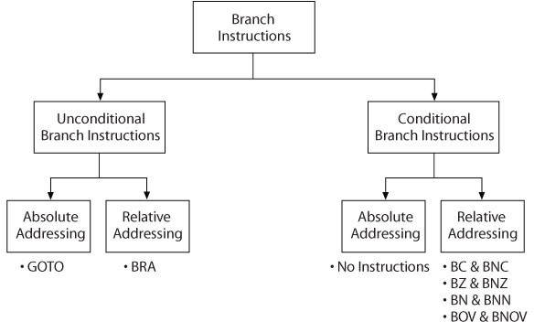
Branch Instructions

Slide 41
Call and Return Instructions
RCALL nn ;Call subroutine within +or – 512 words
CALL 20-bit, s
;Call subroutine
;If s = 1, save W, STATUS, and BSR
;Return subroutine
;If s = 1, retrieve W, STATUS, and BSR
;Return from interrupt
;If s = 1, retrieve W, STATUS, and BSR
RETURN, s
□
RETFIE, s
□
Review

Slide 42
Bit Manipulation Instructions
□ BCF | F, b, a | ;Clear bit b of file register. | b = 0 to 7
□ BSF | F, b, a | ;Set bit b of file register. | b = 0 to 7
□ BTG | F, b, a | ;Toggle bit b of file register. | b = 0 to 7
RLCF F, d, a
RLNCF F, d, a
RRCF F, d, a
□
RRNCF F, d, a
;Rotate bits left in file register through
; carry and save in W or F register
;Rotate bits left in file register
; and save in W or F register
;Rotate bits right in file register through
; carry and save in W or F register
;Rotate bits right in file register
; and save in W or F register

Slide 43
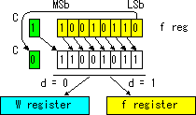
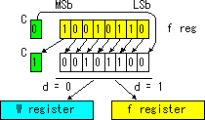
Rotations
Rotate Right through Carry RRCF
Rotate LEFT through Carry RLCF
RLNCF
RRNCF

Slide 44
Test and Skip Instructions
BTFSC F, b, a ;Test bit b in file register and skip the
;next instruction if bit is cleared (b =0)
BTFSS F, b, a ;Test bit b in file register and skip the
;next instruction if bit is set (b =1)
□ CPFSEQ | F, a | ;Compare F with W, skip if F = W
□ CPFSGT | F, a | ;Compare F with W, skip if F > W
□ CPFSLT | F, a | ;Compare F with W, skip if F < W
□ TSTFSZ | F, a | ;Test F; skip if F = 0

Slide 45
Example
MOVLW | 0x1F
BCF | WREG, 0 | ;clear bit 0
BCF | WREG, 1 | ;clear bit 1
BSF | WREG, 6 | ;set bit 6
BSF | WREG, 7 | ;set bit 7
Stop: GOTO | Stop
MOVLW BTFSS | 0x7F WREG, 7 | ;load test data
BCF | WREG, 0 | ;clear bit 0
Stop: GOTO | Stop

Slide 46
Increment/Decrement
and Skip Next Instruction
□ DECFSZ
F, d, a ;Decrement file register and skip the
;next instruction if F = 0
DECFSNZ F, d, a ;Decrement file register and skip the
;next instruction if F ≠ 0
INCFSZ F, d, a ;Increment file register and skip the
;next instruction if F = 0
INCFSNZ F, d, a ;Increment file register and skip the
;next instruction if F ≠ 0

Slide 47
Table Read/Write Instructions (1 of 2)
□ TBLRD*
;Read Program Memory pointed by TBLPTR
;into TABLAT
;Read Program Memory pointed by TBLPTR
;into TABLAT and increment TBLPTR
;Read Program Memory pointed by TBLPTR
;into TABLAT and decrement TBLPTR
□ TBLRD*+
□ TBLRD*-
□ TBLRD+* ; Increment TBLPTR and Read Program
; Memory pointed by TBLPTR into TABLAT
Review

Slide 48
Table Read/Write Instructions (2 of 2)
□ TBLWT*
;Write TABLAT into Program Memory pointed
;by TBLPTR
; Write TABLAT into Program Memory pointed
;by TBLPTR and increment TBLPTR
; Write TABLAT into Program Memory pointed
;by TBLPTR and decrement TBLPTR
; Increment TBLPTR and Write TABLAT into
; Program Memory pointed by TBLPTR
□ TBLWT*+
□ TBLWT*-
□ TBLWT+*
Review

Slide 49
Machine Control Instructions
CLRWDT ;Clear Watchdog Timer
Helps recover from software malfunction
Uses its own free-running on-chip RC oscillator
WDT is cleared by CLRWDT instruction
RESET ;Reset all registers and flags
When voltage < a particular threshold, the device is held in reset
Prevents erratic or unexpected operation
SLEEP
NOP
;Go into standby mode
;No operation

Slide 50
































Sleep Mode
□ The processor can be put into a power-down mode by executing the SLEEP instruction
■
■
■
■
System oscillator is stopped
Processor status is maintained (static design) Watchdog timer continues to run, if enabled
Minimal supply current is drawn - mostly due to leakage (0.1 - 2.0μA typical)
Events that wake processor from sleep
MCLR
Master Clear Pin Asserted (pulled low)
WDT Watchdog Timer Timeout
INT
INT Pin Interrupt
TMR1
Timer 1 Interrupt (or also TMR3 on PIC18)
ADC A/D Conversion Complete Interrupt CMP Comparator Output Change Interrupt CCP Input Capture Event
PORTB
PORTB Interrupt on Change
SSP Synchronous Serial Port (I²C Mode) Start / Stop Bit Detect Interrupt PSP Parallel Slave Port Read or Write

Slide 51
Instruction Format (1 of 3)
The PIC18F instruction format divided into four groups
Byte-Oriented operations
Bit-Oriented operations
Literal operations
Branch operations

Slide 52

PIC18 Instruction Set Overview –
Byte Oriented Operations
15
9 8 7
0
 |  | O | pco | de |  |  | a | f | f | f | f | f | f | f | f
OR
d
Destination (W or F) Access Bank
 |  | Op | co | e |  | d |  | a |  | f | f | f | f | f | f | f | f
 |  |  |  |  |  |  |  |  | File Register Address
ADDWF
Or BSF
0x25, W, A
File Register Address
Use Access Bank (Optional)
Destination

Slide 53

Instruction Set Overview
Bit Oriented Operations
15
11
9 8 7
0
 | Op | cod | e | b | b |  | b | a | f | f | f | f | f | f | f | f
 |  |  |  |  |  | File Register Address
Bit Position (0-7)
BSF 0x25, 3, A
File Register Address
Access Bank (Optional)
Bit Position

Slide 54
Instruction Set Overview
Literal and Control Operations
15 8 7 Literal Value
d
0
 |  |  | Op | co | e |  |  | k | k | k | k | k | k | k | k
OR
d
 |  |  |  |  |  |  | Op | co | e
MOVLW
0x25
Literal Value

Slide 55
Instruction Set Overview
- Two-word instruction
Byte to Byte Move Operations(2 Words)
15
12 11 Source Register Address
0
 | Op | co | e | f_{s} | f_{s} | f_{s} | f_{s} | f_{s} | f_{s} | f_{s} | f_{s} | f_{s} | f_{s} | f_{s} | f_{s}
Opcode |  |  |  | f_{d} f_{d} f_{d} f_{d} f_{d} f_{d} f_{d} f_{d} f_{d} f_{d} f_{d} f_{d}
d
Destination Register Address
MOVFF
0x125, 0x140
Source Address
Destination Address

Slide 56
Instruction Set Overview
Call and Goto Operations (2 Words)
15
11 8 7
d
0
 |  |  | Op | co | e |  |  | n₈ | n₇ | n₆ | n₅ | n₄ | n₃ | n₂ | n₁
Opcode |  |  |  | ^{n}20 ^{n}19 ^{n}18 ^{n}17 ^{n}16 ^{n}15 ^{n}14 ^{n}13 ^{n12 n}11 ^{n}10 ^{n9}
CALL
0x1125
Subroutine Address

Slide 57
Example (do it in class!)
ORG REG0 REG1 REG2
0x20
EQU 0x00
EQU 0x01
EQU 0x02
Explain what this program does, specify PC value for each line, which flags are changed as the program is executed.
MOVLW MOVWF MOVLW MOVWF ADDWF MOVWF SLEEP
0x37 REG0,0 0x92 REG1,0 REG0,0 REG2, 0
Command | PC | REG0,1,2 | STATUS | Time

Slide 58
Example
ORG REG0 REG1 REG2
0x20
EQU 0x00
EQU 0x01
EQU 0x02
MOVLW MOVWF MOVLW MOVWF ADDWF MOVWF SLEEP
0x37 REG0,0 0x92 REG1,0 REG0,0 REG2, 0
→W=0x37
→REG0=0x37
→W=0x92
→REG1=0x92
→W=37+92=C9
→REG2=C9
NOTES:
Each 1W instruction take 4 clock periods Use the STOPWATCH in the simulator!

Slide 59
Next QUIZ: Review the Following
Arithmetic commands (ADDLW, ADDWF, ADDWFC, SUBLW, SUBWF, SUBWB, INC, DEC, MULLW, NEGF, COMPF)
Logical commands, ANDLW, XOR, IOR, AND)
MOVE & Copy (MOVLW, MOVFF, MOVWF, CLR, SETF)
Branches (BC, BNC, BZ, BNZ, BOV, BRA, GOTO)
Bit manipulations (BCF, BSF, BTG, RLCF, RRCF)
Make sure you know about flags.
Make sure you can do the homework assignment

