Slide 1
Chapter 5
Instruction to Data Copy
2/21/14

Slide 2
Data Copy (Move) and Set/Clear Operations
The data copy operations are classified as:
Loading 8-bit data directly in WREG
Copying data between WREG and data (file) register including I/O ports
Copying data from one data (file) register to another data (file) register
Clearing or setting all data bits in data (file) register
Exchanging low-order four bits (nibble) with high-order four bits in data (file) register

Slide 3
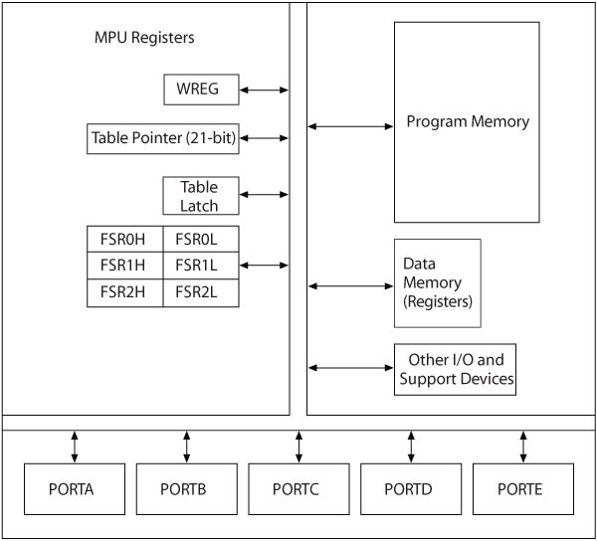
Frequently Used Registers in ALU, Memory, and I/O Ports for Data Copy
Literal to W
W→→ F
F→→ F
F→→ Program memory
Swapping lower order with the higher-order

Slide 4
Addressing Modes
A way of specifying of an operand
 Direct addressing
The operand is a part of the instruction
 Indirect addressing
An address is specified in a register and the MPU looks up the address in that register

Slide 5
MOV (Copy) Operations
Instructions
□ MOVLW
8-bit
Examples
□ MOVLW 0xF2
□ MOVWF F, a
Load F2H in WREG
□ MOVWF REG1, 0 Copy WREG in REG1
□ MOVF
F,d, a
□ MOVF REG1, 1
Copy REG1 in REG1 (check for flag)
MOVF REG1, 0 Copy REG1 into WREG
MOVFF REG1,REG2 Copy REG1 into REG2
□ MOVFF
Fs, Fd
d=0 or omitted then →→ WREG
a=0 or omitted then →→ data reg is from Access Bank

Slide 6
SET/CLR Instructions
Instructions
□ CLRF F,a
Examples
CLRF REG1,0 Clear REG1 located in access bank
SETF REG1,0 Set all bits in REG1
SWAP REG1,1,0 Exchange low and high
nibbles in REG1, save in REG1
□ SETF F, a
□ SWAP
F,d,a

Slide 7
Using File Select Registers (FSRs) as Pointers to Data Registers – Indirect addressing
Memory pointer is a register that holds the address of a data register
 This is called indirect addressing
 Easy to move/copy an entire block
Three registers: FSR0, FSR1, and FSR2
 Each FSR has a High and Low byte associated with an index
 Used as memory pointers to data registers
Each can be used in five different formats (operands) :
 INDF0:
 POSTINC0:
 POSTDEC0:
 PREINC0:
 PLUSW0:
Use FSR0 as pointer (index)
Use FSR0 as pointer and increment FSR0 Use FSR0 as pointer and decrement SR0 Increment FSR0 first and use as pointer Add W to FSR0 and use as pointer

Slide 8
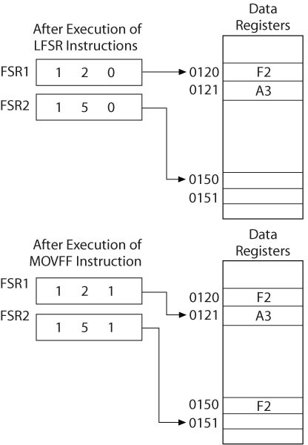
Indirect Addressing - Example
LFSR FSR1,120 ; LOAD 12-BIT ADDRESS 120h INTO FSR1
0x0 0x0
Initially FSR values are 0 and status of registers are given as above
LFSR
LFSR
FSR1,0x0120 ; load the FSR2,0x0150
MOVFF POSTINC1, POSTINC2
; Load the content of FSR1→→FSR2 and increment FSR1 & FSR2

Slide 9
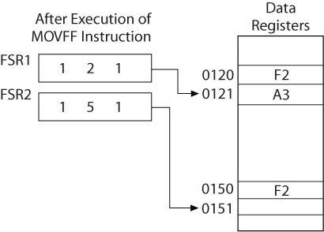
Indirect Addressing – Example (1)
Examples:
MOVFF INDF0,INDF1
; COPY BYTE FROM REGISTERS SHOWN BY
;FSR0 TO FSR1- NO CHANGE IN FSR
; ADD BYTE FROM REGISTERS SHOWN BY
;FSR0 AND W→→REG ;
;FSR0 IS INCREMENTED
ADDWF POSTINC0,1
Hence, we will have A3 in register 0x151 after the MOVFF instruction
Note that the pointer indexes are not changing!
FSR0
FSR1
A3

Slide 10
Indirect Addressing Example (2)
Examples:
MOVFF INDF0,INDF1
; COPY BYTE FROM REGISTERS SHOWN BY
;FSR0 TO FSR1- NO CHANGE IN FSR
; ADD BYTE FROM REGISTERS SHOWN BY
;FSR0 AND W→→REG ;
;FSR0 IS INCREMENTED
ADDWF POSTINC0,1
Assume W=2; after the ADD operation, A3+2=A5→→Reg 0x0121, then FSR=0x0122
FSR0
0x0122
FSR1
A5
A3

Slide 11
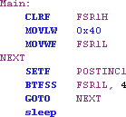
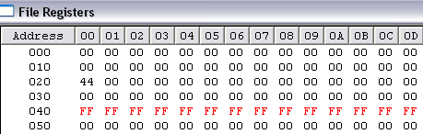
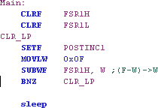
Initializing the RAM – Application of Indirect Addressing
What is this doing?

Slide 12
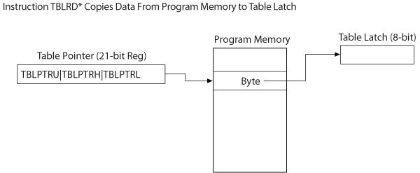
Using Table Pointers to Copy Data
8-bit data registers
21 bit
16 bit

Slide 13
Using Table Pointers to Copy Data from Program Memory into Table Latch (REFER TO PAGE 82-83)
TBLRD*
 Copy from Program Memory into Table Latch Using Table Pointer
TBLRD*+
 Copy from Program Memory into Table Latch and Increment Table Pointer
TBLRD*-
 Copy from Program Memory into Table Latch and Decrement Table Pointer
TBLRD+*
 Increment Table Pointer first and then copy from Program Memory into Table Latch

Slide 14
Using Table Pointers to Copy Data from Table Latch into Program Memory
TBLWT*
 Copy from Table Latch into Program Memory Using Table Pointer
TBL WT*+
 Copy from Table Latch into Program Memory and Increment Table Pointer
TBL WT*-
 Copy from Table Latch into Program Memory and Decrement Table Pointer
TBLWT+*
 Increment Table Pointer first and then copy from Table Latch into Program Memory

Slide 15
Copying Data from Program
Memory to Table Latch
76
Using TBLRD*: Address: 01251H = 76 TABLAT=76 TBLPTR=01251H

Slide 16
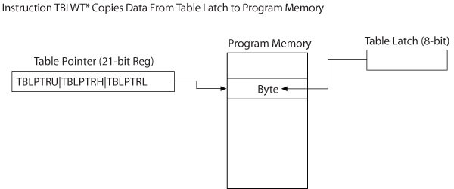
Copying Data from Table
Latch to Program Memory

Slide 17
Arithmetic Operations
□ The PIC18F MPU performs the following arithmetic operations:
 Add
 Subtract
 Multiply
 Complement (1s and 2s)
 Increment
 Decrement

Slide 18
Addition
Instructions:
□ ADDLW
Examples
8-bit
□ ADDLW 0xA2
Add A2H to WREG
□ ADDWF
F, d, a
□ ADDWF REG1, 0
Add WREG to REG1 and save the sum in W
□ ADDWF REG1, 1
Add WREG to REG1 and save the sum in REG1
□ ADDWFC F, d, a
□ ADDWFC REG2, 0
Impacts all the flags
Result can be saved in W if d=0
ADDWFC is used for numbers > 8-bit
Add WREG, REG2 and Carry from previous operation and save the sum in WREG

Slide 19
ADDWF Example
WREG + | 0 | 1 | 0 | 0 | 1 | 1 | 1 | 1 | (4FH)
REG20 | 0 | 1 | 0 | 0 | 1 | 0 | 0 | 0 | (48H)
Carry
1 1
------------------------------------
1 0 0 1 0 1 1 1 (97H) = 151d
N=1, OV=1, Z=0, DC=1, C=0

Slide 20
ADDWF Example
Assume we want to add 0x7292 and 0x1F91 REG10=91, REG11=1F
REG20=92, REG21=72
REG10+REG20=22 & C=1 (291d)
Do 4.5 SE
page 122
N=1, OV=1, Z=0, DC=1, C=1
ADDWFC=REG11+REG21+C
→→0x72+ 0x1F+1= 0x92 (1 0 0 1 0 0 1 0)
N=?, OV=?, Z=?, DC=?, C=?

Slide 21
Subtraction
Instructions:
Examples
□ SUBLW
8-bit
□ SUBLW 0xA2
L-WREG
Subtract WREG from A2H
□ SUBWF REG1, 0
□ SUBWF
F, d, a
Subtract WREG from REG1 and save the result in W
F-WREG
□ SUBWF REG1, 1
Subtract WREG from REG1 and save the result in REG1
□ SUBFWB
F, d, a
□ SUBFWB REG2, 0
Subtract REG2, and Borrow from WREG and save the result in W
□ SUBWFB
F, d, a
□ SUBWFB REG2, 0
Subtract WREG, and Borrow from REG2 and save the result in W
If the number is larger than 8 bit!

Slide 22
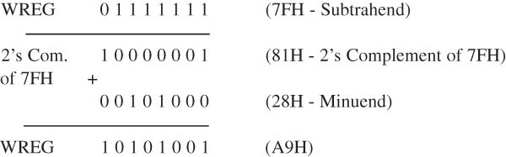
Example
Assume [W] = 7F and [REG5]=28
SUBWF REG5
Means:28-7F→→W

Slide 23
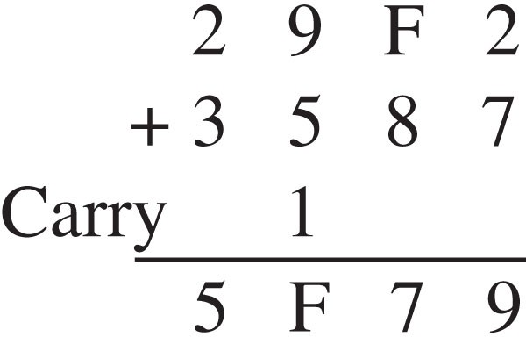
(Adding values larger than 8 bits)
Write a Program
REG10=F2 REG11=29 REG12=87 REG13=35

Slide 24
Increment, Decrement, and Complement Operations
Instructions: Examples:
□ INCF F, d, a □ INCF REG1,1
Increment REG1 and save result in REG1
DECF REG2, 0 Decrement REG2 and save result in W
COMF REG3,0 Complement REG3 and save result in W
NEGF REG1, 0
Take 2s complement of REG1
□ DECF
F, d, a
□ COMF
F, d, a
□ NEGF
F, a

Slide 25
Redirection of Program Execution (Branch and Skip Operations)
□ The PIC18F MPU includes three groups of instructions that change the direction of execution:
 Branch
 Skip
 Call (discussed in Chapter 7)

Slide 26
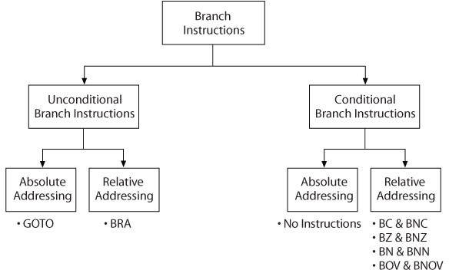
Branch Instructions in PIC18
Family

Slide 27
Unconditional Branch Instructions
Instructions:
□ BRA
n (label)
□ Unconditional relative branch within ± 512 words
□ Unconditional absolute branch anywhere in 2 MB memory locations
□ GOTO
k (label)

Slide 28
Conditional Relative
Branch Instructions
_{□ BC n: Branch if Carry} n is the address the PC should be set to upon
□ BNC | n: | Branch if No Carry executing the command!
□ BZ | n: | Branch if Zero
□ BNZ | n: | Branch if No Zero ^{For Example:}
□ BN | n: | _{Branch if Negative} BC 0x020 ; goto address 20 BZ LOOP; goto loop
□ BNN | n: | Branch if No Negative
□ BOV | n: | Branch if Overflow
□ BNOV | n: | Branch if No Overflow
□ (n is label – represents 8-bit signed number in words)

Slide 29
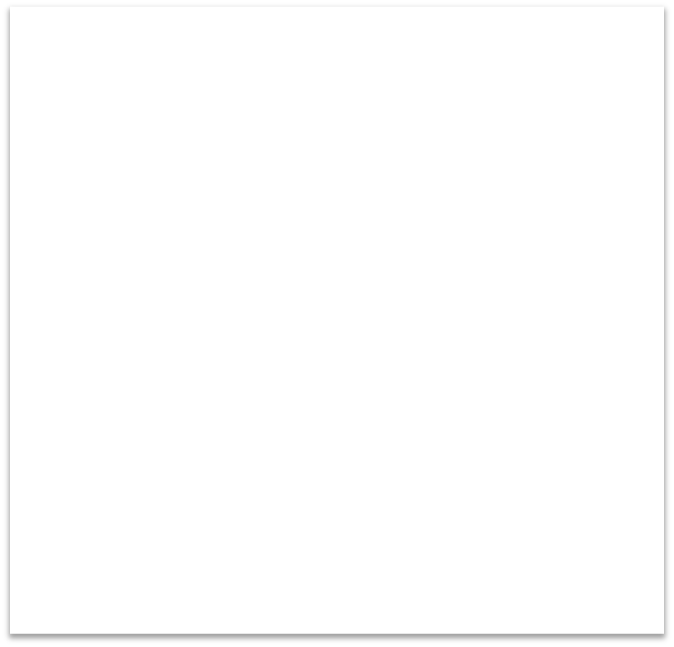
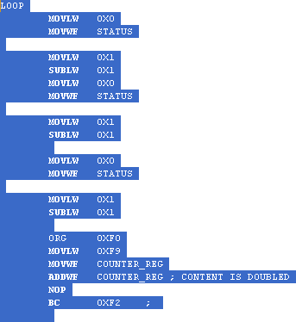




Examples of Relative
Conditional Branch Instructions
Correction to the the TEXT:
BC 0x6
This means:
If carry flag is set then jump to 0x06
The n value is where the jump goes to (what the next PC value should be)

Slide 30
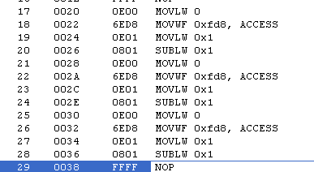

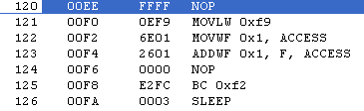


Examples of Relative
Conditional Branch Instructions
BC n refers to the next PC if the condition is met!

Slide 31
Arithmetic Instructions with Skip
□ Compare File (Data) Register with W:
 CPFSEQ | F, a | ;Skip next instruction if F = W
 CPFSGT | F, a | ;Skip next instruction if F > W
 CPFSLT | F, a | ;Skip next instruction if F > W
□ Increment File (Data) Register:
 INCFSZ F, d, a
 INFSNZ F, d, a
;Skip next instruction if F = 0
; Skip next instruction if F ≠ 0
□ Decrement File (Data) Register:
 DECFSZ F, d, a ; Skip next instruction if F = 0
 DCFSNZ F, d, a ; Skip next instruction if F ≠ 0

Slide 32
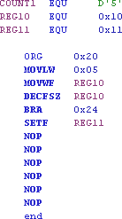
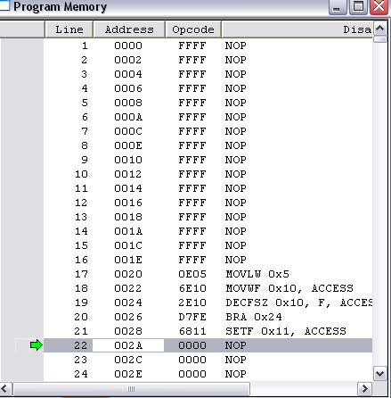
Creating some Delay: Example : When W=0, REG11=1
Skip next instruction if F = 0 Go to location 0x24
What is the delay?

Slide 33



Creating some Delay: Example : When W=0, REG11=1
Operand of BRA is the number of words the program should branch;
In this case 1 word backward →→
-2=FE; NOTE: D7 is
OPCODE for BRA
Skip next instruction if F = 0 Go to location 0x24

Slide 34







Branch (BRA) Examples
FD = -3; Going back 3 words
Starting with PC=0x28 going to PC=22 That is (28-26) / 2 = 3
PC+2 + 2*n
28+2 + 2(-5)=2A-A=20
FB = -5; Going back 5 words
Starting with PC=0x2A going to PC=20; before the branch is executed the PC=2A That is (2A-20) / 2 = 5

Slide 35
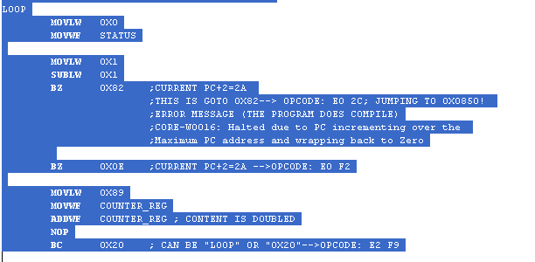







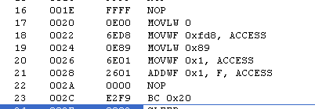


Branch Example
BAD JUMP!
GOOD JUMP!
Note that is the program starts at 0x20
And we use BZ 0x2 →→ the jump will to PC=20
GOOD JUMP!

Slide 36
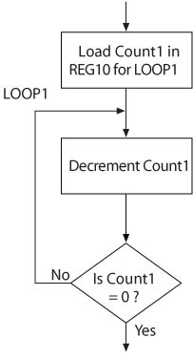
Flowchart for Delay Loop
Delay
Timer
Software
Loops
Nested Loops

Slide 37
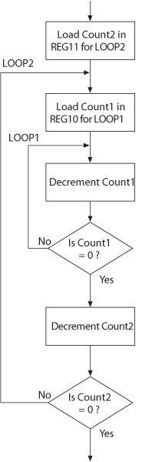
Flowchart for Delay Using Nested Loop

Slide 38
Nested Loop Delay Analysis
□
--------------------------------------------- PIC ASSEMBLER LISTING
Line Address Opcode Instruction
---------------------------------------------
□
□
□
□
□
0001 000000
0002 000000
0003 000000
0004 000000
0005 000000
0006 000000
0007 000000
0008 000000
;Line removed by MPASMWIN preprocessor:
;Line removed by MPASMWIN preprocessor:
;Line removed by MPASMWIN preprocessor:
Title "Ex5-12 Delay Using Nested Loop" List p=18F452,
#include <p18F452.inc> ;This is a header file for 18F452
D'250' 0x10
0x11
□
□
□
COUNT1 REG10 REG11
EQU EQU EQU
□
□
□
□ 0009 | 000000
□ 0010 | 000000 | 6A11 |  | CLRF | REG11 | ;Set up REG11= COUNT2 =0 for 256 execution
□ 0011 | 000002 | 0EFA | LOOP2: | MOVLW | COUNT1 | ;Load decimal count in W
□ 0012 | 000004 | 6E10 |  | MOVWF | REG10 | ;Set up REG10 as a counter
□ 0013 | 000006 | 0610 | LOOP1: | DECF | REG10,1 | ;Decrement REG10 - 1W/1C/4CLK
□ 0014 | 000008 | E1FE |  | BNZ |  | LOOP1 ;Go back to LOOP1 if REG 10 =/ 0
□ 0015 | 00000A | 0611 |  | DECF | REG11,1 | ;Decrement REG11
□ 0016 again | 00000C | E1FA |  | BNZ |  | LOOP2 ;Go back to load 250 in REG10 and start LOOP1
□ 0017 | 00000E |  |  | END
□
---------------------------------------------
Number of errors = 0
□

Slide 39
Delay Analysis | DECF→→1 Cycle; 4 clock periods BNZ→→ 2 Cycles; 8 clock period (w/branch) →→Iclk=12 clock periods (instruction clock cycles) →→Tc=1/40MHz=25ns →→T(one loop)=(1/F ) * Iclk = 12 . 25ns=300 ns →→Total Delay(N loop)=Count*T=75 us →→Total Execution time: TL=Iclk*Tc*Nloop
□ --------------------------------------------- PIC ASSEMBLER LISTING Line Address Opcode Instruction □ ---------------------------------------------
□ 0001 | 000000 ;Line removed by MPASMWIN preprocessor: | Title "Ex5-12 Delay Using Nested Loop"
□ 0002 | 000000 ;Line removed by MPASMWIN preprocessor: | List p=18F452,
□ 0003 | 000000 ;Line removed by MPASMWIN preprocessor: | #include <p18F452.inc> ;This is a header file for 18F452
□ 0004 | 000000
□ 0005 | 000000 COUNT1 EQU | D'250'
□ 0006 | 000000 REG10 EQU | 0x10
□ 0007 | 000000 REG11 EQU | 0x11
□ 0008 | 000000
□ 0009 | 000000
□ 0010 | 000000 6A11 CLRF REG11 | ;Set up REG11= COUNT2 =0 for 256 execution
□ 0011 | 000002 0EFA LOOP2: MOVLW COUNT1 | ;Load decimal count in W
□ 0012 | 000004 6E10 MOVWF REG10 | ;Set up REG10 as a counter
□ 0013 | 000006 0610 LOOP1: DECF REG10,1 | ;Decrement REG10 - 1W/1C/4CLK
□ 0014 | 000008 E1FE BNZ | LOOP1 ;Go back to LOOP1 if REG 10 =/ 0
□ 0015 | 00000A 0611 DECF REG11,1 | ;Decrement REG11
□ 0016 again | 00000C E1FA BNZ | LOOP2 ;Go back to load 250 in REG10 and start LOOP1
□ 0017 | 00000E END
□
---------------------------------------------
Number of errors = 0
□
Remember: 1W/1C/4Clk →→ 1 Word instruction with one clock cycle with 4 clk periods

Slide 40
Delay Analysis | →→In reality, however: Last loop branches, hence only 8clock cycle →→Total Actual Execution time: TL=Iclk*Tc*(Nloop-1) + 8*Tc
□ --------------------------------------------- PIC ASSEMBLER LISTING Line Address Opcode Instruction □ ---------------------------------------------
□ 0001 | 000000 ;Line removed by MPASMWIN preprocessor: | Title "Ex5-12 Delay Using Nested Loop"
□ 0002 | 000000 ;Line removed by MPASMWIN preprocessor: | List p=18F452,
□ 0003 | 000000 ;Line removed by MPASMWIN preprocessor: | #include <p18F452.inc> ;This is a header file for 18F452
□ 0004 | 000000
□ 0005 | 000000 COUNT1 EQU | D'250'
□ 0006 | 000000 REG10 EQU | 0x10
□ 0007 | 000000 REG11 EQU | 0x11
□ 0008 | 000000
□ 0009 | 000000
□ 0010 | 000000 6A11 CLRF REG11 | ;Set up REG11= COUNT2 =0 for 256 execution
□ 0011 | 000002 0EFA LOOP2: MOVLW COUNT1 | ;Load decimal count in W
□ 0012 | 000004 6E10 MOVWF REG10 | ;Set up REG10 as a counter
□ 0013 | 000006 0610 LOOP1: DECF REG10,1 | ;Decrement REG10 - 1W/1C/4CLK
□ 0014 | 000008 E1FE BNZ | LOOP1 ;Go back to LOOP1 if REG 10 =/ 0
□ 0015 | 00000A 0611 DECF REG11,1 | ;Decrement REG11
□ 0016 again | 00000C E1FA BNZ | LOOP2 ;Go back to load 250 in REG10 and start LOOP1
□ 0017 | 00000E END
□
---------------------------------------------
Number of errors = 0
□
Remember: 1W/1C/4Clk →→ 1 Word instruction with one clock cycle with 4 clk periods

Slide 41

Nested Loop Delay Analysis | Second Loop: (1/F=25 nsec) 4 Instructions: 4+4+4+8 clock periods=20 Iclk T(loop2)=20*1/F=500 ns T(loop1+loop2)=75+0.5=75.5 us Total Delay=256 * 75.5=19 .328 msec (ignoring the last cycle in each case)
□ --------------------------------------------- □ PIC ASSEMBLER LISTING
□
□
Line Address Opcode Instruction
---------------------------------------------
□
□
0001 000000
0002 000000
0003 000000
0004 000000
0005 000000
0006 000000
0007 000000
0008 000000
;Line removed by MPASMWIN preprocessor:
;Line removed by MPASMWIN preprocessor:
;Line removed by MPASMWIN preprocessor:
Title "Ex5-12 Delay Using Nested Loop" List p=18F452,
#include <p18F452.inc> ;This is a header file for 18F452
D'250' 0x10
0x11
□
□
□
COUNT1 REG10 REG11
EQU EQU EQU
□
□
□
□ 0009 | 000000
□ 0010 | 000000 | 6A11 |  | CLRF | REG11 | ;Set up REG11= COUNT2 =0 for 256 execution
□ 0011 | 000002 | 0EFA | LOOP2: | MOVLW | COUNT1 | ;Load decimal count in W
□ 0012 | 000004 | 6E10 |  | MOVWF | REG10 | ;Set up REG10 as a counter
□ 0013 000006 0610 LOOP1_{D}: _{elay of ab}D_{o}E_{u}C_{t}F_{75 usec} REG10,1 |  |  |  |  |  | ;Decrement REG10 - 1W/1C/4CLK
□
□
0014 000008 E1FE
BNZ
LOOP1 ;Go back to LOOP1 if REG 10 =/ 0
;Decrement REG11
LOOP2 ;Go back to load 250 in REG10 and start LOOP1
0015 00000A 0611
0016 00000C E1FA
again
0017 00000E
DECF BNZ
REG11,1
□
□
□
---------------------------------------------
Number of errors = 0
END
□

Slide 42
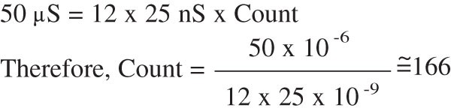
Calculations for Generating Waveforms
Write a program to generate a square wave of 10KHz freq. by turning Bit0 of PORT C ON & OFF using a 40 MHz clk (25 nsec)
LOOP1:
DECF BNZ
REG10,1 LOOP1
;Decrement REG10 - 1W/1C/4CLK
;Go back to LOOP1 if REG 10 =/ 0
□ To generate 50 µS delay, count:
Number of times the program should loop
50 usec
100 usec

Slide 43
Calculations for Generating Waveforms
Write a program to generate square wave of 10KHz freq. by turning Bit0 of PORT C using a 40 MHz clk (25 nsec)
BSF
DECF BNZ
PORTB,0
REG10,1 LOOP1
LOOP1:
;Decrement REG10 - 1W/1C/4CLK
;Go back to LOOP1 if REG 10 =/ 0
BCF PORTB,0
□ To generate 50 µS delay, count:
Number of times the program should loop
50 usec
100 usec

Slide 44
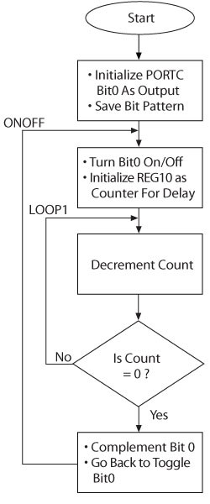
Generating Waveforms
REG1 EQU REG10 EQU
0x01
0x10
;Address of Data Register1
;Address of Data Register10
ORG MOVLW MOVWF MOVWF
0x20 B'11111110' TRISC REG1
START:
;Load number to set up BIT0 as an output
;Initialize BIT0 as an output pin
;Save Bit pattern in REG1
ONOFF:
MOVFF MOVLW MOVWF
REG1,PORTC D'166'
REG10
;(8 Clk)-Turn on/off BIT0
;(4 Clk) -Load decimal count in W
;(4 Clk) Set up REG10 as a counter
LOOP1:
DECF BNZ
REG10, 1 LOOP1
;(4 Clk) - Decrement REG10
;(8/4 Clk)-Go back to LOOP1 if REG 10 not equal 0
COMF BRA END
REG1,1 ONOFF
;(4 Clk)-Complement Bit Pattern
;(8 Clk)-Go back to change LED

Slide 45
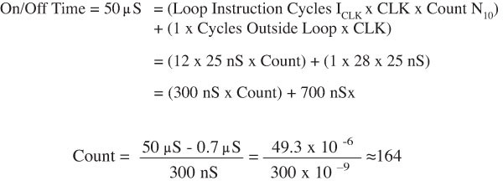
Delay Recalculations to Account
for Outside Instructions – Single Loop

Slide 46
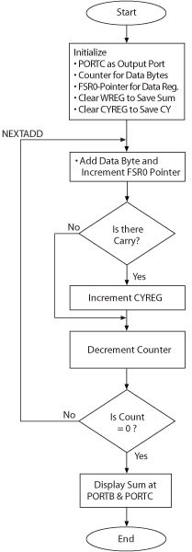
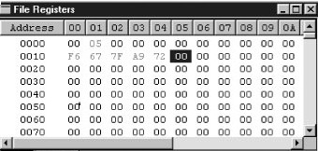
Adding a Block of Data (P.163)
Add five data bytes stored in data registers
(0x10-0x14). The sum should be displayed at PORTB and PORTC.
Use FSR0 – Pointer
Use a carry register: CYREG
Assume values are given:

Slide 47












Adding a block of numbers
□
0005 000000
0006 000000
0007 000000
0008 000000
0009 000000
BUFFER COUNTER CYREG
EQU EQU
EQU 0X02
0x10
0X01
;Define the beginning data register address
;Set up register 01 as a counter
□
Initi□alize
□
□
Initi□alize
ORG
0x20
;Begin assembly at 0020H
Port□s
0010 | 000020 0E00 | START: | MOVLW | 0x00 | ;Byte to initialize port as an output port
0011 | 000022 6E93 |  | MOVWF | TRISB | Initialize Ports B &C as an output ports
□
0012 000024 6E94
0013 000026 0E05
0014 000028 6E01
0015 00002A 6A02
00002C EE00
0016 00002E F010
0017 000030 0E00
MOVWF MOVLW MOVWF CLRF LFSR
TRISC 0X05 COUNTER CYREG
FSR0,BUFFER
□
□
;Count for five bytes
;Set up counter
;Clear carry register
;Set up FSR0 as pointer for data registers
□
Set t□he Ptr0016
□
□
MOVLW ADDWF BNC INCF DECF BNZ MOVWF MOVFF
0x00 POSTINC0,W SKIP
CYREG COUNTER,1,0 NEXTADD PORTC
CYREG, PORTB
;Clear W register to save sum
;Add byte and increment FSR0
;Check for carry-if no carry jump to SKIP (branch if C=0)
;If there is carry, increment CYREG
;Next count and save count in register
;If COUNT =/ 0, go back to add next byte
;Display low-order byte of sum at PORTC
;Display high-order byte of sum at PORTB
Mov□e the P⁰⁰t¹r⁸
000032 24EE
0019 000034 E301
NEXTADD:
□
0020 000036 2A02
0021 000038 0601 SKIP:
0022 00003A E1FB
0023 00003C 6E82
0024 00003E C002
0024 000040 FF81
0025 000042 0003
0026 000044
□
□
□
□
□
□
□
□
□
□
SLEEP END
---------------------------------------------
Number of errors = 0
How do you modify to make the BUFFER size variable?
Lab:
Assume the total is less than 2FFFF and we can only display two byes Using PORT B and C
Modify the program to calculate the sum of registers 10-19 If the sum is zero set bit 0 of PORTA
If the sum>50H set bit 1 of PORT A

Slide 48
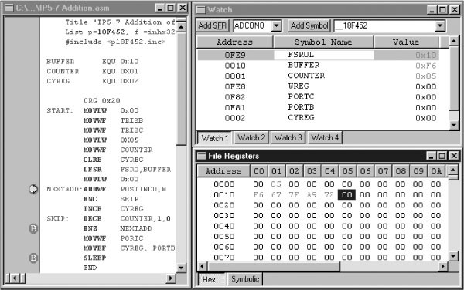
Heading and Include files must be included:
Displaying Breakpoints

Slide 49
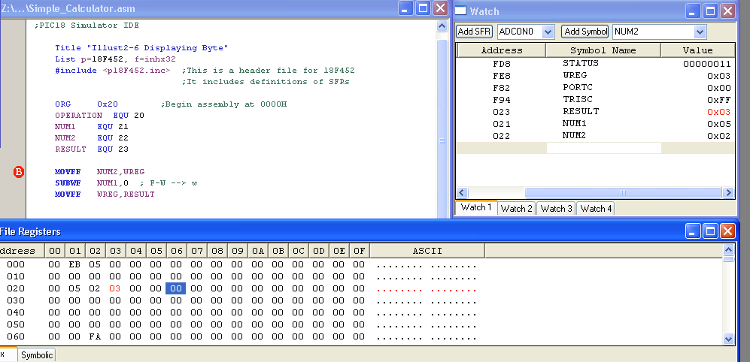
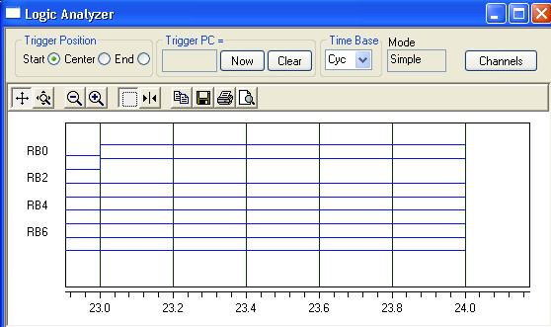
Using the Logic Analyzer
Problem: 5-2→→3 going to REG3
Results
Directed to PortB
RB0 RB1 RB2 RB3
….
….

Slide 50
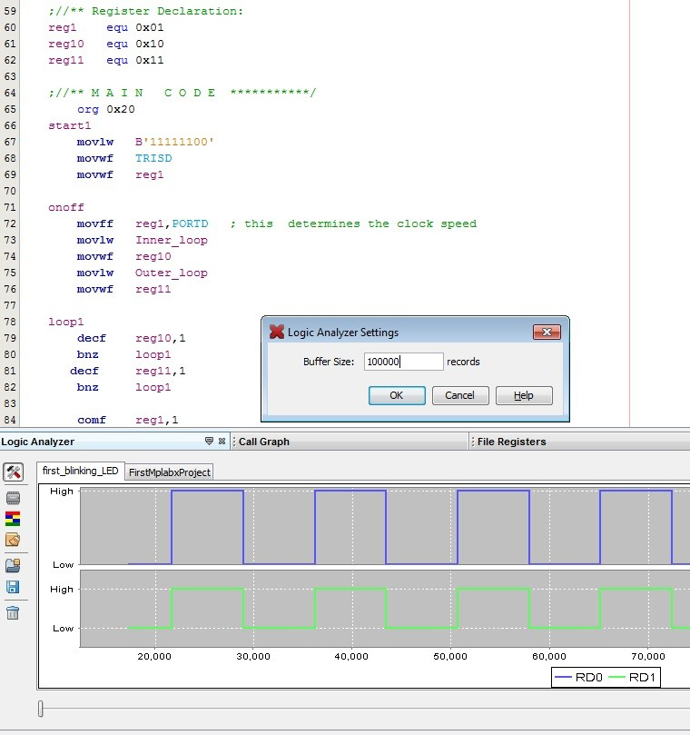

Slide 51
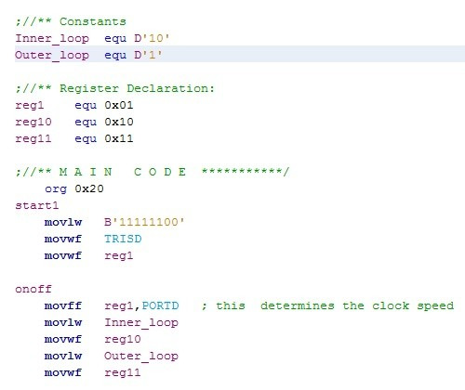
Good Programing

Slide 52
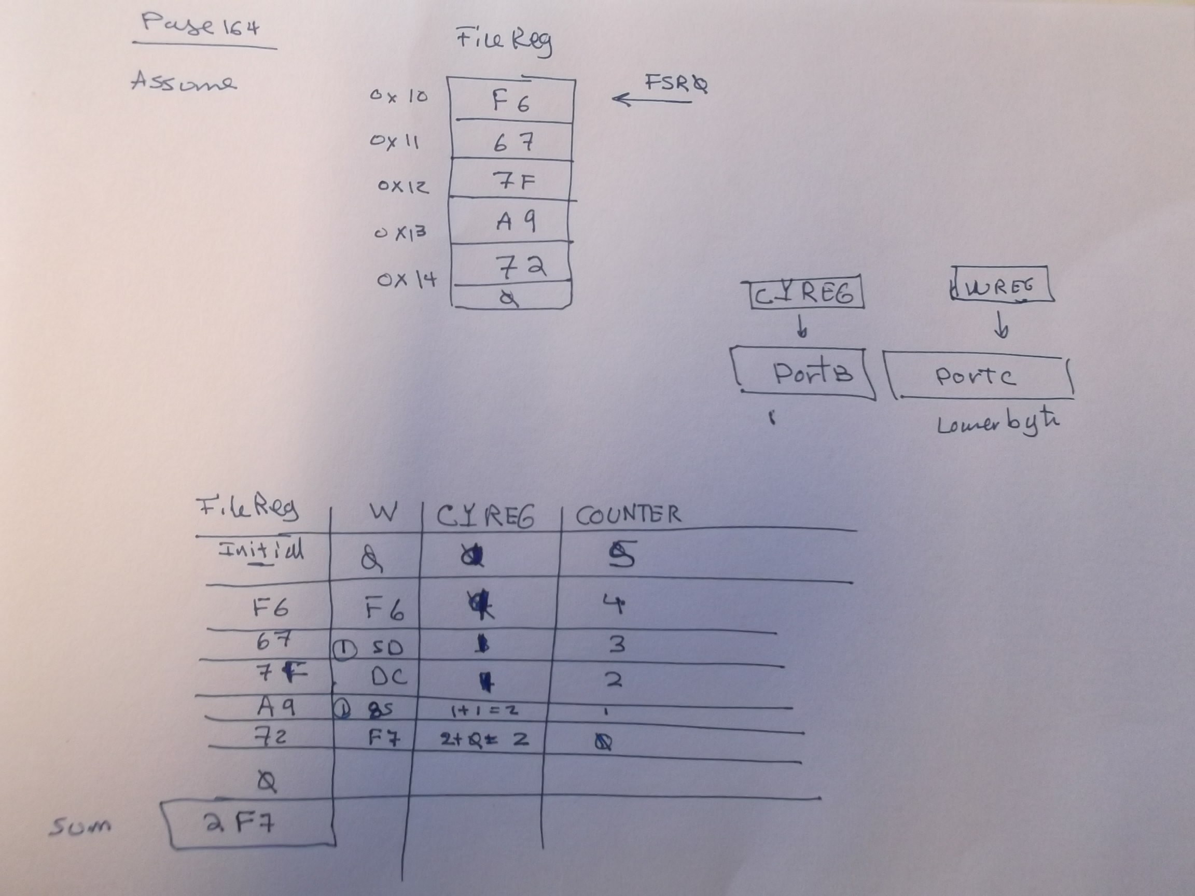
Example on page 164 – Hide it

