Slide 1
Chapter 9
Input/Output (I/O) Ports and Interfacing
Updated: 3/13/12

Slide 2
Basic Concepts in I/O Interfacing and PIC18 I/O Ports (1 of 2)
 I/O devices (or peripherals) such as LEDs and keyboards are essential components of the microprocessor-based or microcontroller-based systems.
 Classified into two groups
 input devices
 output devices

Slide 3
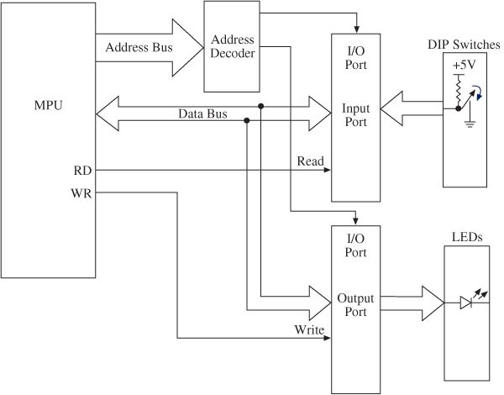
Block Diagram of I/O Interfacing
Buffer
Access one port at a time 8-bit registers
I/O ports are associated with a SFR Each port is associated with 3 registers:
PORT / LAT / TRIS
Latch

Slide 4
I/O Ports:
Interfacing and Addressing
 To read (receive) binary data from an input peripheral
 MPU places the address of an input port on the address bus, enables the input port by asserting the RD signal, and reads data using the data bus.
 To write (send) binary data to an output peripheral
 MPU places the address of an output port on the address bus, places data on data bus, and asserts the WR signal to enable the output port.
 Remember:
 Writing to the port
 When the MPU sends out or transfers data to an output port
 Reading from the port
 When the MPU receives data from an input port

Slide 5
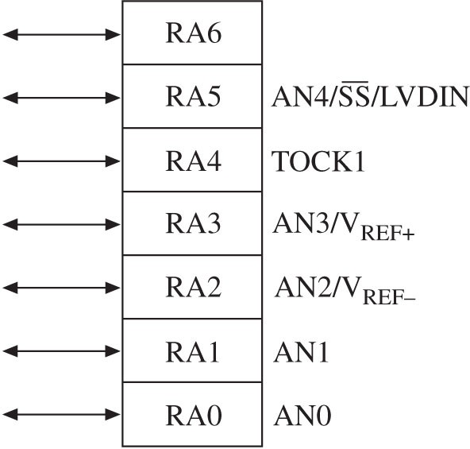
PIC18F452/4520 I/O Ports (1 of 5)
 MCU includes five I/O ports
 PORTA, PORTB, PORTC, PORTD, and PORTE
 Ports are multiplexed meaning they can be set up by writing instructions to perform various functions
PORTA: Example of Multiple Functions
 Digital I/O: RA6-RA0
 Analog Input: AN0-AN4

V _{REF}+ : A/D Reference Plus
Voltage
 V _{REF}- : A/D Reference
 Minus Voltage
 TOCK1: Timer0 Ext. Clock
 SS: SPI Slave Select Input
 LVDIN: Low voltage Detect Input

Slide 6
PIC18F452/4520 I/O Ports (2 of 5)
 Each I/O port is associated with the special functions registers (SFRs) to setup various functions.
 Can be set up as entire ports or each pin can be set up.
 PORT: This register functions as a latch or a buffer determined by the logic levels written into the associated TRIS register.
 TRIS: This is a data direction register. Writing logic 0 to a pin sets up the pin as an output pin, and logic 1 sets up the pin as an input pin.
 LAT: This determines if port is bidirectional .

Slide 7
PIC18F452/4520 I/O Ports (3 of 5)
 Internal block diagram of PORTB includes:
 Three internal D flip-flops (latches)
 Data latch to output data
 TRIS latch to setup data direction
 Input latch for input data

Slide 8
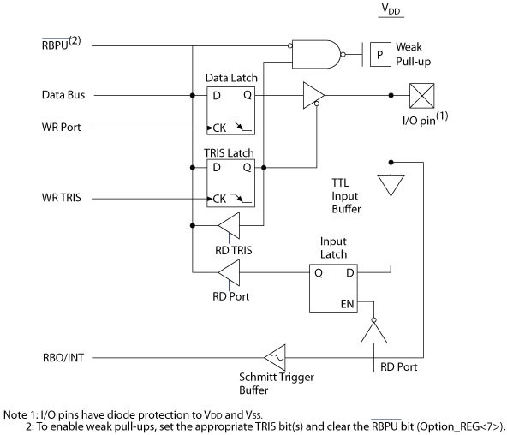
PIC18F452/4520 I/O Ports (4 of 5)
 PORTB Internal Block Diagram
Pull-up
Three internal D flip-flops (latches):
Data latch to output data TRIS latch to setup data
direction
Input latch for input data
A
Q- TRIS: 0 →→ A is enabled
Q- TRIS: 1 →→ A is disabled

Slide 9
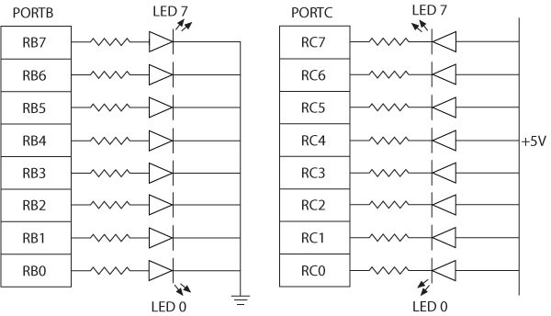
Interfacing Output Peripherals (1 of 2)
 Commonly used output peripherals in embedded systems are
 LEDs, seven-segment LEDs, and LCDs; the simplest is LED
 Two ways of connecting LEDs to I/O ports:
 LED cathodes are grounded and logic 1 from the I/O port turns on the LEDs - The current is supplied by the I/O port called current sourcing.
 LED anodes are connected to the power supply and logic 0 from the I/ O port turns on the LEDs - The current is received by the chip called current sinking.
Common Cathode
Active high
Common Anode
Active low

Slide 10
Interfacing Seven-Segment LEDs as an Output (1 of 4)
 Seven-segment LEDs
 Often used to display BCD numbers (1 through
9) and a few alphabets
 A group of eight LEDs physically mounted in the shape of the number eight plus a decimal point as shown in Figure 9-5 (a)
 Each LED is called a segment and labeled as
ʻaʼ through ʻgʼ.

Slide 11
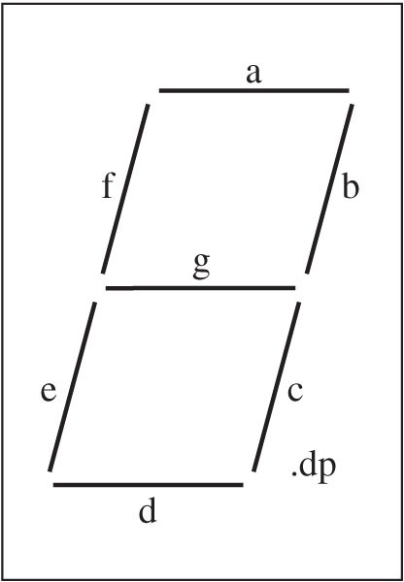
Interfacing Seven-Segment LEDs as an Output (2 of 4)
 Two types of seven- segment LEDs
 Common anode
 Common cathode
decimal point

Slide 12
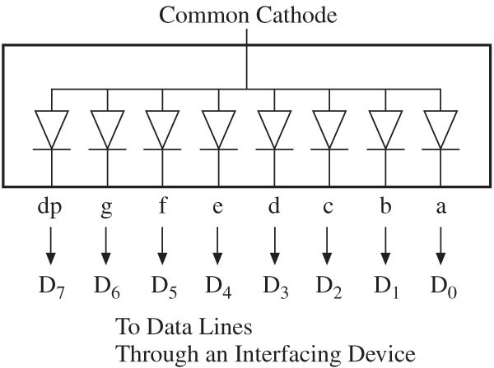
Interfacing Seven-Segment LEDs as an Output (3 of 4)
5V (Common Anode)
 In a common anode seven- segment LED
 All anodes are connected together to a power supply and cathodes are connected to data lines
 Logic 0 turns on a segment.
 Example: To display digit 1, all segments except b and c should be off.
 Byte 11111001 = F9H will display digit 1.

Slide 13
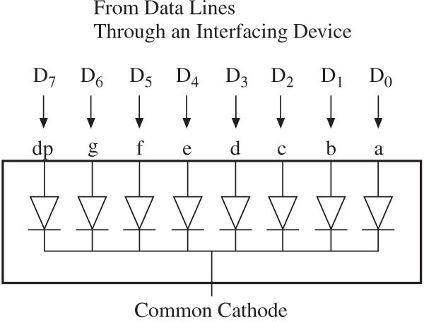
Interfacing Seven-Segment LEDs as an Output (4 of 4)
 In a common cathode seven-segment LED
 All cathodes are connected together to ground and the anodes are connected to data lines
 Logic 1 turns on a segment.
 Example: To display digit 1, all segments except b and c should be off.
 Byte 00000110 = 06H will display digit 1.
GND (Common Cathode)

Slide 14
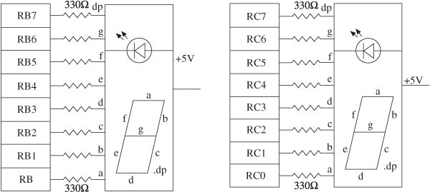
Segment LEDS to PORTB and
PORTC

Slide 15
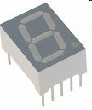
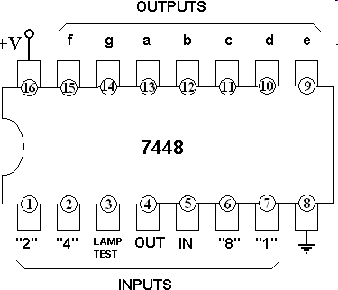
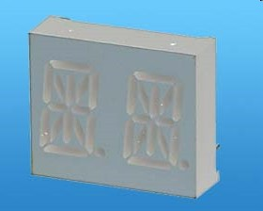
Seven-Segment Chips
ALPHA/ NUMERIC C/A DISPLAY

Slide 16
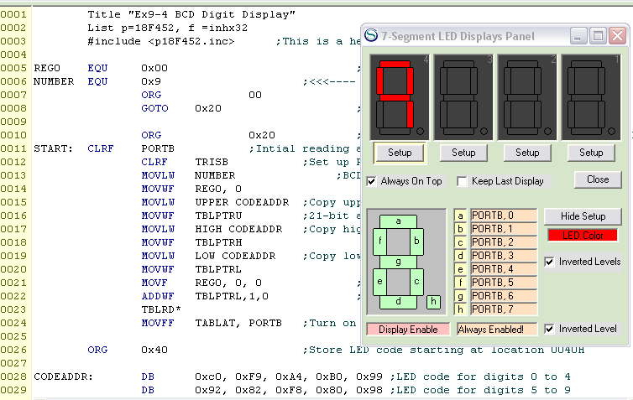
Sample Program

Slide 17
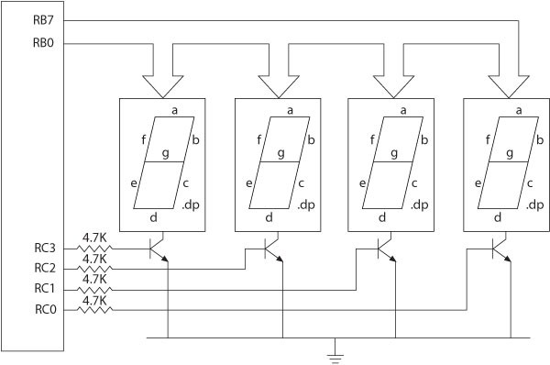

Interfacing to Multiple 7-Segments

Slide 18
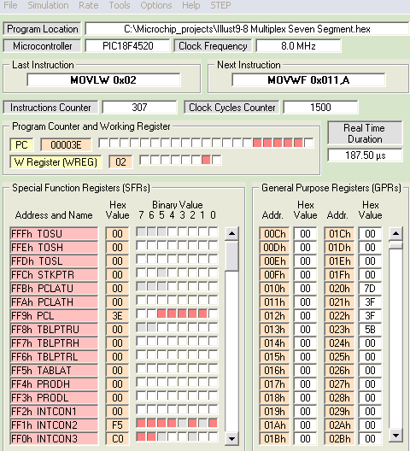
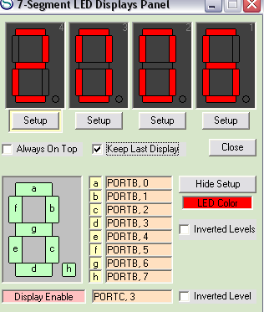
Using the Simulator

Slide 19
Interfacing Input Peripherals
 Commonly used input peripherals in embedded systems are:
 DIP switches, push-button keys, keyboards, and A/D converters.
 DIP switch: One side of the switch is tied high (to a power supply through a resistor called a pull-up resistor), and the other side is grounded. The logic level changes when the position is switched.
 Push-button key: The connection is the same as in the DIP switch except that contact is momentary.

Slide 20
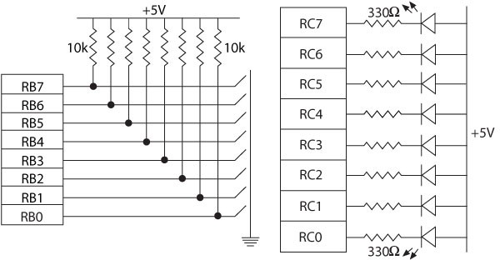
Interfacing Dip Switches and Interfacing LEDs

Slide 21
Driving an LED
 Transistor inverter acting as the driver
 Assume LED requires 3.5 Volts and 20 mA
 2N2222 is Current Amplifier →→ generates collector current
(multiplies base-current)
 In this case the current gain is 100!
 Note Vbe=0.7
+12V
8.5 V
8.5 V
R1 430
20 mA
D1
3.5 V
4.3-0.7
3.6 V
R2
20 mA
4.3 V minimum
3.0 mA maximum
Q1
2N2222
18K
Port Pin
0.2 mA
3.6 V
0.2 mA
3.6/18000

Slide 22
Driving a RELAY & SOLENOID
 Controlling appliances
 Driving solenoid
+12V
LS1 RELAY
SPDT
DS1
+5V
3
5
25 Watt Lamp
Solenoid
4
1
2
1
2
R1
Q1 2N2222A
D1
R1
Q1 MPSA13
D1
RB0
RB0
5.6K
5.6K

Slide 23
Example: Reading from an I/O Port
 The instruction: MOVF PORTB, W reads from PORTB.
 To execute the instruction, the MPU does the following:
 Reads the instruction from memory
 Places the address of PORTB (F81H) on the address bus of data memory
 Selects PORTB
 Asserts the RD signal and enables PORTB
 Reads logic levels (1/0) of the switches and places on the data bus
 Saves the reading in the WREG

Slide 24
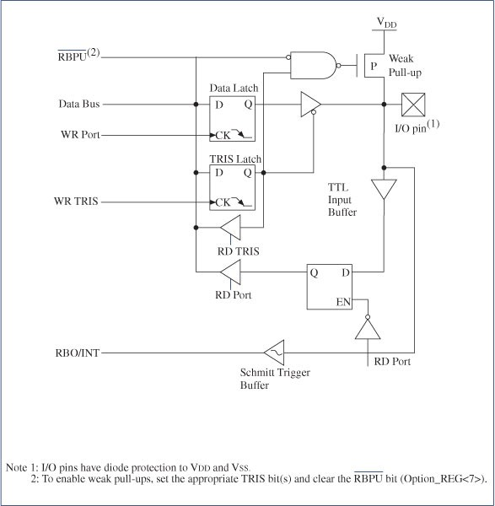
Internal Pull-Up Resistor (1 of 2)
 The pull-up resistors are connected externally.
However, PORTB can provide equivalent resistors internally through initialization.
 Turning off the internal FET is equivalent to providing a pull-up resistor.

Slide 25
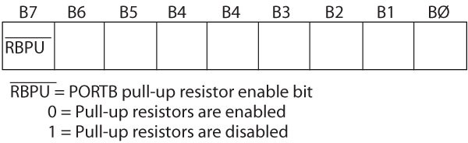
Internal Pull-Up Resistor (2 of 2)
 Bit7 (RBPU) in the INTCON2 register enables or disables the pull-up resistor
 Instruction to Enable Pull Up Resistors: BCF INTCON2 7, 0
C Code: INTCON2bit.RBPU = 0 // pull-ups on

Slide 26
Interfacing Push-Button Keys (1 of 2)
 Electrical connection of a push-button key is same as that of a DIP switch except that the connection is temporary when the key is pressed.
 When a key is pressed (or released), mechanical metal contact bounces and can be read as multiple inputs.
 The reading of one contact as multiple inputs can be eliminated by a key-debounce technique, using either hardware or software.

Slide 27
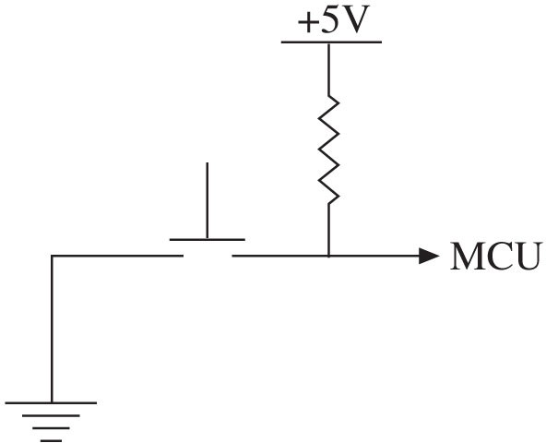
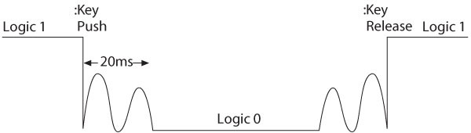
Interfacing Push-Button Keys (2 of 2)
(a)
(b)

Slide 28
Various Switches
VCC
VCC
10K
10K
1 2
SPST Toggle Switch
SPST Pushbutton Switch
SPST Toggle Switch
SPST Pushbutton Switch
VCC
VCC
10K
10K
SPDT Toggle Switch
SPDT Pushbutton Switch
SPDT Toggle Switch
SPDT Pushbutton Switch
VCC
VCC
10K
10K
DPDT Pushbutton Switch
DPDT Toggle Switch
DPDT Pushbutton Switch
DPDT Toggle Swtich

Slide 29
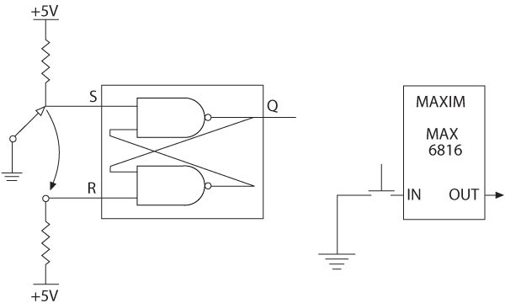
Key Debounce Techniques
 Hardware technique
 Two circuits, based on the principles of generating a delay and switching the logic level at a certain threshold level.
 Two NAND gates connected back to back, equivalent of a S-R latch. The output of the S-R latch is a pulse without a bounce.
 An integrated circuit (MAX 6816) that bounces the key internally and provides a steady output.

Slide 30
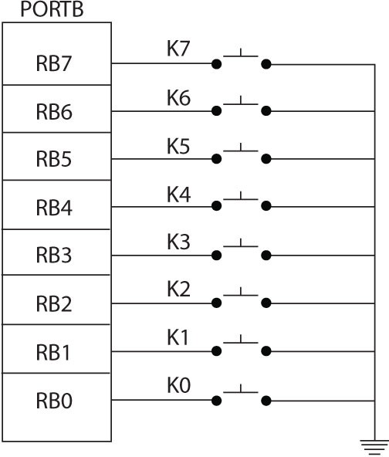
Illustration:
Interfacing Push-Button Keys (1 of 6)
 Problem statement
 A bank of push-button keys are connected as inputs to PORTB.
 The pull-up resistors are internal to PORTB.
 Write a program to recognize a key pressed, debounce the key, and identify its location in the key bank with numbers from 0 to 7.

Slide 31
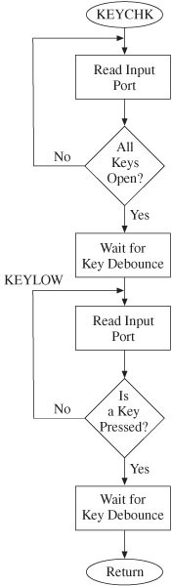
Interfacing Push-Button Keys (3 of 6)
 Hardware
 PORTB should be set up as input port
 Internal pull-up resistors should be enabled
 Software
Alternatively
 Checking a key closure Debouncing the key
 Encoding the key

Slide 32
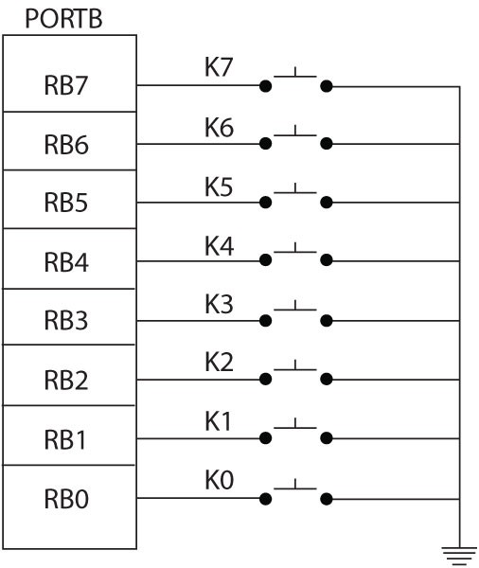
Interfacing Push-Button Keys
- Software Debounding
 Checking a key closure
 When a key is open, the logic level is one (assuming pull-ups are enabled) and when it is closed, the logic level is zero.
 When all keys are open, the reading will be 0xFF, and when a key is closed, the reading will be less than 0xFF.
 Therefore, any reading less than FFH indicates a key closure.
 This will be the first read!
 Debouncing the key
 Software technique
 Wait for 20 ms.
 Read the port again.
 If the reading is still less than FFH, it indicates that a key is pressed.
 Encoding the key
 Key closure can be identified by rotating the reading right and looking for ʻNo Carryʼ and counting the rotations

Slide 33
Software Debouncing –
Used for Active LOW!



















// >>> Donʼt forget the #include <delays.h> statement <<<
// ************************ Switch *******************************
// to use this function, make sure that it is invoked as follows
//
// Switch( 0x04 ) ←← switch on bit 2
//
// or
//
// Switch( 0x40 ) ←← switch on bit 6
//
// or
//
// Switch( 0x03 ) ←← switches on bits 0 and 1
//
Switch(0x22)
0010 0010
Bits 1 or 5 is activated
// ********************** CONSTANTS ******************************
#define KEYPORT PORTA #define DELAY 15
void Switch( char bit )
// change to match the actual port
// change as needed for time delay – 15 msec.
{
   |  | do { | // wait for release while ( ( KEYPORT & bit ) != bit );
  |  | } | Delay1KTCYx(DELAY);
 |  |  | while( ( KEYPORT & bit ) != bit );
   |  | do { | // wait for press while ( ( KEYPORT & bit ) == bit );
  |  | } | Delay1KTCYx(DELAY);
 | } |  | while( ( KEYPORT & bit ) == bit );

Slide 34
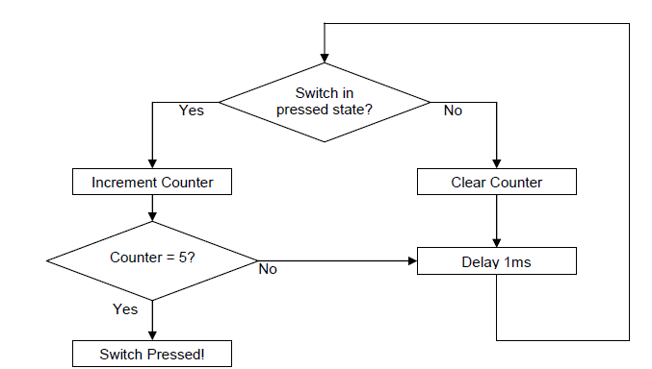
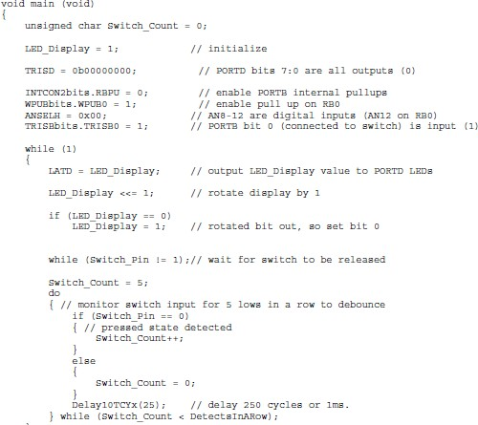
Software Debouncing – Used for Active LOW!
Another Example
#define Switch_Pin PORTBbits.RB0 The demo board switch is connected to I/O pin RB0, which is normally pulled up to VDD internally. When the switch is pressed, it pulls RB0 to ground (low state).

Slide 35
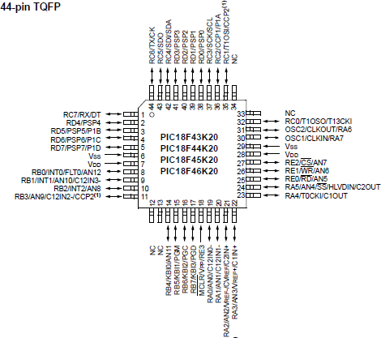
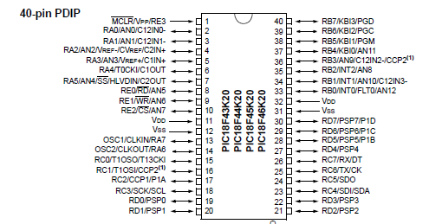
PIC18F46K20 Pin Diagram

Slide 36
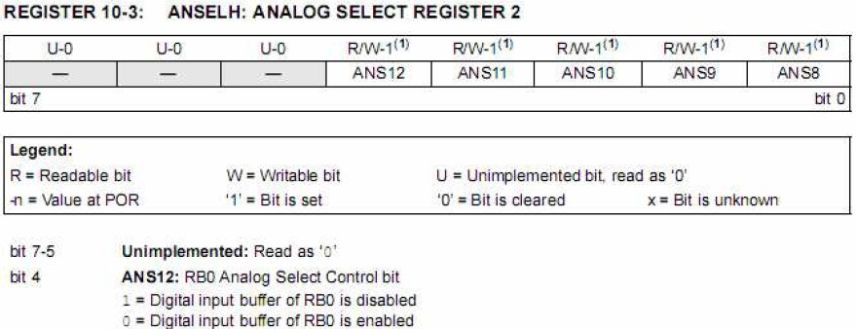
Digital Input Port
Interrupt Control Weak Pull Up
Analog Sel
PIC18F46K20
Pins are configured as analog or digital in the SFRs ANSEL and ANSELH

Slide 37
Class Exercise
 Find the following bits in the Data Sheet:
 http://ww1.microchip.com/downloads/en/ DeviceDoc/41303G.pdf

Slide 38
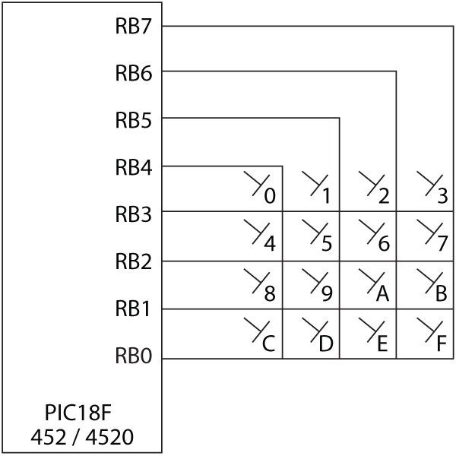
Interfacing a Matrix Keyboard
1 | 2 | 3
4 | 5 | 6
7 | 8 | 9
10 | 0 | 11
0 | 4 | 8
1 | 5 | 9
2 | 6 | 10
3 | 7 | 11
Actual Keyboard
Keyboard as seen by software before the lookup table
VCC
Telephone-style 4x3 Keyboard
10K
RA0
RA3 RB0
RB2
1 |  | 2 |  |  | 1 |  | 2 |  |  | 1 |  | 2
 | 1 |  |  |  |  | 2 |  |  |  |  | 3
1 |  | 2 |  |  | 1 |  | 2 |  |  | 1 |  | 2
 | 4 |  |  |  |  | 5 |  |  |  |  | 6
1 |  | 2 |  |  | 1 |  | 2 |  |  | 1 |  | 2
 | 7 |  |  |  |  | 8 |  |  |  |  | 9
1 |  | 2 |  |  | 1 |  | 2 |  |  | 1 |  | 2
 | * |  |  |  |  | 0 |  |  |  |  | #

Slide 39
Interfacing a Matrix Keyboard
 Software
 To recognize and encode the key pressed, the program should:
 Ground all the columns by sending zeros.
 Check each key in a row for logic zero.
 Ground one column at a time and check all the rows in that column.
 Once a key is identified, it is encoded based on its position in the column.

Slide 40
Matrix Keyboard Software



























//
// key codes for a telephone style keypad
// stored as static constants in the program memory
//
1 | 2 | 3
4 | 5 | 6
7 | 8 | 9
10 | 0 | 11
rom near char lookupKey[] =
{
1, 4, 7, 10,
2, 5, 8, 0,
3, 6, 9, 11
};
//
// uses function Switch
//
unsigned char Key(void)
{
#define MASK 0x0f #define ROWS 4 char a;
char keyCode;
PORTB = keyCode = 0; Switch( MASK ); PORTB = 0xFE;
// left column
// middle column
// right column
// set mask
// set number of rows
//clear Port B & keyCode
// de-bounce and wait for any key
// select a leftmost column
while ( ( PORTA & MASK ) == MASK ) // while no key is found
{
PORTB = (PORTB << 1) | 1;
keyCode += ROWS;
// get next column
// add rows to keycode
  |  | } for ( a = 1; a != 0; a <<= 1)
 |  | {
  |  | if ( ( PORTA & a ) == 0 ) break;
  |  | keyCode++; }
 |  | return lookupKey[keyCode]; // lookup correct key code
 | }
// find row

Slide 41
7-Segment Interface
+5V
R3 R2 R1 3.9K 10K 10K
C3
0.1 uF
SW1
U1
14
U2
20
330
1
2
RA0 RBO
RA1 RB1
RA2 RB2
RA3 RB3
RA4 RB4 #MCLR RB5 OSC1 RB6
OSC2 RB7
8 | 2
9 | 4
17 | 6
18 | 8
10 | 11
11 | 13
12 | 15
13 | 17
 | 1
A1 A2 A3 A4 A5 A6 A7 A8
Y1 Y2 Y3 Y4 Y5 Y6 Y7 Y8
18
16
VDD
VCC
COUNT
6
7
14
12
3
4
9
7
16
15
VSS
5
3
PIC18F1220
5
19
1OE
2OE
GND
C2 30 pF
C1
1.0 uF
74LS244
10

Slide 42

















































// ***************** program memory data ************************** rom near char look7[] = // 7-segment lookup table
{
0x40,
0x79,
0x24,
0x30,
0x19,
0x12,
0x02,
0x78,
0x00,
0x10
// 0
// 1
// 2
// 3
// 4
// 5
// 6
// 7
// 8
// 9
active low signals x g f e d c b a
7-Segment
Control Software with De-bounce →→
};
// ***************** data memory data ***************************** int count;
#pragma code
// *****************de-bounce functions ************************************
Each time the input is
void Switch( char bit )
{
do
{
Pressed the number Shown by the 7-segemnt Increments!
// wait for release
while ( ( PORTA & bit ) != bit ); Delay1KTCYx(30);
// 15 ms delay
}while( ( PORTA & bit ) != bit );
do // wait for press
{
while ( ( PORTA & bit ) == bit ); Delay1KTCYx(30);
}
}while( ( PORTA & bit ) == bit );
// ***************** main program ********************************* void main (void)
{
ADCON1 = 0x7F; TRISA = 1;
TRISB = 0;
count = 0;
// Port A, bit 0 is input
// Port B is output
// start count at zero
// Ports A and B are digital
while ( 1 )
{
PORTB = look7[count]; Switch( 1 );
count++;
if ( count >= 10 )
count = 0;
// main loop
// display number
// wait for pushbutton
}
}

Slide 43
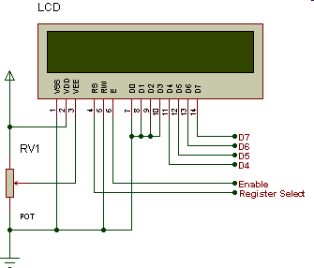
Interfacing LCD (Liquid Crystal Display)
 Problem statement
 Interface a 2-line x 20 character LCD module with the built-in HD44780 controller to I/O ports of the PIC18 microcontroller
 Multi-LCDs refer to LCDs with different interfaces

Slide 44
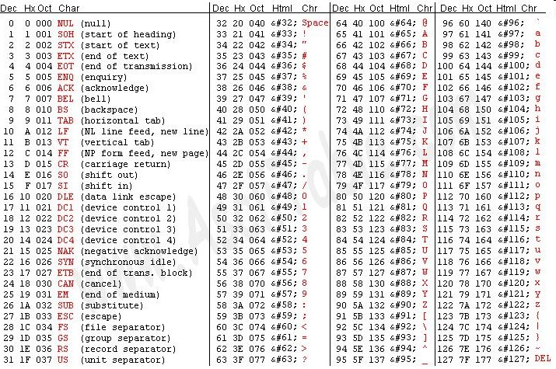
Converting to ASCII
 The LCD can represent characters in ASCII
 For example number 0x08 →→ must be converted to 0x38
 To perform this:
 If W=0x08 then ASCII=XORLW 0x30→→W=38

Slide 45
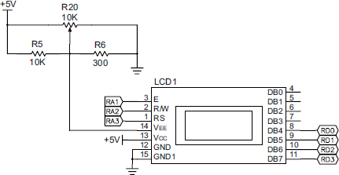

Interfacing LCD
 Hardware
 20 x 2-line LCD displays (two lines with 20 characters per line)
 LCD has a display Data RAM (registers) that stores data in 8-bit character code.
 Each register in Data RAM has its own address that corresponds to its position on the line.
 The address range for Line 1 is 00 to 13H and Line 2 is 40H to 53H.
PICDEMO
0x38
0x00
0x39
0x013
0x014
8
0x38
0x040
8
2x20
0x053

Slide 46
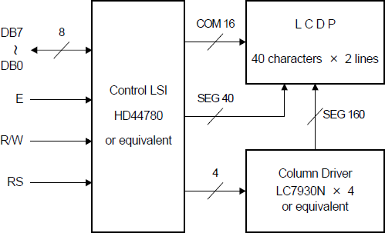
Interfacing LCD
 Driver HD77480
 Three control signals:
 RS – Register Select (RA3)
 R/W – Read/Write (RA2)
 E – Enable (RA1)
 Three power connections
 Power, ground, and the variable register to control the brightness

Slide 47
Interfacing LCD
 Can be interfaced either in the 8-bit mode or the 4-bit mode
 In the 8-bit mode, all eight data lines are connected for data transfer
 In the 4-bit mode, only four data lines (DB7-DB4 or DB3-DB0) are connected and two transfers per character (or instruction) are needed
 Driver (HD77480) has two 8-bit internal registers
 Instruction Register (IR) to write instructions to set up LCD
 Data Register (DR) to write data (ASCII characters)
IR REGISTER
DR REGISTER

Slide 48
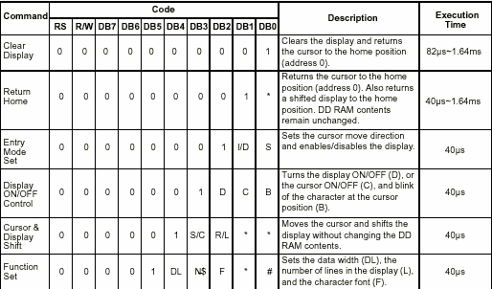
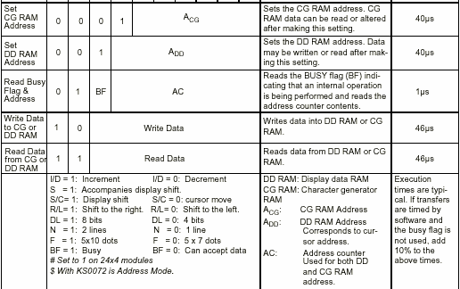
Command and Instruction set for
LCD type HD44780

Slide 49
Interfacing LCD
 LCD Operation
 When the MPU writes an instruction to IR or data to DR, the controller:
 Sets the data line DB7 high as a flag indicating that the controller is busy completing the operation
 Sets the data line DB7 low after the completion of the operation
 The MPU should always check whether DB7 is low before sending an instruction or a data byte
 After the power up, DB7 cannot be checked for the first two initialization instructions.

Slide 50
Interfacing LCD
 Writing to or reading from LCD
 The MPU:
 Asserts RS low to select IR
 Reads from LCD by asserting the R/W signal high
 Asserts the E signal high and then low (toggles) to latch a data byte or an instruction
 Asserts RS high to select DR
 Writes into LCD by asserting the R/W signal low
 Asserts the E signal high and then low (toggles) to latch a data byte or an instruction

Slide 51
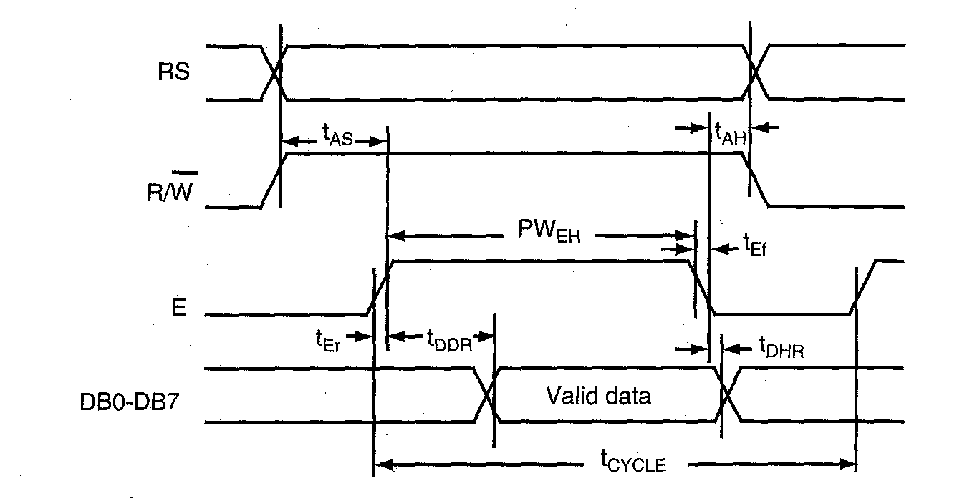
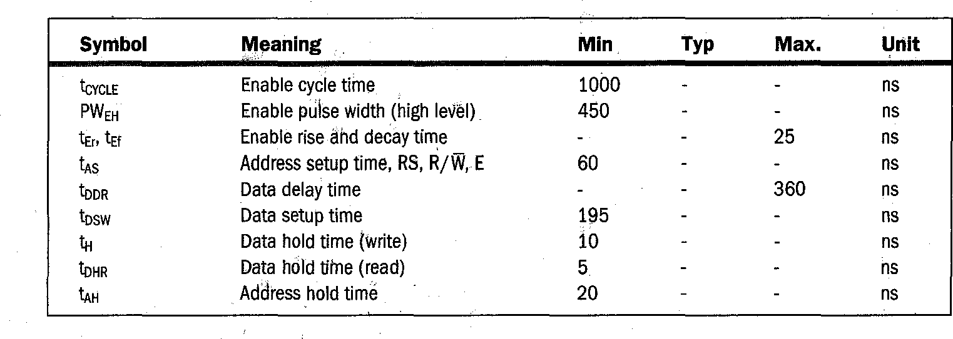
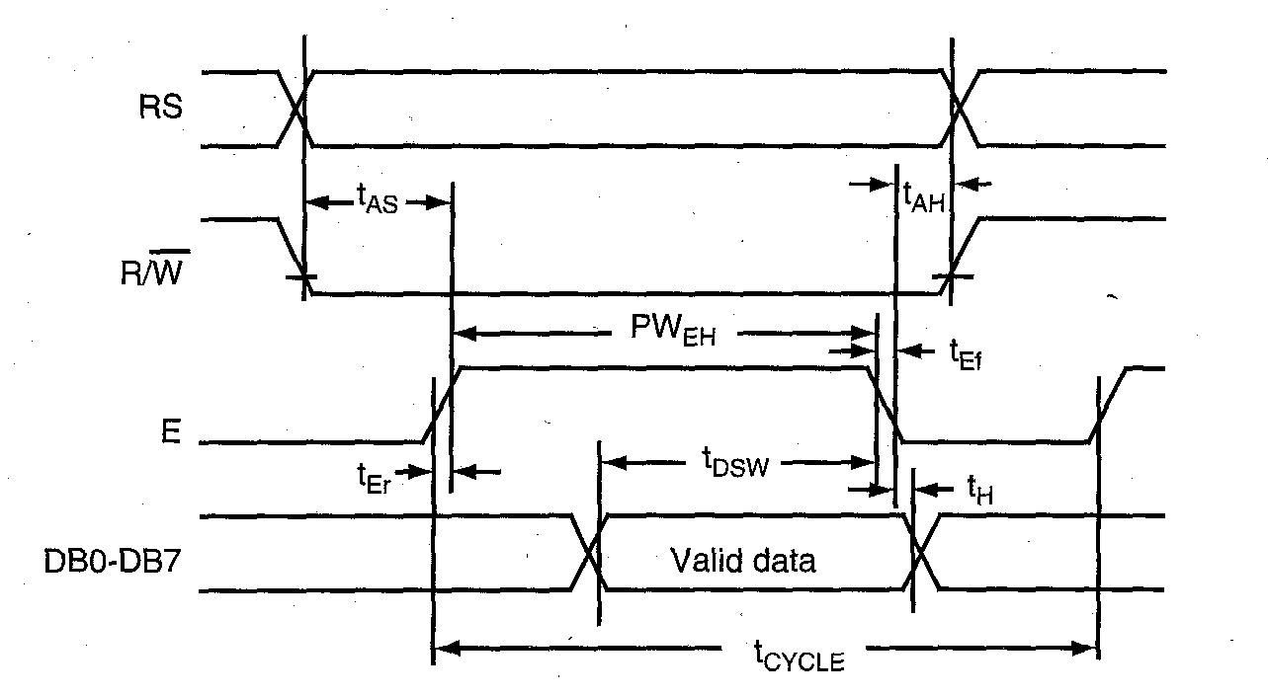
HD44780 Bus Timing
Read timing diagram
RS is asserted High
Asserts RS high to select DR
Writes into LCD by asserting the R/W signal low
Asserts the E signal high and
then low (toggles) to latch a data byte or an instruction
Write timing diagram

Slide 52
Interfacing LCD (Write)
 Software
 To write into the LCD, the program should:
 Send the initial instructions (commands) before it can check DB7 to set up the LCD in the 4-bit or the 8-bit mode.
 Check DB7 and continue to check until it goes low.
 Write instructions to IR to set up the LCD parameters such as the number of display lines and cursor status.
 Write data to display a message.

Slide 53
Resetting LCD
 In 4-bit mode the data is sent in nibbles
 First we send the higher nibble and then the lower nibble.
 To enable the 4-bit mode of LCD, we need to follow special sequence of initialization that tells the LCD controller that user has selected 4-bit mode of operation:
 Wait for about 20mS
 Send the first init value (0x30)
 Wait for about 10mS
 Send second init value (0x30)
 Wait for about 1mS
 Send third init value (0x30)
 Wait for 1mS
 Select bus width (0x30 - for 8-bit and 0x20 for 4-bit
 Wait for 1mS
http://www.8051projects.net/lcd-interfacing/commands.php

Slide 54
http://www.youtube.com/watch?v=tTym5apZwCE
http://video.google.com/videoplay?docid=7437543675646211278#

Slide 55
Organic LED
 Organic light-emitting diodes - OLEDs - emit light when a current flows through them
 Unlike conventional LEDs, OLEDs are made from layers of plastic and other organic (carbon-based) materials
 Very flexible!
 Applications: displays in MP3 players and phones
 Advantages:
 cheaper than the techniques required to make conventional LEDs.
 inherently thin
 can be made on flexible plastic substrates
 all colors, and multi-colors, are possible
 Disadvantages
 incredibly sensitive to moisture which leads to short life - glass blocks
all moisture, so displays made on a glass substrate and covered by a second glass sheet can have a long life, particularly if the edges are hermetically sealed
http://en.wikipedia.org/wiki/Organic_LED

Slide 56
Organic LED
 OLEDs are generally made of several layers
 A typical stack (variations are possible):
 Anode
 Electron donor
 Electron transport
 Emitter
 Hole transport
 Hole donor.
 Cathode

Slide 57
References
http://home.iae.nl/users/pouweha/lcd/ lcd0.shtml
Huang

