Slide 1
Data Converters

Slide 2
Data Converters:
Basic Concepts
□□ Analog signals are continuous, with infinite values in a given range.
□□ Digital signals have discrete values such as on/off or 0/1.
□□ Limitations of analog signals
 Analog signals pick up noise as they are being amplified.
 Analog signals are difficult to store.
 Analog systems are more expensive in relation to digital systems.

Slide 3
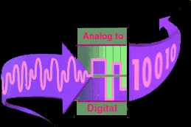
Data Converters: Basic Concepts
□□ Advantages of digital systems (signals)
 Noise can be reduced by converting analog signals in 0s and 1s.
 Binary signals of 0s/1s can be easily stored in memory.
 Technology for fabricating digital systems has become so advanced that they can be produced at low cost.
□□ The major limitation of a digital system is how accurately it represents the analog signals after conversion.

Slide 4
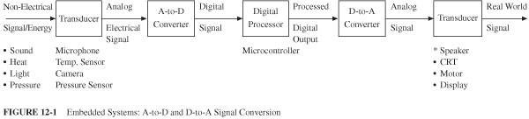
Embedded System
□□ A typical system that converts signals from analog to digital and back to analog includes:
 A transducer that converts non-electrical signals into electrical signals
 An A/D converter that converts analog signals into digital signals
 A digital processor that processes digital data (signals)
 A D/A converter that converts digital signals into equivalent analog signals
 A transducer that converts electrical signals into real life non-electrical signals (sound, pressure, and video)
So, how does A/D Converter works?

Slide 5
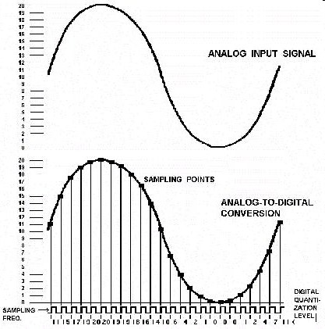
A/D Converter
□□ In order to change an analog signal to digital, the input analog signal is sampled at a high rate of speed.
□□ The amplitude at each of those sampled moments is converted into a number equivalent – this is called quantization.
□□ These numbers are simply the combinations of the 0s and 1s used in computer language – this called encoding.
http://www.cybercollege.com/tvp008.htm

Slide 6
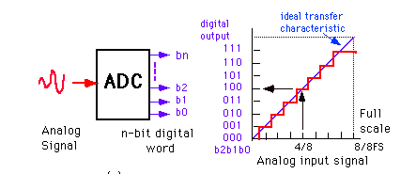
Analog-to-Digital
7/8
□□ A simple hypothetical A/D converter circuit with one analog input signal and three digital output lines with eight possible binary combinations: 000 to 111
 Shows the graph of digital output for FS V analog input
□□ The following points can be summarized in the above process:
 Maximum value this quantization process reaches is 7/8 V for a 1 V analog signal; includes 1/8 V an inherent error
 1/8 V (an inherent error) is also equal to the value of the Least Significant Bit (LSB) = 001.
 Resolution of a converter is defined in terms of the number of discrete values it can produce; also expressed in the number of bits used for conversion or as 1/2^{n} where n =number of bits
 The value of the most significant bit (MSB) -100- is equal to ½ the voltage of the full-scale value of 1 V.
 The value of the largest digital number 111 is equal to full-scale value minus the value of the LSB.
 The quantization error can be reduced or the resolution can be improved by increasing the number of bits used for the conversion

Slide 7
PIC18F4520 Analog-to-Digital (A/D) Converter Module (1 of 3)
□□ The PIC184520 microcontroller includes:
 10-bit A/D converter
 13 channels AN0 – AN12
 Three control registers
□□ ADCON0, ADCON1, and ADCON2

Slide 8
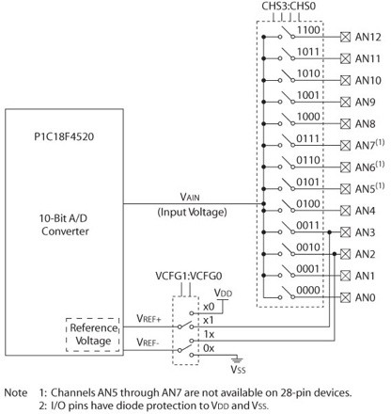
PIC18F4520 Analog-to-Digital (A/D) Converter Module (2 of 3)
ADCON0
□□ ADCON0, ADCON1, and ADCON2
□□ ADRESH and ADRESL
ADRESH/L
16-bit
VCFG0
VCFG1

Slide 9
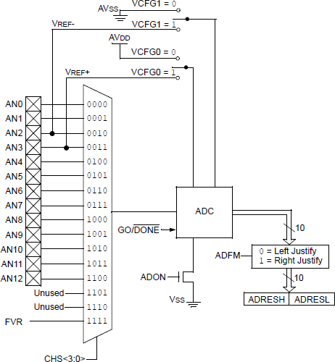
PIC18F2XK20/4XK20 Analog-to-
Digital (A/D) Converter Module (2 of 3)
VCFG1
□□ ADCON0, ADCON1, and ADCON2
□□ ADRESH and ADRESL
VCFG0 ADCON1
ADCON0
ADCON2
1.2V Fixed Voltage Reference (FVR)
Register: CM2CON1
ADCON0 CHSx
ADRESH/L
16-bit

Slide 10
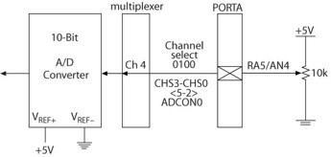
PIC18F4520 Analog-to-Digital (A/D) Converter Module (3 of 3)
□□ Three control registers are used to:
 Set up the I/O pins for analog signals from ports A, B, and E that are used as inputs for A/D conversion. RA5
 Select a channel: AN4
 Set up pins RA2 and RA3 to connect external V_{REF} + and V_{REF} - if specified in the control register ADCON1.
 Select an oscillator frequency divider through the control register ADCON2.
 Select an acquisition time through the control register ADCON2.
If the input is 0-1V→→ Vin=[0-1]: Option1: Vref+ & Vref- →→ 1V & GND
Option 2: Shift Vin to Vin’= Vin=[0-Vcc] and then Vref+ & Vref- →→ Vcc & GND

Slide 11
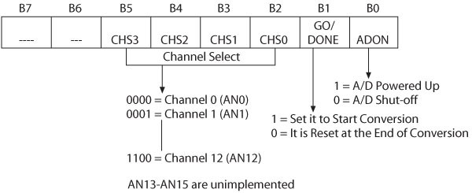
A/D Control Register0 (ADCON0)
□□ Primary function of the ADCON0 register:
 Select a channel for input analog signal
 Start a conversion
 Indicate the end of the conversion
□□ Bit1 is set to start the conversion, and at the end of the conversion this bit is reset.

Slide 12
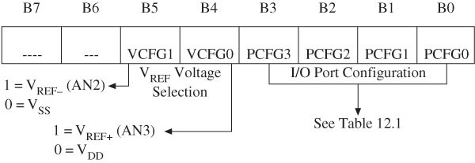
A to D Control Register1 (ADCON1)
□□ ADCON1 is primarily used to set up the I/O pins either for analog signal or for digital signals (see Table 12.2) and select V_{REF} voltages (see Table 12.1).

Slide 13

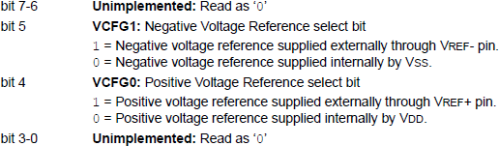
A to D Control Register1 (ADCON1)
□□ ADCON1 is primarily used to set up the I/O pins either for analog signal or for digital signals
Refer to ANSEL and ANSELH Registers to setup inputs as analog ports

Slide 14
A to D Control Register1 (ADCON1)
□□ ADCON1 is primarily used to set up the I/O pins either for analog signal or for digital signals
Refer to ANSEL and ANSELH Registers to setup inputs as analog ports

Slide 15

Selecting the Analog Port
ANSEL
PIC18F2XK20 devices: RE2
RE1 RE0
RA5 RS3 RA2 RA1
RA0 (bit 0)
RB6 RB4 RB1 RB3
RB0 (bit 0)

Slide 16
A to D Control Register2 (ADCON2)
(1 of 2)
□□ Used to:
 Select an acquisition time and clock frequency
 Right or left justify output reading
□□ The output reading, after a conversion, is stored in the 16-bit register ADRESH and ADRESL. However, this is a 10-bit A/D converter leaving six bit positions unused.
□□ Bit7 ADFM enables the user either to right justify or left justify the 16-bit reading leaving the unused positions as 0s.

Slide 17
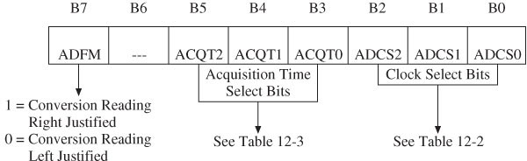
A to D Control Register2 (ADCON2)
(2 of 2)

Slide 18
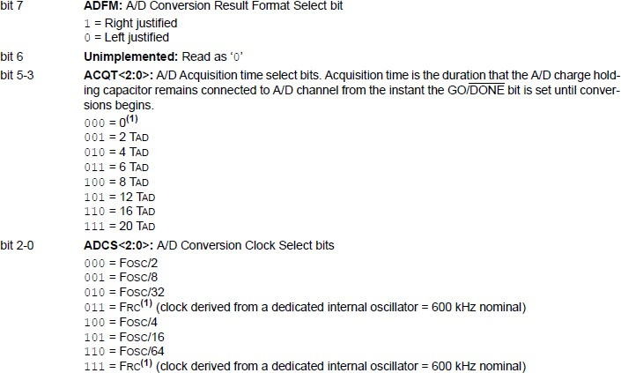
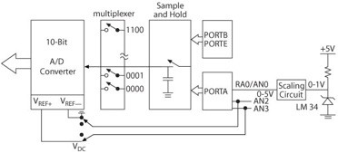
A to D Control Register2 (ADCON2)
(2 of 2)
TAD
TACQ
Note this is in Hz

Slide 19



Reading the OUTPUT Results
Left ustificatio
J
n
Right ustificatio
J
n

Slide 20
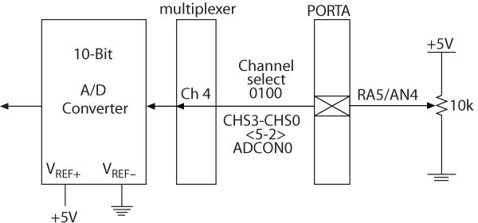
Example 12.3
□□ Interfacing a 10 k Pot
Refer to : ANSEL

Slide 21
Example
□□ Assumptions
 Use RE0 on the demo board.
 Use external oscillator
 Assuming conversion time (TAD) is 4 usec, what is the clock frequency requirement (ADCON2)
 Assume acquisition time is 48 usec. What will be the acquisition time setting?
 Write the program
□□ Set up the following registers properly:
 ADCON0, ADCON1, ADCON2.

