Slide 1
Introduction to SPI and I2C
Dr. Farid Farahmand

Slide 2
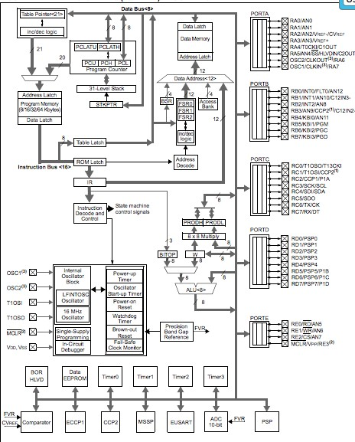

PIC Serial Interface

Slide 3
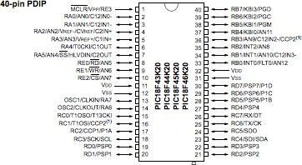

PIC Out for MSSP
(Master Synchronous Serial Port)

Slide 4
MSSP Module -­‐ SPI
Supports SPI and I2C Protocols
SPI: Serial Peripheral Interface
Applications: Interface to EEPROM, ADC, Sensors, LCD
Characteristics: Slower than parallel port, fewer signals
SPI General Operation:
4-­‐ Wire communication (clock, data in, data out, CS)
Synchronous →→ high speed interfaces can be handled
Master/Slave conﬁguration – the master chip controls all the slaves and provided clock
Uses serial data exchange protocols (MSB goes out ﬁrst)
Data exchange can be on rising or falling edge of the clock

Slide 5
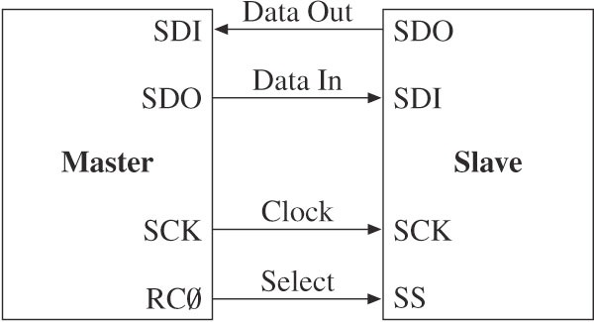
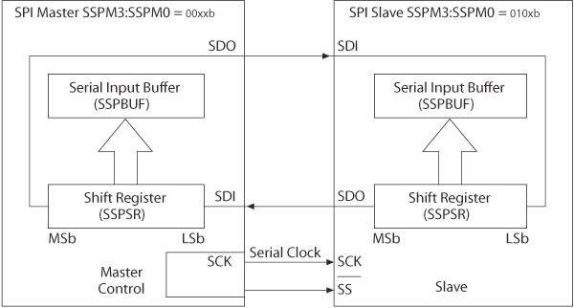

SPI Protocol Interface
RC4=
RC5=
RC3=
Write/Read Characters into SSPBUFF

Slide 6
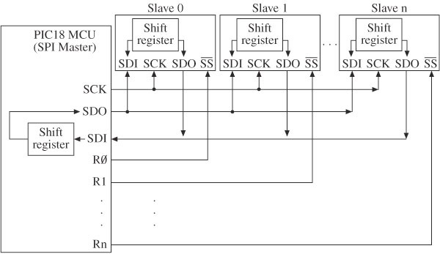
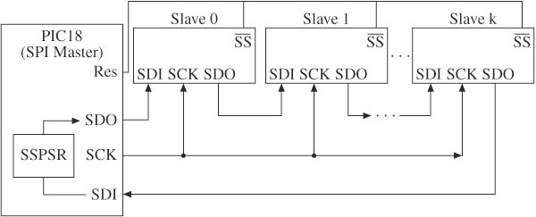
SPI Protocol Interface
RC4=
RC5=
RC3=
Data is being broadcasted to all chips

Slide 7
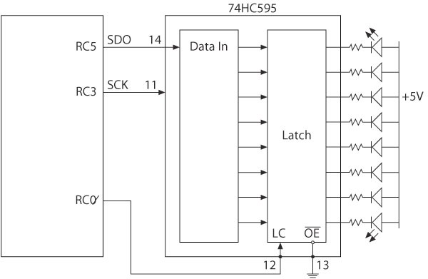
SPI Application Example
Registers: SSPCON1 SSPSTAT TRISC

Slide 8
SPI Programing Example
Assume:
Fosc = 10 MHz;
Data Transfer is 2.5 MHz
Data is sampled at the fallin
Data sent at the rising edge of the clock
Idle clock state is HIGH
What will be the conﬁguration for the Master and Slave Chips
Write the code to transmit characters
g edge of the clock

Slide 9

SPI Programing Example (solution)
Master Mode
SSPCON1 Register
Set to SPI Mater Mode Fosc/4 = 2.5 MHz
SSPCON1 bit.CKP = 1
SSPCON1 bit.EN = 1
– →→ SSPCON1 = 0011 0000
SSPSTAT Register
SSPSTAT bit.SMP = 0 ; rising edge; idle is high
SSPSTAT bit.CKE = 1
SSPSTAT bit.BF = 0
– →→ SSPSTAT = 0100 0000
TRISC Register
TRISCbit.SDO (RC5) = 0
TRISCbit.SDI (RC4) = 1
TRISCbit.SCK (RC3) = 0
TRISCbit.SS (RC0) = 0
– →→ TRSC = 0001 0000

Slide 10

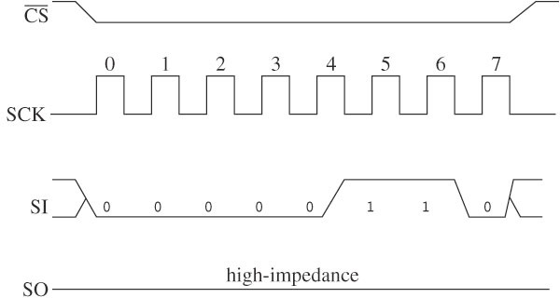
SPI Programing Example (solution) Slave Mode
SSPCON1 Register
– →→ SSPCON1 = 0011 0100
SSPSTAT Register (same)
– →→ SSPSTAT = 0100 0000
Timing Diagram
TRISC Register
TRISCbit.SDO (RC5) = 0
TRISCbit.SDI (RC4) = 1
TRISCbit.SCK (RC3) = 1
TRISCbit.SS (RC0) = 1
– →→ TRSC = 0001 1001

Slide 11
SPI Programing Example (solution) Master Mode Program
Setup TRISC, SSPCON1, & SSPSTAT
Set ChiSel=0
Write a charcter (0x55) into SSPBUF
Loop: Check if SSPBUF.bit.BF = 1 (buﬀer is full)
IF so : MOVF SSPBUF→→WREG
Set ChipSel = 1 (deactivate the slave chip)
Timing Diagram

Slide 12
Inter-­‐Integrated Circuit (I2C) Interface
Created by Philips Inc
Designed to interface ICs on PCB boards (I2C)
Characteristics:
2-­‐Wire (SCK & SDA)
Synchronous (100 Kbs or 400 Kbps)
Master/Slave modes of operation
Addressing can be 7 or 10 bit

Slide 13

Pin Out for MSSP I2C Interface

Slide 14
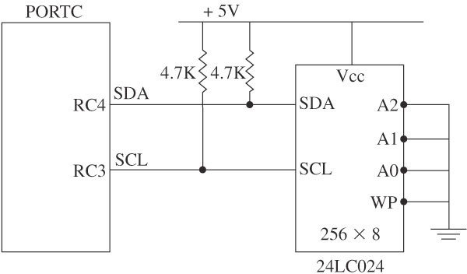
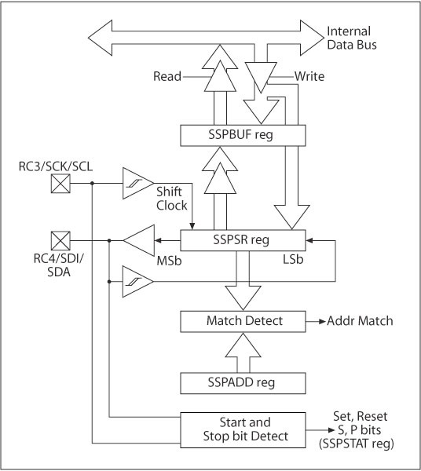
I2C Interface
2-­‐ Wire Interface
Registers: SSPCON1 SSPSTAT TRISC
SSPCON2 (port idle or not) SSPADD (address)
SSPSR
SSPBUF (data read/write)

Slide 15
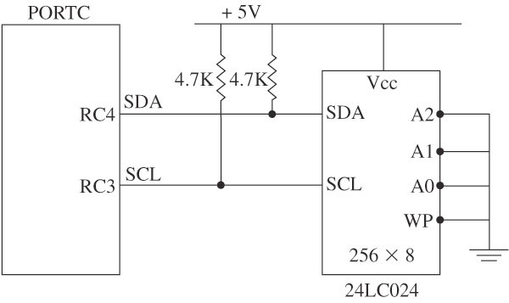
I2C Programing Example
Assume:
Fosc = 10 MHz;
I2C Master Mode
Transmission Rate is 100 KHz
Enable slew rate for high speed
No error detection
What will be the conﬁguration for the Master
Write the code to transmit characters

Slide 16
I2C Programing Example (solution)
Master Mode
SSPCON1 Register
Set to SPI Mater Mode Fosc/4 = 2.5 MHz
SSPCON1 bit.CKP = 1
SSPCON1 bit.EN = 1
– →→ SSPCON1 = 0011 0000
SSPSTAT Register
SSPSTAT bit.SMP = 0 ; rising edge; idle is high
SSPSTAT bit.CKE = 1
SSPSTAT bit.BF = 0
– →→ SSPSTAT = 0100 0000
TRISC Register
TRISCbit.SDO (RC5) = 0
TRISCbit.SDI (RC4) = 1
TRISCbit.SCK (RC3) = 0
TRISCbit.SS (RC0) = 0
– →→ TRSC = 0001 0000

Slide 17


















Programing Example
Is I2C
Idle
W = SSCON2
If bit0-­‐bit 4 of SSPCON2 = 1 →→ not in idle mode Else: Check SSPSTATbit.RW; If 1 →→ Transmit
Is TX in progress
W = Character MOVWF SSPBUF
WREG=
Character
Check SSPSTATbit.BF = 0
Go to next Character Transmission
WREG=
Character
Is FLAG
cleared

