Slide 1
Clocks, Watchdog Timer / Timers

Slide 2
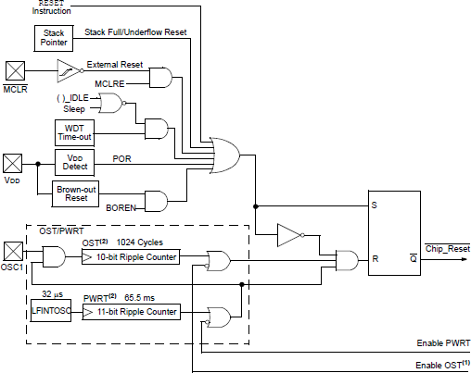
Reset Conditions
Master Clear
Initializes the MCU Starts with memory 0x00
RC time constant 10-20 msec (R=10K/C=1uF)
#pragma config MCLRE = ON
VCC
R1 R
MCLR SW
C1 C

Slide 3
Watchdog Timer
The watchdog timer is a device that resets the microcontroller if it is allowed to expire.
The watchdog timer is programmable to expire between 4 ms and 131 seconds.
The watchdog timer is restarted with a ClrWdt() function in C-Language to reset it so it does not expire and cause a reset.
C statement | Assembly Language | Scaling factor | Time to Reset
#pragma config WDTPS = 1 | _WDTPS_1_2H | 1:1 | 4 ms
#pragma config WDTPS = 32768 | _WDTPS_32768_2H | 1:32768 | 131.072 sec

Slide 4
Brownout Reset
The brownout reset is programmed and used to reset the microcontroller if the power supply voltage drops below a pre-programmed value.
The brownout reset triggers the microcontroller and waits at the reset state until the power supply voltage returns to a level higher then the programmed brownout voltage.
C language | Assembly Language | Brownout Voltage
#pragma config BORV = 45 | _BORV_45_2L | 4.5 V
#pragma config BORV = 42 | _BORV_42_2L | 4.2 V
#pragma config BORV = 27 | _BORV_27_2L | 2.7 V
#pragma config BORV = 20 | _BORV_20_2L | 2.0 V

Slide 5
Clocks
The PIC18 family allows many different clocking modes for operation. Some include internal timing and some external.
External timing sources are very accurate and are crystal- or resonator-based. A less accurate, but less expensive timing source is an RC circuit. An oscillator module or external timing signal can also be used for the microcontroller.

Slide 6
Clock Sources
□
□
□
□
□
□
□
□
□
□
1. Low power crystal (LP)
Examples of
External XTL or ceramic
2. Crystal or ceramic resonator (XT)
High-speed crystal or ceramic resonator (HS) ^{Resonator (OSC1/OSC2)}
High-speed crystal or ceramic resonator with PLL (HSPLL)
External resister/capacitor with Fosc/4 output on OSC2 (RC)
External resister/capacitor with I/O on OSC2 (RCIO)
*Internal oscillator with Fosc/4 on RA6 and I/O on RA7 (INTIO1)
*Internal oscillator with I/O on RA6 and RA7 (INTIO2)
External clock with Fosc/4 (EC)
External clock with I/O on RA6 (ECIO)
*some versions do not have an internal oscillator and
some versions may have additional modes

Slide 7
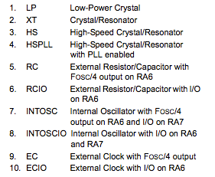
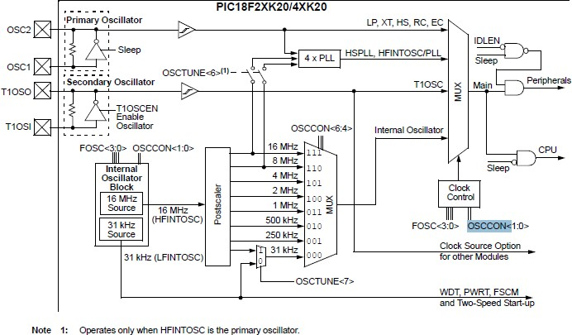
MCU Clock Source Diagram

Slide 8
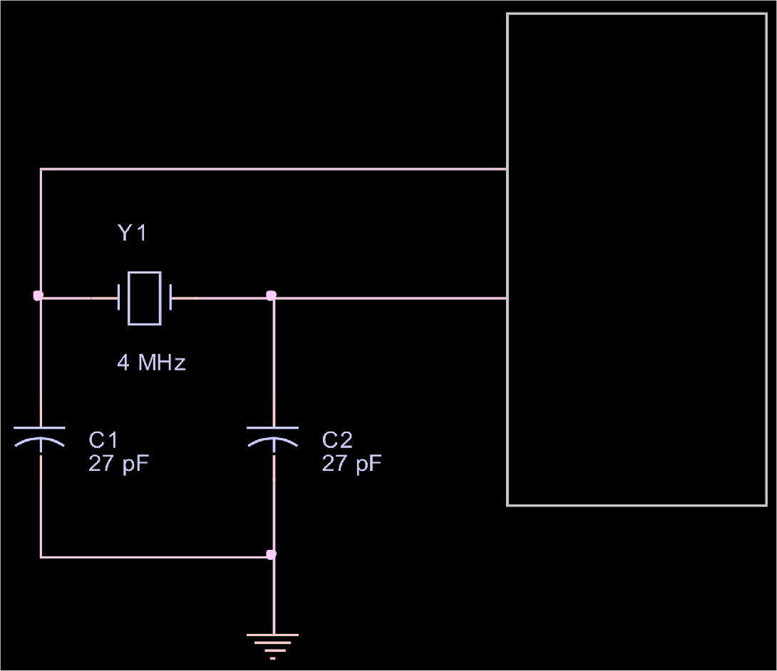
XTL / Ceramic
Clock Source Connection
PIC
PLL internal function Allows multiplying the External clock by 4;
This is used to reduce the EMI (Electromagnetic Interference) on the board
OSC1
OSC2

Slide 9
RC Oscillator
Clock Source Connection
OSC2 Fosc/4 OSC1
PIC
External Clock Input
OSC1
□External resister/capacitor with Fosc/4 output on OSC2 (RC) 2 MHz operation is attained with R = 3.9K
and C = 30 pF, Fosc/4 is 500 KHz with these values Frequency = 1/[RC(4.2)] ; can vary slightly
External clock source Connected to OSC1

Slide 10
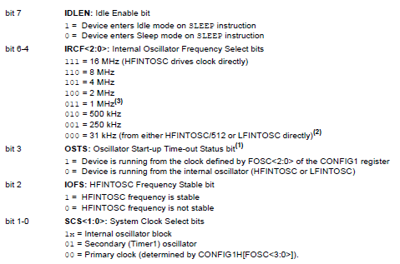
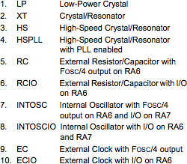
Clock Examples
#pragma config OSC = HS // high speed crystal oscillator
#pragma config OSC = RC // RC oscillator
#pragma config OSC = INTIO1 // internal oscillator
OSCCON Register

Slide 11
Programming Example
#pragma config MCLRE = ON #pragma config OSC = HS #pragma config WDT = ON #pragma config WDTPS = 256 #pragma config BORV = 42 #pragma BOR = ON
// enable master clear input
// select crystal oscillator
// set watchdog
// watchdog time is 1 second
// set brownout reset voltage
// brownout is on
void main(void)
// initialize system here
while ( 1 )
{
ClrWdt();
// main program loop
// reset watchdog
// system software goes here
}

Slide 12
Basic Concepts in Counters and Timers
In digital systems
Counting is a fundamental concept.
Clock is an essential element.
Count is in synchronization with the clock.
Count is converted in time by multiplying the count and the clock period.

Slide 13
Hardware Counters and Timers
Counter is a register that can be loaded with a binary number (count) which can be decremented or incremented per clock cycle.
Calculating time:
Find the difference between the beginning count and the last count
Multiply the count difference by the clock period
The register can also be used as a counter by replacing the clock with a signal from an event.
When a signal from an event arrives, the count in the register is incremented (or decremented); thus, the total number of events can be counted.

Slide 14
Types of Counters
Up-counter
Counter is incremented at every clock cycle
When count reaches the maximum count, a flag is set
Counter can be reset to zero or to the initial value
Down-counter
Counter is decremented at every clock cycle
When count reaches zero, a flag is set
Counter can be reset to the maximum or the initial value
Free-running counter
Counter runs continuously and only readable
When it reaches the maximum count, a flag is set
What are applications on timers?

Slide 15
Timer Applications
Time delay
Pulse wave generation
Pulse width or frequency measurement
Timer as an event counter

Slide 16
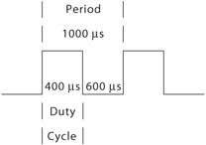
Capture, Compare, and PWM (CCP) Modules
CCP modules are commonly found in recent microcontrollers
16-bit (or two 8-bit) registers specially designed to perform the following functions in conjunction with timers
Capture: The CCP pin can be set as an input to record the arrival time of a pulse.
Compare: The CCP pin is set as an output, and at a given count, it can be driven low, high, or toggled.
Pulse width modulation (PWM): The CCP pin is set as an output and the duty cycle of a pulse can be varied.
The count for the period and the duty cycle are loaded into CCP registers.
In this mode, the duty cycle of the output pulse can be varied.

Slide 17
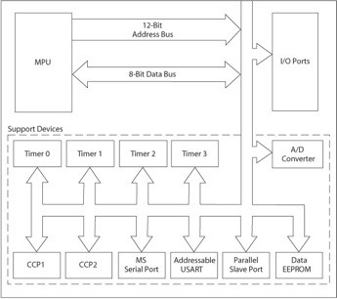
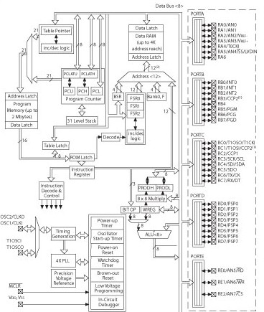

Same for:

Slide 18
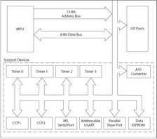
PIC18 Timers
The PIC18 microcontroller have multiple timers, and all of them are up-counters.
Timers are divided into two groups: 8-bit and 16-bit
Labeled as Timer0 to Timer3 or Timer4 (if available)
Timer0 can be set up as an 8-bit or 16-bit timer.
Timer1 and Timer3 are 16-bit timers.
Timer2 and Timer4 (if available) are 8-bit timers.
Each timer associated with its Special Function Register (SFR): T0CON-T3CON or T4CON

Slide 19
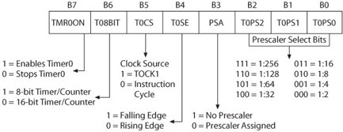
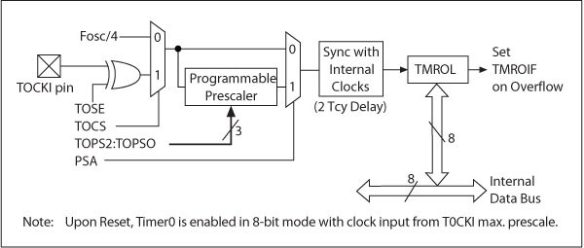
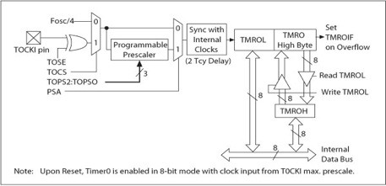
Timer0
Note: TMR Flags are set when the counter reg. has reached it max.
Timer0 8- bit
Timer0 Control Register (T0CON)
Can be set up as an 8-bit or 16-bit timer
Has eight options of pre-scale values (Divides)
Can run on internal clock source (instruction
cycle) or external clock connected to pin RA4/T0CK1
Generates an interrupt or sets a flag when it
overflows from FFH to 00 in the 8-bit mode and from FFFFH to 0000 in the 16-bit mode
Can be set up on either rising edge or falling edge when an external clock is used
Timer0 16-bit
Instruction cycle = 4 clock cycle

Slide 20
Timer0
Timer0 8- bit
Timer0 Control Register (T0CON)
Can be set up as an 8-bit or 16-bit timer
Has eight options of pre-scale values (Divides)
Can run on internal clock source (instruction
cycle) or external clock connected to pin RA4/T0CK1
Generates an interrupt or sets a flag when it
overflows from FFH to 00 in the 8-bit mode and from FFFFH to 0000 in the 16-bit mode
Can be set up on either rising edge or falling edge when an external clock is used
Timer0 16-bit
Instruction cycle = 4 clock cycle

Slide 21
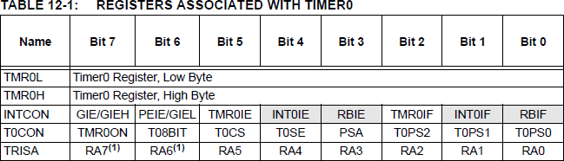
TIMER0 Registers

Slide 22
Timer0
TMROH buffer between internal data bus and TMR0 high byte
Read from the TMR0L register, the upper half of Timer0 is latched into the TMR0H register
Ensures that the PIC18 always reads a 16-bit value that its upper byte and lower byte belong to the same time (since only read 8-bits at a time)

Slide 23
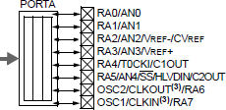
Timer0 Control Register (1 of 2)
□ Timer0 as timer
■
Bit5 must be cleared to use the internal clock.
At each instruction cycle (four clock cycles), the timer register is incremented.
■
□ Timer0 as a counter
■
■
Bit5 must be set 1 to use an external clock.
In this mode, input signal at PORTA-pin RA4/T0CK used as a clock.
When Bit4 = 1, register is incremented on the falling edge, and when Bit4 = 0, the register is incremented on the rising edge.
■
□ Prescaler
■
■
Divides clock frequency by a specified ratio.
To use prescaler, Bit3 = 0, and three bits Bit2-Bit0 specify scaler ratio from 1:2 to 1:256

Slide 24
Timer0 Control Register (2 of 2)
Interrupt
When Timer0 overflows from FFH to 00 in the 8-bit mode and from FFFFH to 0000 in the16-bit mode, it sets TMR0IF (Timer0 Interrupt Flag) –Bit2 in the INTCON register.
□
Flag can be used two ways: 1) a software loop can be set up to monitor the flag, or 2) an interrupt can be generated.
Flag must be cleared to start the timer again.
□
16-bit mode
When Timer0 is set in the 16-bit mode, it uses two 8-bit registers TMR0L and TMR0H.

Slide 25
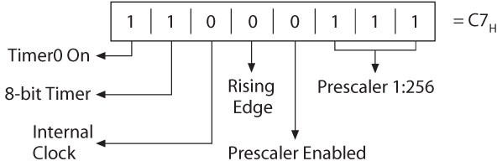
Control Word to Initialize Timer0

Slide 26
Example - Set TMR0 as an 8-bit timer
Every instruction cycle the register is updated → 4x(Clock_Period)
With a pre-scale=1:256 (divide the clock by 256)→  pre_scalex4x(Clock_Period)
8-bit register allows counting 256 values →
(2^n)x pre_scalex4x(Clock_Period)
Assuming using a 10MHz internal clock, rising edge clock, how often the flag is set if timer 0 is set as 8-bit counter? What should TMR0 (T0CON ) setup be?
256x256x4x0.1E-6=Every 26.21 msec
1
1
0
0
0
1
1
1

Slide 27
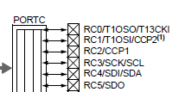
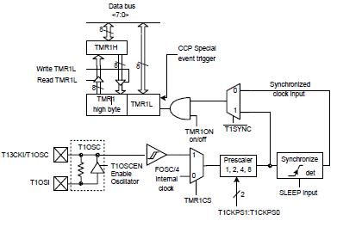
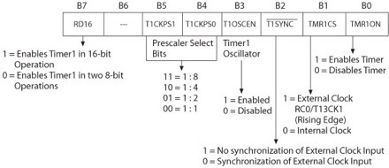
Timer1 – 16-bit (1 of 5)
A 16-bit counter/timer with two 8-bit registers (TMR1H and TMR1L); both registers are readable and writable
Four options of prescale value (Bit5-Bit4)
Clock source (Bit1) can be internal (instruction cycle) or external (pin RC0/T13CK1) on rising edge
Sets flag or generates an interrupt when it overflows from FFFFH to 0000
Used to synch with the rising edge of the external clock

Slide 28
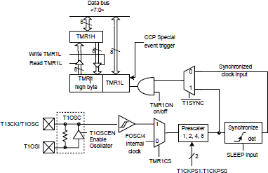

Timer1 (3 of 5)
Timer1 Operation
Can operate in three modes:
timer,
synchronous counter,
asynchronous counter
Bit0 enables or disables the timer
When Bit1 = 0, it operates as a timer and increments count at every instruction cycle.
When Bit1 = 1, it operates as a counter and increments count at every rising edge of the external clock.
When Bit3 = 1, Timer1 oscillator is enabled which is used for low frequency operations.

Slide 29
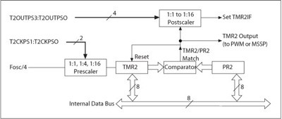
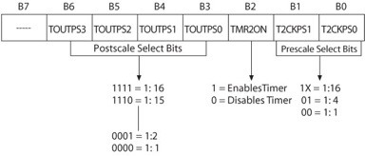
Timer2
Two 8-bit registers (TMR2 and PR2)
An 8-bit number is loaded in PR2 and the timer is turned on, which is incremented every instruction cycle.
When the count in the timer register and the PR register match, an output pulse is generated and the timer register is set to zero.
The output pulse goes through a postscaler that divides the frequency by the scale factor and sets the flag TMR2IF-
Freq. Clk
Pulse
Master Synchronous Serial Port (MSSP)
Bit1 in the Peripheral Interrupt Register1 (PIR1) that can be used to generate an interrupt.

Slide 30
Example for Timer2
□ Generate a periodic high-priority interrupt every 8-msec using Timer2. Assume a 32-MHz crystal oscillator.
Assume post/pre scaled values are 16
Loaded value in PR2 will be
Remember, we start
with 0 count → -1 is needed
□
PR2 = [Td / [Inst. Clock Cycle(4) x Prescaler x PostScaler x clock period)]] - 1 PR2 = [ 8msec/[4x16x16x(1/32MHZ)] ] -1 =249
□
PR2=249 RCON: IPEN=1
IPR1: TMR21P=1; TMR2IF=CLR INTCON=C0; GLOBAL INT
T2CON=7E; TMR2 ENABLE AND SCALING SETUP PIE1: TMR2IE=SET
TMR2
Comp
PR2

Slide 31
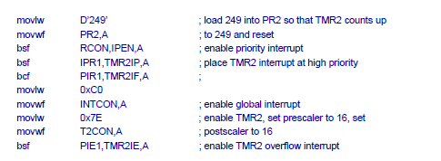
Example for Timer2 - continue
□ Actual code:
PR2=249 RCON: IPEN=1
IPR1: TMR21P=1; TMR2IF=CLR INTCON=C0; GLOBAL INT
T2CON=7E; TMR2 ENABLE AND SCALING SETUP PIE1: TMR2IE=SET

Slide 32
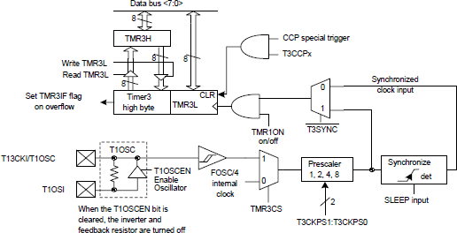
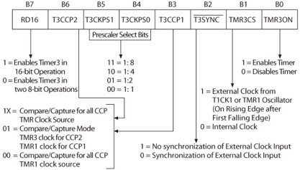
Timer3
□ Similar to Timer1

Slide 33
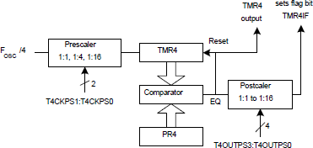
Timer4
Only available to the PIC18F8X2X and PIC6X2X devices
The value of TMR4 is compared to PR4 in each clock cycle
When the value of TMR4 equals that of PR4, TMR4 is reset to 0
The contents of T4CON are identical to those of T2CON
….similar to Timer2 (Two 8-bit registers )

