Slide 1
Introduction UART

Slide 2
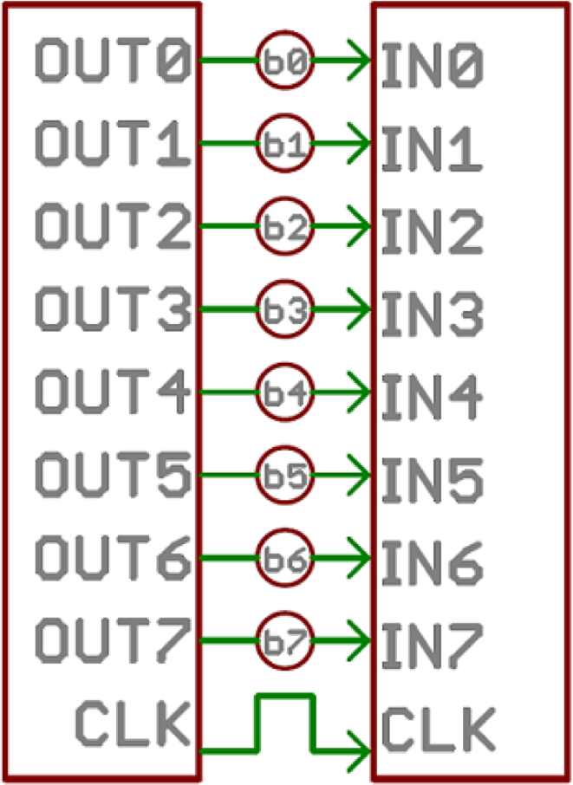
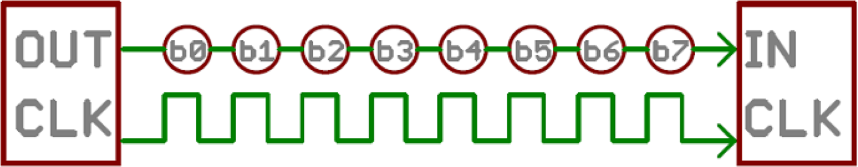
Communication Protocols
Parallel Vs. Serial
Parallel: Faster / More expensive
Serial: Cheaper / slower

Slide 3
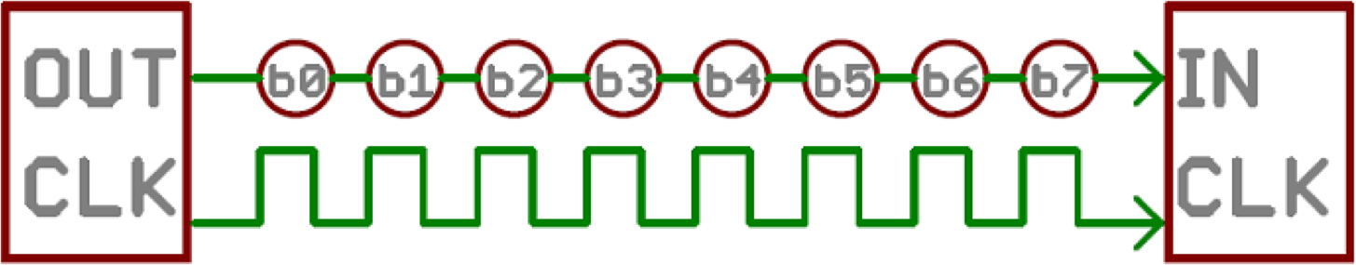
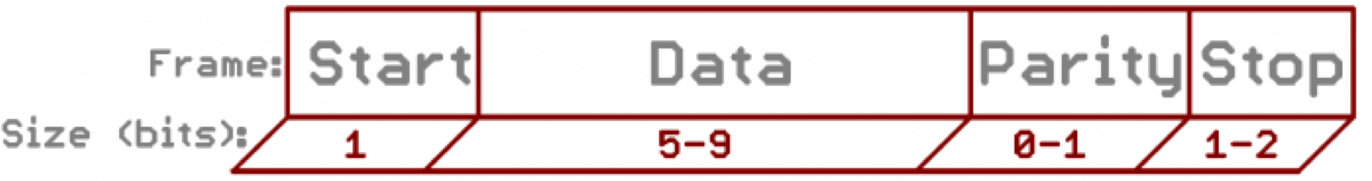
Communication Protocols
Timing in serial communication
Synchronous Serial
Asynchronous Serial
Rules of Asynch. Protocols
Synch bit
Parity bit
Baud rate
Data bit

Slide 4

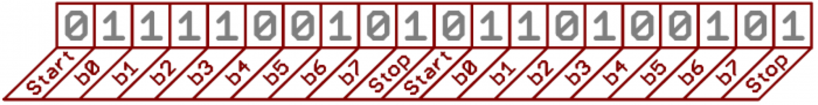
Parity and Baud Rate
Parity
– Even Parity : 10101010101 → 6 one’s → EP=0
– Odd Parity : 01010101010 → 5 one’s → OP=0
Baud Rate
Pulse per second
In digital world: Bits per second
9600 baud → 9600 bps or 104 µs per bit.
Synch bit
9600 8N1 – 9600 bps/
8 bits per data / No parity / One Stop bit Always has start bit
Required to define the beginning/end of the data
the start bit [LOW] and the stop bit [HIGH]

Slide 5
Questions
What will be the EVEN parity value if n=1111 1110?
What will be the ODD parity value if n=1111 1110?
How long does it take to transmit a 1-Mbit file at 9600 baud rate?
Let’s say P represents Even Parity. Assume P=1. Can we accept this as a correct frame: 1101 1110P?

Slide 6
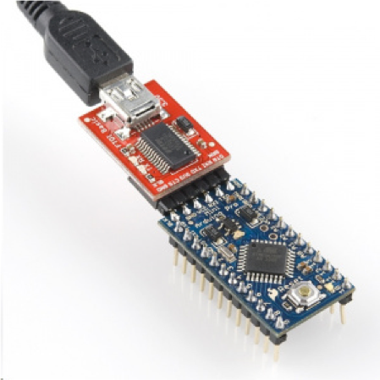
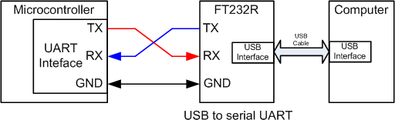
Serial Communication
Universal Asynchronous Receiver and Transmitter (UART)
UART is programmable.
Asynchronous
Sender provides no clock signal to receivers
FT232R converts the UART port to a standard USB interface

Slide 7
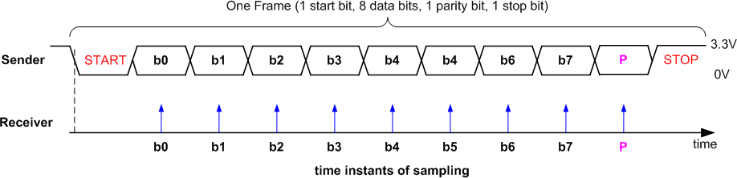
Data Frame
Tolerate 10% clock shift during transmission
Sender and receiver uses the same transmission speed
Data frame
Overhead % =
1 - (Useful Data / Total Data)
– One start bit
– Data (LSB first or MSB, and size of 7, 8, 9 bits)
Optional parity bit
One or two stop bit
9600/(1 + 8 + 1 + 1) = ~872 frames/second
7

Slide 8
Problem
Assume we have a file with size 1 million bits. Assume we use 9600:8-1-1 (includes STOP and SATRT bits). How long does it take to transmit the file? Calculate the Overhead %.
8-1-1→ each frame has 11 bits
Baud rate is 9600 bits/sec--> Frame rate = 9600/11=872.72 Frames/sec or 1.146 msec/frame
Number of frames generated: 1,000,000 bits x 1 frame/8 bit= 125,000 frames
Time to transmit 125,000 frames = 125000 frame x 1.146 msec/frame = 143.25 sec!
Overhead % = [1 - (Useful Data / Total Data)]x100 = [1 - (8/11)] x 100=27.3
How long does it take to transmit 100,000 bits at 57,600 baud rate?

Slide 9
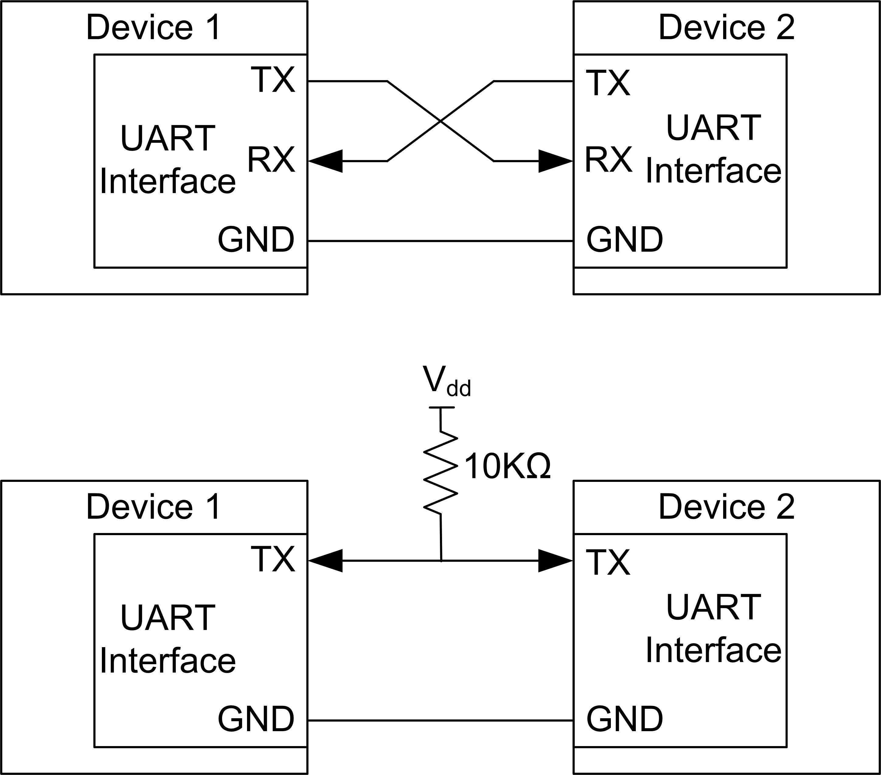
Communication Modes
A serial interface can have different communication modes
Full Duplex - means both devices can send and receive simultaneously.
Half-Duplex - means serial devices must take turns sending and receiving.

Slide 10
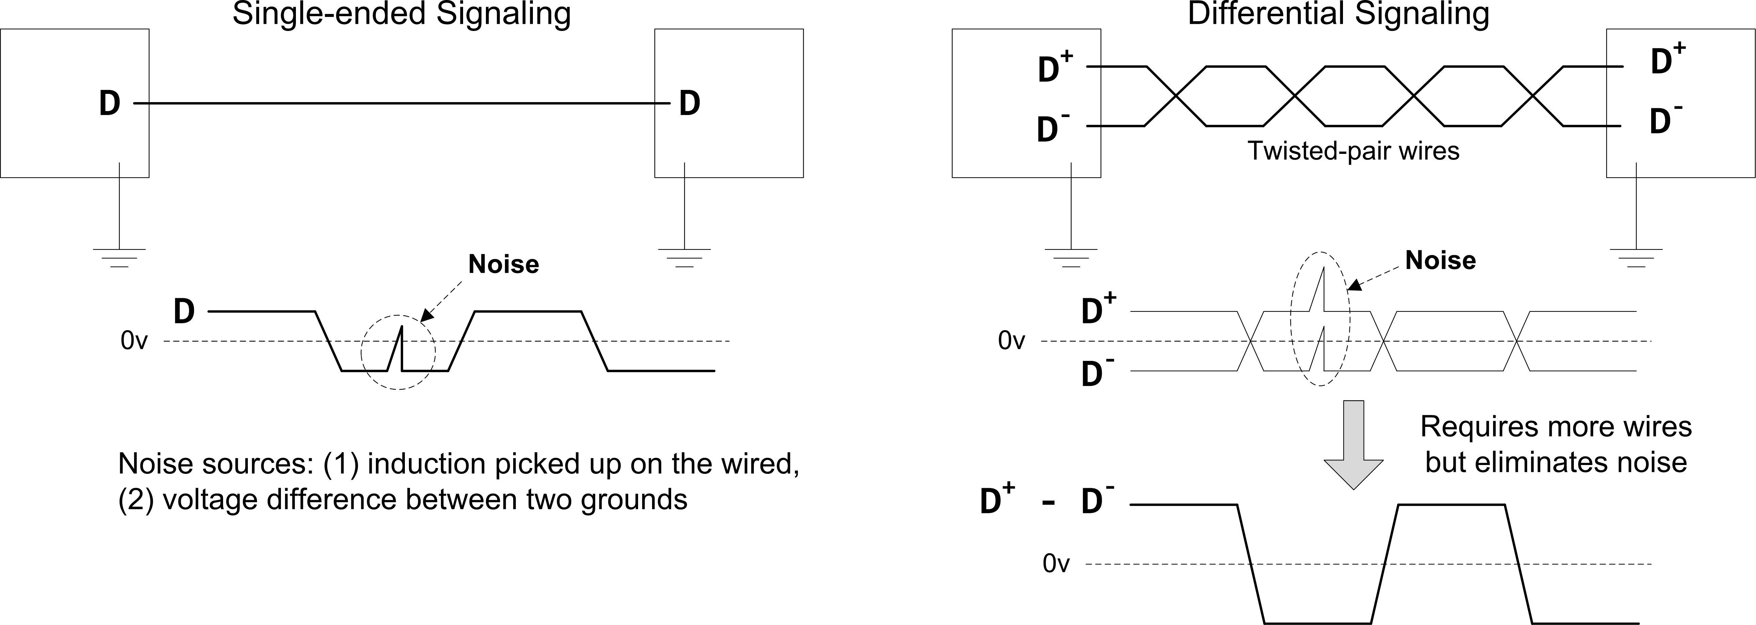

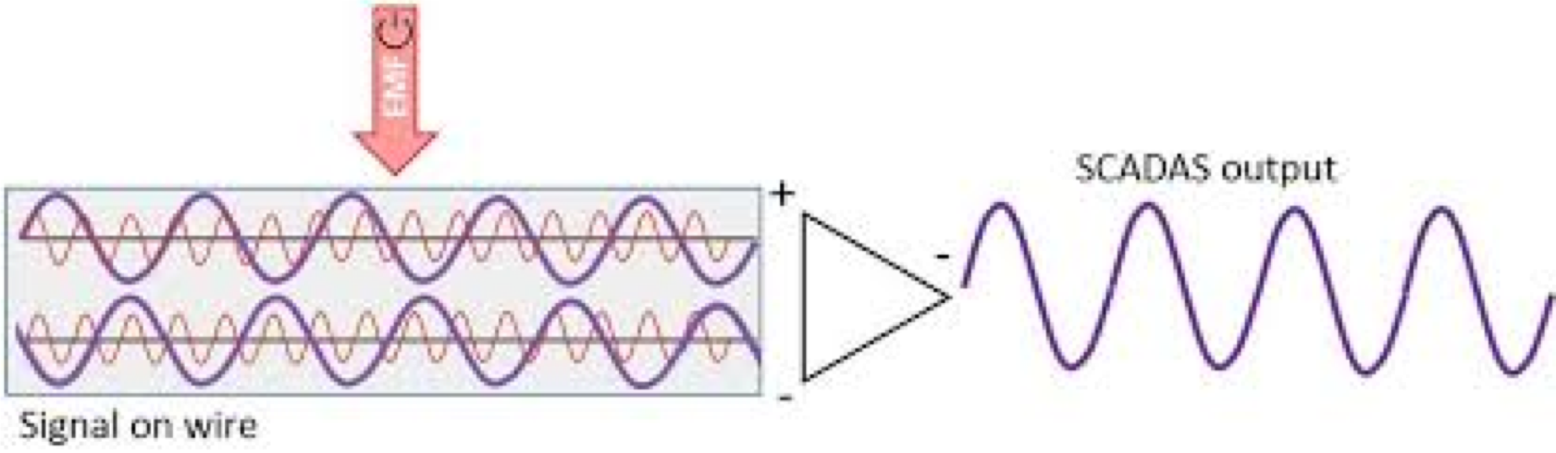


Differential Vs. Single Ended
Signal with less noise!

Slide 11
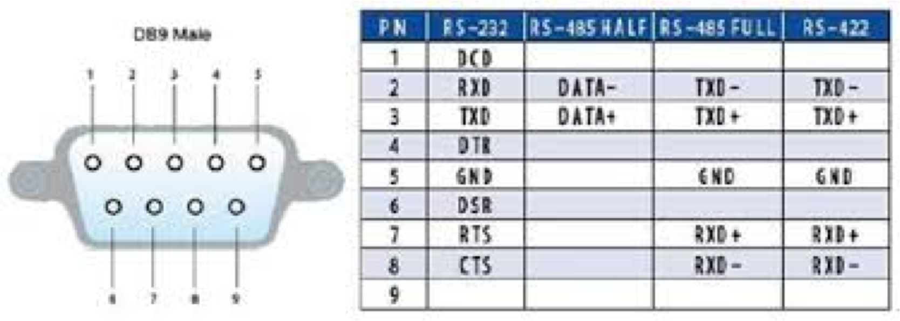
UART Protocols Different Voltage Levels
Standard | Voltage signal | Max distance | Max speed | Number of devices supported per port
RS-232 | Single end ( logic 1: +5 to +15V, logic 0: -5 to -15 V) | 100 feet | 115Kbit/s | 1 master, 1 receiver
RS-422 | Differential (-6V to +6V) | 4000 feet | 10Mbit/s | 1 master, 10 receivers
RS-485 | Differential (-7V to +12V) | 4000 feet | 10Mbit/s | 32 masters, 32 receivers

Slide 12
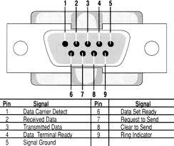
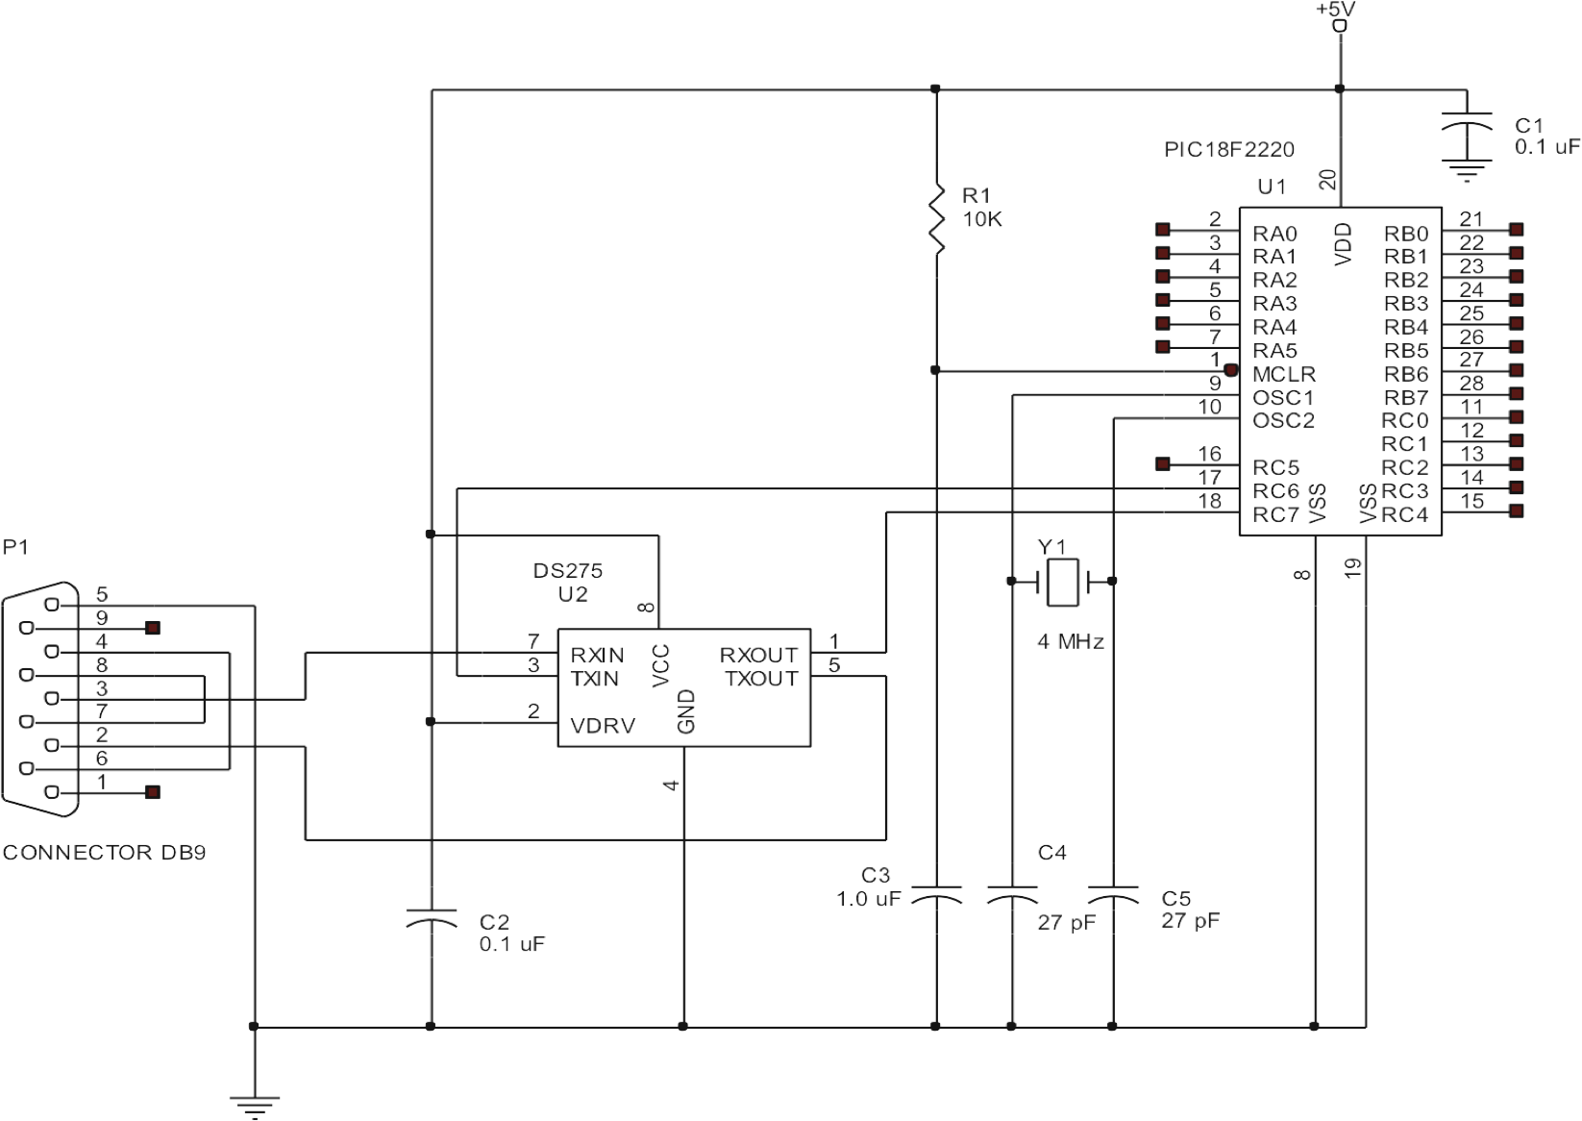
Interfacing
Note that in general we SHOULD use something like Maxim's MAX232 in order to ensure voltage compa)bility between the PIC and the RS232 or the terminal
It is also possible to INVERT polarity of the signals on TX and RX pins of USART, to interface to the terminal

Slide 13
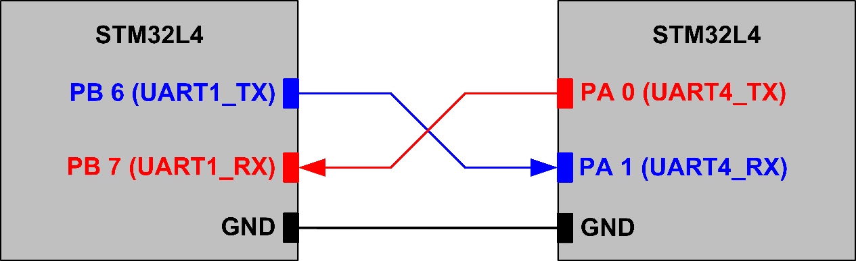





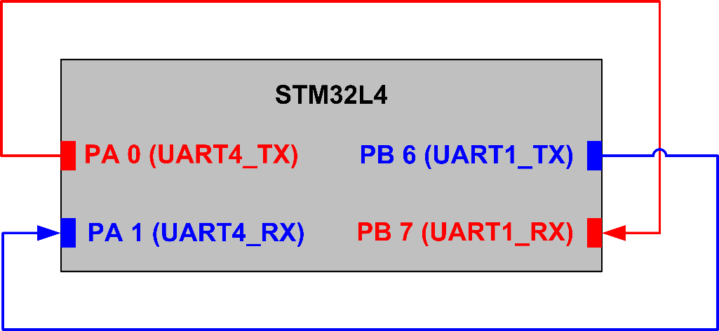


UART Connection
To send and receive data using UART we can use several methods including:
polling, interrupt
PIC
PIC
PIC
19

