Slide 1
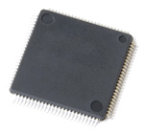
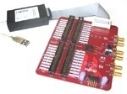
PIC Microcontroller and Embedded Systems
Muhammad Ali Mazidi, Rolin McKinlay and Danny Causey
Eng. Husam Alzaq
The Islamic Uni. Of Gaza
11-<number>

Slide 2
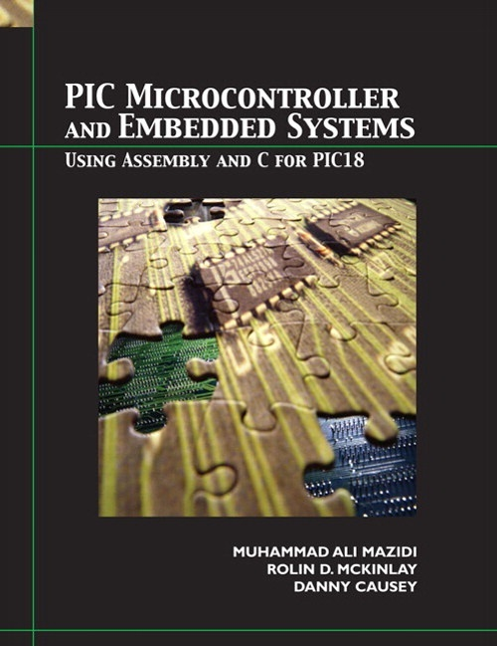
Chapter 11: Interrupts programming in Assembly
PIC Microcontroller and Embedded Systems
Muhammad Ali Mazidi, Rolin McKinlay and Danny Causey, February 2007.
11-<number>

Slide 3

Objective
11-<number>

Slide 4
Introduction
Interrupts are mechanisms which enable instant response to events such as counter overflow, pin change, data received, etc.
In normal mode, microcontroller executes the main program as long as there are no occurrences that would cause an interrupt.
Upon interrupt, microcontroller stops the execution of main program and commences the special part of the program(ISR) which will analyze and handle the interrupt.
11-<number>

Slide 5
11.1:PIC18 interrupts
PIC can serve multiple devices using mechanisms of
  Polling
    PIC continuously monitors the status of each device
    Each device get the attention of the CPU as the same level of priority
    Wastes u-Controllers time by polling devices that do not need service.
  Interrupt
    Devices get the attention of the CPU only when it needs a service
    Can service many devices with different level of priorities
11-<number>

Slide 6
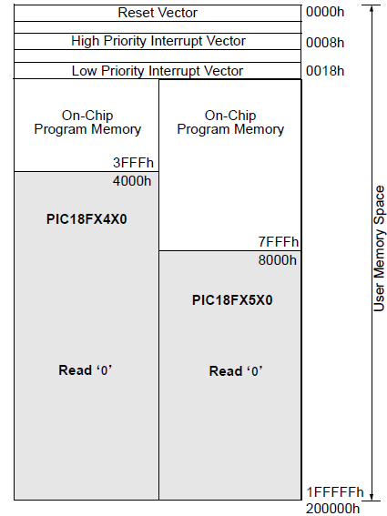
Interrupt service routine (ISR)
When an interrupt is invoked the uC runs the Interrupt Service Routine(ISR)
Interrupt vector table holds the address of ISRs
  Power-on Reset 0000h
  High priority interrupt 0008h
  Low priority interrupt 0018h
11-<number>

Slide 7
Steps in executing an interrupt
Upon activation of interrupt the microcontroller
  Finishes executing the current instruction
  Pushes the PC of next instruction in the stack
  Jumps to the interrupt vector table to get the address of ISR and jumps to it
  Begin executing the ISR instructions to the last instruction of ISR (RETFIE)
  Executes RETFIE
    Pops the PC from the stack
    Starts to execute from the address of that PC
11-<number>

Slide 8
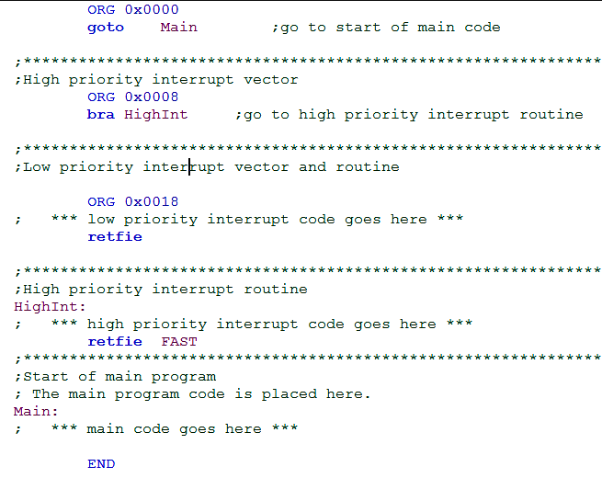
Program organization in MPLAB
11-<number>

Slide 9
Sources of interrupts in PIC18
External hardware interrupts
  Pins RB0(INT0),RB1(INT1),RB2(INT2)
PORTB change
Timers
  Timer0 , Timer1 ,Timer2
ADC (analog to digital converter)
CCP (compare capture pulse width modulation, PWM)
... etc
11-<number>

Slide 10
Enabling and disabling an interrupt
When the PIC is powered on (or resets)
  All interrupts are masked (disabled)
  The default ISR address is 0008h
    No interrupt priorities for interrupts
11-<number>

Slide 11
Enabling and disabling an interrupt
In general, interrupt sources have three bits to control their operation. They are:
Flag bit
  to indicate that an interrupt event occurred
Enable bit
  that allows program execution to branch to the interrupt vector address when the flag bit is set
Priority bit
  to select high priority or low priority
11-<number>

Slide 12
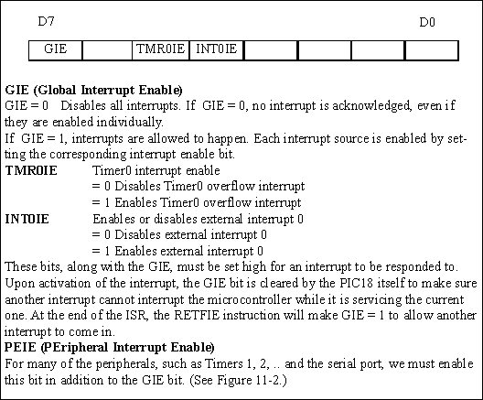
Steps in enabling an interrupt
Set the GIE bit from INTCON REG
Set the IE bit for that interrupt
If the interrupt is one of the peripheral (timers 1,2 , serial,etc ) set PEIE bit from INTCON reg
11-<number>

Slide 13
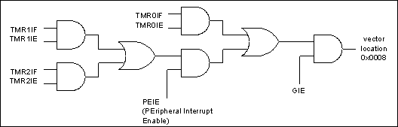
Example 11.1
a)
BSF INTCON,TMR0IE
BSF INTCON,INT0IE
BSF INTCON,GIE
Or
MOVLW B’10110000’
MOVWF INTCON
b)
BCF INTCON,TMR0IE
c) BCF INTCON,GIE
11-<number>

Slide 14
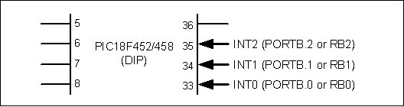
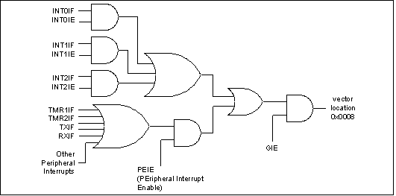
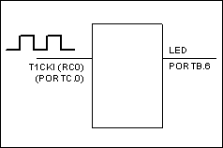
Program 11-4 External hardware interrupt
ORG 0000H
GOTO MAIN
ORG 0008H
BTFSS INTCON,INT0IF
RETFIE
GOTO INT0_ISR
ORG 00100H
MAIN
BCF TRISB,7
BSF TRISB,INT0
CLRF TRISD
SETF TRISC
BSF INTCON,INT0IE
BSF INTCON,GIE
OVER MOVFF PORTC,PORTD
BRA OVER
INT0_ISR
ORG 200H
BTG PORTB,7
BCF INTCON,INT0IF
RETFIE
END
11-<number>

Slide 15
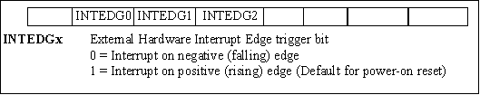
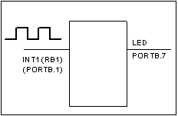
Program 11-5 negative Edge-triggered interrupts
ORG 0000H
GOTO MAIN
ORG 0008H
BTFSS INTCON,INT0IF
RETFIE
GOTO INT1_ISR
ORG 00100H
MAIN
BCF TRISB,7
BSF TRISB,INT1
BSF INTCON3,INT1IE BCF INTCON2,INTEDGE1
BSF INTCON,GIE
OVER BRA OVER
BRA OVER
INT1_ISR
ORG 200H
BTG PORTB,7
BCF INTCON3,INT1IF
RETFIE
END
11-<number>

Slide 16
Sampling the Edge triggered interrupt
The external source must be held high for at least two instruction cycles
For XTAL 10Mhz
Instruction cycle time is 400ns,0.4us
So minimum pulse duration to detect edge triggered interrupts = 2 instruction cycle =
0.8us
11-<number>

Slide 17
11-<number>

Slide 18
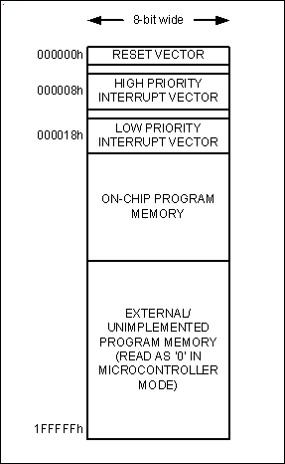
Figure 2-11. PIC18 Program ROM Space
Powering UP
At what address does the CPU wake up when power applied?
The uC wakes up at memory address 0000
The PC has the value 0000
ORG directive put the address of the first op code at the memory location 0000
1-<number>

Slide 19

Intcon
ENABLES
FLAGS
• GP port change interrupt
• GP port change interrupt
global interupt
enable
• INT pin interrupt
• TMR0 overflow interrupt
• INT pin interrupt
• TMR0 overflow interrupt

Slide 20
Timer Interrupts
Interrupt | Flag Bit | Register | Enable Bit | Register
Timer0 | TMR0IF | INTCON | TMR0IE | INTCON
Timer1 | TMR1IF | PIR1 | TMR1IE | PIE1
Timer2 | TMR2IF | PIR1 | TMR3IE | PIE1
Timer3 | TMR3IF | PIR3 | TMR3IE | PIE2
Timer Interrupt Flag Bits and Associated Registers
INTCON Register with Timer0 Interrupt Enable and Interrupt Flag
11-<number>

Slide 21
Timer Interrupts
11-<number>

Slide 22
Program 11-1 (pg 430)
ORG 0000H
GOTO MAIN
ORG 0008H
BTFSS INTCON,TMR0IF
RETFIE
GOTO T0_ISR
ORG 00100H
MAIN BCF TRISB,5
CLRF TRISD SETF TRISC MOVLW 0x08 MOVWF T0CON
MOVLW 0xFF MOVWF TMR0H
MOVLW 0xF2 MOVWF TMR0L
BCF INTCON,TMR0IF
BSF T0CON,TMR0ON BSF INTCON,TMR0IE BSF INTCON,GIE
OVER MOVFF PORTC,PORTD
BRA OVER
T0_ISR
ORG 200H
MOVLW 0xFF MOVWF TMR0H MOVLW 0xF2 MOVWF TMR0L BTG PORTB,5 BCF INTCON,TMR0IF
RETFIE
END
Timer0 Interrupt
11-<number>

Slide 23
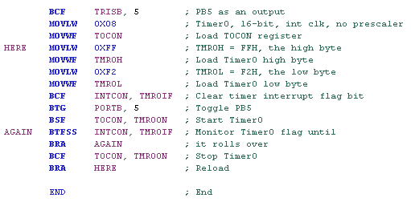
Revisit
11-<number>

Slide 24
Please see Program 11-2 (pg 432) and Program 11-3 (pg 433)
11-<number>

Slide 25
Serial Communication Interrupts
Interrupt | Flag Bit | Register | Enable Bit | Register
TXIF (Transmit) | TXIF | PIR1 | TXIE | PIE1
RCIF (Receive) | RCIF | PIR1 | RCIE | PIE1
Serial Port Interrupt Flag Bits and Associated Registers
PIE1 Register Bits Holding TXIE and RCIE
11-<number>

Slide 26
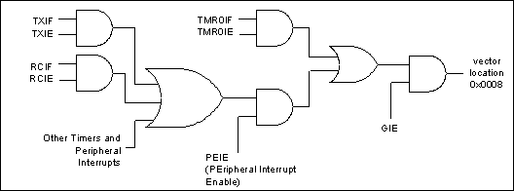
Figure 11-13: Serial Interrupt Enable Flags
11-<number>

Slide 27
Program 11-6 (pg 446)
8 bit switch is connected to port.D. the PIC18 reads data from PORTD and writes it to TXREG.
ORG 0000H
GOTO MAIN
ORG 0008H
BTFSC PIR1,TXIF
BRA TX_ISR
RETFIE
ORG 00100H
MAIN SETF TRISD MOVLW 0x20
MOVWF TXSTA
MOVLW D'15'
MOVWF SPBRG
BCF TRISC, TX
BSF RCSTA, SPEN BSF PIE1,TXIE
BSF INTCON,PEIE
BSF INTCON,GIE
OVER BRA OVER
END
Serial Port Interrupt
ORG 0040H
TX_ISR
MOVWFF PORTD,TXREG
RETFIE
Enable peripheral Interrupt
11-<number>

Slide 28
Program 11-7 page 447
ORG 00100H
MAIN CLRF TRISB
SETF TRISD
MOVLW 0x20
MOVWF TXSTA
MOVLW D'15'
MOVWF SPBRG
BCF TRISC,TX
BSF TRISC,RX
MOVLW 0x90
MOVWF RCSTA
BSF PIE1,TXIE
BSF PIE1,RCIE
BSF INTCON,PEIE
BSF INTCON,GIE
OVER BRA OVER
ORG 0000H
GOTO MAIN
ORG 0008H
HI_ISR BTFSC PIR1,TXIF
BRA TX_ISR
BTFSC PIR1,RCIF
BRA RC_ISR
RETFIE
TX_ISR MOVFF PORTD,TXREG
GOTO HI_ISR
RC_ISR
MOVFF RCREG,PORTB
GOTO HI_ISR
11-<number>

