Slide 1

SMART INDIA HACKATHON 2026
TITLE PAGE
Problem Statement ID –26173
Problem Statement Title-iTantra -Indian Multilingual TTS & STT Aided Neural Transceiver Radio Access for low bitrate links
Theme-Smart Automation
PS Category- Software
Team ID-
Team Name (Registered on portal)

Slide 2
iTantra -Indian Multilingual TTS & STT Aided Neural Transceiver Radio Access for low bitrate links
Convergex
Proposed Solution
Detailed explanation of the proposed solution:
Offline Android app for cross-language voice communication
Converts speech → text → meaning → target-language speech
Supports 10 Indian languages on low-power devices
Innovation and uniqueness of the solution:
SONAR-based cross-lingual semantic communication
One shared semantic layer supports multiple languages
Combines Edge AI, offline STT/TTS, and adaptive voice communication
How it addresses the problem:
Eliminates dependency on Internet connectivity
Transmits compact semantic data instead of raw audio
Enables low-latency communication over Bluetooth/Wi-Fi

Slide 3
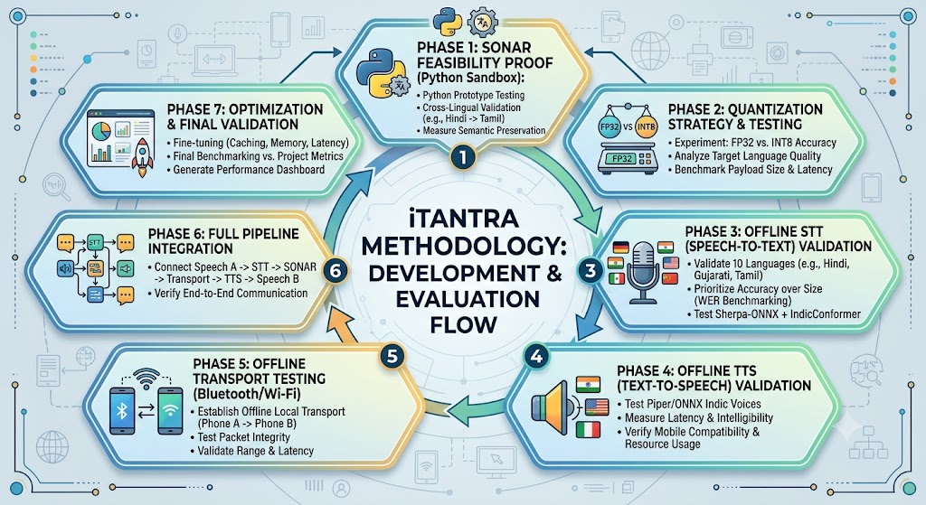
TECHNICAL APPROACH
ConvergeX
Technologies to be used
Kotlin + Python — Android development & AI optimization
ONNX Runtime — Efficient INT8 edge inference
Silero VAD — Speech detection & segmentation
Sherpa-ONNX + IndicConformer — Offline Indian-language STT
Meta SONAR — Cross-lingual semantic encoding/decoding
Piper TTS — Lightweight offline speech synthesis
BLE L2CAP / RFCOMM — Offline Bluetooth data transfer
SQLite — Local semantic cache for faster responses

Slide 4
FEASIBILITY AND VIABILITY
ConvergeX
Feasibility of the idea:
Technically feasible on low/mid-range Android devices
Fully offline using optimized Edge AI models
Scalable across 10 languages using shared SONAR representation
Potential challenges and risks
STT accuracy across diverse Indian accents
Model size & RAM constraints on low-end devices
Latency in semantic processing and voice generation
Strategies for overcoming these challenges
INT8 quantization and lightweight model optimization
VAD + sentence streaming to reduce processing delay
Benchmark & tune WER, RAM, CPU and end-to-end latency

Slide 5
IMPACT AND BENEFITS
ConvergeX
Potential impact on the target audience:
Bridges language barriers during critical communication
Enables offline communication in remote and low-connectivity areas
Improves accessibility for regional-language users
Benefits of the solution:
Social: Inclusive communication across Indian languages
Economic: Low-cost solution using existing smartphones
Emergency: Reliable voice alerts without Internet dependency

Slide 6
RESEARCH AND REFERENCES
ConvergeX
Meta SONAR (GitHub Repository): https://github.com/facebookresearch/SONAR
AI4Bharat (Official Research Portal): https://ai4bharat.iitm.ac.in/
Sherpa-ONNX (GitHub Repository): https://github.com/k2-fsa/sherpa-onnx
Silero VAD (GitHub Repository): https://github.com/snakers4/silero-vad

Slide 7
IMPORTANT INSTRUCTIONS
Please ensure below pointers are met while submitting the Idea PPT:
Kindly keep the maximum slides limit up to six (6). ( Including the title slide)
Try to avoid paragraphs and post your idea in points /diagrams / Infographics /pictures
Keep your explanation precise and easy to understand
Idea should be unique and novel.
You can only use provided template for making the PPT without changing the idea details pointers (mentioned in previous slides).
You need to save the file in PDF and upload the same on portal. No PPT, Word Doc or any other format will be supported.
Note - You can delete this slide (Important Pointers) when you upload the details of your idea on SIH portal.

