Slide 1


SMART INDIA HACKATHON 2026
TITLE PAGE
Problem Statement ID –SIH26227
Problem Statement Title-Semantic Retrieval and Multi-Temporal Change Analysis of Satellite lmagery
Theme-Space Technology
PS Category- Software
Team ID-
Team Name (Registered on portal)

Slide 2
GeoLens Offline: AI Semantic Search & Change Detection for Satellite Imagery
ConvergeX
Proposed Solution
Detailed explanation of the proposed solution:
AI-powered EO search: Converts satellite imagery into semantic embeddings for text-to-image and image-to-image retrieval.
Temporal intelligence: Compares multi-date imagery to detect, classify and locate meaningful changes.
Analyst-centric platform: Combines Qdrant + PostGIS with an offline dashboard for ranked results, evidence and provenance.
How it addresses the problem:
Search by meaning: Finds relevant locations using natural-language queries instead of relying only on metadata.
Reduces false alarms: Uses quality masks, image alignment and multi-signal confidence to suppress seasonal/cloud-related changes.
Fully on-premises: Supports incremental ingestion and local processing of Sentinel-1, Sentinel-2 and Landsat data without cloud APIs.
Innovation and uniqueness of the solution:
Semantic + temporal intelligence: Combines semantic discovery with multi-temporal change analysis in one system.
Discover beyond known locations: HDBSCAN identifies similar sites, while Rocchio feedback improves analyst-driven ranking.
Offline & sovereign by design: Local AI models + Qdrant + PostGIS + Docker enable air-gapped Earth-observation analysis.

Slide 3
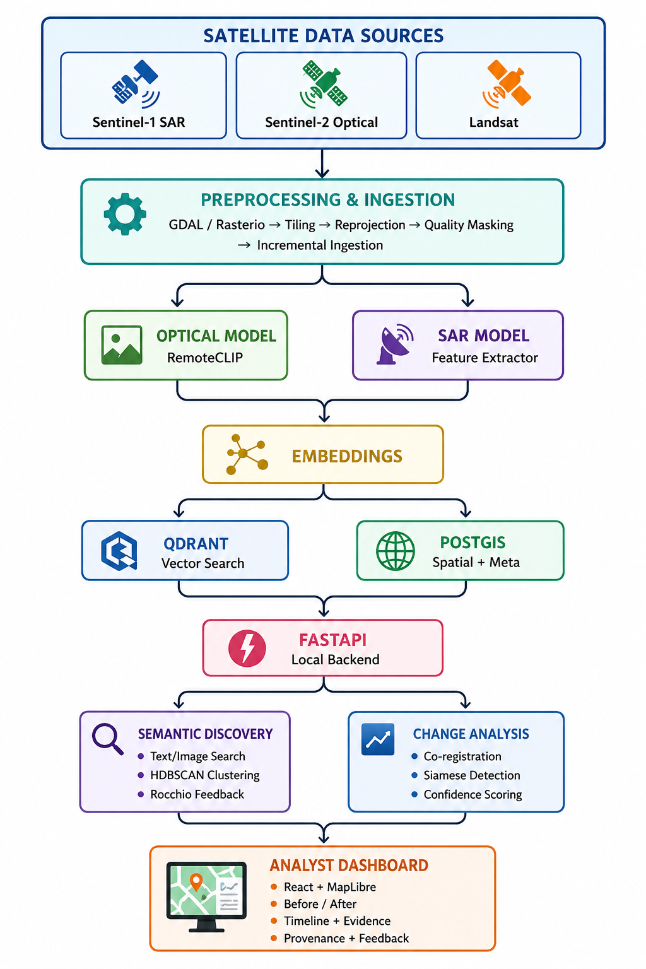
TECHNICAL APPROACH
ConvergeX
Technologies to be used:
Python + PyTorch — AI model development & local inference
RemoteCLIP — Text/image semantic satellite retrieval
SAR Feature Extractor — Sentinel-1 SAR feature extraction
Siamese Change Detection — Multi-temporal change analysis
HDBSCAN + Rocchio — Similar-site discovery & search refinement
GDAL + Rasterio — Satellite raster processing & tiling
Qdrant — Vector embedding storage & similarity search
PostgreSQL + PostGIS — Spatial, temporal & metadata queries
FastAPI — Local AI/backend service integration
React + MapLibre GL JS — Offline analyst dashboard & map visualization
PMTiles — Offline map tile storage
Docker Compose — Reproducible on-premise deployment
Sentinel-1 / Sentinel-2 / Landsat — SAR, optical & historical satellite imagery

Slide 4
FEASIBILITY AND VIABILITY
ConvergeX
Feasibility of the idea:
• Proven open-source AI & geospatial technologies
• Public Sentinel-1, Sentinel-2 & Landsat data available
• Modular architecture enables rapid MVP development
• Offline/on-premise deployment is achievable
Potential challenges and risks:
• Large satellite data volume & processing requirements
• False alarms from clouds, shadows & seasonal changes
• Multi-temporal image misalignment
• Limited labeled data for validation
Strategies for overcoming these challenges:
• Tile-based & incremental data processing
• Quality masking, normalization & image co-registration
• GPU acceleration and model quantization
• Multi-signal confidence scoring + analyst verification

Slide 5
IMPACT AND BENEFITS
ConvergeX
Potential impact on the target audience:
• Faster identification of meaningful changes in satellite imagery
• Improved situational awareness for analysts and decision-makers
• Reduced manual effort in large-scale image investigation
• Supports rapid detection of emerging or previously unknown sites
Benefits of the solution:
• Social — Enables better environmental monitoring and informed decision-making.
• Economic — Reduces the time and cost of large-scale satellite analysis.
• Emergency — Enables rapid before/after assessment of disaster-affected areas.

Slide 6
RESEARCH AND REFERENCES
ConvergeX
RemoteCLIP (Optical RS Vision‑Language Model):
https://github.com/remote-clip/RemoteCLIP
SAR Vision‑Language Models (SARCLIP / SAR‑VLM family, arXiv / IEEE / GitHub, 2023–2025).
Qdrant Vector Database (offline vector search & filtering):
https://github.com/qdrant/qdrant

