Slide 1

SMART INDIA HACKATHON 2026
TITLE PAGE
Problem Statement ID –26173
Problem Statement Title-iTantra -Indian Multilingual TTS & STT Aided Neural Transceiver Radio Access for low bitrate links
Theme-Smart Automation
PS Category- Software
Team ID-
Team Name (Registered on portal)

Slide 2
iTantra – Multilingual Neural Transceiver for Low-Bitrate Links
ConvergeX
Proposed Solution
Detailed explanation of the proposed solution:
Offline Android app for cross-language voice communication
Converts speech → text → meaning → target-language speech
Supports 10 Indian languages on low-power devices
Innovation and uniqueness of the solution:
SONAR-based cross-lingual semantic communication
One shared semantic layer supports multiple languages
Combines Edge AI, offline STT/TTS, and adaptive voice communication
How it addresses the problem:
Eliminates dependency on Internet connectivity
Transmits compact semantic data instead of raw audio
Enables low-latency communication over Bluetooth/Wi-Fi

Slide 3
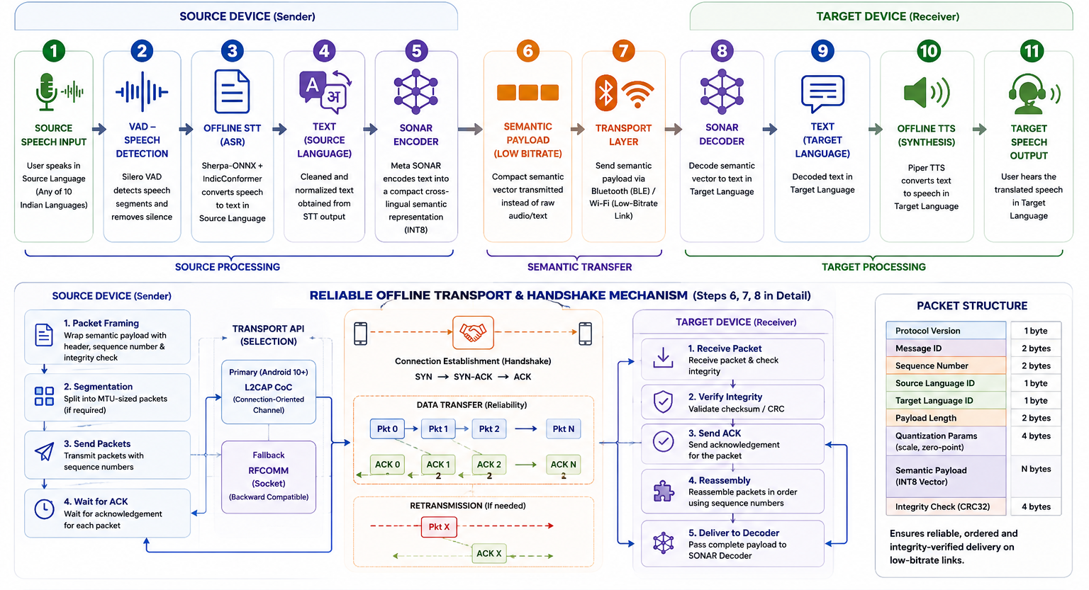
TECHNICAL APPROACH
ConvergeX
Technologies to be used
Kotlin + Python — Android development & AI optimization
ONNX Runtime — Efficient INT8 edge inference
Silero VAD — Speech detection & segmentation
Sherpa-ONNX + IndicConformer — Offline Indian-language STT
Meta SONAR — Cross-lingual semantic encoding/decoding
Piper TTS — Lightweight offline speech synthesis
BLE L2CAP / RFCOMM — Offline Bluetooth data transfer
SQLite — Local semantic cache for faster responses

Slide 4
FEASIBILITY AND VIABILITY
ConvergeX
Feasibility of the idea:
Technically feasible on low/mid-range Android devices
Fully offline using optimized Edge AI models
Scalable across 10 languages using shared SONAR representation
Potential challenges and risks
STT accuracy across diverse Indian accents
Model size & RAM constraints on low-end devices
Latency in semantic processing and voice generation
Strategies for overcoming these challenges
INT8 quantization and lightweight model optimization
VAD + sentence streaming to reduce processing delay
Benchmark & tune WER, RAM, CPU and end-to-end latency

Slide 5
IMPACT AND BENEFITS
ConvergeX
Potential impact on the target audience:
Bridges language barriers during critical communication
Enables offline communication in remote and low-connectivity areas
Improves accessibility for regional-language users
Benefits of the solution:
Social: Inclusive communication across Indian languages
Economic: Low-cost solution using existing smartphones
Emergency: Reliable voice alerts without Internet dependency

Slide 6
RESEARCH AND REFERENCES
ConvergeX
Meta SONAR (GitHub Repository): https://github.com/facebookresearch/SONAR
AI4Bharat (Official Research Portal): https://ai4bharat.iitm.ac.in/
Sherpa-ONNX (GitHub Repository): https://github.com/k2-fsa/sherpa-onnx
Silero VAD (GitHub Repository): https://github.com/snakers4/silero-vad

