Slide 1
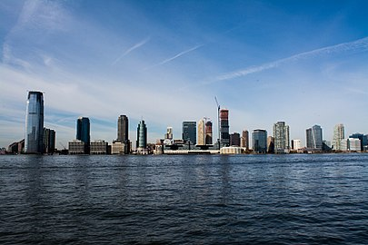
Analysis of candid location for starting new stores business at New Jersey, US
Capstone Project assignment – Kalyan Gogulapati

Slide 2
Analysis of candid location for starting new stores business at New Jersey, US
Introduction
Problem background:
Mr. Patel requested to help him identifying candid location to start new Department store/Convenient store/Grocery store in New Jersey state.
Other criteria to meet the requirement are:
Should be one of top 10 cities by population of NJ
Need at least 5 options to choose
Less competition

Slide 3
Data acquisition and cleaning
Data Sources
  https://en.wikipedia.org/wiki/New_Jersey
  http://www.city-data.com/city/New-Jersey.html
  https://www.geonames.org/US/NJ/largest-cities-in-new-jersey.html
  https://en.wikipedia.org/wiki/List_of_neighborhoods_in_Newark,_New_Jersey
  https://www.britannica.com/place/New-Jersey
  https://developer.foursquare.com/
Cleaning
  Identified total of 571 cities of NJ where population > 6k
  Latitude and Longitude details generated for top10 cities
  Identified 19 neighborhoods of Newark
  Venues information generated using FourSqure API
  Sorted, formatted and cleaned data

Slide 4
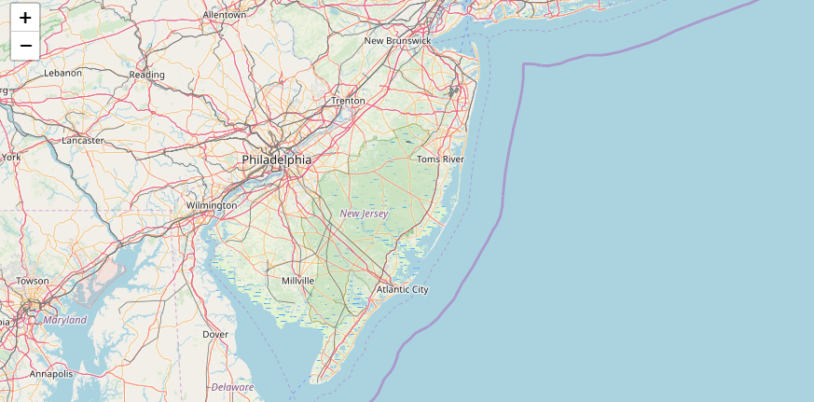
Methodology - Exploratory Data Analysis
Used Folium to visualize NJ map

Slide 5
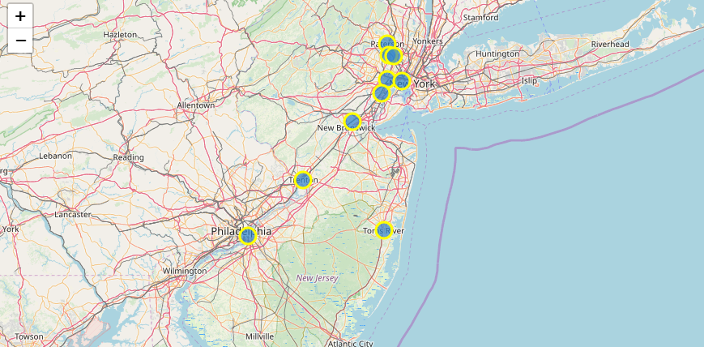
Methodology - Exploratory Data Analysis
Used Folium to visualize top 10 cities of NJ by population

Slide 6
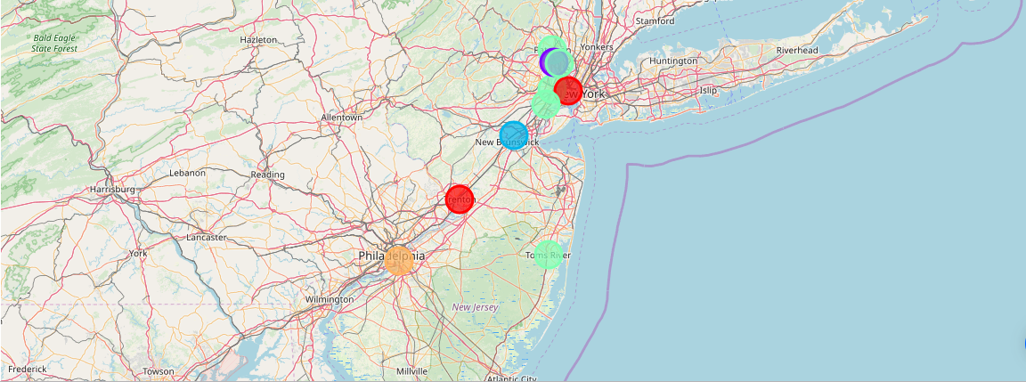
Methodology - Exploratory Data Analysis
K-Means algorithm used cluster the top 10 cities by venues/ businesses then plotted on New Jersey state map

Slide 7
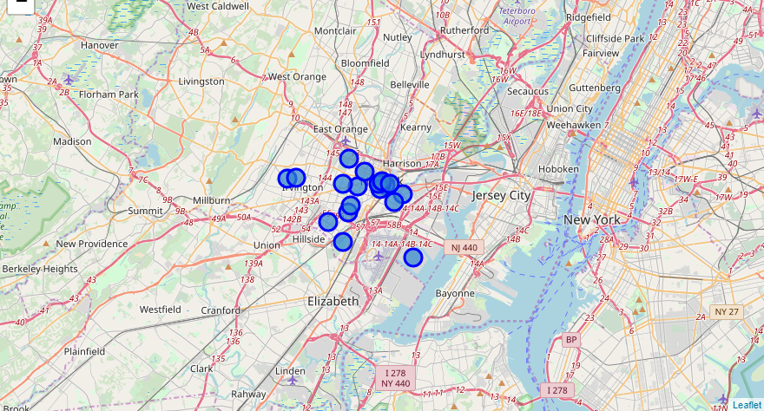
Methodology - Exploratory Data Analysis
Analyzed the resulted merged data set for the requirement. Identified Newark is the prime location. Hence gathered information on Newark state for 19 neighborhoods and plotted on map as below.

Slide 8
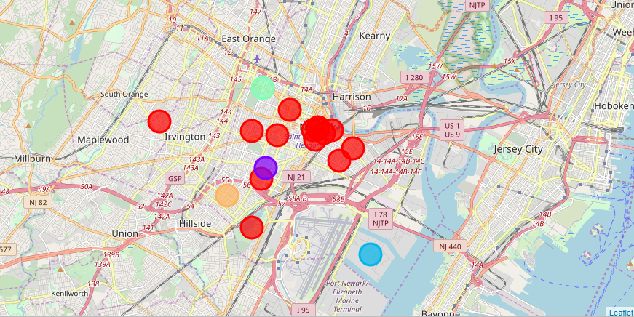
Methodology - Exploratory Data Analysis
K-Means algorithm used cluster the top 19 neighborhoods of Newark by venues/ businesses then plotted on Newark map

Slide 9
Results
Analysis results on most common venues of:
NJ cities
Grocery store
Paterson city- 6th
Edison city- 6th
Convenient store
Toms River - 7th
Trenton city- 8th
Department Store
Clifton city- 6th
Newark neighborhoods
^{Grocery Store}
^{West Side - 3rd}
^{Ivy Hill - 8th}
^{Five Corners - 5th}
^{Weequahic - 2nd}
^{Department store}
Government Cente,Port Newark - 8th
^{Sourth Brad Valley - 9th}
^{Convenience Store}
^{Clinton Hill, Dayton - 8th}
^{Weequahic 7th}
Downtown Newark, Teachers Village 10th

Slide 10
Conclusion
Recommended ideal locations in order are Fairmount, Four Corners, Gateway Center, Springfield/Belmont, The Coast/Lincoln Park, The Ironbound, University Heights, Vailsburg, Downtown Newark, Teachers Village, South Broad Valley, Government Center, Ivy Hill, Port Newark, Clinton Hill, Dayton, Five Corners, Weequahic, West Side
Analyzed data of State, City and neighborhood specific data for businesses and their density in nature
Built useful models to predict candid location for starting new business of a given state
These models can be very useful in helping future investors/businessmen in a number of ways
This analysis can be extended to any geographic location and to any specific business by changing the few parameters.
Accuracy of the models has room for improvement.

