Slide 1




Next Gen Employability Program
Full Stack Web Development with AI Tools
Team Details – NG_CP_Team_5131
Gogulraj U
Kalaiyarasan H
Sanjaikumar S
Bhuvanesh R
Chandru A E
College: Adhiparasakthi Engineering College, Chennai

Slide 2

The content is curated from online/offline resources and used for educational purpose only.
Notes:
Speaker would be briefing the students that this content has been prepared for the educational purpose only and is referred from multiple sites which are cited in the last.​​
---------------------------------------------------​​
A disclaimer is a statement or notice that is intended to clarify, limit, or provide information about the scope, limitations, or potential risks associated with certain actions, information, products, services, or content. ​​
​​
​

Slide 3

Project Title
Smart Bus Route Finder
Notes:
In this slide speaker will be introducing the program and its outcomes. The speaker will introduce himself in brief

Slide 4

Table of Contents:
Problem statement and Existing System
Project Objectives
Introduction
Modules
Conclusion
References
Notes:
This slide, The speaker will talk about the content that we will be covering in this session as follows:
Introduction
Importance of UI/UX in industry
History and Definitions of UI and UX
Key Differences between UI/UX
Use Cases
Significance in Web Development
Use Cases
Visual Design Principles
Design process
Color theory and psychology
Typography and readability
Layout and Spacing
Responsive design basics
Usability and Accessibility
Usability Aspects
Web Content Accessibility Guidelines (WCAG)
Inclusive design practices
Consistency
User Experience
User-Centered Design
User research methods
Interactive Elements and Feedback
Mini Case Study
Discussing a popular UI/UX design
Hands-On
Introduction to Figma for UI/UX design

Slide 5
Problem Statement:
Passengers do not have access to real-time bus location information.
Bus arrival times are uncertain due to traffic and delays.
Long waiting time at bus stops causes inconvenience.
Lack of a simple digital platform to track buses easily.
Existing System:
Depends on fixed timetable schedules.
Passengers rely on manual inquiry at bus stands.
No proper real-time GPS tracking in many areas.
Information provided is often inaccurate or delayed.
Notes:
This slide, The speaker will talk about the content that we will be covering in this session as follows:
Introduction
Importance of UI/UX in industry
History and Definitions of UI and UX
Key Differences between UI/UX
Use Cases
Significance in Web Development
Use Cases
Visual Design Principles
Design process
Color theory and psychology
Typography and readability
Layout and Spacing
Responsive design basics
Usability and Accessibility
Usability Aspects
Web Content Accessibility Guidelines (WCAG)
Inclusive design practices
Consistency
User Experience
User-Centered Design
User research methods
Interactive Elements and Feedback
Mini Case Study
Discussing a popular UI/UX design
Hands-On
Introduction to Figma for UI/UX design

Slide 6
Project Objectives:
The main objective of the MyBusStand project is to develop a user-friendly web application that enables passengers to track buses easily and efficiently. The system aims to provide secure access through mobile OTP authentication to ensure safe usage. It allows users to search for buses by entering their source and destination locations and displays available buses with route details dynamically. The application also simulates real-time bus tracking and calculates the Estimated Time of Arrival (ETA) to reduce waiting time and travel uncertainty. Overall, the project focuses on improving public transport convenience by using simple and effective digital technology.

Slide 7
Introduction :
MyBusStand is a user-friendly mobile application designed to help people in villages and towns track the live location of buses and find bus routes easily. The app allows users to know where the bus is, its route, and expected arrival time, reducing waiting time at bus stops. With a simple interface and local language support, MyBusStand makes public transportation more convenient and efficient.
Notes:
This slide, The speaker will talk about the content that we will be covering in this session as follows:
Introduction
Importance of UI/UX in industry
History and Definitions of UI and UX
Key Differences between UI/UX
Use Cases
Significance in Web Development
Use Cases
Visual Design Principles
Design process
Color theory and psychology
Typography and readability
Layout and Spacing
Responsive design basics
Usability and Accessibility
Usability Aspects
Web Content Accessibility Guidelines (WCAG)
Inclusive design practices
Consistency
User Experience
User-Centered Design
User research methods
Interactive Elements and Feedback
Mini Case Study
Discussing a popular UI/UX design
Hands-On
Introduction to Figma for UI/UX design

Slide 8
Requirements:
Hardware Requirements
Processor: Intel i3 or above
RAM: Minimum 4 GB
Hard Disk: Minimum 20 GB free space
Device: Desktop / Laptop / Mobile
Internet connection required
Software Requirements
Operating System: Windows / Linux / macOS
Frontend: HTML, CSS, JavaScript
Backend: Python 3.8 or higher
Framework: Django 5.0
Database: MySQL 8.0.45
Web Browser: Chrome / Edge / Firefox
Notes:
This slide, The speaker will talk about the content that we will be covering in this session as follows:
Introduction
Importance of UI/UX in industry
History and Definitions of UI and UX
Key Differences between UI/UX
Use Cases
Significance in Web Development
Use Cases
Visual Design Principles
Design process
Color theory and psychology
Typography and readability
Layout and Spacing
Responsive design basics
Usability and Accessibility
Usability Aspects
Web Content Accessibility Guidelines (WCAG)
Inclusive design practices
Consistency
User Experience
User-Centered Design
User research methods
Interactive Elements and Feedback
Mini Case Study
Discussing a popular UI/UX design
Hands-On
Introduction to Figma for UI/UX design

Slide 9
Modules:
User Authentication Module Allows users to log in using mobile OTP verification to ensure secure and authorized access.
Route Search Module Enables users to enter source and destination to search for available buses easily.
Bus Listing Module Displays available buses with bus numbers and route details based on user search.
Live Bus Tracking Module Simulates real-time bus location and shows Estimated Time of Arrival (ETA).
Chatbot Support Module Provides automated assistance to answer user queries and improve user experience.
Notes:
This slide, The speaker will talk about the content that we will be covering in this session as follows:
Introduction
Importance of UI/UX in industry
History and Definitions of UI and UX
Key Differences between UI/UX
Use Cases
Significance in Web Development
Use Cases
Visual Design Principles
Design process
Color theory and psychology
Typography and readability
Layout and Spacing
Responsive design basics
Usability and Accessibility
Usability Aspects
Web Content Accessibility Guidelines (WCAG)
Inclusive design practices
Consistency
User Experience
User-Centered Design
User research methods
Interactive Elements and Feedback
Mini Case Study
Discussing a popular UI/UX design
Hands-On
Introduction to Figma for UI/UX design

Slide 10
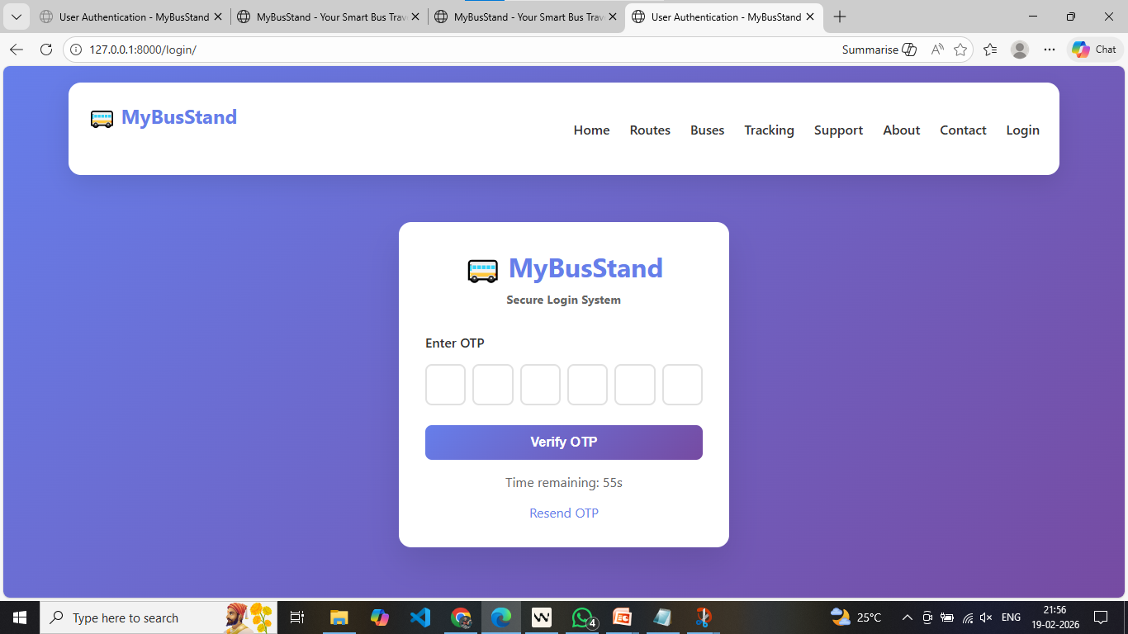

Slide 11
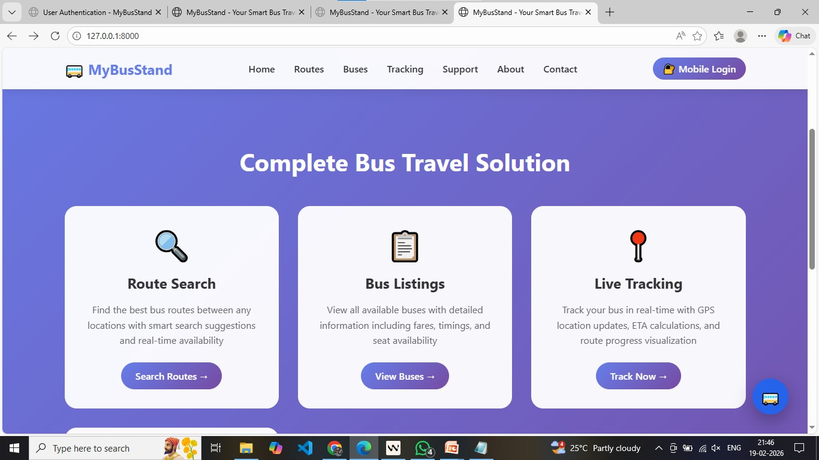

Slide 12
Future Enhancement:
Real-time traffic updates for accurate arrival time.
Online ticket booking facilit.
SMS and notification alerts for bus arrival.
Voice guidance and local language support.
Offline access for basic bus route information.

Slide 13
Conclusion:
The MyBusStand project provides an effective solution for tracking village and town buses in real time. It helps users know the bus location, route, and arrival time, reducing waiting time and confusion at bus stops. With a simple and user-friendly design, this application improves the public transportation experience and is highly useful for daily commuters.

Slide 14
References:
https://nodejs.org/api/net.html
W3Schools Web Development Tutorials – https://www.w3schools.com
Google Maps Platform – Used for map display and live bus tracking\
Firebase – Used for real-time data storage and updates
Android Developers – Reference for mobile app development
Django – Used for backend service and APIs
OpenStreetMap – Alternative map and route data source
Notes:
This slide, The speaker will talk about the content that we will be covering in this session as follows:
Introduction
Importance of UI/UX in industry
History and Definitions of UI and UX
Key Differences between UI/UX
Use Cases
Significance in Web Development
Use Cases
Visual Design Principles
Design process
Color theory and psychology
Typography and readability
Layout and Spacing
Responsive design basics
Usability and Accessibility
Usability Aspects
Web Content Accessibility Guidelines (WCAG)
Inclusive design practices
Consistency
User Experience
User-Centered Design
User research methods
Interactive Elements and Feedback
Mini Case Study
Discussing a popular UI/UX design
Hands-On
Introduction to Figma for UI/UX design

