Slide 1


Slide 2
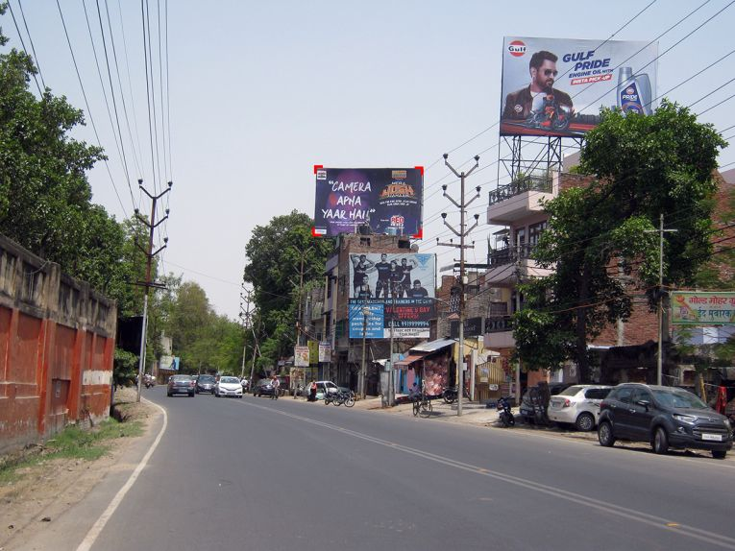

CAMPAIGN DETAILS OF
Site name : V.I.P. Road, Kanpur sdfsdf
Media Type : Billboard
SITE
Name : V.I.P. Road, Kanpur sdfsdf
Media Type : Billboard
Name : V.I.P. Road, Kanpur sdfsdf
Media Type : Billboard
Name : V.I.P. Road, Kanpur sdfsdf
Media Type : Billboard

Slide 3


