Slide 1
Command Injection Vulnerability
Understanding, Exploiting, and Mitigating Risks

Slide 2
OUR TEAM
GOHAR REHMAN
MUHAMMAD ABDULLAH
MUHAMMAD SOHAIB
HUZAIFA AHMED

Slide 3
TABLE OF CONTENTS
01
02
03
04
Vulnerability Overview
Exploitation Process
Tools & Demonstrations
Mitigation Strategies

Slide 4
What is Command Injection?
Command Injection is an attack method in which an attacker can execute arbitrary commands on a system by injecting malicious code into a command-line script or application.

Slide 5
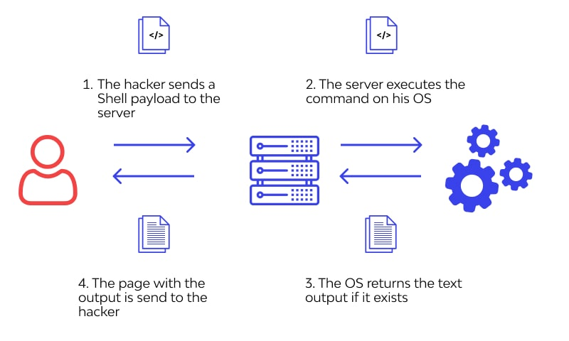
Command Injection

Slide 6
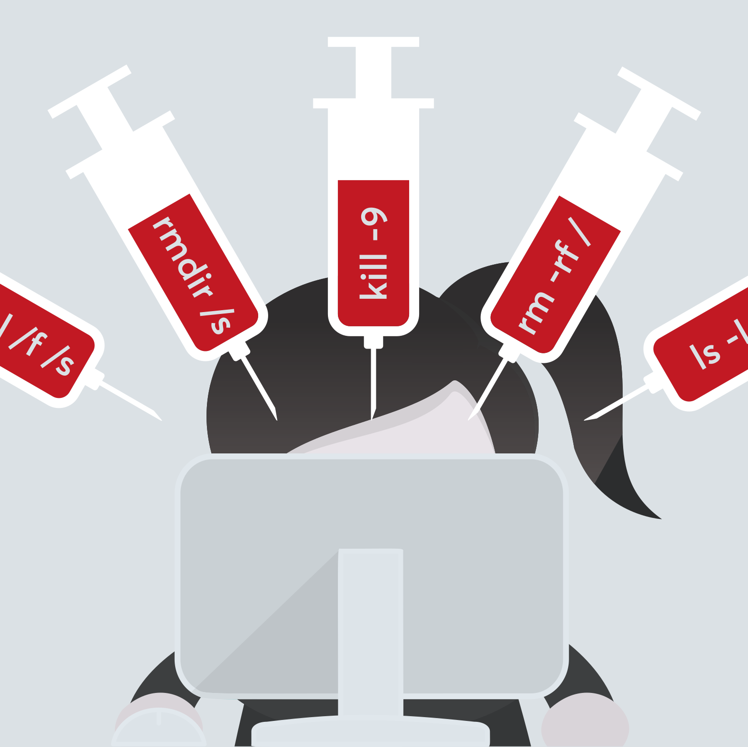
How the Vulnerability Arises
Common scenarios: Improper input validation, handling user inputs, and misuse of system commands
System trust in user inputs leading to vulnerabilities.

Slide 7

How Does it Work?
Step 1: Attacker inserts malicious commands via input fields.
Step 2: The system, trusting the input, executes these commands.
Step 3: Malicious actions (e.g., data theft) are carried out.

Slide 8
How Command Injection is Exploited
Identifying Vulnerable Points:
Target Inputs
Analyzing Code
Crafting Malicious Inputs:
Basic Injection
Payloads

Slide 9
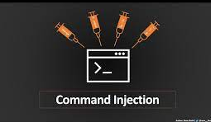
Exploiting Command Injection Vulnerabilities:
3. Testing for Blind Injection:
Trial and Error
Automated Tools
4. Executing Commands
System Commands
Privilege Escalation
5. Covering Tracks:
Minimizing Detection
Logging Evasion

Slide 10
Impact of Exploitation
Short-term Consequences:
Immediate data leaks, system crashes, or unauthorized access.
Long-term Impacts:
Reputation damage, legal consequences, financial implications.

Slide 11
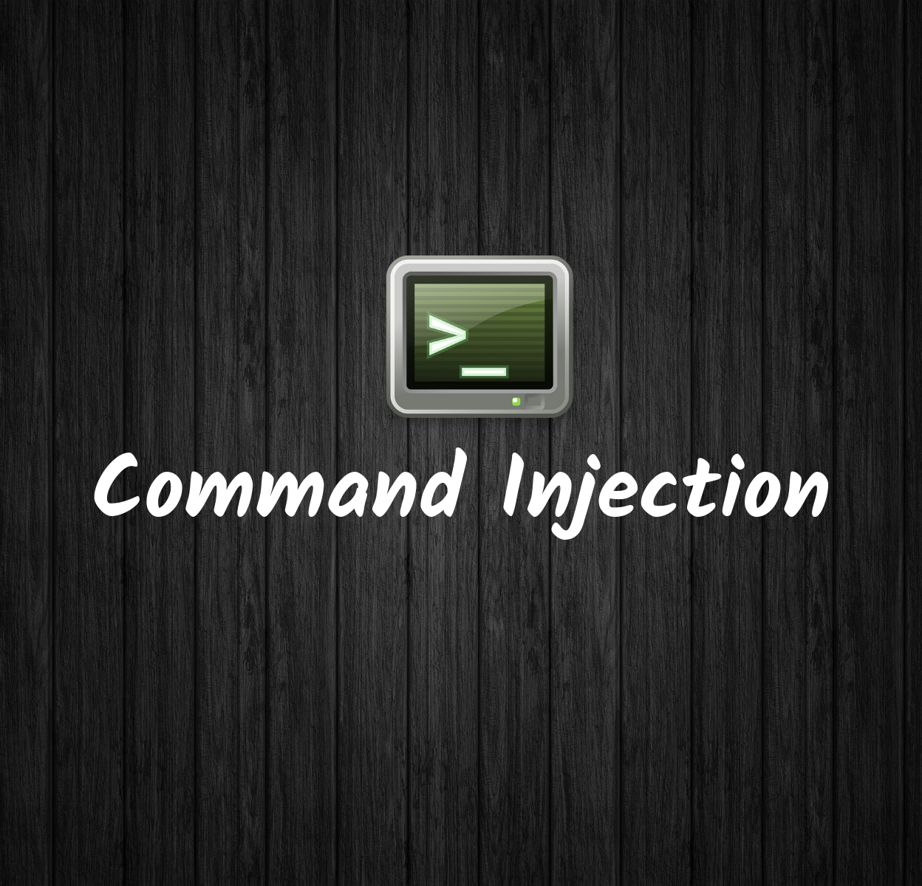
Tools Used - Introduction
Popular Tools Overview:
Highlighting features, strengths, and areas of application for tools like Commix, Burp Suite and OWASP ZAP.
Tool Landscape:
Mentioning other tools or utilities that might be relevant.

Slide 12
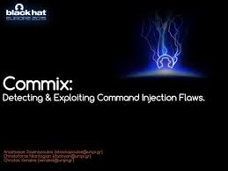
Tools Used - Usage
Commix - A Tool Overview:
Automated Detection
Custom Payloads
Interactive Shell
Support for Various Platforms
Usage Example: commix -u "http://target.com/page?param1=value1&param2=value2" –all
OWASP ZAP - A Tool Overview:
Active and Passive Scanning
Automated Attack Modes
Interactive Proxy
Scripting Support
Usage Example: Configure ZAP as a proxy, initiate an active scan.

Slide 13
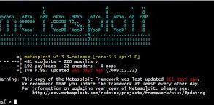
Tools Used - Usage
Metasploit - A Tool Overview:
Exploit Modules
Post-Exploitation Modules
Community-Driven Exploits
Payload Customization
Usage Example: msfconsole, select an exploit module, set target IP, exploit.

Slide 14
Patching & Mitigation
Demonstration Benefits:
Discussing the advantages of using these tools for vulnerability assessment.
Interactive vs. Automated:
Differentiating between manual testing and automated scans for command injection.

Slide 15
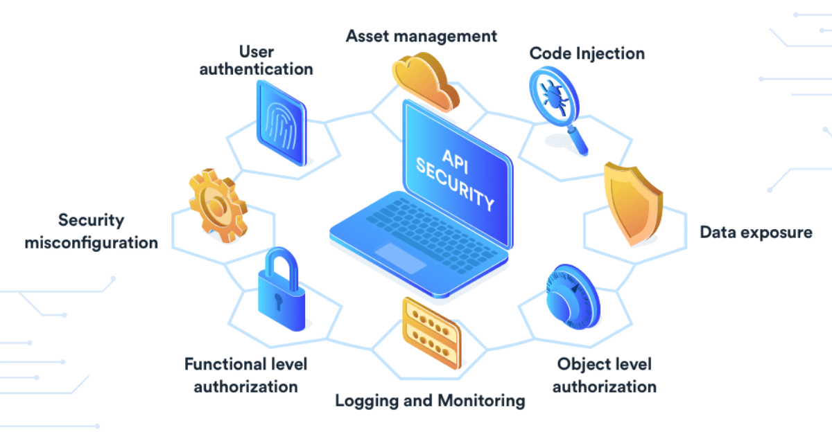
Patching & Mitigation
Proactive Measures - Input Validation
Validation: Ensuring inputs meet defined criteria.
Sanitization: Cleaning inputs to remove or neutralize malicious content.
Proactive Measures - Using Safe APIs
Introduction: Transitioning from direct command execution to safer APIs.
Benefits: Improved security, better error handling.

Slide 16
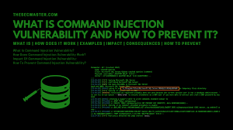
Patching & Mitigation
Proactive Measures - Whitelisting Inputs
Definition: Allow only pre-approved, known inputs.
Implementation: Regularly update and review the whitelist
Proactive Measures - Regular Audits & Monitoring
Continuous Monitoring: Regularly scan for vulnerabilities.
Benefits: Early detection, timely response.

Slide 17

Patching & Mitigation
Proactive Measures - Least Privilege Principle
Definition: Allow only pre-approved, known inputs.
Implementation: Regularly update and review the whitelist
Proactive Measures - Using Safe APIs
Introduction: Transitioning from direct command execution to safer APIs.
Benefits: Improved security, better error handling.

Slide 18


THANKS!
DO YOU HAVE ANY QUESTIONS?

