Slide 1
Overview of Operator
Steven Zou / Harbor maintainer

Slide 2
Harbor Operators – Overall Architecture
Harbor Cluster Operator is designed as full set (all-in-one) Harbor installation with PostgreSQL and REDIS installed in HA mode.
Minimal spec configurations to focus on HA case
Provision PostgreSQL HA and REDIS cluster and then configure them to the Harbor core provisioned by the core operator as external services
Harbor Core Operator covers the Harbor business components and treat DB and REDIS as dependent external services
Common replica settings and replica setting by components will be both supported
Business components:
Primary ones: core, portal, registry, registryctl, jobservice, log
Optional ones: notary server & signer, Clair adapter & Clair, Chartmuseum
Minimal spec configurations to simplify the provision process
Leave flexibility by supporting configMap which can contain the full set configuration options
The backup and recovery can be covered by separate operators
Provision
Scale
Upgrade
Uninstall
Harbor Cluster Operator
CR: harbor-cluster
minIO Operator^{[5]}
storage
harbor (replicas)
harbor-redis
harbor-db
Provision
Scale
Upgrade
Uninstall
Harbor Core Operator^{[1]}
CR: harbor
CR: …
PostgreSQL HA Operator^{[2]}
REDIS Cluster Operator^{[3]}
Harbor Backup Operator^{[4]}
CR: Backup
CR: Recovery
Backup
Recovery
Scanner Operator^{[6]}
Notary Operator^{[7]}
NOTES:
[1]: Harbor core operator is built based on the OVH version
[2]: Depends on an OSS community PostgreSQL HA Operator: [PLACEHOLDER]
[3]: Depends on an OSS community REDIS Cluster Operator: [PLACEHOLDER]
[4]: Backup may have to cover both storage and database backup procedures
[5]: Provide a default HA in-cluster storage service instead of relying on PV/PVC
[6]: Scanner can be Clair or Trivy
[7]: Cover notary server and signer
Notes:
-provisioning
-scaling up/down
-upgrades
-uninstall
-set up HA redis
-set up HA postgre

Slide 3
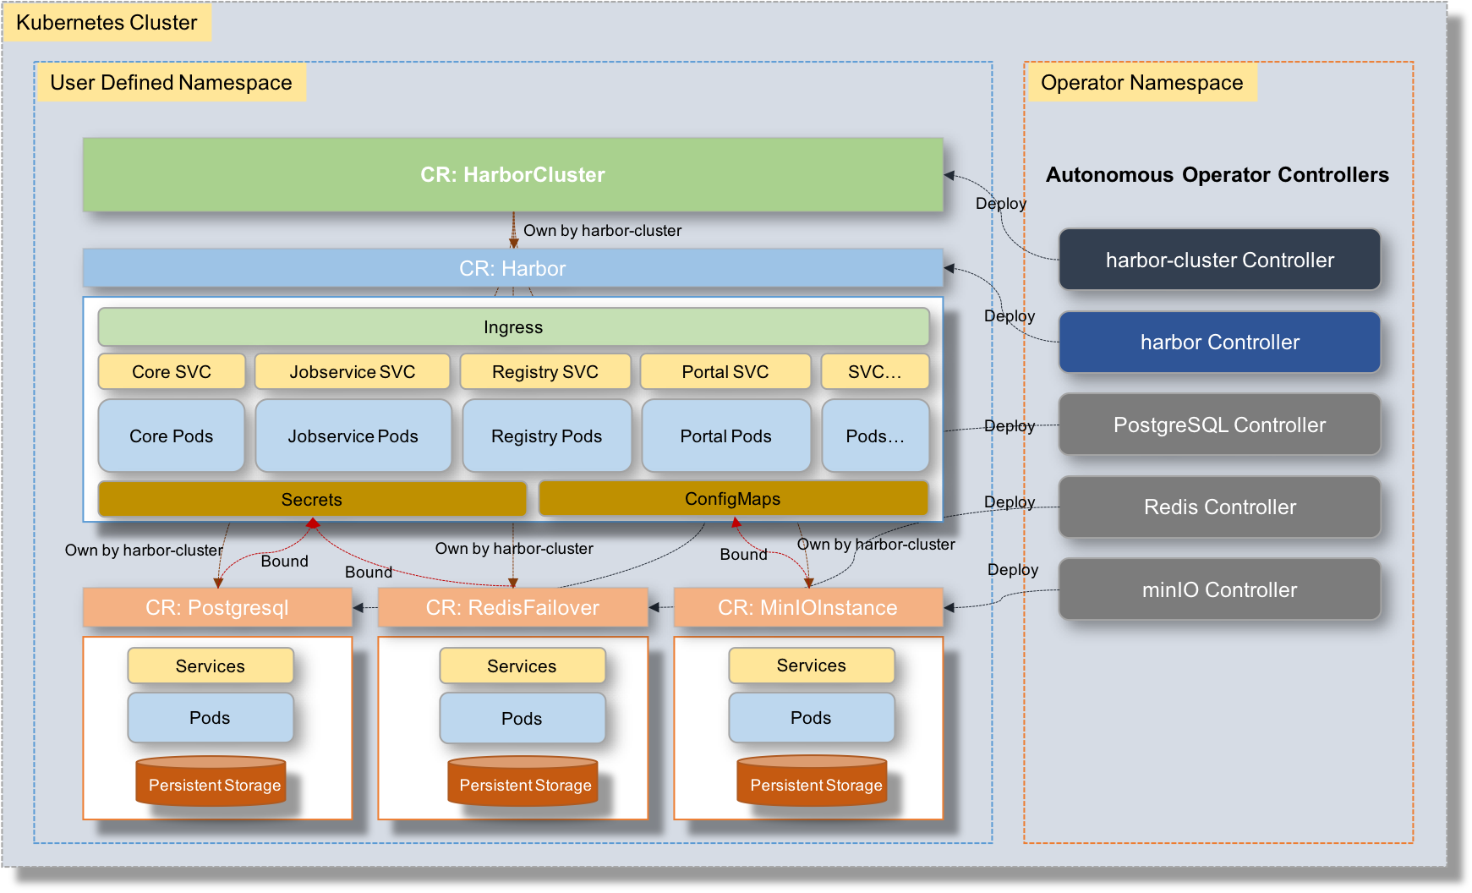
Relationship with harbor-cluster operator
harbor-operator
harbor-cluster-operator
[Long term]: One operator

Slide 4
Harbor Operator Roadmap
Discuss and confirm direction
Opensource OVH version to goharbor as the base version (harbor core operator 0.5)
Do improvements to harbor core operator and release 1.0
Develop Harbor cluster operator and release 1.0
Develop Harbor backup and recovery operator
Develop and migrate the core operator to multiple CRs model and release 1.0+

