Slide 1
MATH513 Sentiment Analysis Presentation
Cassandria Goh (10715753), Lim Jun Yong (10715755), Lee Wei Jian (Zeon) (10715754), Muhammad Firdaus (10715756)

Slide 2
Structure
Case Study Introduction
Exploration of Tweets & Sentiment Analysis
Statistical Analysis
Discussion & Conclusion

Slide 3
Business Case
The net income of General Motors has been declining since 2015. Mary T.Barra, the CEO of General Motors, is tasked by the shareholders of the company to restructure and turnaround the business. The restructuring will involve closing down of factories and dropping slow moving car models. In order to steer the company into the right direction, Mary will need data to support her decision-making.
Mary has task the General Motor’s data analytics team to perform sentiment analysis and provide statistical test on the analysis on the trend of electric cars compared to petrol cars. These findings will help the company to make the following decisions:
Convert existing factories facilities to manufacture electrical cars.
Convert existing factories facilities to improve the efficiency of the petrol cars.

Slide 4
Objectives
Our analysis should provide the business with a strategic decision or marketing interest.
Strategic decision: Whether to restructure the business from petrol cars to electric cars?
Marketing interest: Areas for marketing and promoting new products (e.g., electric cars). On football events, Superbowl?

Slide 5
Libraries used
library(tidyverse) library(rtweet) library(ggthemes) library(jsonlite) library(tidytext) library(wordcloud) library(wordcloud2) library(syuzhet) library(RColorBrewer) library(webr) library(gridExtra)

Slide 6
Sentiment Analysis

Slide 7
Twitter Exploration
In order to search Twitter, we decided to compare “electric car” vs “petrol car”. Though other variations were tried, these two were the closest to our business case and could consistently produce results.
The code will return the most recent tweets that are not retweets as they can end up skewing the data.

Slide 8
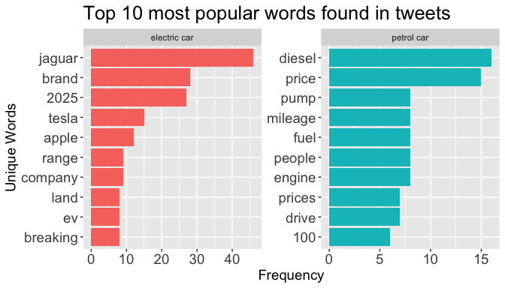
Top 10 Words Electric vs Petrol

Slide 9
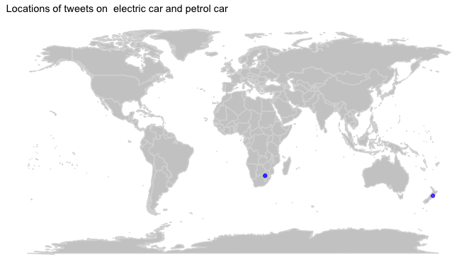
Tweet Locations
blue = word1, purple = word2

Slide 10
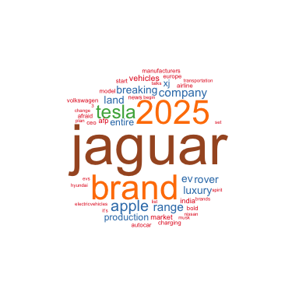
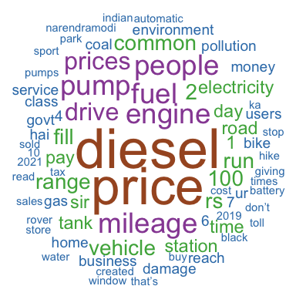
Wordclouds
Electric cars
Petrol cars

Slide 11
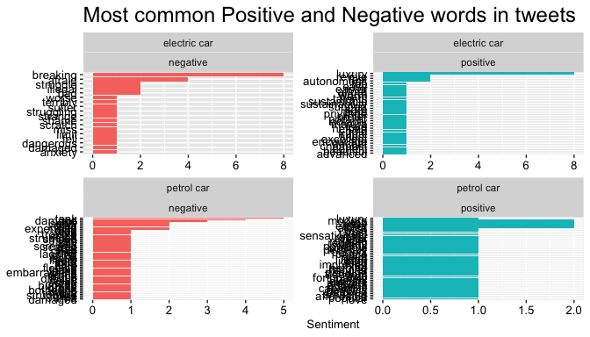
Top Positive and Negative Words for Petrol and Electric Cars with “bing” sentiment

Slide 12
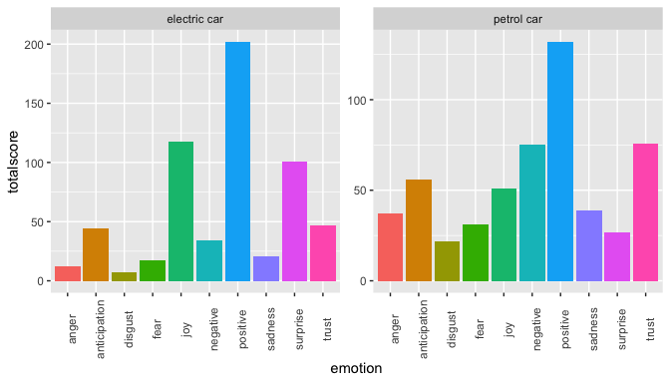
Categorizing Sentiments with Syuzhet and “nrc” Sentiment

Slide 13
Statistical Tests

Slide 14
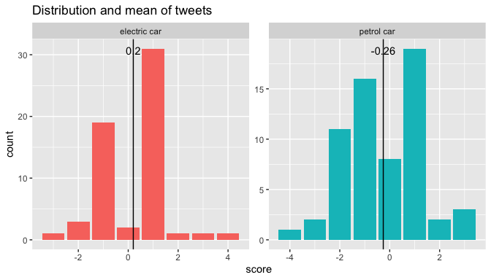
Visualizing Means

Slide 15
Is a T-test appropriate?

Slide 16
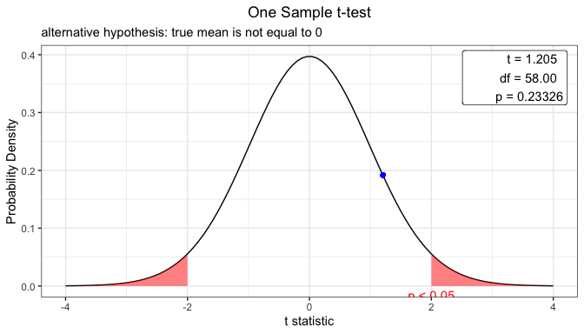
One sample, 2 tailed T-test on Electric Cars
null hypothesis: The mean for electric cars is not significant (0)

Slide 17
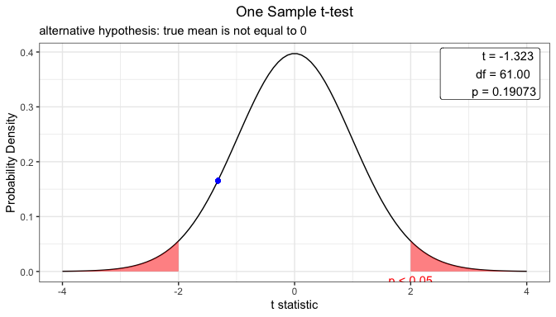
One sample, 2 tailed T-test on Petrol Cars
null hypothesis: The mean for petrol cars is not significant (0)

Slide 18
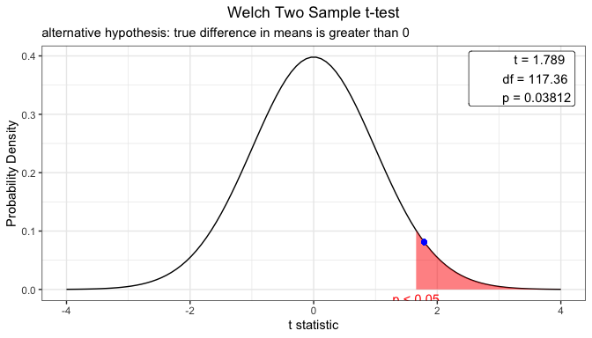
Two sample, Right tailed T-test
null hypothesis: The mean for electric cars is less than or equal to the mean for petrol cars

Slide 19
Conclusion
So, should General Motors move towards electric cars?
Through Twitter sentiment analysis, there is not only more conversation about electric cars but also a better sentiment toward electric cars compared to petrol cars.
Therefore it would be a great idea to move towards electric cars for General Motors. For marketing purposes, GM can make use of trending topics in whatever country they are trying to focus on.

Slide 20
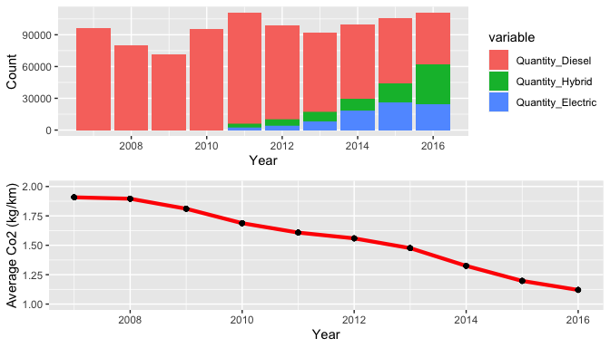
Rise of Electric Cars in Norway

Slide 21
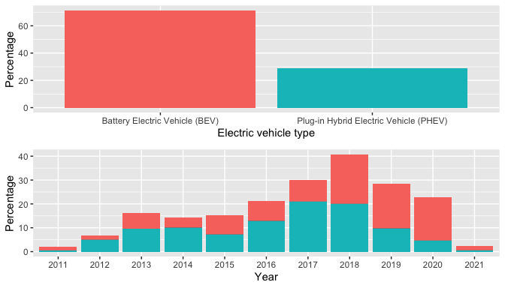
Car Sales in Washington, USA

Slide 22
Considerations of Switching to Electric
U.S. & Biden & Paris Agreement
VES Singapore
CO2 taxes
Charging locations
Charging speed
Other options

Slide 23
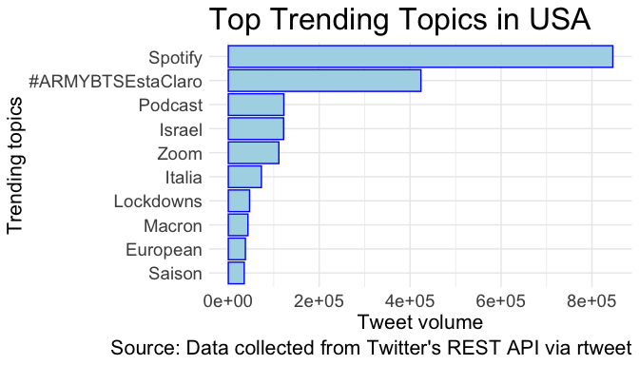
Trends in USA

Slide 24
References
“Carbon Tax.” National Environment Agency, www.nea.gov.sg/our-services/climate-change-energy-efficiency/climate-change/carbon-tax#:~:text=The%20carbon%20tax%20is%20set,of%20GHG%20emissions%20by%202030.
Chen, James. “Z-Test Definition.” Investopedia, Investopedia, 29 Aug. 2020, www.investopedia.com/terms/z/z-test.asp.
Data.gov. (2020, November 20). Electric vehicle population data. Datasets - CKAN. https://catalog.data.gov/dataset/electric-vehicle-population-data.
Meena, Subhash. “Hypothesis Testing: Difference between Z-Test and T-Test.” Analytics Vidhya, 23 Dec. 2020, www.analyticsvidhya.com/blog/2020/06/statistics-analytics-hypothesis-testing-z-test-t-test/.
Naldi, Maurizio. “A Review of Computation Methods with R Packages.” ArXiv.org, 24 Jan. 2019, arxiv.org/pdf/1901.08319.pdf.
Perepølkin, Dmytro. “New Car Sales in Norway.” Kaggle, 18 Feb. 2017, www.kaggle.com/dmi3kno/newcarsalesnorway.
“The Paris Agreement.” Unfccc.int, unfccc.int/process-and-meetings/the-paris-agreement/the-paris-agreement.
RS, AbdulMajedRaja. “Sentiment Analysis in R - Good vs Not Good - Handling Negations.” Medium, Towards Data Science, 16 Apr. 2020, towardsdatascience.com/sentiment-analysis-in-r-good-vs-not-good-handling-negations-2404ec9ff2ae.
Sipra, Vajiha. “Twitter Sentiment Analysis and Visualization Using R.” Medium, Towards Data Science, 21 Jan. 2020, towardsdatascience.com/twitter-sentiment-analysis-and-visualization-using-r-22e1f70f6967.

