Slide 1
Emotion Detection Master
Team : IM2
Member1 : Brahma Shiva Teja Ongole
Member2 : Ravi Sankar Burri
Member3 : Voohitha Atluri
Member4 : Shahanaz Shaik

Slide 2
Table of Contents:
Introduction
Requirements
Console Application Overview
Command-Line Interface
Graphical User Interface

Slide 3
Introduction:
A command-line interface or command language interpreter (CLI), also known as a command-line user interface, console user interface and character user interface (CUI), is a means of interacting with a computer program where the user (or client) issues commands to the program in the form of successive lines of text(command lines).
Today, many end users rarely, if ever, use command-line interfaces and instead rely upon graphical user interface and menu-driven interactions.

Slide 4
Requirements:
IDE : Python (version 2.7)
Repository : GIT HUB(files storing and sharing)
API used: Twitter API( User account is mandatory to pull the tweets)

Slide 5
Console Application Overview:
The console application is purely based on command line and all that we do is we pass the data(tweet files) , input option using console and as a user its hard to look at the black screen and keep continuing on the same page.

Slide 6
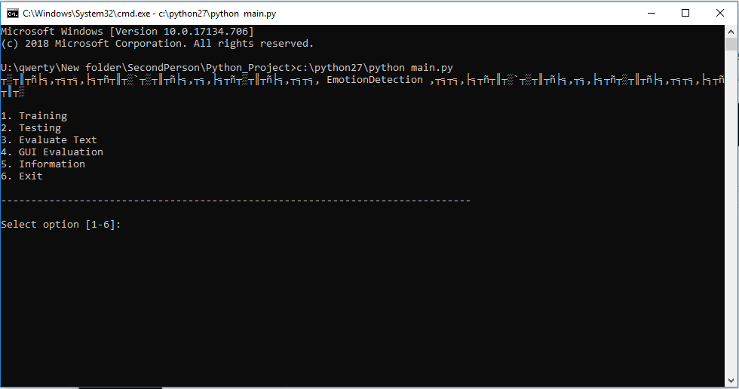
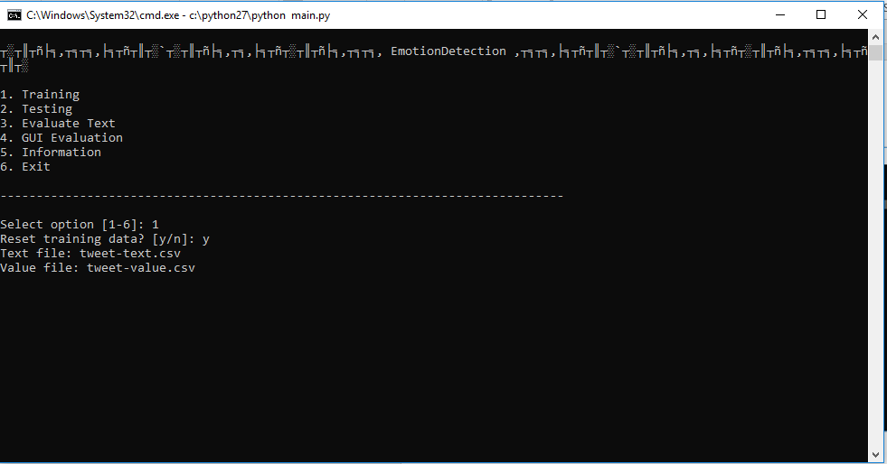
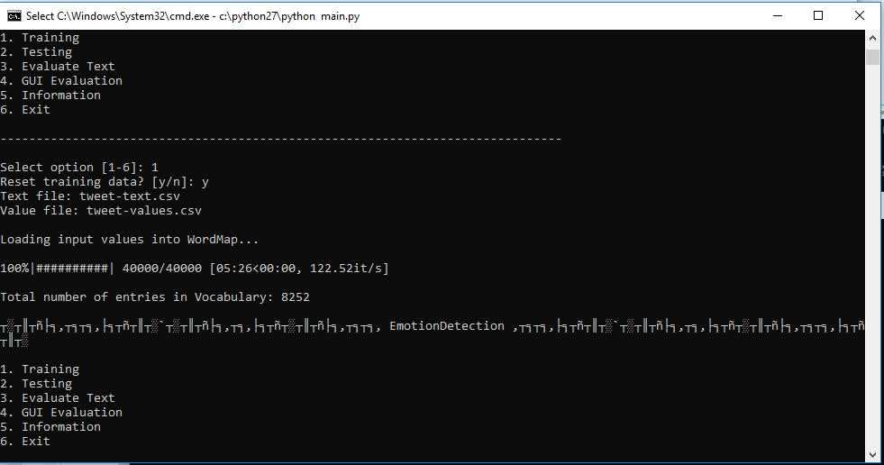
Command-Line Interface:

Slide 7
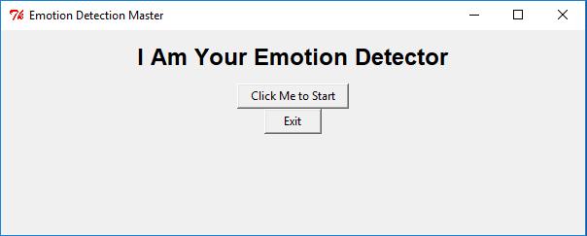
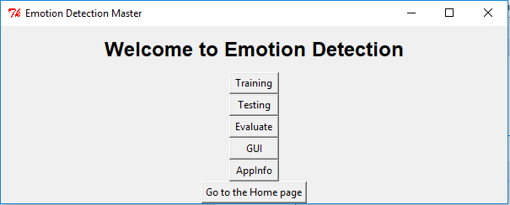
Graphical User Interface:

Slide 8
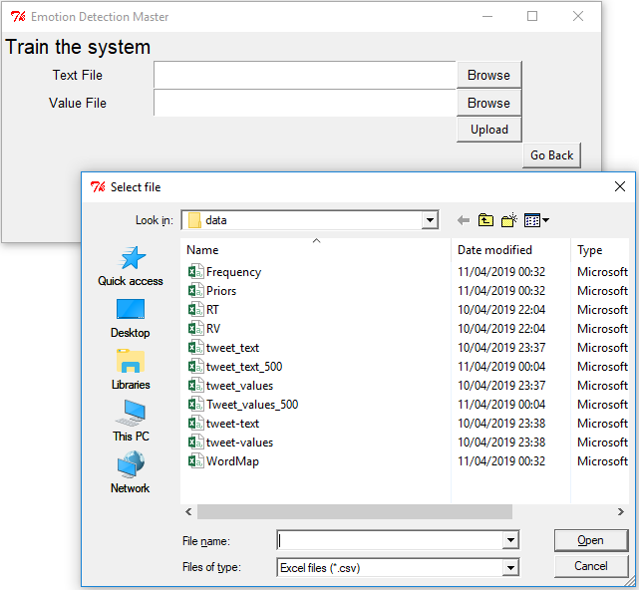
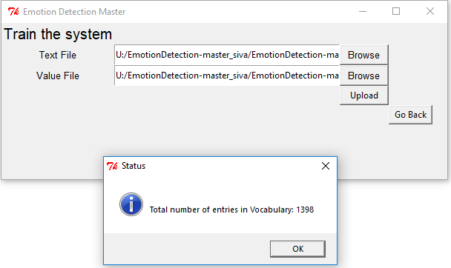
Graphical User Interface:
To Train the application using the tweets collected

Slide 9
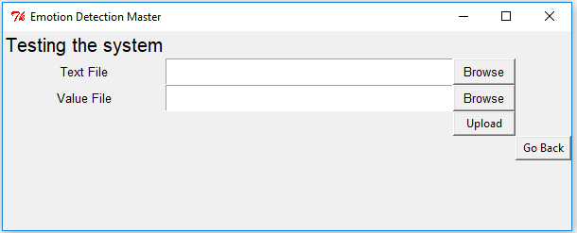
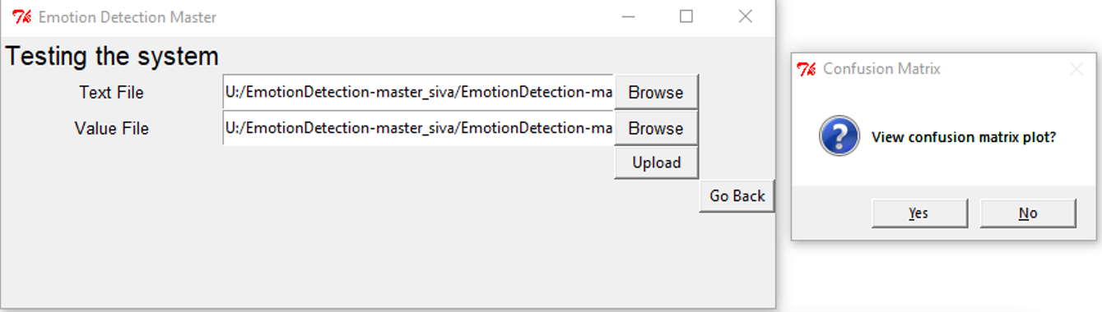
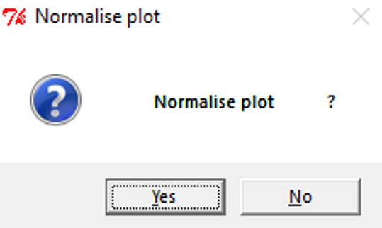
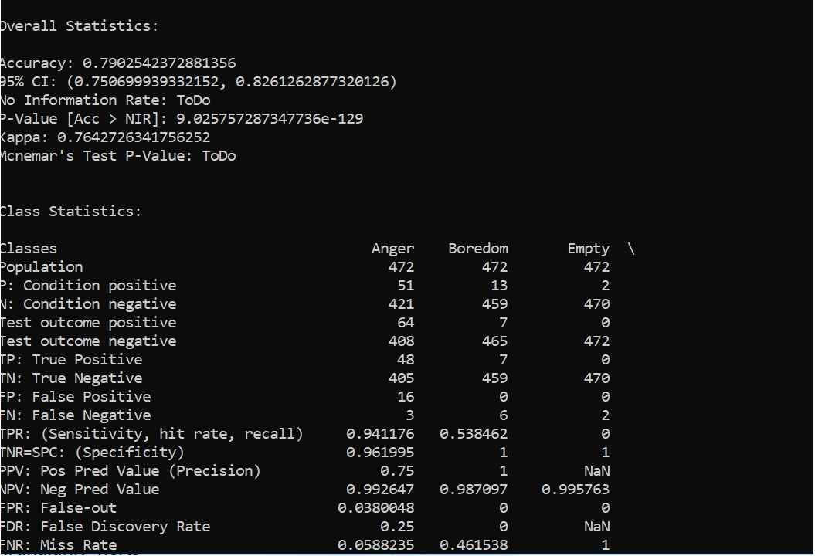
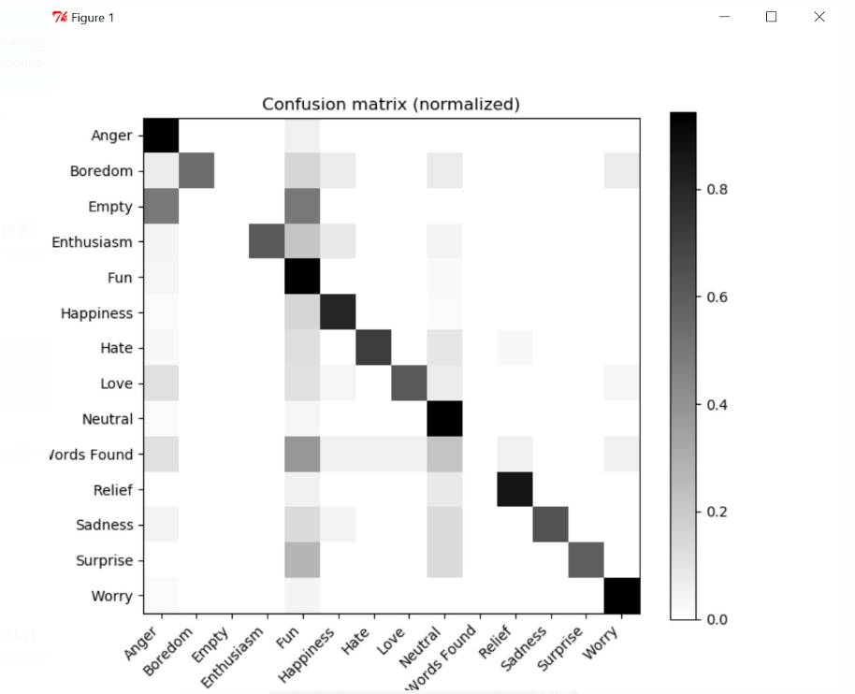
Graphical User Interface:
To Test the application using other tweet content.
Accuracy level =79%

Slide 10
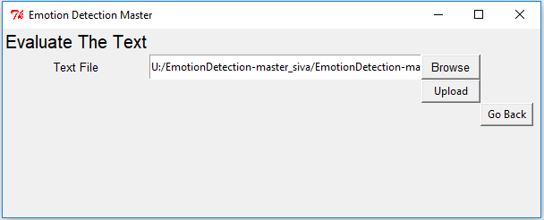
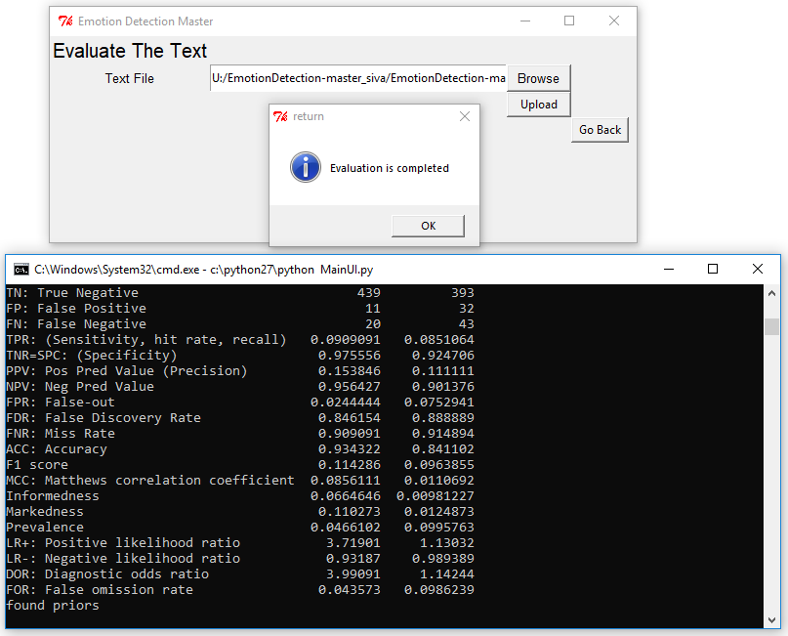
Graphical User Interface
Evaluate the text

Slide 11
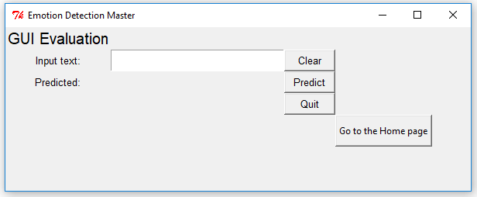
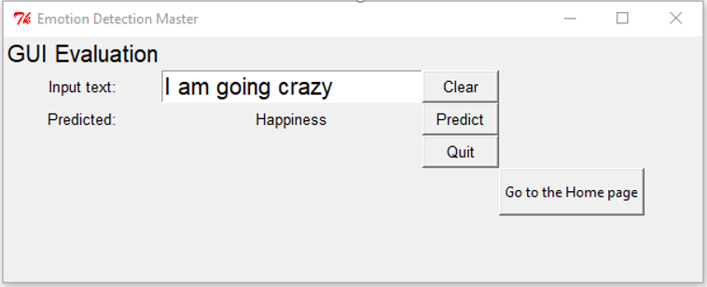
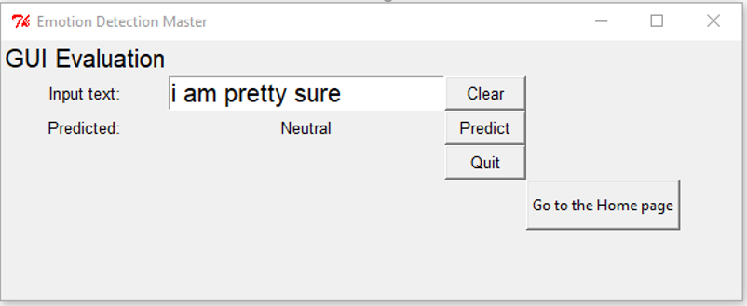
Graphical User Interface
Evaluate GUI based on the trained data.

Slide 12
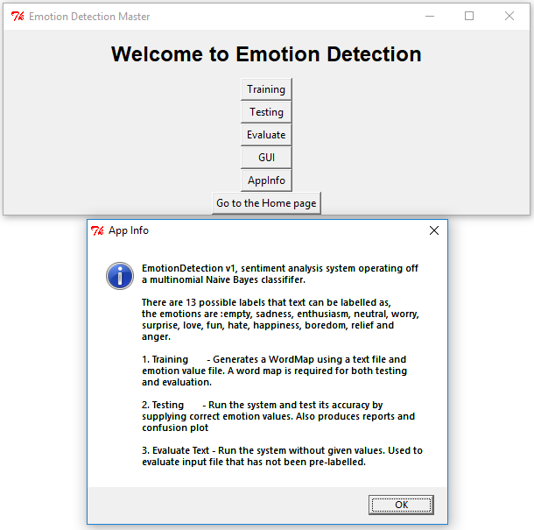
Graphical User Interface
Application Information

Slide 13
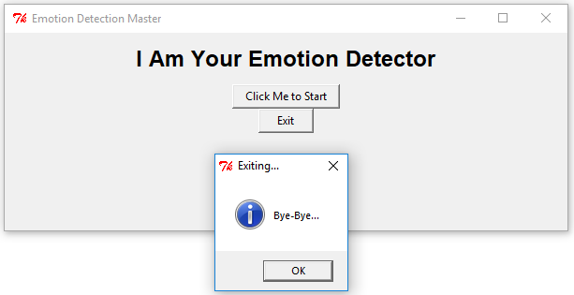
Graphical User Interface
Exiting application…

Slide 14
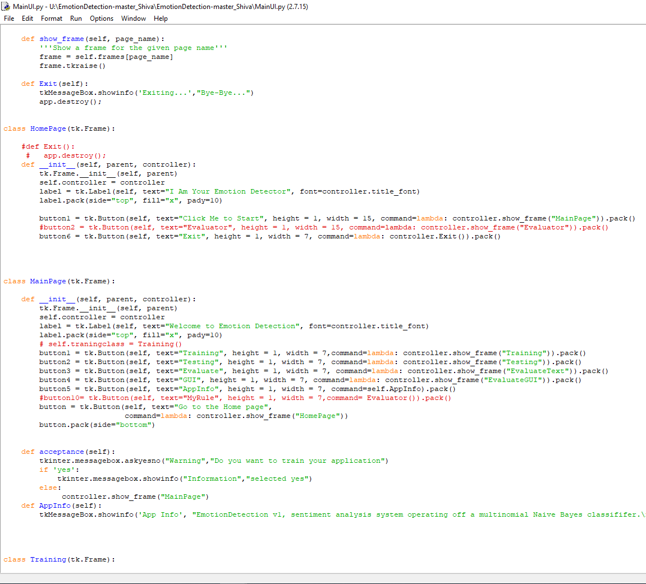
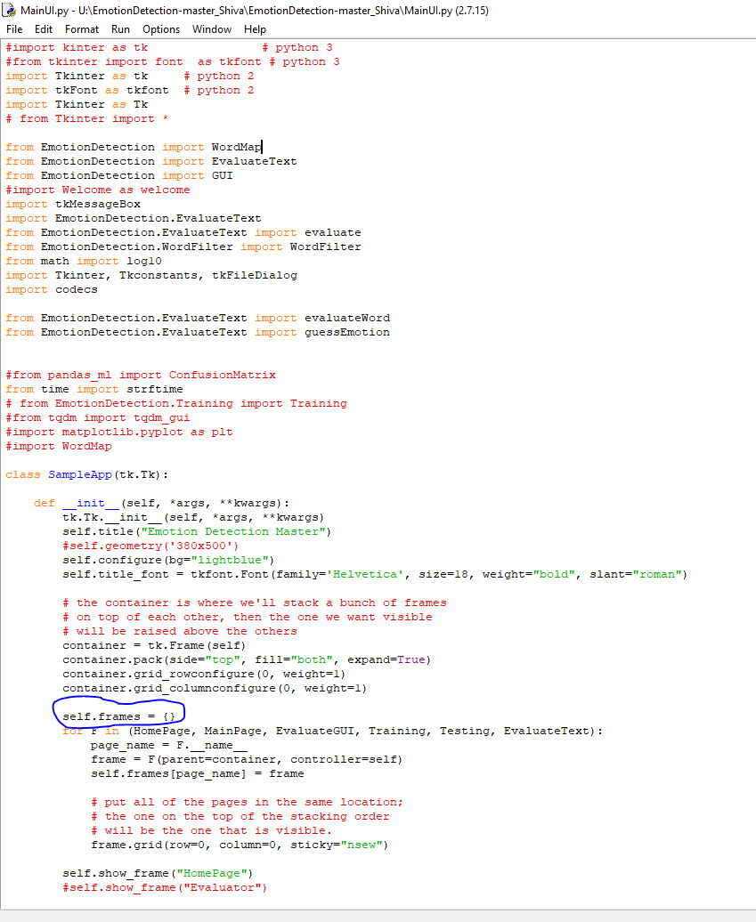
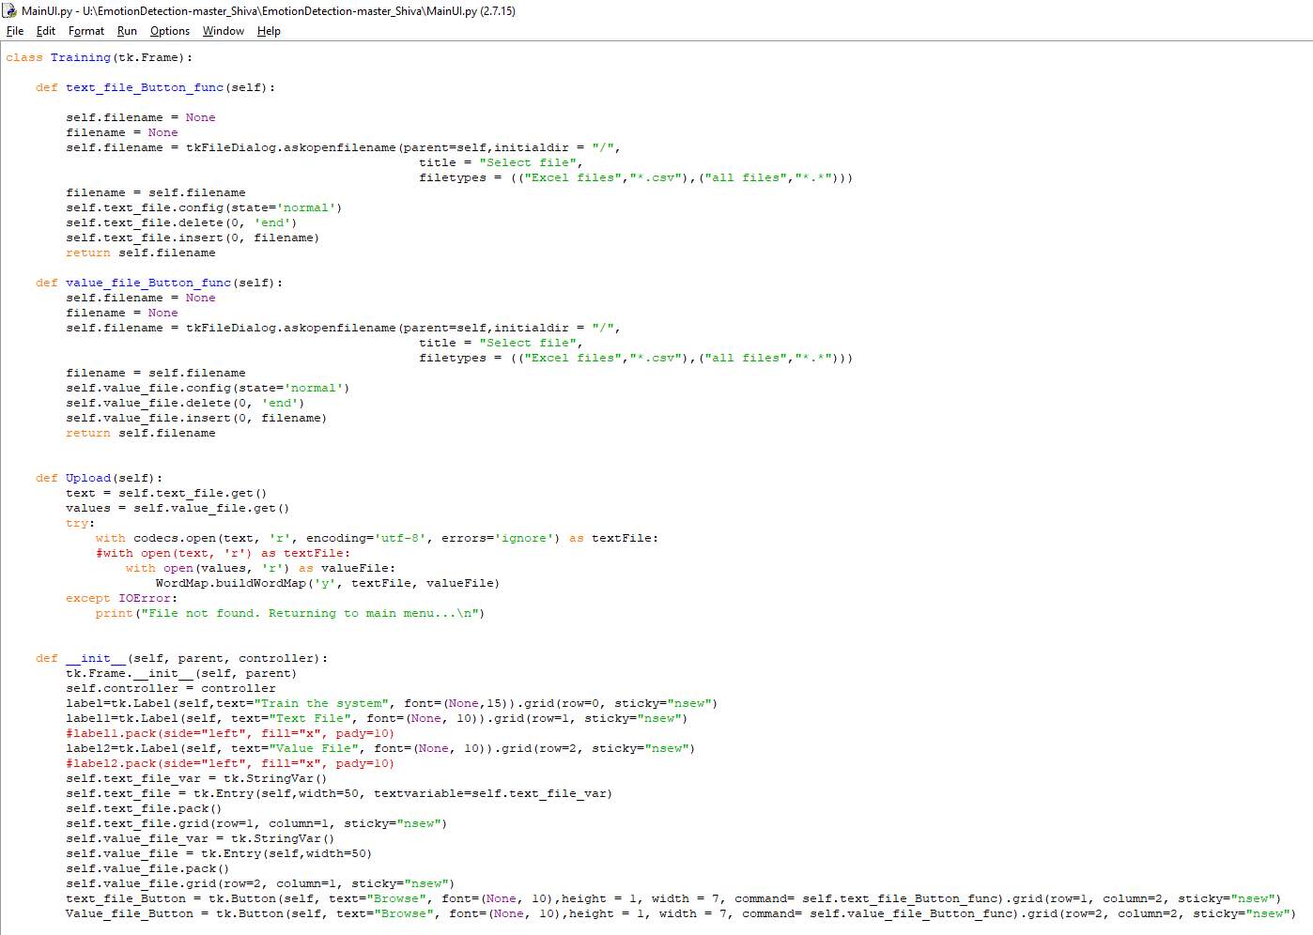
Code Snippet:

Slide 15
Any Queries ?
Thank You All..
ShivaTeja - Team Chair & Lead Programmer
Ravi - UI Developer
Voohitha - Tester and Requirement Engineer
Shahanaz - Tester and Requirement Engineer

