Slide 1


Slide 2
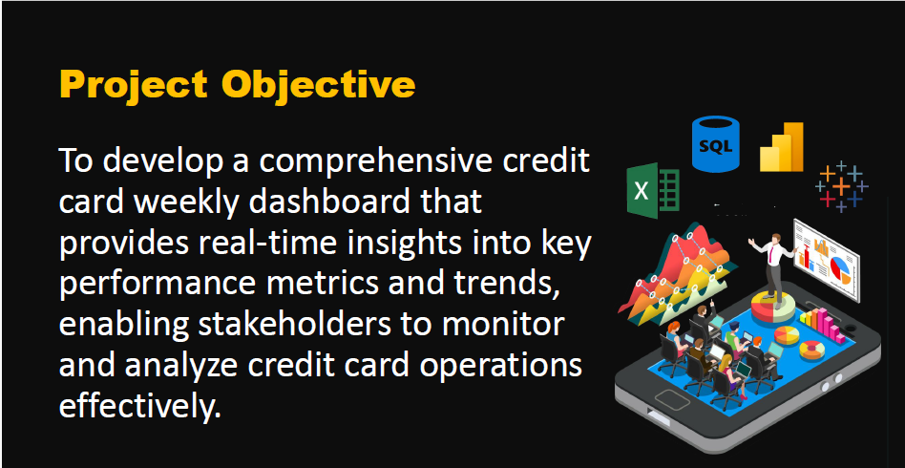

Slide 3
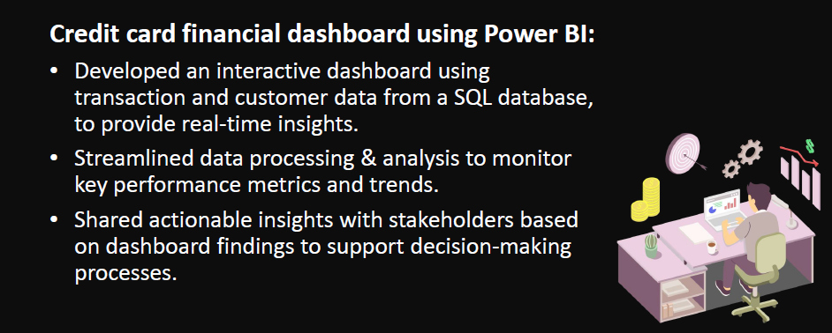

Slide 4
Download Data
GitHub:
https://github.com/gohil0369/CreditCard07

