Slide 1
Milestone 1
CSC3007

Slide 2
Visualization 1
https://sgp.fyi/
Notes:
Now I’ll be going through the second sprint, the analytics requirements

Slide 3
SGP.fyi
Display details based on query
Display sales transactions
Query
Display Past Sales
Allows user to query for a particular block
Display nearby HDBs around the queried HDB
Shows the amount of transaction of sales for each HDB in the area
Display past sales of the blocks in a scatterplot

Slide 4
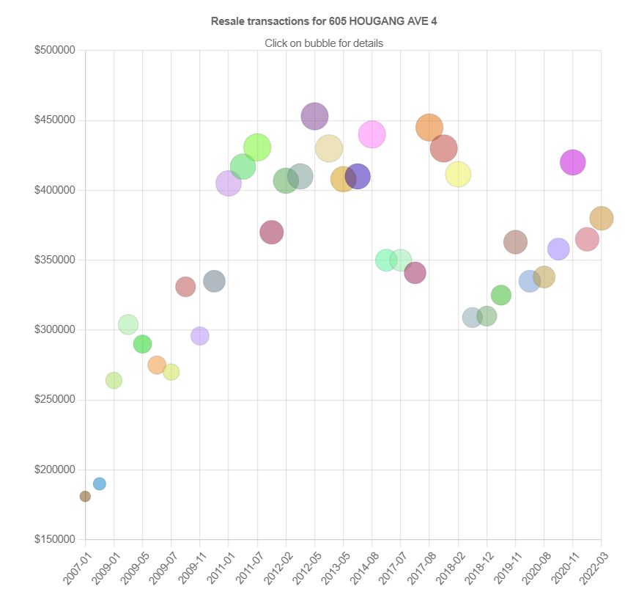
Task
Task
What is the long term price change/fluctuations on a particular HDB block?
What are some of the other popular HDB blocks in that neighbourhood (and why)
Data
Data on hover
month, town, flat type, block, street name, storey range, floor area sqm, flat model, lease commence date, remaining lease and resale price.
year-month, resale amount, storey range, total square meters, price per square feet, flat type, and flat model of each transaction.
x-Axis
y-Axis
Year & month of the transaction
Resale amount

Slide 5
Idiom
The idiom chosen is a scatter plot which shows the resale transaction for the selected block. Each coloured point of varying size on the scatter plot indicates a past resale transaction.
To answer the second exploratory question, the idiom chosen is a street map and a table. The street map shows various red pins.
The table displays a list of nearby blocks in the same street and is sorted numerically in an ascending order. with each item detailing the block/address, the start lease year, total number of floors, total number of units and total number of resale transaction.

Slide 6
Critic on scatter plot - Task 1
Colour and Size of each point does not mean anything
Instruction to click for more details does not do anything
Not Responsive and does not fit the screen
User are not able to understand the trend
Critic table - Task 2
The given table shows nearby blocks, years, floors, units, transactions but is not meaningful.
The street map and table does not answer the “why” of the second question.
The number of pins in the street map does not tally with the number of items/rows in the table.

Slide 7
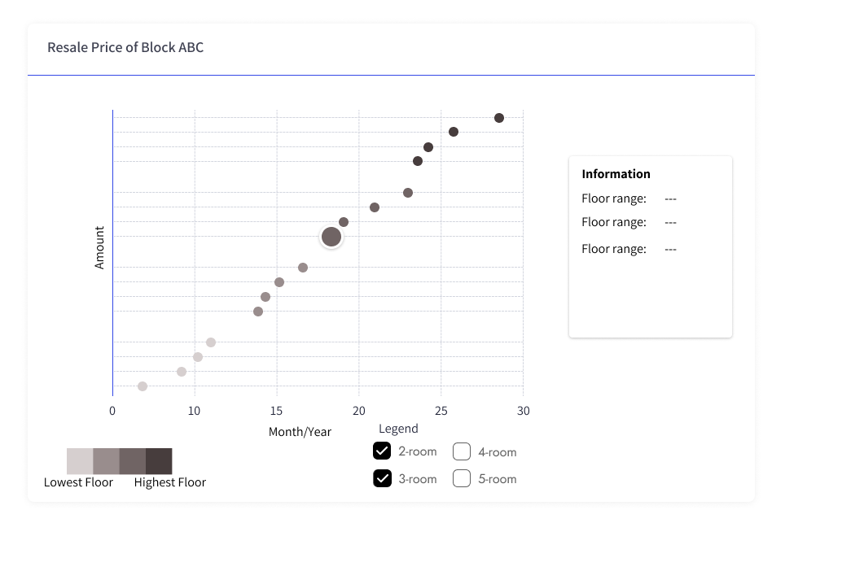
Improvements for design
Notes:
Implement choropleth maps and bar graphs.
Users can choose between debtor and creditor perspective
Users can filter based on year, with the default showing the present/latest year.
Debtor option
Choropleth map shows debtor country regions coloured.
Countries that does not have debt will not be coloured.
Selecting a debtor country updates the bar graph which shows the debt amount on the y-axis and the different creditor country on the x-axis.
The default bar graph shows the country with most debt.
The creditor option uses the same idiom but for creditor perspective.

Slide 8
Improvements
Have same sized dots in the scatter plot
Each dot can be coloured based on a colour spectrum (of light to dark colours ), indicating the storey range
Checkbox function can be implemented to allow user to filter based on flat type
Clicking on a point will introduce a box beside the graph showing the various details of the resale transaction
Allow user to select up to 2 dots to compare the resale transaction
The coloured points (storey-range) and filtering based on flat type allows a fair comparison of equal basis.
With the function of selecting 2 dots it allows the user to further examine the flat model (if varying)

Slide 9
Visualization 2
https://www.worldbank.org/en/programs/debt-statistics/dssi
Notes:
Now I’ll be going through the second sprint, the analytics requirements

Slide 10
World bank debts statistics DSSI
Debtors
Creditors
Shows countries that the debtor (country) owes to and the amount
Shows countries that the creditor (country) lends to and the amount

Slide 11
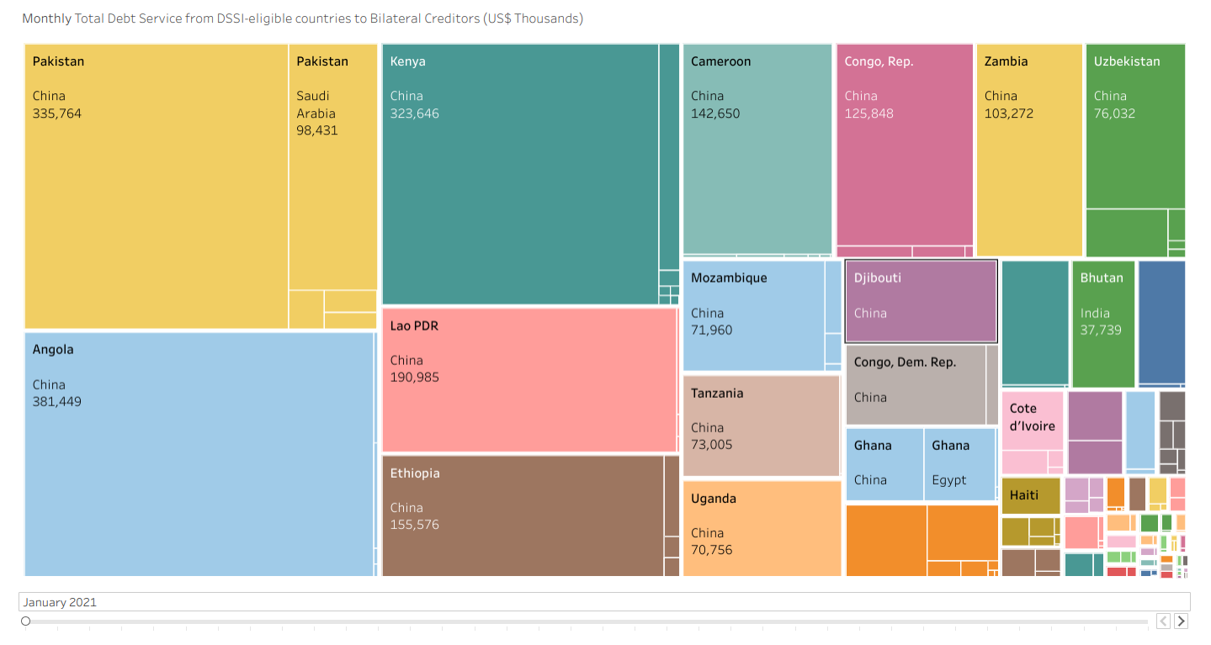
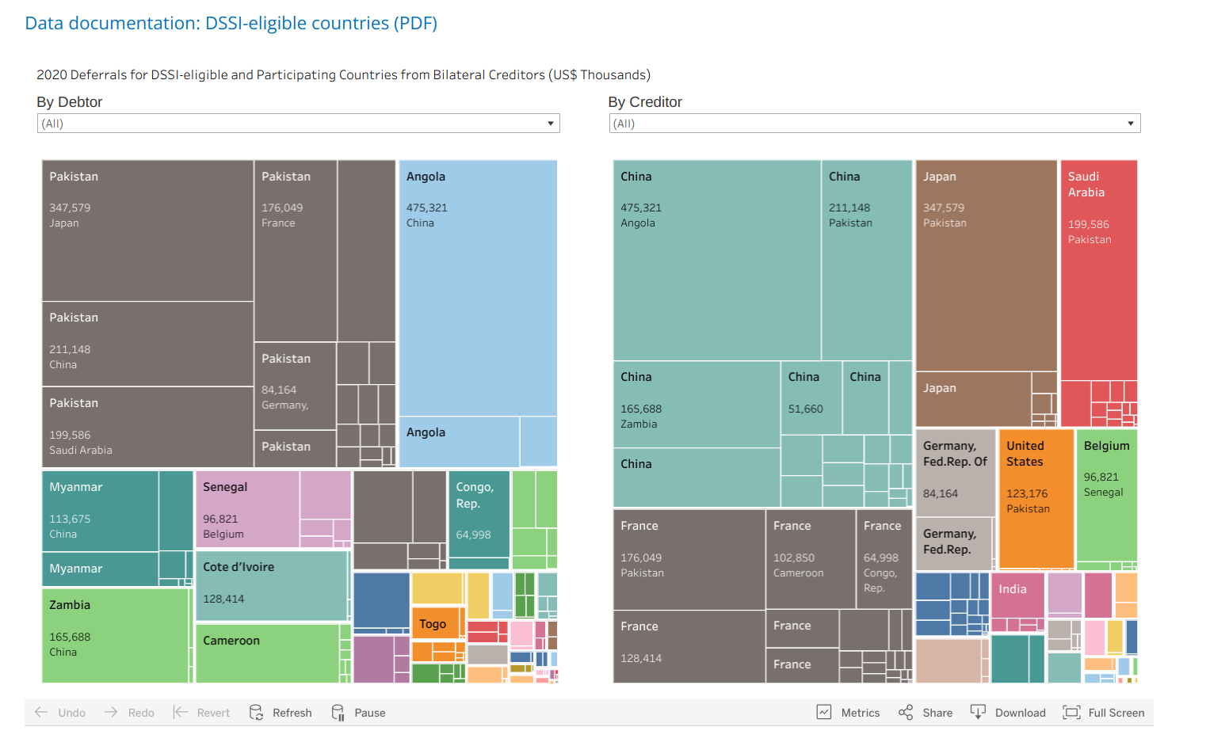
Task
Task
Show the debt due by the creditor or debtor country.
Data
Data on hover
List of debtors (countries), list of creditors (countries), amount that debtors owe creditors / Amount that creditors loan to debtors
List of debtors (countries), list of creditors (countries), amount that debtors owe creditors / Amount that creditors loan to debtors

Slide 12
Monthly

Slide 13
Yearly

Slide 14
Idiom
The idiom chosen is a treemap chart. The treemap conveys the overall relationships (between the debtors and creditors) in a large dataset.
Each rectangle shows the debtor country, creditor country and the debt. Additionally, the area of the rectangles denotes the debt.
There exists a slider below the treemap which indicates the month & year.
Users can select a rectangle and an additional tooltip will appear which includes “Keep only”, “Exclude” and “View Data” features.

Slide 15
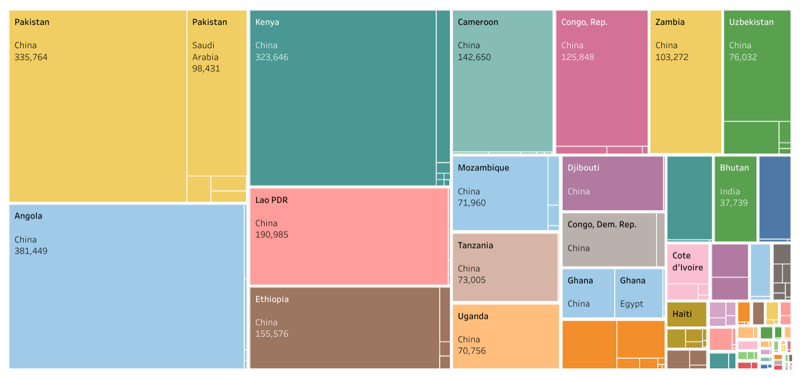
Monthly
Yearly

Slide 16
Critic on Design - Monthly
The debt amount is denoted by the area of the rectangle. However, making comparisons is difficult using visual perception. (Size/Area is not representative)
The slider is hard to navigate to the exact year and month.

Slide 17
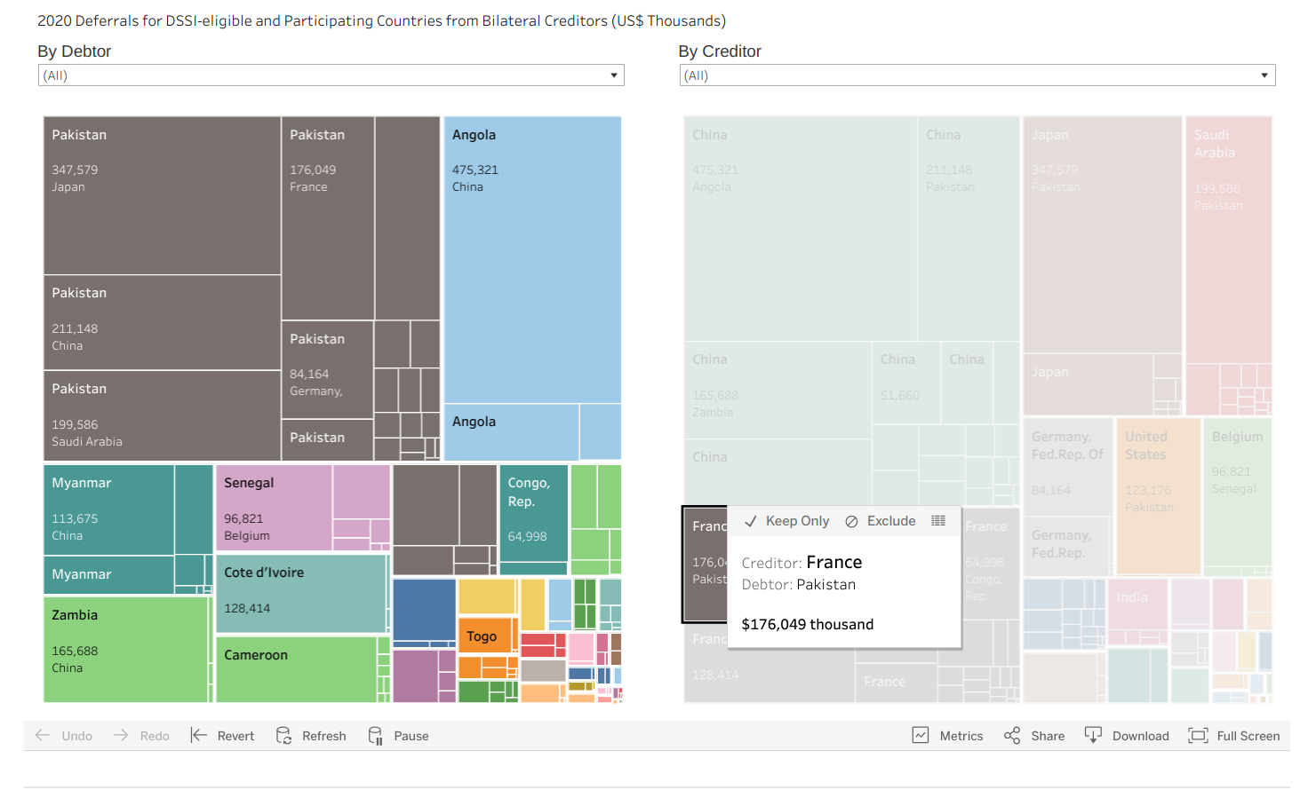
Critic on Design - Yearly
Additional “Keep Only” feature can cause the visualisation to ‘disappear’ which makes it annoying and frustrating as the feature does not do anything beneficial
A lot of the rectangles, with smaller debt size, are too small to be viewed properly.

Slide 18
Critic on Design - Yearly & Monthly Design
Users expect the monthly and annual presentations to present similar representation of results but the monthly and annual representations have a totally different representation.
Monthly representation shows perspective of which debtor owes which creditors and how much.
Annual representation shows 2 treemaps side-by-side; debtor perspective for one treemap and creditor for the other treemap.

Slide 19
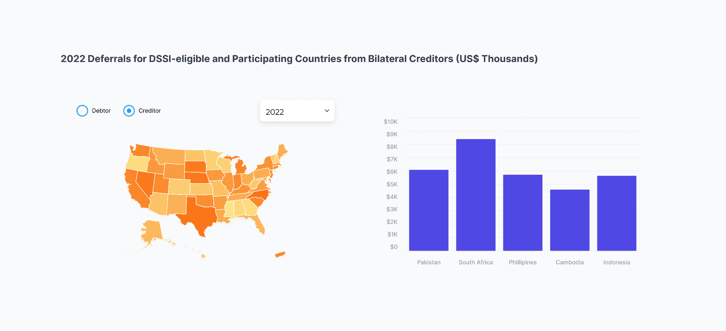
Improvements for design
Users can filter based on year, with the default showing the present/latest year.
Choose to see the choropleth map either from a debtor or creditor perspective
Notes:
Implement choropleth maps and bar graphs.
Users can choose between debtor and creditor perspective
Users can filter based on year, with the default showing the present/latest year.
Debtor option
Choropleth map shows debtor country regions coloured.
Countries that does not have debt will not be coloured.
Selecting a debtor country updates the bar graph which shows the debt amount on the y-axis and the different creditor country on the x-axis.
The default bar graph shows the country with most debt.
The creditor option uses the same idiom but for creditor perspective.

Slide 20
Improvements for design
Choropleth map shows creditor country regions coloured - Countries that does not have debtors will not be coloured.
The debtor option uses the same idiom but for debtor’s perspective.
Notes:
Implement choropleth maps and bar graphs.
Users can choose between debtor and creditor perspective
Users can filter based on year, with the default showing the present/latest year.
Debtor option
Choropleth map shows debtor country regions coloured.
Countries that does not have debt will not be coloured.
Selecting a debtor country updates the bar graph which shows the debt amount on the y-axis and the different creditor country on the x-axis.
The default bar graph shows the country with most debt.
The creditor option uses the same idiom but for creditor perspective.

Slide 21
Improvements for design
Selecting a creditor country updates the bar graph which shows the debt amount on the y-axis and the different debtor country on the x-axis.
The default bar graph shows the country that loaned out the most.
Notes:
Implement choropleth maps and bar graphs.
Users can choose between debtor and creditor perspective
Users can filter based on year, with the default showing the present/latest year.
Debtor option
Choropleth map shows debtor country regions coloured.
Countries that does not have debt will not be coloured.
Selecting a debtor country updates the bar graph which shows the debt amount on the y-axis and the different creditor country on the x-axis.
The default bar graph shows the country with most debt.
The creditor option uses the same idiom but for creditor perspective.

Slide 22
Thank you!
Notes:
Now I’ll be going through the second sprint, the analytics requirements

