Slide 1
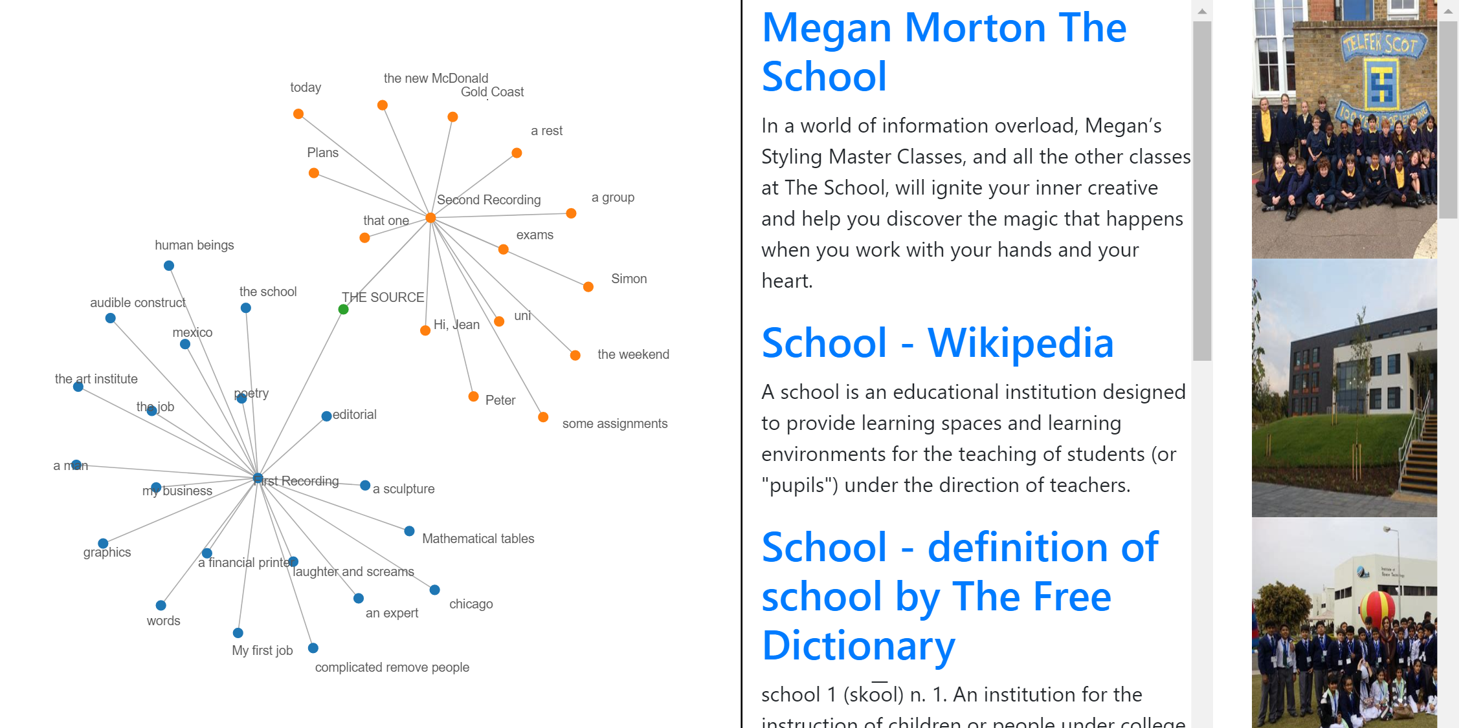



Mundane chatter and smart speakers: What happens when people become aware of how it can be used.
Jeffrey Goh, Jacki Liddie, Peter Worthy
ABSTRACT
Smart speakers have been increasingly popular and are being adopted by many companies such as Google, Amazon and Apple. As a marketing strategy, these devices are also being given away for free as part of a promotion or deal. People are allowing these devices into their home, office etc. without knowing the full extent of consent they are giving. Users are also unaware of the process and storing of data in a smart speaker, which may come to a shock for some after knowing what actually happens. This paper explores the perception and level of acceptability of users towards smart speakers before and after making ‘hidden’ interactions that are not visible to users visible, more specifically, visualizing the history of voice commands in a meaningful way for users to see and reflect.
BACKGROUND
Prior to implementing this project, a two-stage interview was conducted to get information on the perception and concerns of people on smart speakers. First interview consisted of five participants and the second interview consisted of six participants. Four out of six have never used a smart speaker while the other two have a smart speaker set up as a smart home. A few issues were identified but given the time and resources for this project, only one can be investigated further.
GOALS
One interesting finding was that most participants were not aware that the list of voice commands given are stored online. Participants found it ‘creepy’. Based on this, an application was created to extract the history of voice command and visualize it in a meaningful manner. There are two main goals for this project which are :
To explore the current perception, understanding and acceptance of smart speaker technologies of users and nonusers.
To explore/evaluate the impact of making hidden aspects of the smart speaker technology visible/obvious on perceptions, acceptance and attitudes
Use Selenium and BeautifulSoup4. Gets data periodically.
Use D3.js to visualize data using a network diagram.
Use Google API to search for related information based on network diagram
1. Extract voice commands
2. Populate
network diagram
3. Get related information
4. Get feedback

