Slide 1

ExamEye
A silent witness for online exams
What it does, how to set it up in five steps, and how to read what it records.
For exam-centre staff and invigilators. No technical background needed.
Notes:
ExamEye is a small add-on for the Chrome browser. It watches what happens in the browser while a candidate sits an online paper and writes a record to a folder on the same machine. It never interferes with the paper.

Slide 2


What ExamEye is
A recorder, not a gatekeeper. It writes down what happened; people decide what it means.
It does
It never does
Starts and stops on its own when the exam website opens and when the paper is submitted
Writes one line for every notable event, with the time
Takes a screenshot of the exam tab when something happens, and every few minutes
Can photograph the whole screen while the candidate is away from Chrome
Produces a readable report with screenshots at the end of every paper
Blocks a page, a key, or the candidate. Nothing is prevented, only recorded
Reads or changes the candidate’s answers
Names other applications. It records that Chrome lost focus, not what was opened
Sends anything anywhere. Every file stays on the exam machine
Needs the candidate or the invigilator to click anything during the paper (except one screen-share prompt)
ExamEye · 2
Notes:
The key message for staff: ExamEye cannot stop cheating and does not try to. It gives the centre an evidence trail. The one thing the candidate is asked to do is accept the screen-share prompt once.

Slide 3


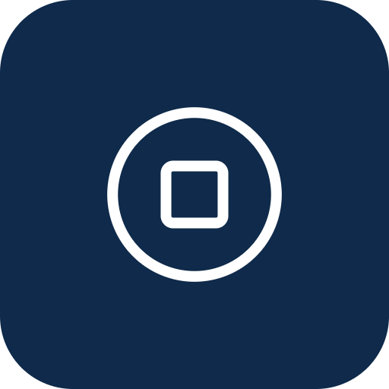

How it works, in one picture
Everything happens automatically once the settings are saved.
1. Paper opens
›
2. Recording starts
›
3. Events and screenshots
›
4. Paper submitted
›
5. Folder written
The candidate lands on the exam start page.
ExamEye notices the address and arms itself.
Tab switches, copy, focus lost… each gets a log line and a picture.
The submit button, a result page, or a phrase on screen ends it.
Log, screenshots and a report land in the Downloads folder.
A paper that is never submitted still ends: after the maximum length you set, or once the exam tab has been gone for a while.
ExamEye · 3
Notes:
Walk through the five boxes left to right. Stress that no one has to start or stop anything.

Slide 4
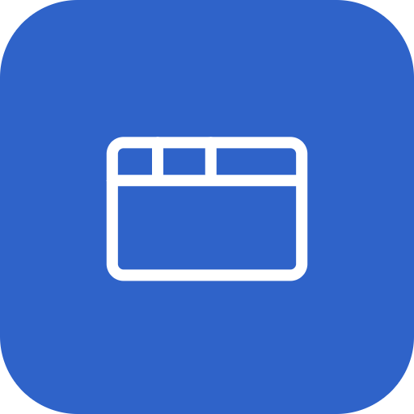


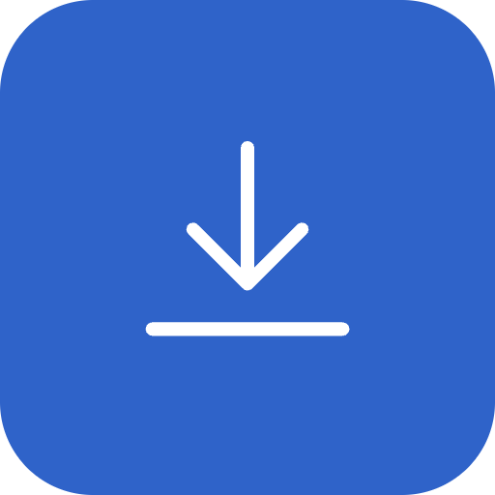
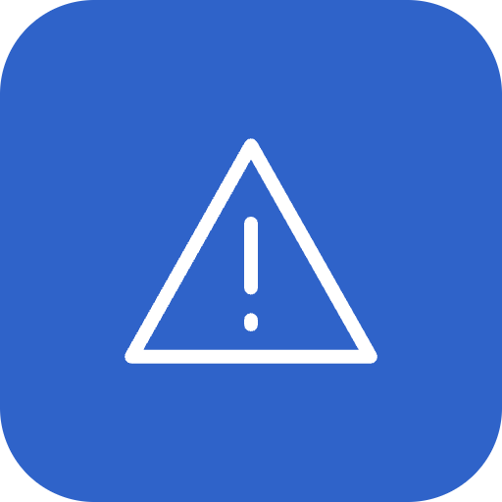
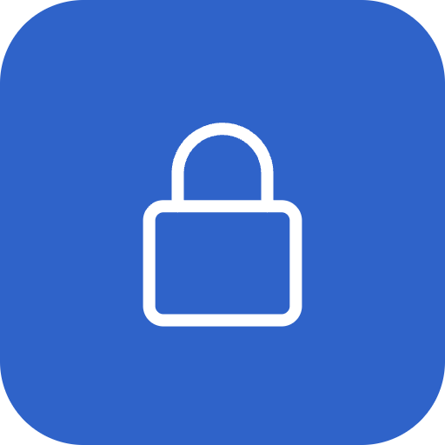


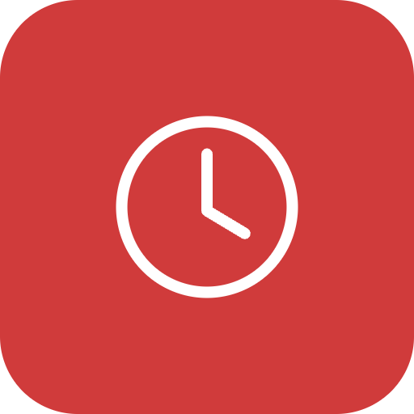

What gets recorded
Each of these becomes a line in the log and, in most cases, a screenshot.
Other tabs and pages
Leaving Chrome
Copy, cut, paste, print, drag
Downloads
Window changes
Switching to another tab, and which page it was
Another application in front, and for how long
And the length of the text involved
Any file the candidate downloads
Minimised, restored, fullscreen left
Screen lock or idle
Developer tools
Settings changed mid-paper
Clock set back
Second monitor
The screensaver, the lock screen, long inactivity
The browser’s inspection panel being opened
Which fields, and a screenshot of that moment
The computer clock jumping backwards
More than one screen attached
Plus a routine screenshot of the exam tab at a fixed interval (10 minutes by default), so a quiet paper still has pictures.
ExamEye · 4
Notes:
Red icons are the events treated as most serious in the report. The full list with severities is on the flags slide near the end.

Slide 5


Setup: five steps, once per machine
About 20 minutes including the dry run. After that, nothing to click on exam day.
1
2
3
4
5
Install
Allow in Incognito
Downloads setting
Configure
Dry run
Load the ExamEye folder into Chrome
So private windows are seen too
Chrome must not ask where to save
Fill in the five sections and save
Ten minutes with a test paper
Managed fleets: IT can push ExamEye and its settings by policy instead of steps 1 to 3. Ask before doing them by hand.
ExamEye · 5
Notes:
The detailed checklist is docs/centre-setup.md in the ExamEye folder. The next slides show each step.

Slide 6
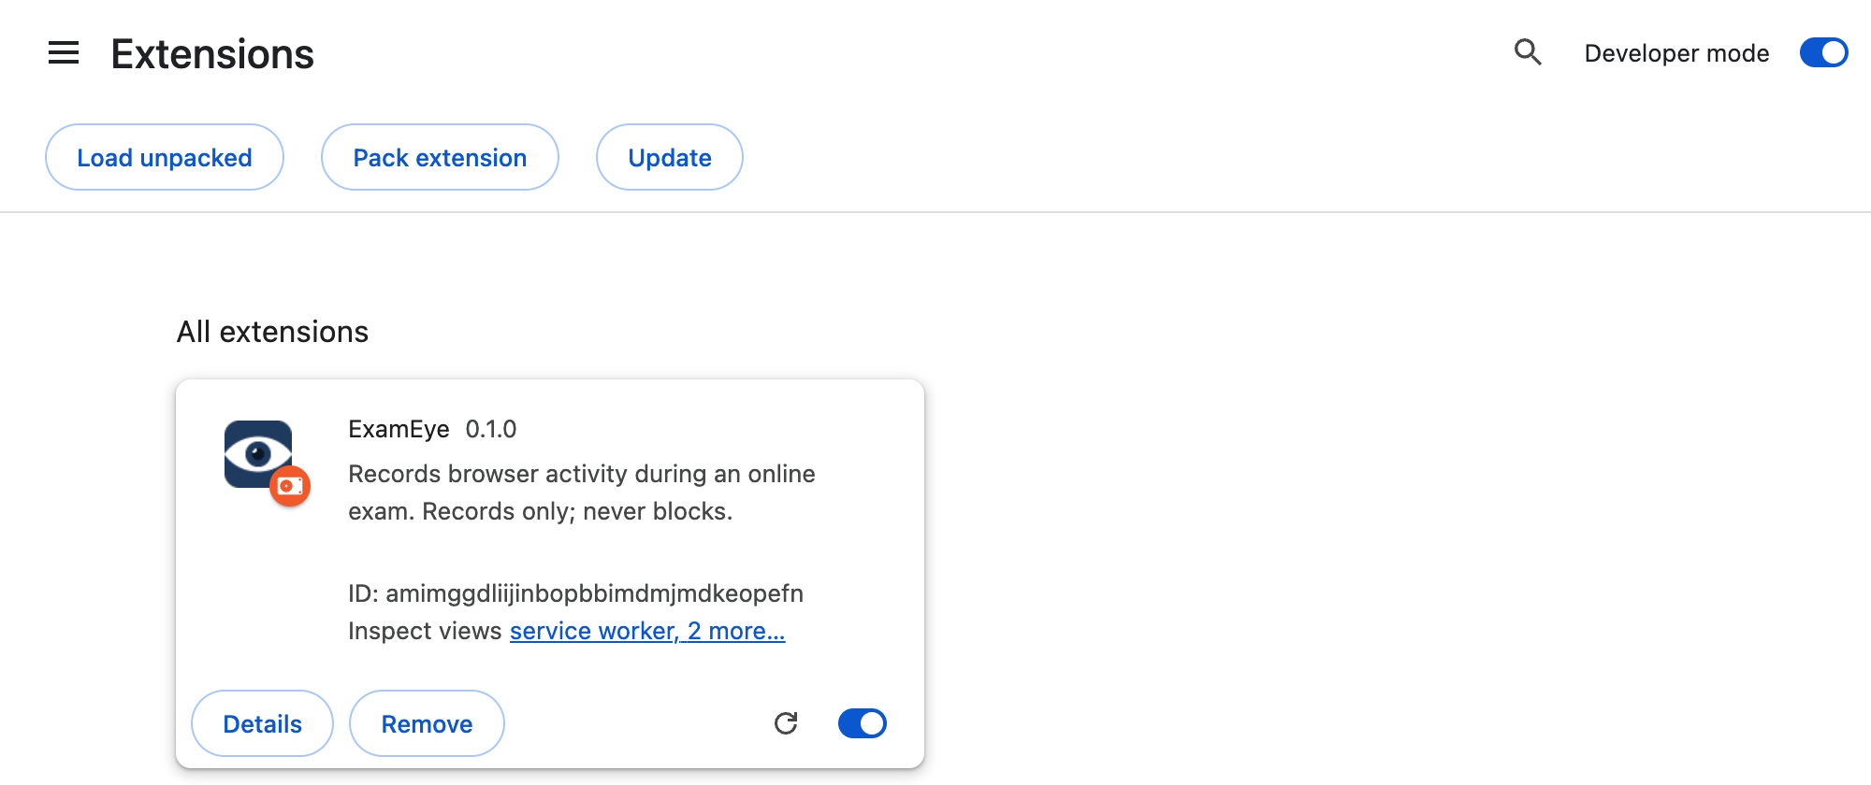
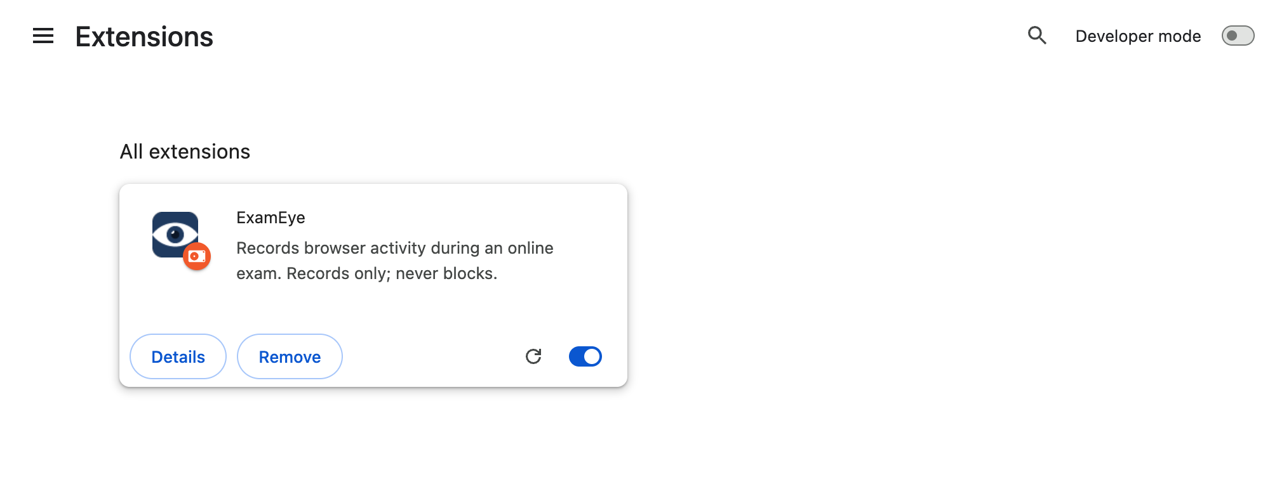
Step 1: Install
Chrome loads ExamEye from a folder on the machine.
Copy the ExamEye folder somewhere permanent, for example C:\ExamEye. Moving or deleting it later switches the extension off.
In Chrome, open chrome://extensions and switch Developer mode on (top right).
Click Load unpacked and choose the ExamEye folder.
ExamEye appears in the list with its toggle on. Leave Developer mode on: Chrome then shows no warning bubble at start-up.
Microsoft Edge works the same way at edge://extensions.
ExamEye · 6
Notes:
If Chrome shows a "Disable developer mode extensions" bubble, click Cancel. Its Disable button would switch ExamEye off.

Slide 7

Steps 2 and 3: two Chrome settings
Both are one-time switches. Without them ExamEye works, but misses things.
Allow in Incognito
Downloads: do not ask
macOS only: screen recording
chrome://extensions → ExamEye → Details → Allow in Incognito: on.
Otherwise a private window is invisible to ExamEye and an incognito window opened during the paper is never recorded.
Chrome Settings → Downloads → "Ask where to save each file before downloading": off.
Otherwise every screenshot and log file would pop up a save dialog. Note the download location: that is where the recordings go.
System Settings → Privacy & Security → Screen Recording → enable Chrome, then quit and reopen Chrome.
Without it, whole-screen pictures come out black and nothing warns you. Windows needs nothing here.
ExamEye · 7
Notes:
Also add the exam site to Chrome’s "Always keep these sites active" list under Performance, so a sleeping tab does not look like the candidate left.

Slide 8
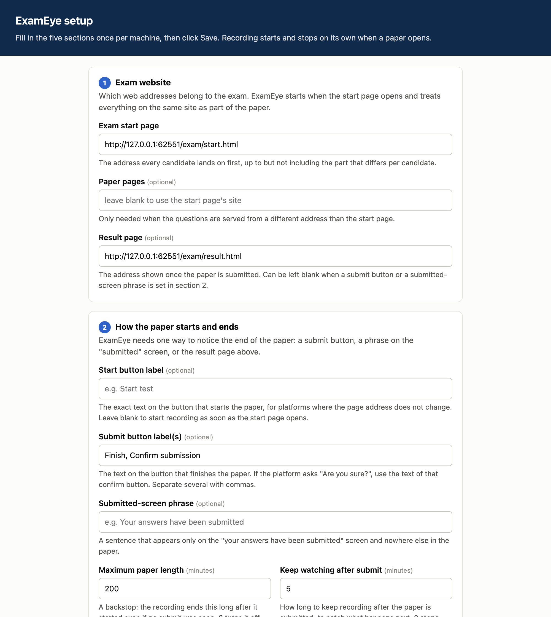
Step 4: Configure
Right-click the ExamEye icon → Options. Five short sections, then Save.
1
Exam website
The start page address, and the result page if there is one.
2
How the paper starts and ends
The submit button text or a phrase from the "submitted" screen, plus the maximum length.
3
This machine
A seat or centre ID for the file names, and the folder name.
4
Recording
How often to take a routine screenshot; defaults are fine.
5
Screen capture
Whole-screen pictures on or off, and how often to ask again if the candidate refuses.
Shown: sections 1 and 2. Every field has a one-line explanation under it; the values for a given exam platform are usually worked out once and copied to every machine.
ExamEye · 8
Notes:
The exact values for the centre’s exam platform are in the setup checklist table (docs/centre-setup.md, section 4).

Slide 9
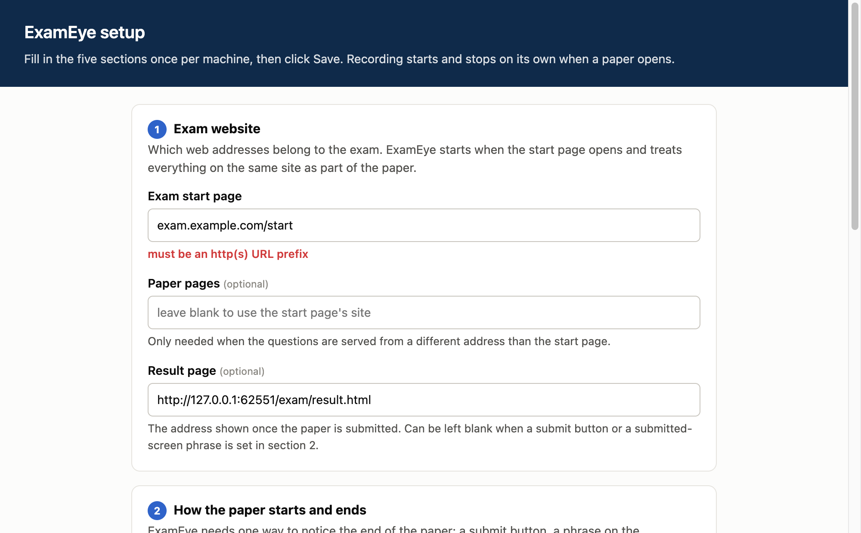
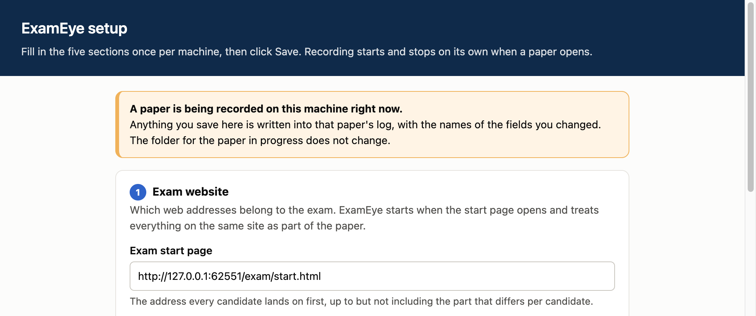
Step 4: the page tells you what to fix
Nothing is saved until every problem is cleared.
A problem is shown in red directly under the field it belongs to, in plain words.
The Save bar counts the fields still to fix. The green "Saved." confirms the settings are stored.
If a paper is being recorded on the machine, an orange notice appears at the top. Any change saved then is written into that paper’s log with the names of the fields, and the folder for the paper in progress does not move.
ExamEye · 9
Notes:
The orange banner exists so that a settings change during a paper can never be silent.

Slide 10
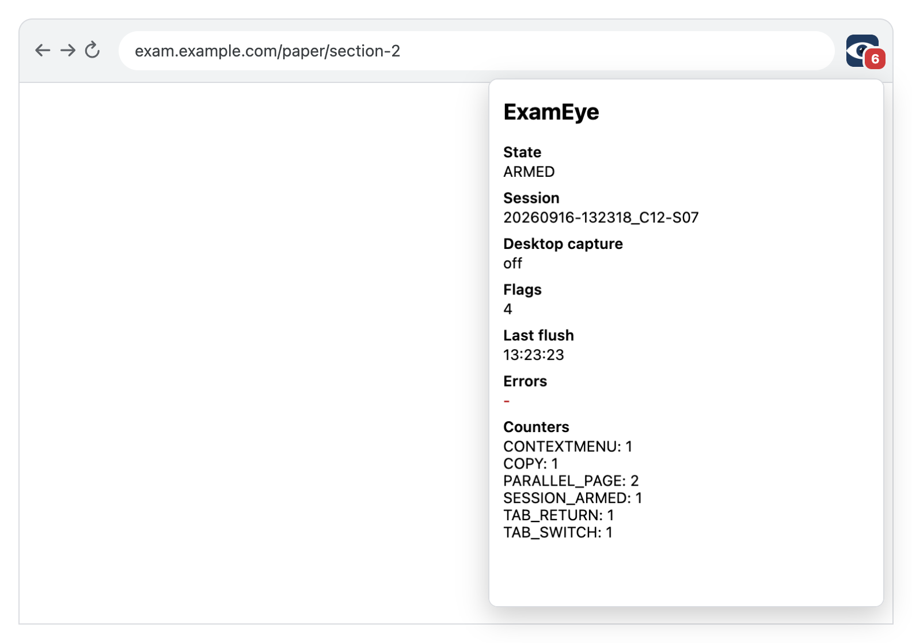
Step 5: Dry run
Ten minutes with a throw-away test login. Do it on the day, on every machine.
Open the exam start page
The icon shows a red 0; the popup says ARMED with a session id.
Open another tab, then come back
Popup counters show TAB_SWITCH: 1. The badge turns to 1.
Minimise the window and restore it
Counters show WINDOW_MINIMIZED: 1.
Lock the screen or wait for the screensaver, then unlock
Counters show SCREENSAVER: 1.
Submit the test paper (or open the result page)
State returns to IDLE. The badge disappears.
Look in Downloads → ExamEye
One folder with log.txt, summary.html and a screenshots folder.
ExamEye · 10
Notes:
If a check fails, the setup checklist names the usual cause for each. Screen capture, if on, adds a share prompt at step 1 (next slides).

Slide 11
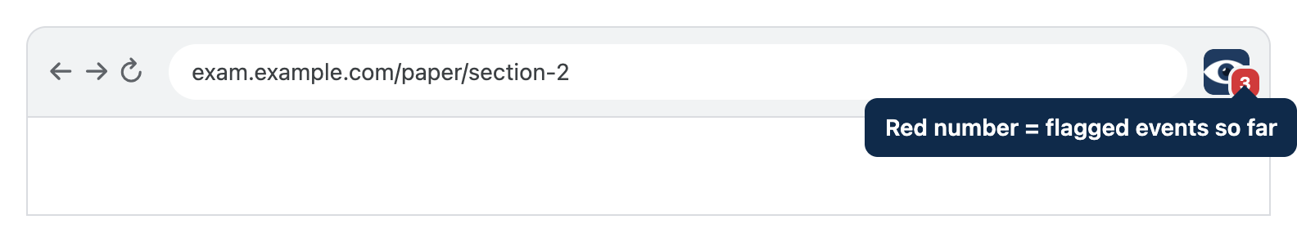

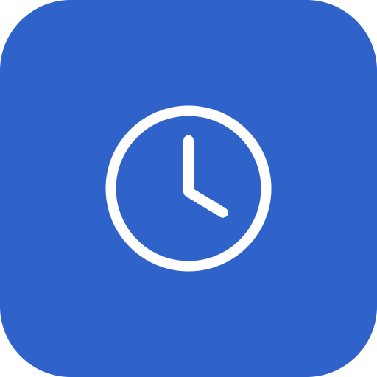
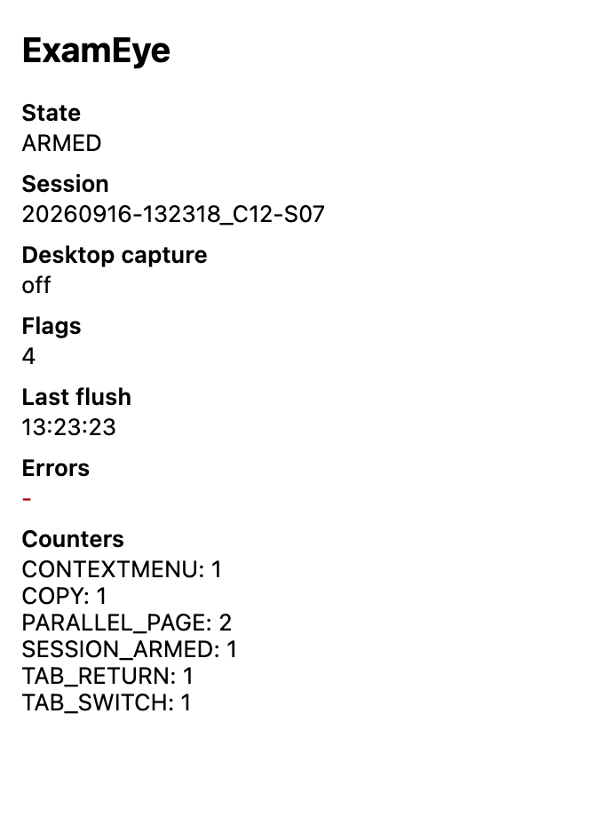
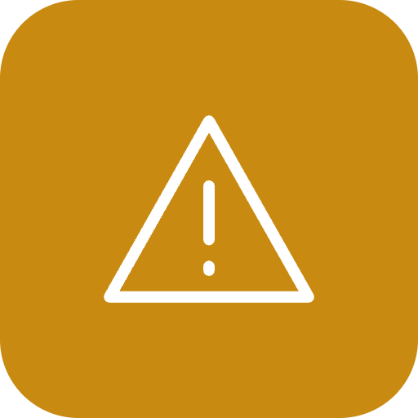
On exam day: what you see
Nothing to start. Glance at the icon; click it for detail.
Session
The date, time and seat ID that name the output folder.
Last flush
When files were last written to disk. It updates every 30 seconds while recording.
Red badge = flagged events
Tab switches, other pages, copy, focus lost… counted live. 0 in red means recording with nothing flagged yet.
Errors
Normally a dash. Anything else names the setting or the file that failed; the setup page opens from the link.
State ARMED = recording
CLOSING means the paper was submitted and the last minutes are still being watched. IDLE means no paper is open.
ExamEye · 11
Notes:
Invigilators do not need to open the popup at all. The badge alone shows that recording is on and whether anything was flagged.

Slide 12
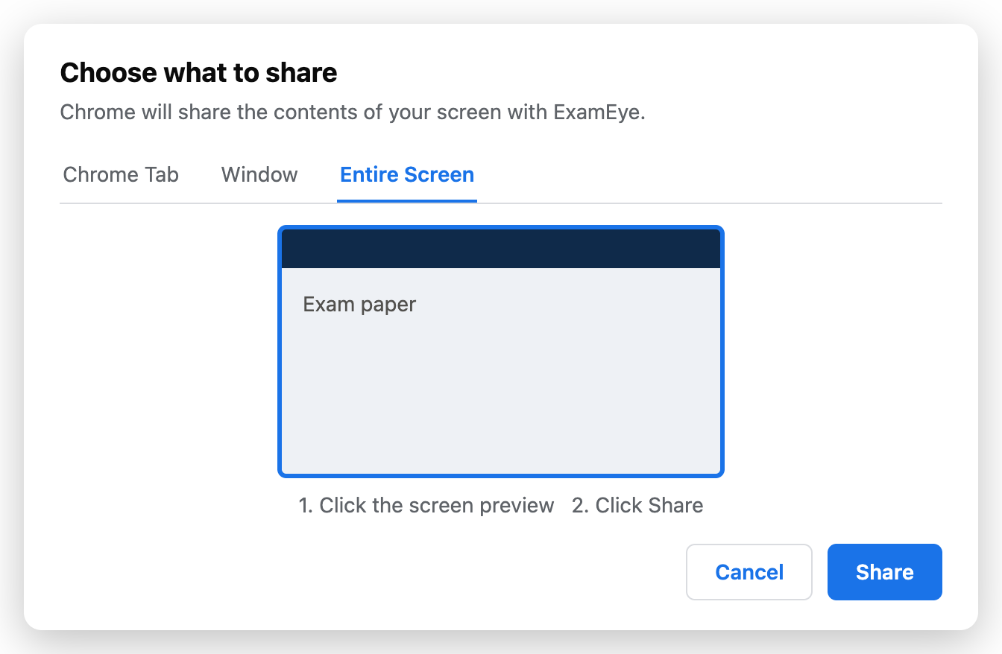
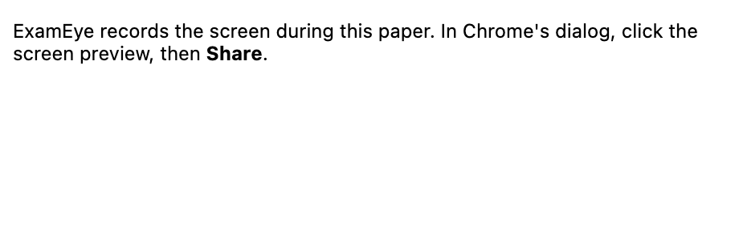
Screen capture: the one thing the candidate does
When the start page opens, Chrome asks once to share the screen.
A small "ExamEye screen capture" window appears and Chrome shows its share dialog.
The candidate clicks the screen preview, then Share. Chrome only enables Share after the preview is clicked.
The small window minimises itself. It must stay open; closing it stops capture and is logged.
Whole-screen pictures are then taken while Chrome is not the active window and at each routine screenshot.
If the candidate cancels, that is logged and the question is asked again after five minutes (adjustable).
With two screens, only the shared one is captured, and the paper is flagged MULTI_MONITOR.
ExamEye · 12
Notes:
On macOS the pictures are black unless Chrome has the Screen Recording permission (step 3). Check one desktop frame during the dry run.

Slide 13
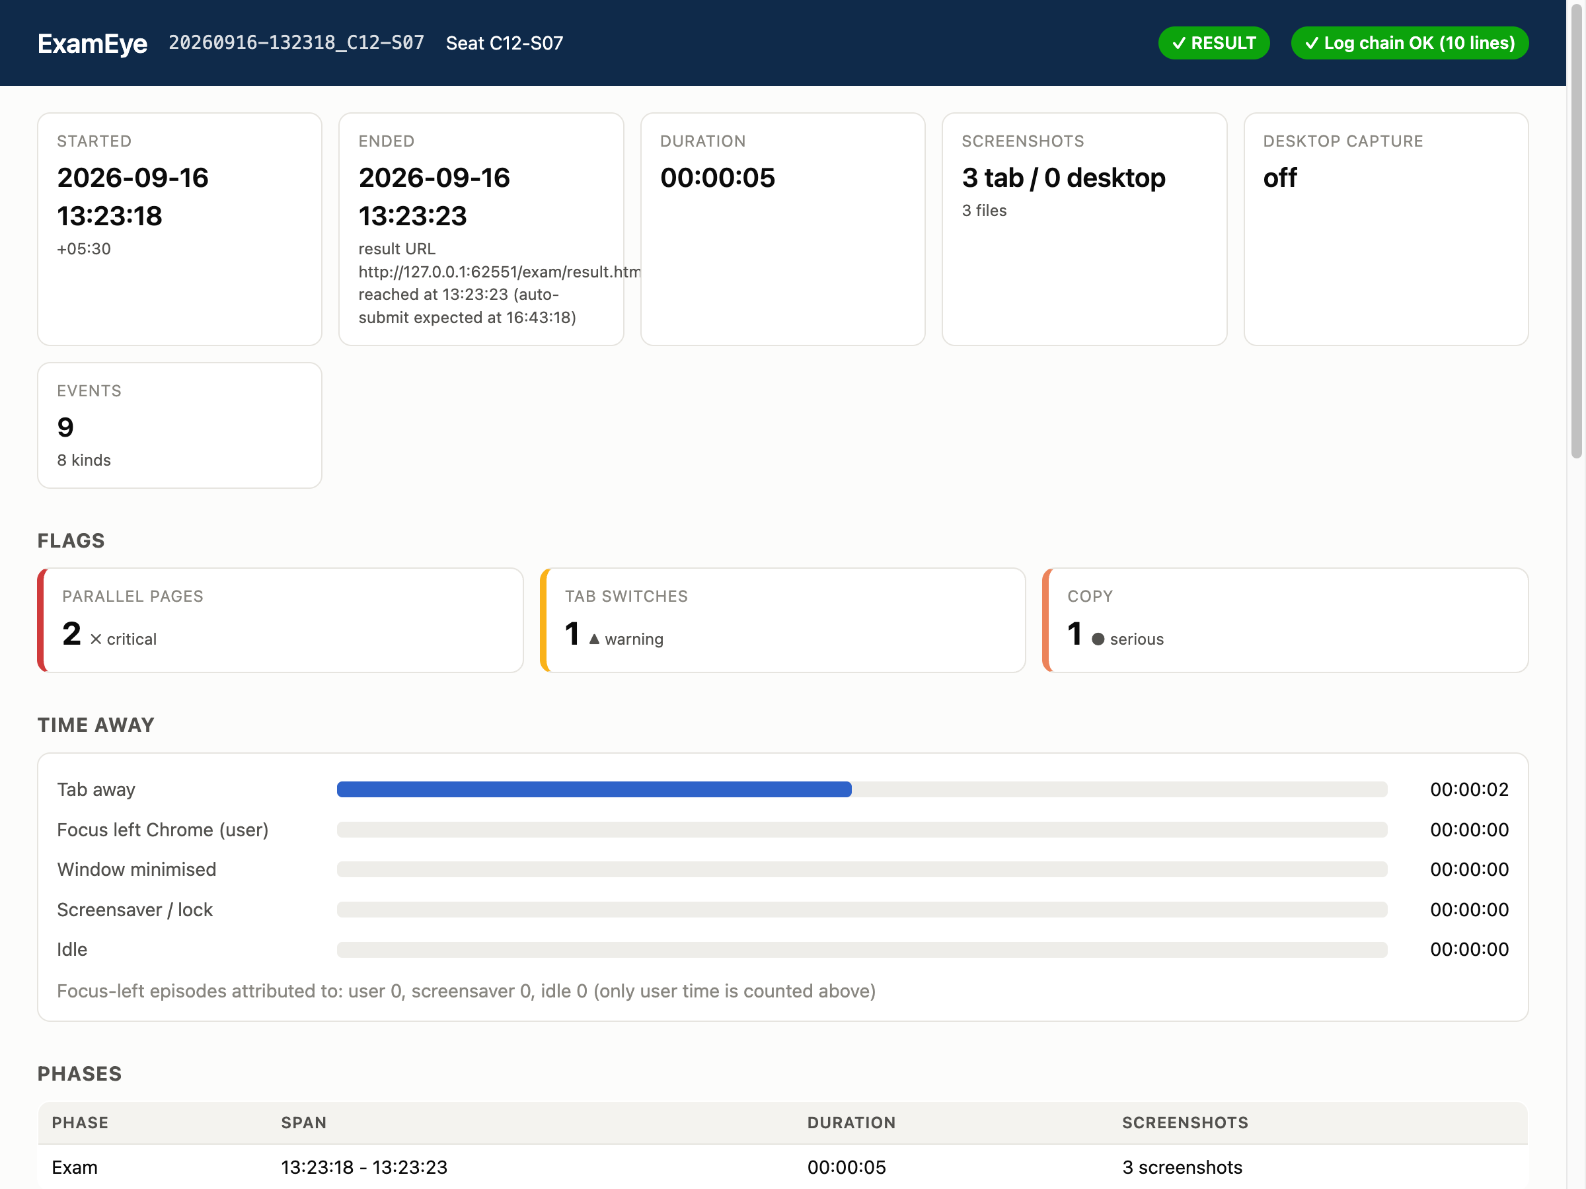

What you get: one folder per paper
Downloads → ExamEye → <date-time_seat>. Open summary.html in any browser.
20260916-131011_C12-S07/
date, time and seat ID
summary.html
the report: flags, timeline, every screenshot
summary.txt
the same report as plain text
log.txt
one line per event, each chained to the previous
events.jsonl
the same events for software to read
screenshots/
exam-tab pictures, named by time and event
screenshots/desktop/
whole-screen pictures, when capture is on
ExamEye · 13
Notes:
summary.html is self-contained: the screenshots are embedded, so the single file can be copied or emailed on its own.

Slide 14
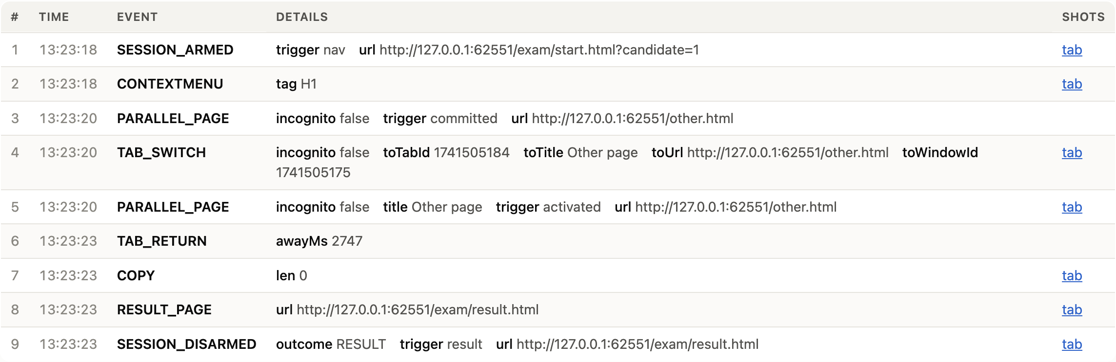
Reading the report
Top to bottom: outcome, flags, time away, then the full timeline with pictures.
Outcome and log chain
RESULT / SUBMITTED / TIMED OUT / ABANDONED. "Log chain OK" means no line of the log was altered afterwards.
Flags
Each flagged event type with its count and a colour: red critical, orange serious, yellow warning.
Time away
How long the exam tab was not in front, Chrome was not the active app, the window was minimised, the screen was locked.
Parallel pages
Every other page visited during the paper, with focused time and visits.
Timeline and screenshots
Every event in order; "tab" and "desktop" links open the picture taken at that moment.
ExamEye · 14
Notes:
For a dispute, start with the flags, then use the timeline links to see the screenshot at each flagged moment.

Slide 15
Flags and what they mean
The same list drives the red badge, the popup and the report.
Critical
Serious
Warning
Parallel pages
Copy / Cut / Paste
Tab switches
another web page was used
clipboard use on the exam page
another tab came in front
Incognito windows
Print
Left Chrome
a private window was opened
the print dialog was opened
another application came in front
DevTools
Drag out
Window minimised
the browser inspector was opened
content dragged out of the exam page
the exam window was minimised
Config changed
Downloads
Fullscreen exits
ExamEye settings were changed mid-paper
a file was downloaded
the paper left full-screen mode
Clock set back
Recording gaps
Screensaver / lock
the computer clock jumped backwards
ExamEye was not running for a while
the screen locked or the screensaver ran
Multiple screens
more than one monitor was attached
ExamEye · 15
Notes:
Severity is a reading aid, not a verdict. A tab switch can be innocent; five parallel pages during a closed-book paper usually are not.

Slide 16

Can the record be trusted?
Every log line carries a fingerprint of the line before it. Change one, and everything after it breaks.
What the chain proves
The checker
The report’s "Log chain OK" badge shows the log is intact from the first line to the last.
A gap where ExamEye was switched off shows up as a Recording gap flag with its length.
The screenshots named in the log must be present in the folder.
It cannot prove who was at the keyboard. That is the invigilator’s job.
IT can re-check any folder later, independently of the report, with one command from the ExamEye folder:
node tools/verify.mjs "<folder>"
OK 20260916-132318_C12-S07:
10 lines, 9 events, 3 screenshots present
A modified copy reports BROKEN and names the first bad line or the missing picture.
ExamEye · 16
Notes:
The checker needs Node.js on the machine that runs it, which is why it is described as an IT task.

Slide 17
Limits and privacy
Know these before relying on the record.
A candidate can switch the extension off
On an unmanaged machine nothing prevents it. The switch-off appears as a Recording gap, and a paper with missing files is itself evidence. Managed machines can lock it by policy.
It sees only the browser
Phones, paper notes and a second computer are invisible. Whole-screen capture shows other applications only while Chrome is not in front, and only if the candidate accepted the share.
The settings page is open to anyone at the machine
That is why every change during a paper is logged with a screenshot, and why the output folder is fixed when the paper starts.
Nothing leaves the machine
ExamEye has no server. Files are written to the local Downloads folder and stay there until the centre collects them. Candidates should be told they are being recorded.
ExamEye · 17
Notes:
A candidate notice template is in the setup checklist, section 8.

Slide 18
Exam-day checklist
ExamEye shows as enabled at chrome://extensions
Chrome does not ask where to save downloads
Settings saved for today’s paper; seat ID is this desk
Dry run done on this machine today
Extra monitors disconnected; screen-share prompt explained to candidates
After the paper: copy the session folder from Downloads → ExamEye
Full checklist: docs/centre-setup.md in the ExamEye folder.
ExamEye · 18

