Slide 1

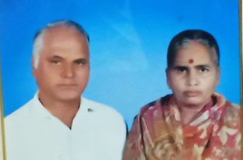
Online Virtual Event -सामाजिक सभा
FOUNDER & OWNER
SMT. THAKUR RAM KAMLA
BHIKAM SINGH

Slide 2


Agenda
JAN FRI 21 2021
JAN SAT 22 2021
Online Live Digital Platform for bringing families together.
JAN SUN 23 2021
JAN WED 26 2021
Morning – 10am to 12.30am
Afternoon – 1pm to 4.30pm
Evening – 5pm to 7.00pm
Our focus is to let you find like-minded matches whom neither you can reject nor can they reject you.

Slide 3


Mega Matrimonial Event for all categories and caste.
They say marriages are made in heaven and we at ShubhShaadiVivah, are trying to bring together that someone who is made for you.
We have organized Mega Matrimonial Events for all Community in the month of JAN-2022 for the Business Class, Professionals, Manglik, Late Marriage and Re-marriage.

Slide 4

Online Event
Jan - 2022
Brace up yourself to witness online event process the best matchmaking process, which ensures a perfect E-match for your profile.
Your profile is brought into the limelight, thus it gets brighter chances of getting noticed by the eligible profiles.

Slide 5
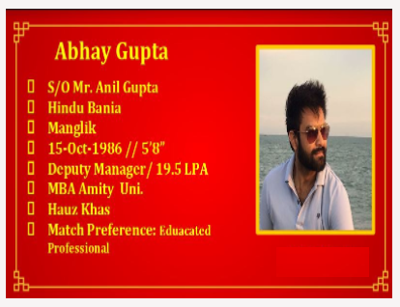
Highlights of the events
FREE REGISTERATION
Event entry Free
Profile Creations and Presentation
In this digital event we are introducing a self introduction video.
If you can share your self introduction videos we will offer you discounts vouchers or extend your membership days.
All profiles will be shared on Google Drive the next day. You still have time to review the prospectus and note the user id. After shortlisting , now our professional relationship manager will come into play and organize a zoom meeting in this Covid era. The meeting will be under the eye our experienced team members.

Slide 6

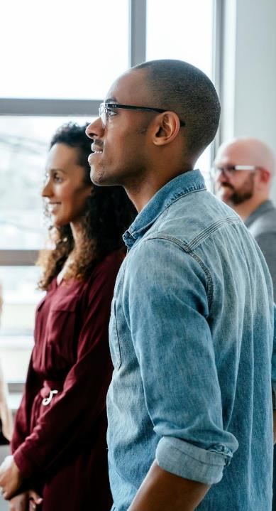
Event Management Technology
Plan Impactful Online and In-Person Events
Create your profile ShubhShaadiVivah
Fill the required data with correct information and click the SUBMIT button.
Remember your User ID, User Name and Password.
Login with your username and password
ShubhShaadiVivah
Click on PROFILE button
Profile (shubhshaadivivah.herokuapp.com)
Update your data, upload video , photos. Filling 100% information will help the system to find exact match.

Slide 7

28
Scientific Approach
for e-matching.

Slide 8
Online Astrologers / Counselors will be present. Special request to solve your personnel issues if any will be entertained.
1

Slide 9
Meet us online and you will know the reason behind our successful matches. We strive to provide best matchmaking service to our clients.
1

Slide 10




Zoom Events
The registration procedures will help ShubhShaadiVivah to collect signups for the free events.
Our Online virtual Event platform will have virtual common spaces, chat features, and contact info swap tools.
You're in good hands
Our event planning platform gives you the tools to design memorable experiences and make matching event success online .
Our digital platform will facilitate seamless online networking between guests during digital gatherings.
Two factor authentication options and other security features help to protect registrants’ data and keep the event cyber safe.

Slide 11
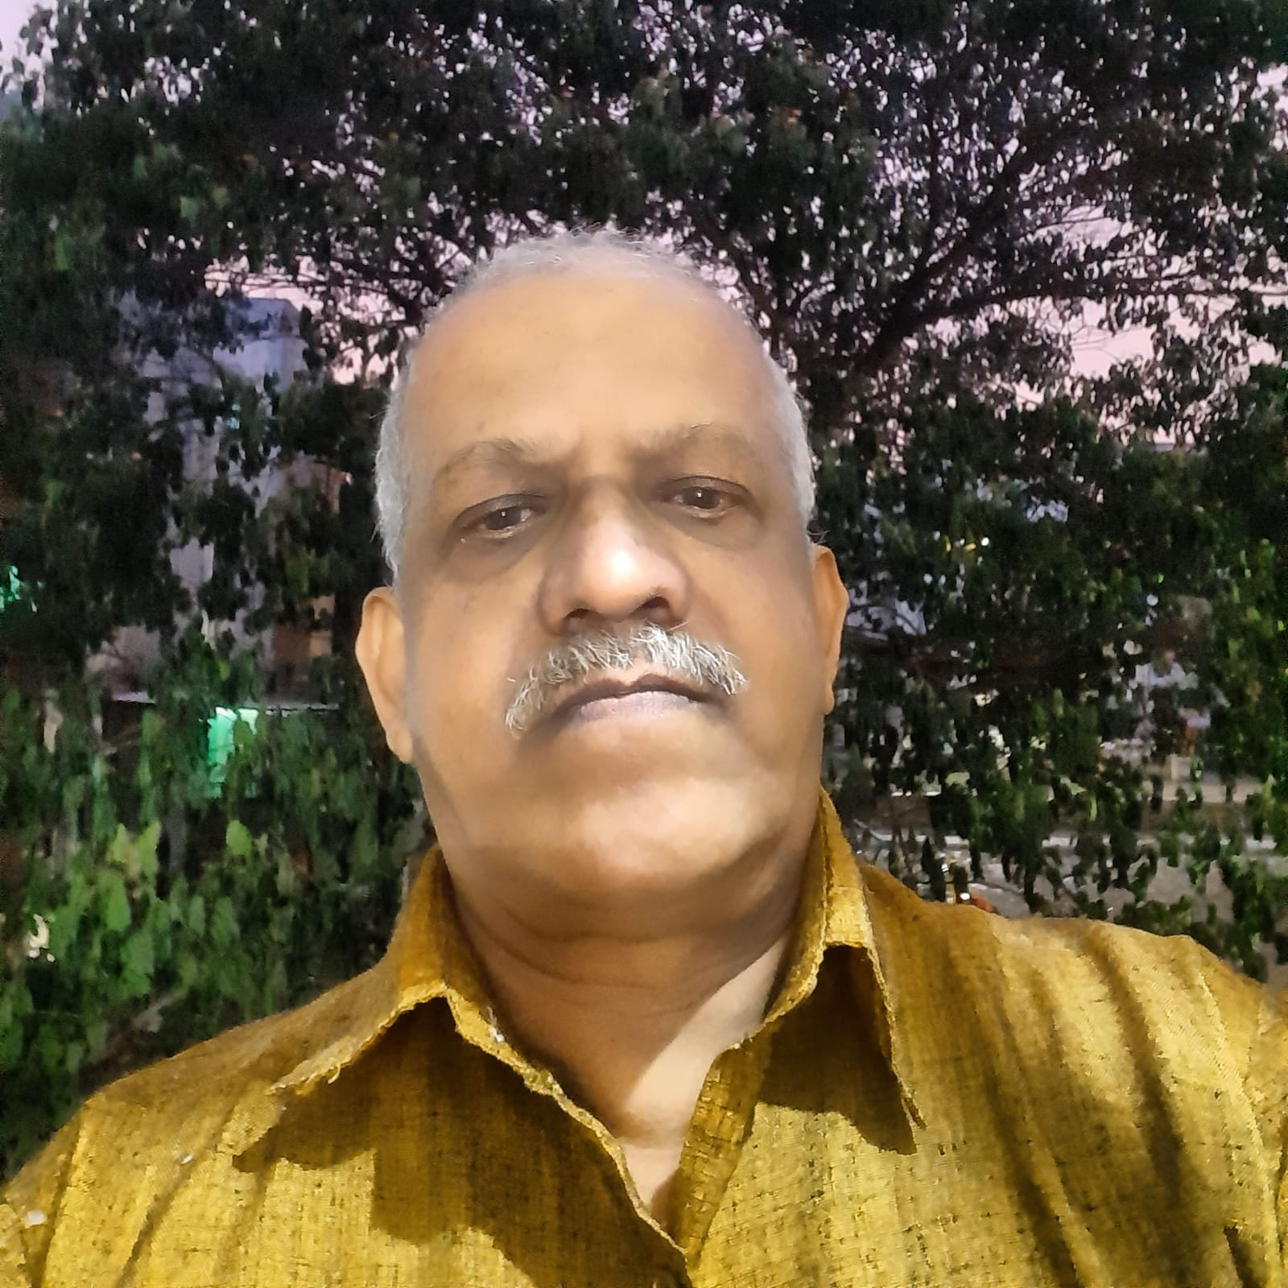
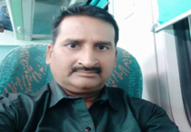
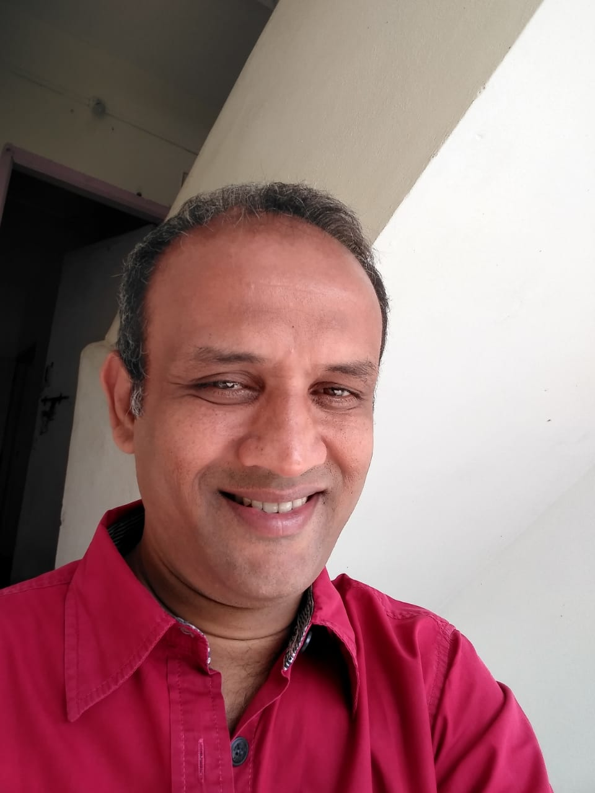
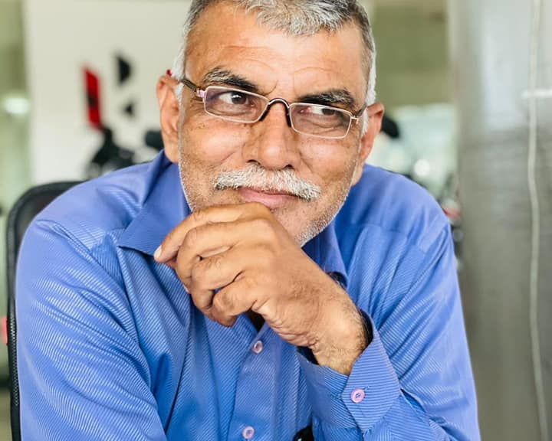
Event Help Line Support :- +91-9075445588, +91-7013451914, +91-9182879344, +91-7972502800, +91-7032748038, +91-9642555144
RAJARAM CHAUHAN
Head Of Operations
Adv. MP Kanoje (Sisodia)
51 Years young, dynamic, post graduate , working as senoir manager in leading Bajaj Showroom. Expert in Team Building.
Rajput Vivah Maharashtra is the admin of Group 1 to 14 and Maharashtra Rajput Remarriage Group and is in daily contact with 3500 members of the Rajput community.
Sunil M Jangira
Mr. Shashank Wadekar
He has deep knowledge in Vedic astrology, Numerology, Gemology, Vastu Shastra etc.
He has known for his innovative skills and experience to create long term technical solutions for various businesses.

Slide 12
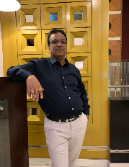
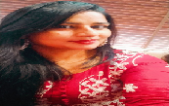
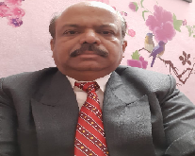
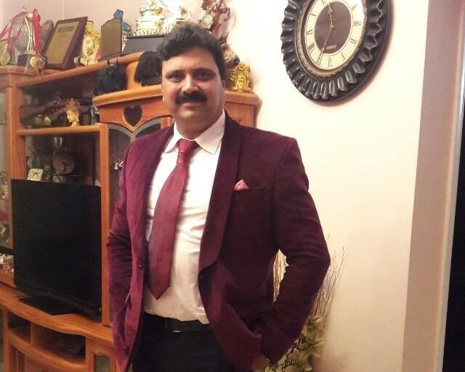
Event Help Line Support :- +91-9075445588, +91-7013451914, +91-9182879344, +91-7972502800, +91-7032748038, +91-9642555144
Mr. Sandeep Kumar Jindal
Agarwal Samaj
Business man
Mrs. Sangeeta Chopra
(Fashion Designer)
Punjabi Khatri Samaj
India
Mr. Shyam Sahni
Represented India in Power lifting events and won many medals.
Representing Pune Punjabi Samaj.
Mr. Srihari kadam: Working in Electronics Media and Entrepreneur.
He is represent for Marathi in Telangana

Slide 13






Photo Collage
Sign up and create your profile
Launch the event
Fill in the event data
.
Let the magic happen

Slide 14

www.ShubhShaadiVivah.com
THANK YOU

