Slide 1
ASP.NET
Suvash Shah Thakuri
DWIT

Slide 2
ASP.NET Introduction
ASP.NET is a server side web application framework design for web development to produce dynamic Web pages.
It is the successor of Active Server Page (ASP) Microsoft technology.
ASP.NET application can be built with any .NET supported languages(http://en.wikipedia.org/wiki/Category:.NET_programming_languages)
There are 40 .NET programming languages

Slide 3
ASP.NET Introduction
ASP.NET web pages are called web forms
Web forms has .aspx extension
Web pages contains HTML, server side web controls, scripts, CSS and server code
Using ASP.NET we can built distributed applications, with separate logical tires like data, business and user interface
Single application can work with multiple client database through each connectionString

Slide 4
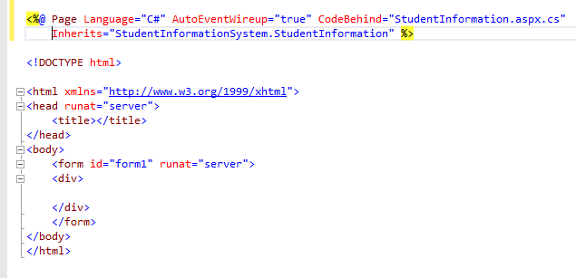
First ASP.NET page

Slide 5
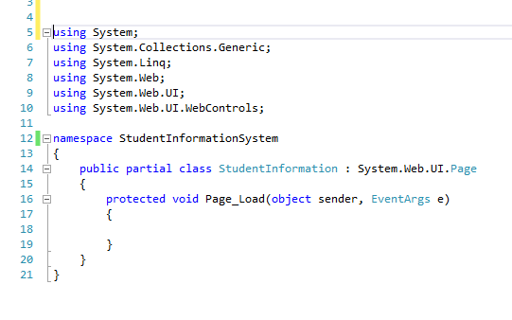
Code Behind

Slide 6
Web Controls
A Control is an object that can be drawn on to the Web Forms to enable or enhance user interaction with the application.
Types of controls
HTML Controls
Web Server Controls
Validation Controls
User Controls

Slide 7
Web Controls
HTML server controls HTML elements exposed to the server so you can program them. HTML server controls expose an object model that maps very closely to the HTML elements that they render.
HTML Table
HTML Button
Web server controls Controls with more built-in features than HTML server controls. Web server controls include not only form controls such as buttons and text boxes, but also special-purpose controls such as a calendar, menus, and a tree view control. Web server controls are more abstract than HTML server controls in that their object model does not necessarily reflect HTML syntax.
Button
Check Box
DataGrid

Slide 8
Web Controls
Validation controls Controls that incorporate logic to enable you to what users enter for input controls such as the TextBox control. Validation controls enable you to check for a required field, to test against a specific value or pattern of characters, to verify that a value lies within a range, and so on. For more information, see Validation ASP.NET Controls.
Required field Validator
Compare Validator
Range Validator
User controls Controls that you create as ASP.NET Web pages. You can embed ASP.NET user controls in other ASP.NET Web pages, which is an easy way to create toolbars and other reusable elements. For more information

Slide 9
Web Forms
Web forms in web pages allows us to submit the data to the server for processing.
Web forms can be used to retrieve the server data for display in web pages
Web forms contain text box, buttons, check box, radio button, file upload etc.

Slide 10
State Management
ViewState
Save web forms data on post back
ViewState data expires after moving to another page
It’s scope is only within single page.
Session
Save the data of single user and are available on every pages of application
Session expires after certain time
It’s scope is within entire application

Slide 11
State Management
Cookies
A cookie is often used to identify a user. A cookie is a small file that the server embeds on the user's computer. Each time the same computer requests a page with a browser, it will send the cookie too.
With Cookies we can store and retrieve users information with the browser
Cookies expires after certain time specified while creating cookie variable

