Slide 1

TransitBLU
Jonathan Goins, Kyle Ma, Max Saldi, Owen Helfer, Rafael Neves

Slide 2

What is TransitBLU?
We are a customizable bus tracking service. Allowing you to always get the latest information on where you need to go.
Features
Walking speed
Saving favourite routes
Interactive Map
Step by Step directions with time
FeedBack
Notes:
Features: favorite route, walking speed

Slide 3









Tools
Project Tracker - Jira
Version Control - GitHub
Backend API - Node.js/Express
Relational database - PostgreSQL
Containerization - Docker
API - Google Maps Javascript API
Deployment - Local Host
Notes:
Jira - project management
Git hub - version control
Node / express - Backend API
PostgreSQL - Database
Docker - Container
Local host

Slide 4

Methodologies
Agile
Paired Programing
Peer code reviews

Slide 5
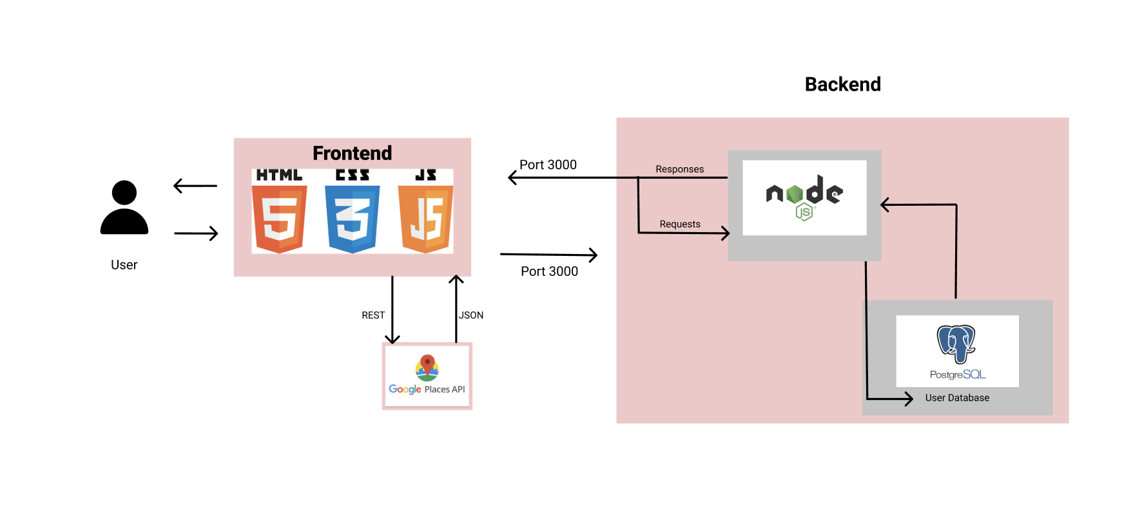
Architecture Diagram

Slide 6
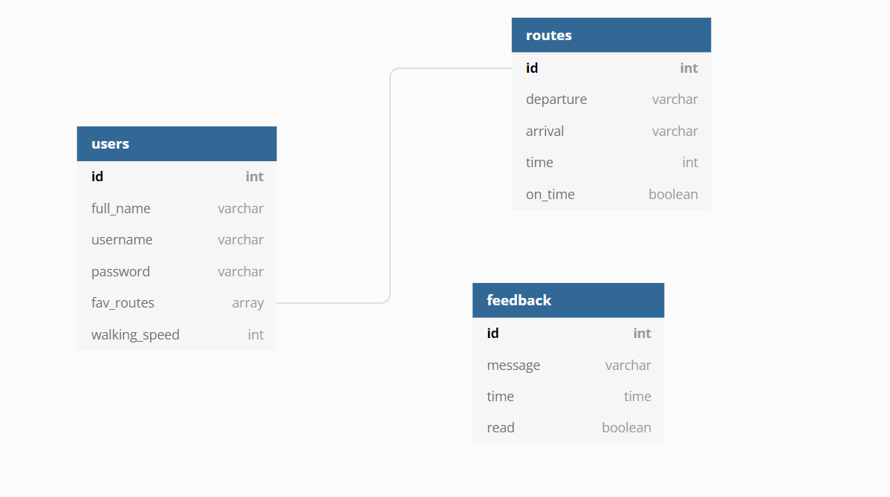
Database Diagram

Slide 7

Challenges
Integration/Communication
Postgres/Docker/Node synthesis
Modifying the data as it comes from the Google API
Favorite routes for each user
Finding the users position
Notes:
Jon
Owen
Rafa
Kyle
Max

