Slide 1
DIRAC Tutorial
By R. Graciani
Lisbon, Nov 8th 2012

Slide 2
Workplan
Introduction
IBERGRID DIRAC installation
Coffee break
Parametric jobs & Mandelbrot quest
Summary

Slide 3
The project
DIRAC was developed by LHCb to implement its distributed computing model.
In 2010, DIRAC became a general purpose framework for distributing computing, providing integration and interoperability among different types of computing resources.
Now DIRAC is used by several large communities: LHCb, Belle II, SuperB, BES III, CTA,…
Trying to create a “DIRAC Consortium” for the support and development of DIRAC.
http://diracgrid.org

Slide 4
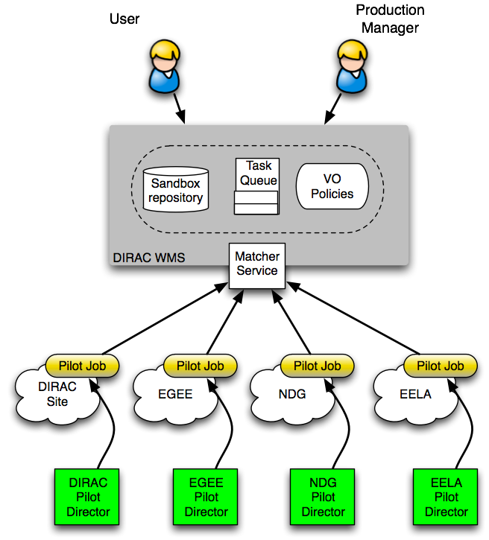
Workload Management
Jobs are submitted to the DIRAC Central Task Queue with credentials of their owner (VOMS proxy)
Pilot Jobs are submitted by specific Directors to a Grid WMS with credentials of a user with a special Pilot role
The Pilot Job fetches the user job and the job owner’s proxy
The User Job is executed with its owner’s proxy used to access SE, catalogs, etc

Slide 5
Interfaces
Very rich command line:
Simple interface for linux users.
Full functionality available through the python API:
Allow to create customized scripts for advanced users.
Most efforts now on Web Portal interface
Desktop like application, initially designed for monitoring but with increasing interactivity
In all cases user grid credentials are used to secure and authenticate.

Slide 6
DIRAC for IBERGRID

Slide 7
DIRAC 4 IBERGRID
This initiative aims to provide DIRAC as a Service for IBERGRID to simplify the access of the users to resources.
http://icc.ub.edu/gr_DIRAC.php
All users registered on Ibergrid Macro VOs are registered in the portal:
http://dirac.ub.edu/DIRAC
or
http://dirac.ub.es/DIRAC

Slide 8
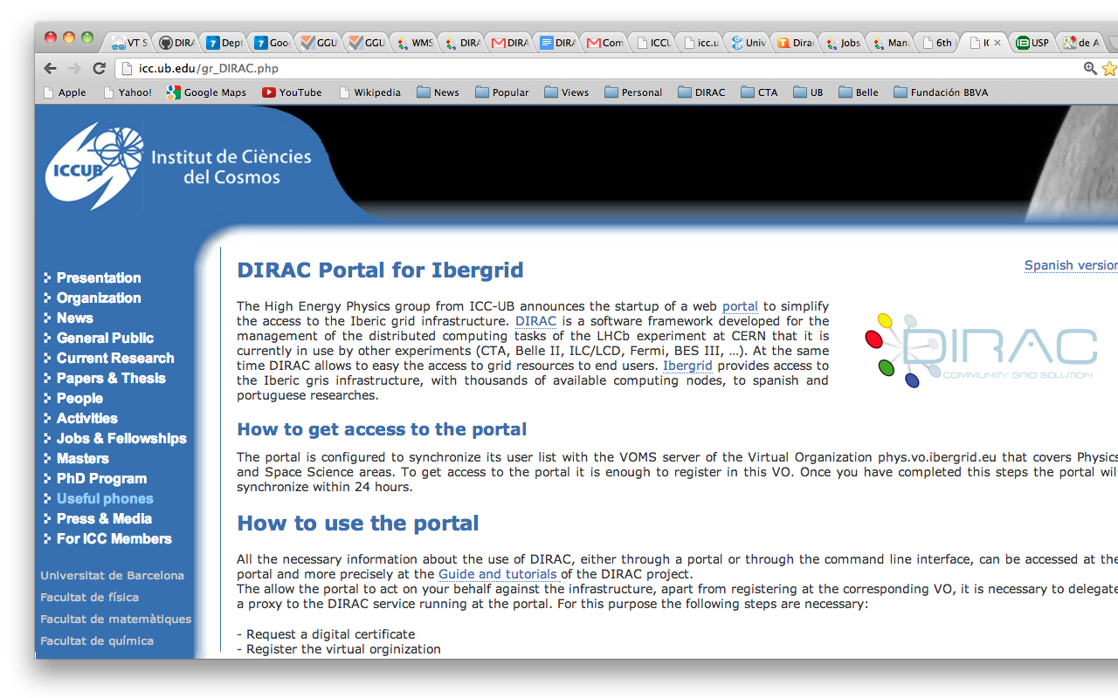

Slide 9
Groups
Users are organized in groups:
iber_phys -> phys.vo.ibergrid.eu
iber_life -> life.vo.ibergrid.eu
iber_eng -> eng.vo.ibergrid.eu
iber_ict -> ict.vo.ibergrid.eu
iber_earth -> earth.vo.ibergrid.eu
iber_social -> social.vo.ibergrid.eu
iber_chem -> chem.vo.ibergrid.eu
user -> (all) tut.vo.ibergrid.eu

Slide 10
Step 1: Installing your DIRAC client
Available for most *nix flavors.
Download the DIRAC installation script
Install the software (using IBERGRID defaults)
Source the environment
Create a proxy and configure your client
Create your working proxy
# wget http://lhcbproject.web.cern.ch/lhcbproject/dist/Dirac_project/dirac-install
# chmod +x dirac-install
# ./dirac-install -V IBERGRID
# source bashrc
# dirac-proxy-init -x
# dirac-configure defaults-IBERGRID.cfg
# dirac-proxy-init -g user

Slide 11
Step 2: simple jobs submission
Using an existing definition:
Creating a trivial JDL:
# cp DIRAC/WorkloadManagementSystem/tests/GenericJob.jdl .
# dirac-wms-job-submit GenericJob.jdl
JobID = 17508
# cat simple.jdl
JobName = "Simple Job";
Executable = "/bin/ls";
# dirac-wms-job-submit simple.jdl
JobID = 17509

Slide 12
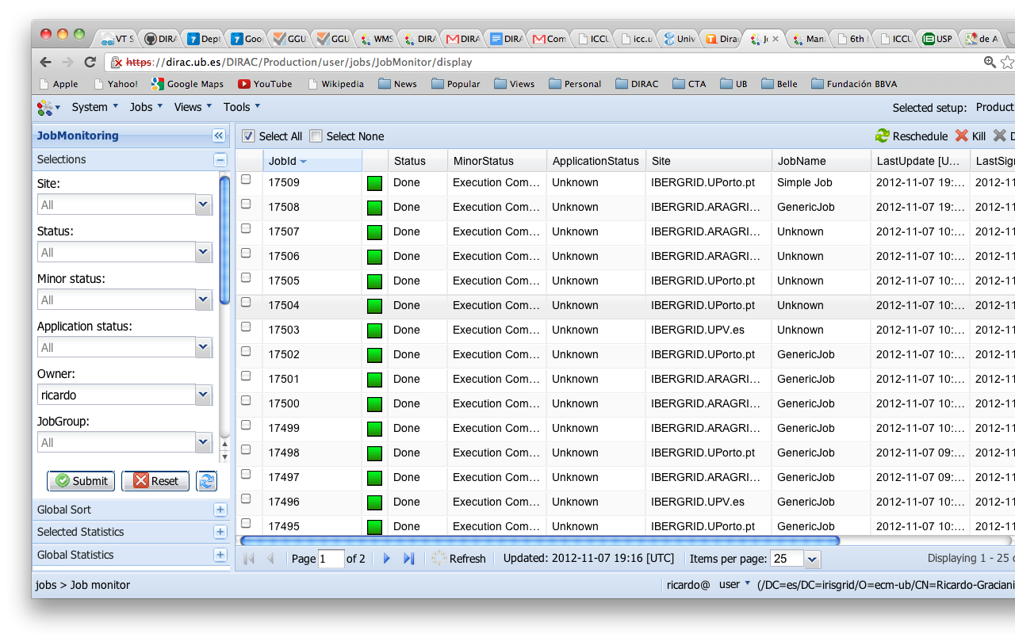
Step 3: Monitoring your jobs

Slide 13
Exercise 1
Get your certificate and key in ~/globus
Install and configure your IBERGRID DIRAC client
Submit a trivial job
Monitor its execution

Slide 14
A Mandelbrot Job

Slide 15
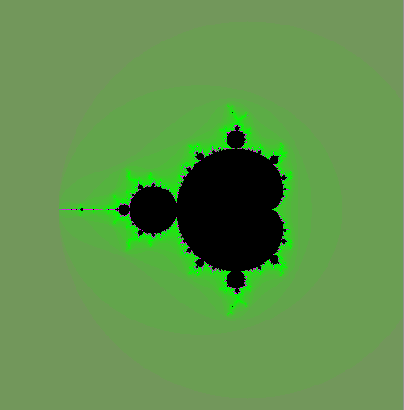
Mandelbrot set
Complex plane
The Mandelbrot set definition
http://en.wikipedia.org/Mandelbrot
The vicinities of the Mandelbrot set area provide an astonishingly rich fractal images
The algorithm consists in assigning a color to each point in the complex plane as a function of a speed of divergence of the Mandelbrot sequence
You certainly have seen some of them but even more are even not discovered yet
In the tutorial we will explore those images while exercising the use of DIRAC tools and grid resources
0
0

Slide 16
Mandelbrot application
In the quest we will be using the mandelbrot application
http://dirac.france-grilles.fr/demo/mandelbrot
The mandelbrot application is a simple python script to construct fractal images:
Builds a fractal image around a chosen C point
One can vary the size of the image, its precision ( zoom level ), color scheme
The output is an image file in BMP format
Can be easily visualized in a Web browser
The mandelbrot application is available also from a grid Master-SE Storage Element:
LFN:/UB-Master/user/a/atsareg/mandelbrot
# dirac-dms-get-file /UB-Master/user/a/atsareg/mandelbrot
{'Failed': {},
'Successful': {'/UB-Master/user/a/atsareg/mandelbrot': '/tmp/rgracian/mandelbrot'}}

Slide 17
mandelbrot application usage
Usage:
mandelbrot [options] [<output_file>]
Options:
-X, --cx - the real part of the C parameter in the center of the image, default = -0.5
-Y, --cy - the imaginary part of the C parameter in the center of the image, default = 0.0
-P, --precision - the step size of the C parameter increment per pixel of the image, default = 0.01
-M, --max_iterations - the maximum number of the mandelbrot algorithm iterations, default = 100
-W, --width - image width in pixels, default = 300
-H, --height - image height in pixels, default = 300
-B, --bw - force black and white image, default is a color image
-F, --color_factor - color palette parameter defining how quickly the colors are changing, the value should be in the range 0.<x<1.0, default = 0.02
-S, --color_phase - a magic color palette parameter, default = 1.0
-D, --color_delta - yet another magic color palette parameter, default = 1.0
-h, --help - print this usage info

Slide 18

Mandelbrot Job
Goal: find a new interesting and beautiful area in the Mandelbrot set vicinity and let everybody admire it !
Of course, by doing the whole work with the mandelbrot grid jobs
mandelbrot -W 600 -H 600 -X -0.46490 -Y -0.56480 -P 0.000002 -M 500

Slide 19
Option 1: Command line
Submit job:
Get output
# cat mandelbrot.jdl
JobName = "Mandelbrot";
Executable = "mandelbrot";
Arguments = "-W 600 -H 600 -X -0.46490 -Y -0.56480 -P 0.000002 -M 500";
InputSandbox = {"LFN:/UB-Master/user/a/atsareg/mandelbrot"};
StdOutput = "std.out";
StdError = "std.err";
OutputSandbox = {"std.out","std.err","*.bmp"};
MaxCPUTime = 1000;
# dirac-wms-job-submit mandelbrot.jdl
JobID = 17510
# dirac-wms-job-get-output 17510
Job output sandbox retrieved in 17510/

Slide 20
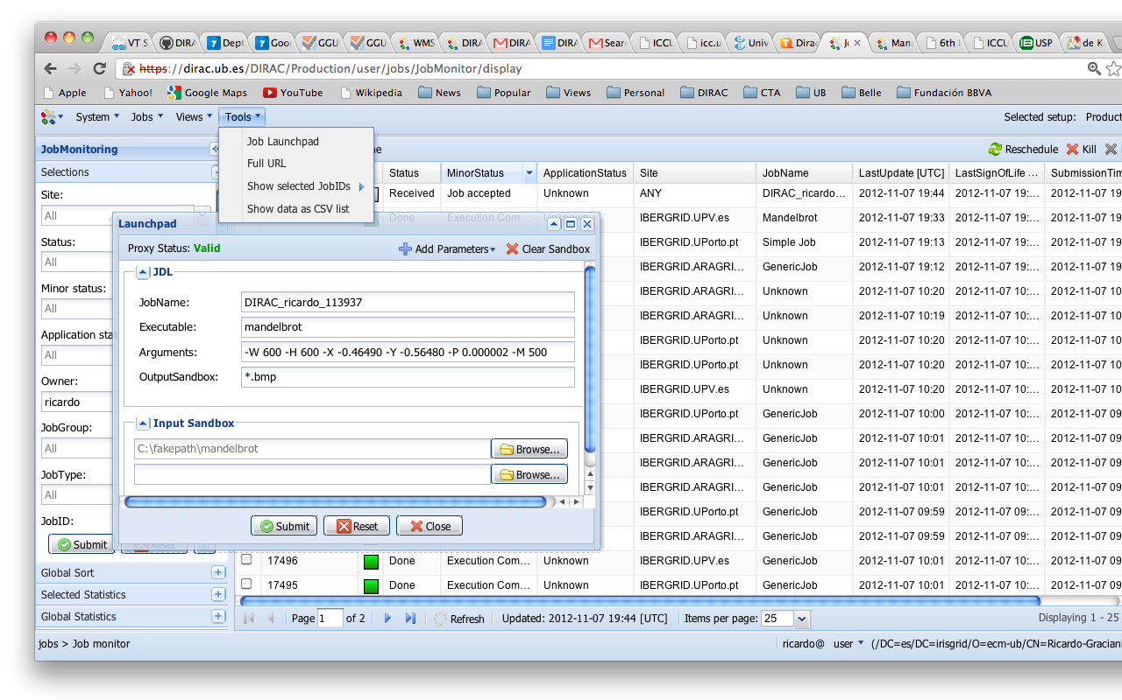
Option 2: Web Portal

Slide 21
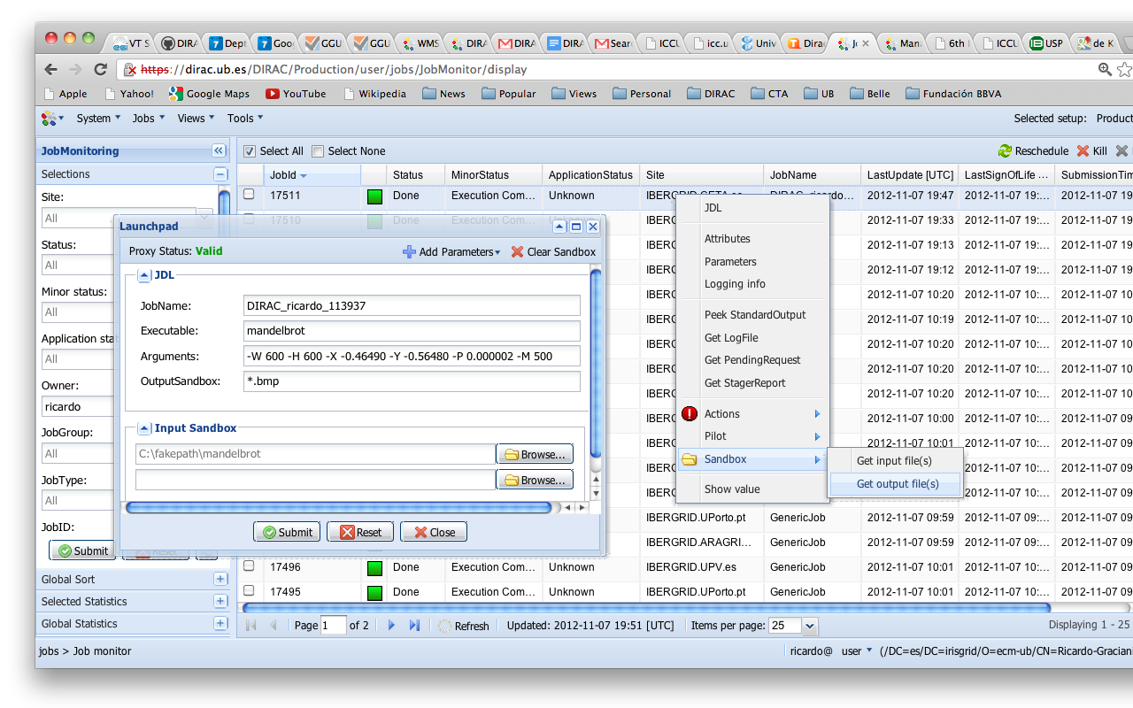

Slide 22
Exercise 2
Retrieve the mandelbrot application
Execute few mandelbrot jobs using command line and web portal interfaces
Retrieve the output of the jobs

Slide 23
Parametric Jobs

Slide 24
Parametric Jobs
A parametric job consists in submission of a set of jobs where only a parameter make the difference between the jobs.
The job parameters are defined as the JDL attribute “Parameter”. It can take the following values:
A list (strings or numbers).
Or, an integer or float specifying the number of parameters to generate, in this case the JDL attributes ParameterStart and ParameterStep/ParameterFactor must be defined in order to create the sequence of values:
P₀ = ParameterStart
P_{i} = P_{i-1}*ParameterFactor + ParameterStep

Slide 25
Parametric Jobs
Parameter value:
At job submission time, the value of the parameter for each job is determined and the %s placeholder can be used in JDL attributes.
Parameter number:
It can be represented in JDL by %n

Slide 26
Parametric Job - JDL
Executable = "testParametricJob.sh";
JobName = ”Parametric_%n";
Arguments = "%s";
Parameters = 20;
ParameterStart = 0;
ParameterStep = 0.02;
ParameterFactor = 1;
StdOutput = "StdOut_%n";
StdError = "StdErr_%n";
InputSandbox = {"testParametricJob.sh"};
OutputSandbox = {"StdOut_%n","StdErr_%n"};
Placeholder replaced by Parameter
value for each job
Placeholder replaced by Parameter
Number value for each job

Slide 27
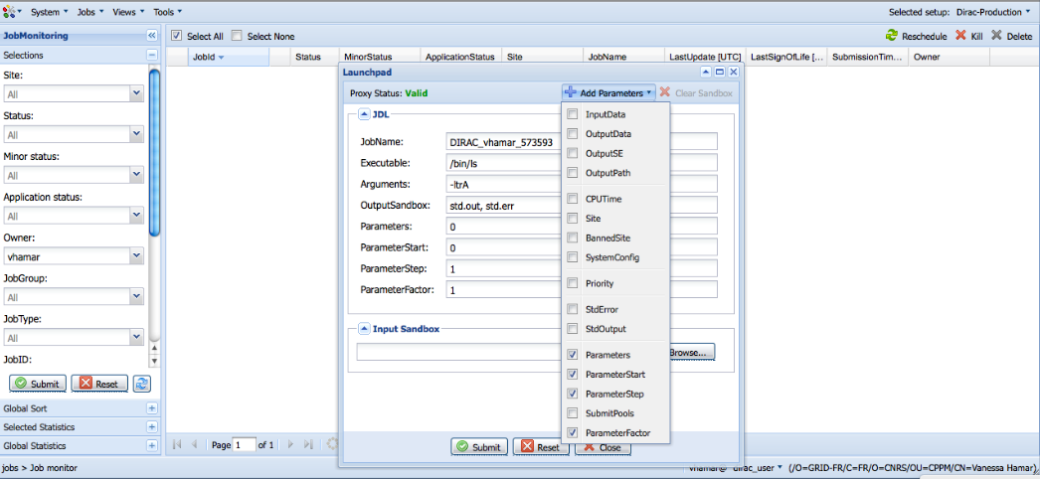
Parametric Job - JDL
Parameters
in JDL
Add parameters

Slide 28
Exercise 3
Prepare and execute some trivial parametric jobs
Combine the mandelbrot and parametric job examples to create a series of mandelbrot images
You can make a short movie using the command
# convert -loop 0 *.bmp movie.gif

Slide 29


Slide 30
Questions?

