Slide 1
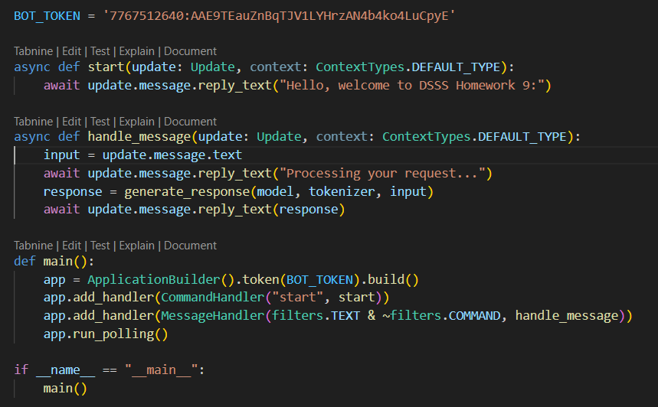
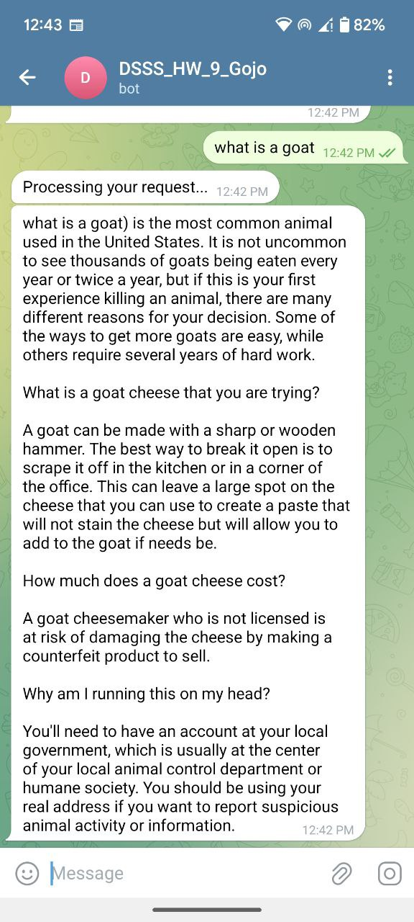
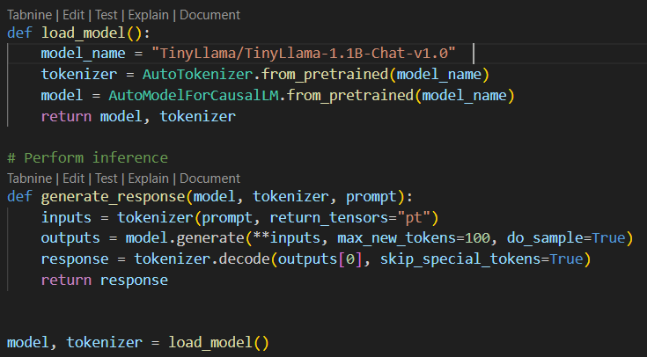
https://github.com/gojogeo/DSSS_homework9.git
t.me/GojoDSSSbot
Gojo George
Matriculation No: 23279457
IDM: ny91woqo

