Slide 1

Recommendation Engine
Jeff Baker
Kailey Hoo
Griffin Okamoto
Notes:
Outline: Project Overview, Workflow, Challenges, Feature Engineering, Model Selection, Next Steps

Slide 2
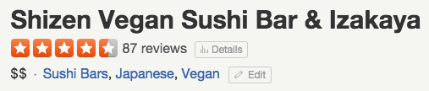


Project Overview
Notes:
Goal: Create a recommendation engine that would predict a user’s rating of a business

Slide 3
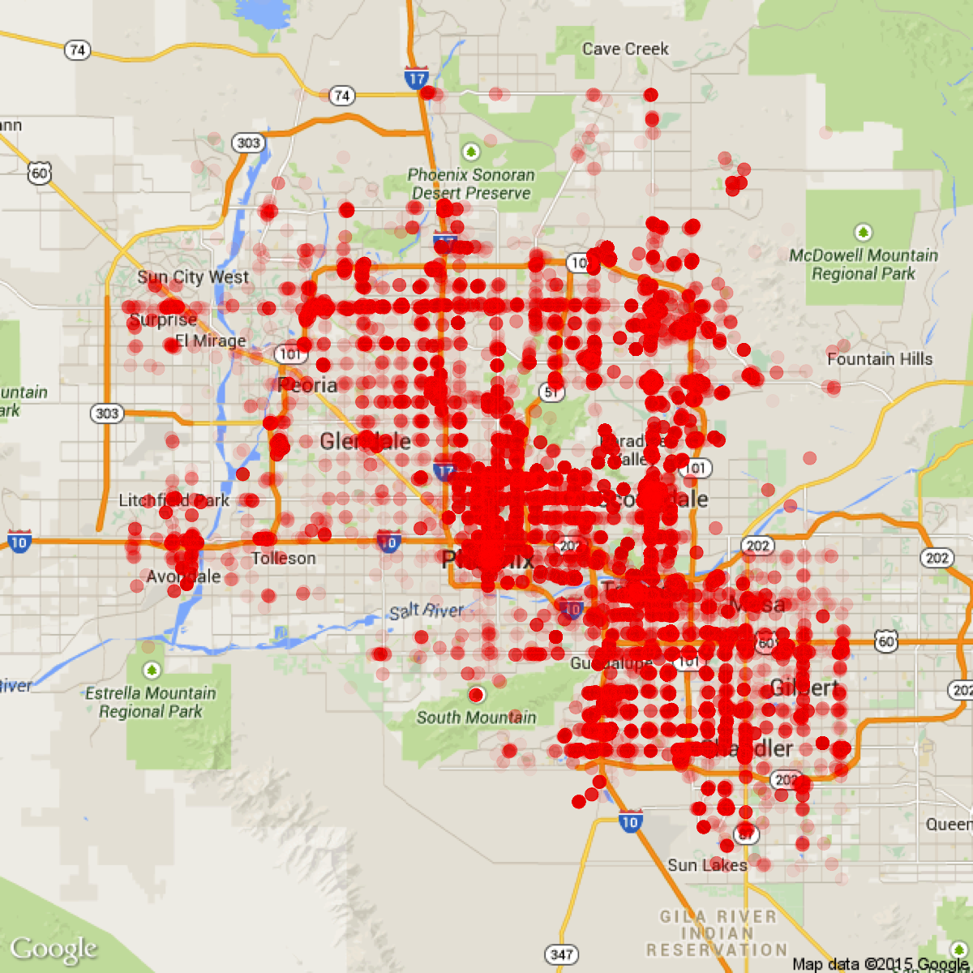
Data
Yelp’s RecSys2013 Kaggle data (Phoenix, AZ)
4 files:
44K users
230K reviews
11.5K businesses
8.2K check-ins
Notes:
Was originally going to retrieve restaurant data in SF via Yelp API & web scraping; not enough time to execute this, so we leveraged existing data instead

Slide 4
Workflow
Data Preprocessing
Exploratory Data Analysis
Baseline Modeling
Feature Engineering
Model Selection

Slide 5
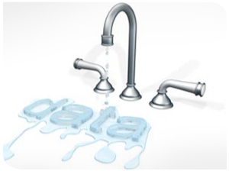
Challenge: Data Leakage
User and business overall review counts included in test set data
Notes:
Our biggest challenge: sanitizing our training and testing data

Slide 6
Feature Engineering
PCA on business categories
i.e. restaurants, beauty spas, automotive
K-means clustering of users
i.e. user review counts, avg. star ratings
N-gram text features from user reviews
i.e. “so bad”, “very good”, “sweet potato fries”
Collaborative filtering
Users similar in rating behavior

Slide 7
Model Selection
Final Algorithms
Linear Regression
Random Forest
Linear Regression | Random Forest | Boosting
Boosting
Features
Category Principal Components
Collaborative Filtering
Category Principal Components | Collaborative Filtering
Text Analysis | User Clusters
Text Analysis
User Clusters
Notes:
Included these features
Maximum features considered at a split

Slide 8
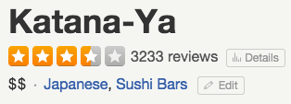
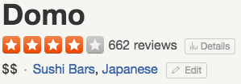
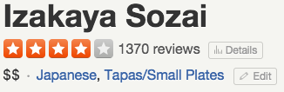
Next Steps
Create a tool to recommend businesses
Augment data to decrease sparsity
Using Yelp API and web scraping

Slide 9
We’re available to discuss technical details. jrbaker2@usfca.edu kmhoo@usfca.edu gmokamoto@usfca.edu https://github.com/kmhoo/AdvancedMLProject www.usfca.edu/artsci/msan/students/ Thanks!
Notes:
We will be sticking around after the presentations so if you have any questions please feel free to find us

