Slide 1

Yelp Recommendation Engine
Jeff Baker, Griffin Okamoto, Kailey Hoo

Slide 2
Outline
Project overview
Feature engineering
Model testing
Outcomes

Slide 3
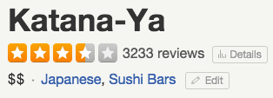


Project Overview
Notes:
Goal: Create a recommendation engine that would predict a user’s rating of a business

Slide 4
Workflow
Data Preprocessing
Exploratory Data Analysis
Baseline Modeling
Feature Engineering
Model Selection

Slide 5
Feature Engineering
PCA of business categories
K-means clustering of users
N-gram text features from user reviews
Collaborative filtering (user similarity)

Slide 6
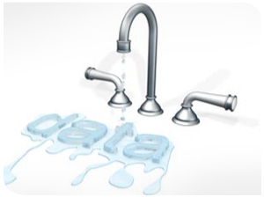
Challenge: Data Leakage
Users have multiple reviews
Businesses have multiple reviews from users
Notes:
Our biggest challenge: sanitizing our training and testing data

Slide 7

Model Tuning & Selection
Final candidate models:
Linear Regression
Boosting
Random Forest
Linear result
Boosting result
RF result

Slide 8
Outcomes
What worked | Challenges
Notes:
Our biggest hurdle: predicting

Slide 9
We’re available to discuss technical details. Thanks!

Slide 10
Appendix

Slide 11
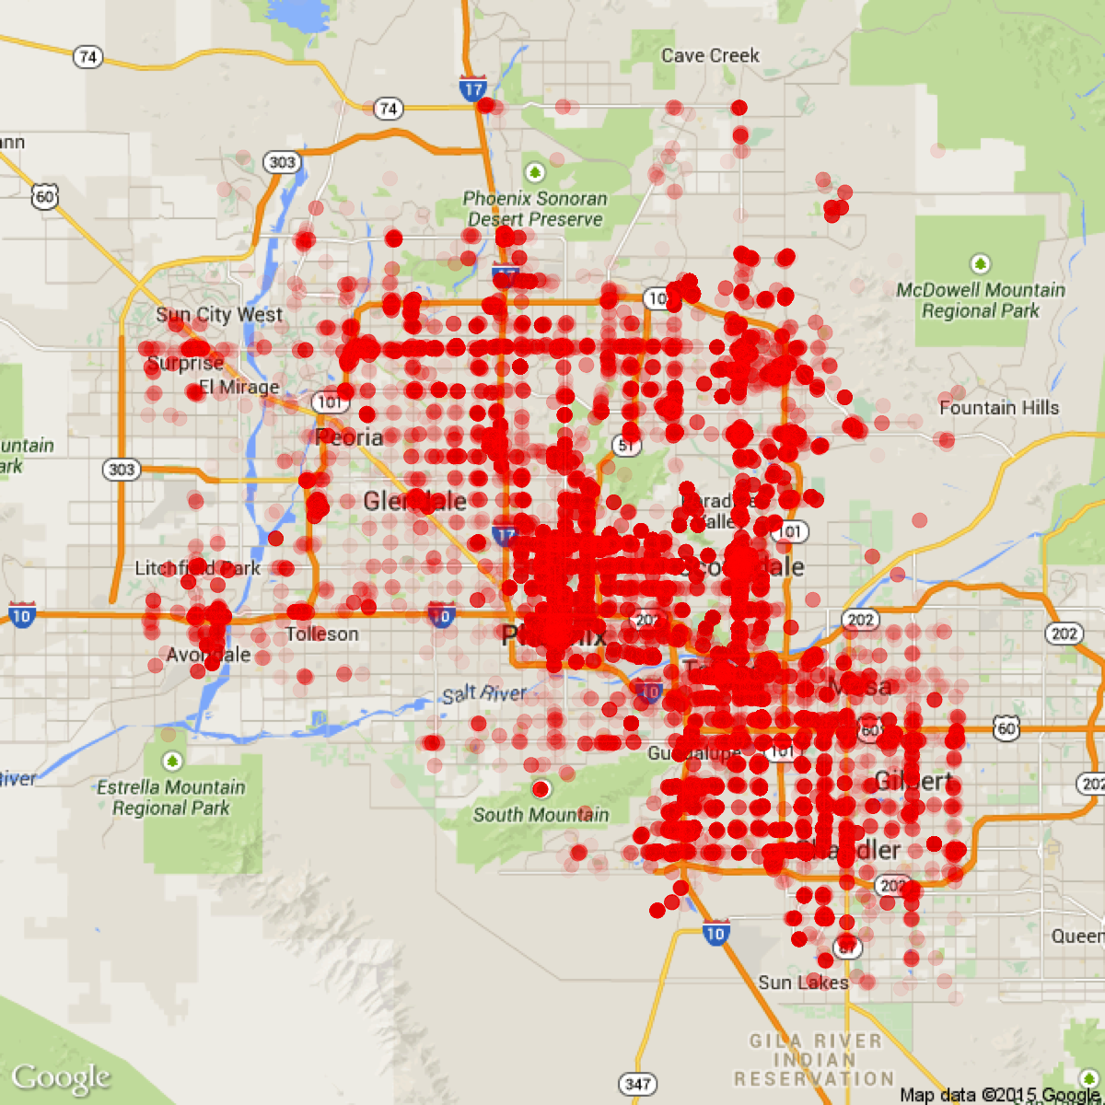
Data
Yelp’s RecSys2013 kaggle data (Phoenix, AZ)
4 files:
44K users
230K reviews
11.5K businesses
8.2K check-ins
Notes:
Was originally going to retrieve restaurant data in SF via Yelp API & web scraping; not enough time to execute this, so we leveraged existing data instead

