Slide 1

Recommendation Engine
Recommendation Engine
Jeff Baker
Griffin Okamoto
Kailey Hoo
Jeff Baker
Griffin Okamoto
Kailey Hoo
Notes:
Outline: Project Overview, Workflow, Challenges, Feature Engineering, Model Selection, Next Steps

Slide 2
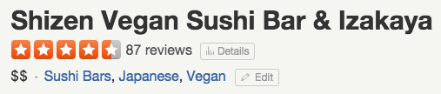


Project Overview
Notes:
Goal: Create a recommendation engine that would predict a user’s rating of a business

Slide 3
Workflow
Data Preprocessing
Exploratory Data Analysis
Baseline Modeling
Feature Engineering
Model Selection

Slide 4

Challenge: Data Leakage
User and business overall review counts included in test set data
Notes:
Our biggest challenge: sanitizing our training and testing data

Slide 5
Feature Engineering
PCA of business categories
K-means clustering of users
N-gram text features from user reviews
Collaborative filtering (user similarity)

Slide 6
Model Selection
Final Models
Linear Regression | Random Forest | Boosting
Features
Category Principle Components | Collaborative Filtering
Text Analysis | User Clusters
Notes:
Included these features
Maximum features considered at a split

Slide 7
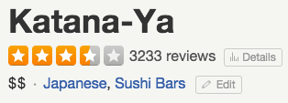
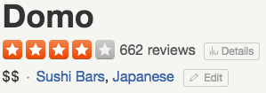
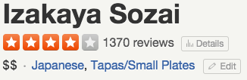
Next Steps
Create a tool to recommend businesses
Augment data to decrease sparsity

Slide 8
We’re available to discuss technical details. jrbaker2@usfca.edu gmokamoto@usfca.edu kmhoo@usfca.edu Thanks!
Notes:
We will be sticking around after the presentations so if you have any questions please feel free to find us

