Slide 1
Sample Course Name
Sample Course Module Name Author: Asst. Prof. Dr. Uğur CORUH

Slide 2
Algorithms And Programming
Week-2 (Git)
Spring Semester, 2022-2023
Download DOC, SLIDE, PPTX

Slide 3
Git
How to use Git?

Slide 4
How to use Git?

Slide 5
Git
Here is a basic overview of how Git works 1.Create a “repository” (project) with a git hosting tool (like Bitbucket) 2.Copy (or clone) the repository to your local machine 3.Add a file to your local repo and “commit” (save) the changes 4.”Push” your changes to your main branch 5.Make a change to your file with a git hosting tool and commit 6.”Pull” the changes to your local machine 7.Create a “branch” (version), make a change, commit the change 8.Open a “pull request” (propose changes to the main branch) 9.”Merge” your branch to the main branch

Slide 6
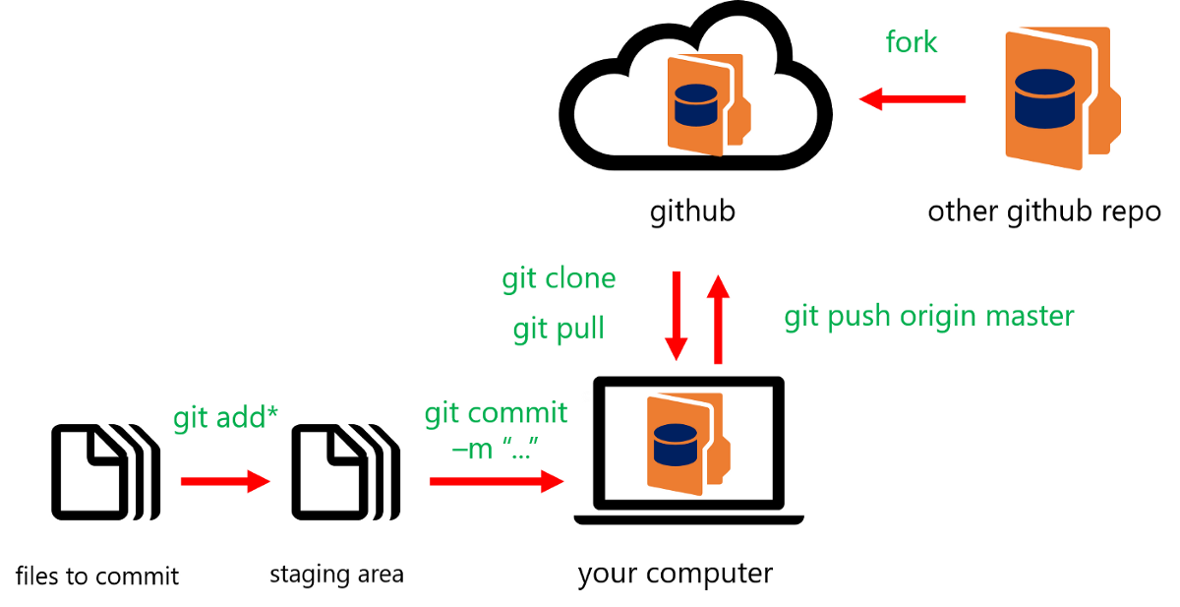
Git
Sample git notation A simple modeled version of the git shown in this image.
bg right:50% h:300px

Slide 7
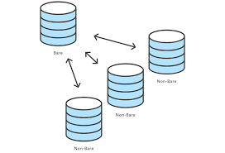
Git
Simple “git init” notation
The git init command creates a new Git repository. It can be used to convert an existing, unversioned project to a Git repository or initialize a new, empty repository.
bg right:50% center h:300px

Slide 8
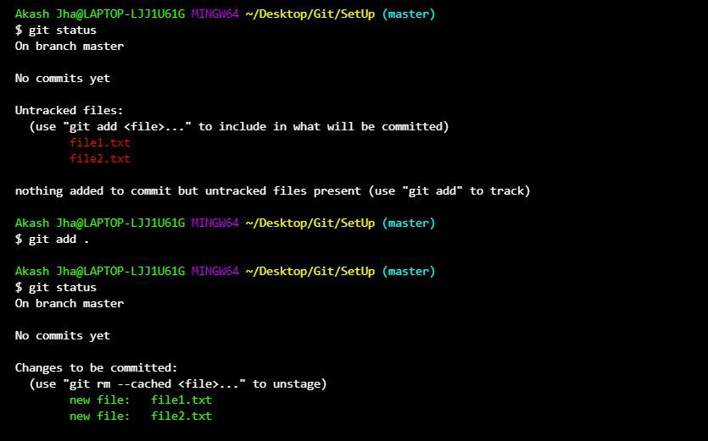
Git
How to use “git add” Here you see using a git add from the command line.
bg left:60% h:350px

Slide 9
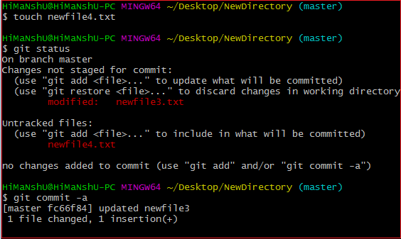
Git
How to use “git commit” Here you see using a git commit from the command line.
bg left:60% h:350px

Slide 10
TODO DO MORE LEARN

Slide 11
References
https://www.atlassian.com/git/tutorials/learn-git-with-bitbucket-cloud
https://www.atlassian.com/git/tutorials/setting-up-a-repository/git-init
https://www.atlassian.com/git/tutorials/learn-git-with-bitbucket-cloud
https://medium.com/swlh/an-introduction-to-git-and-github-22ecb4cb1256
https://git-scm.com/

Slide 12
$End−Of−Week−2−Module$

