Slide 1
Introduction to Machine Learning
Lecture 1
Goker Erdogan
26 – 30 November 2018
Pontificia Universidad Javeriana

Slide 2
Introduction to Machine Learning
Instructor: Goker Erdogan (gokererdogan@gmail.com) http://gokererdogan.com
About the course
An introduction to machine learning with a focus on its applications in economics and business
20 hours of lectures with occasional exercises and programming assignments
A basic understanding of calculus, probability/statistics, and linear algebra
This lecture
  AI vs. ML vs. Data Science vs. Business Analytics
  Brief history of AI/ML
  Sample applications
  Course outline

Slide 3
Artificial Intelligence
Machine Learning
Deep Learning
Data Science

Slide 4
Artificial Intelligence | Machine Learning | Data Science
Aim: Mimicking intelligent behavior^{[1]} Started around 1950s Problems: - Reasoning - Knowledge Representation - Planning - Learning - Natural language processing - Perception/action Approaches: - Symbolic/logic-based - Brain simulation - Statistical learning - ... | Aim: Give computer systems the ability to "learn" from data, without being explicitly programmed^{[2]} As old as AI itself Learning rather than programming to mimic intelligent behavior Focuses more on prediction and performance than interpretability Larger and higher dimensional datasets | Aim: To extract knowledge and insights from data in various forms^{[3]} Relatively modern (2000s) Relies heavily on statistics Focuses more on application Focuses more on understanding and interpretability Generally smaller datasets (with fewer features/attributes)
Deep learning: Subset of ML that use artificial neural networks with many layers
Business analytics: More or less synonymous with data science. Focuses on business applications.

Slide 5
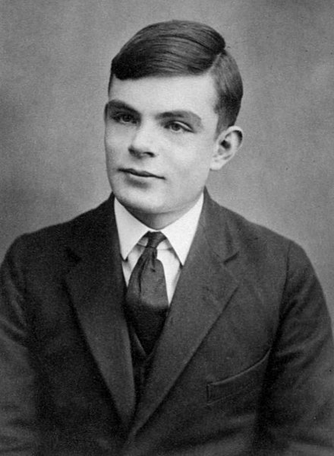
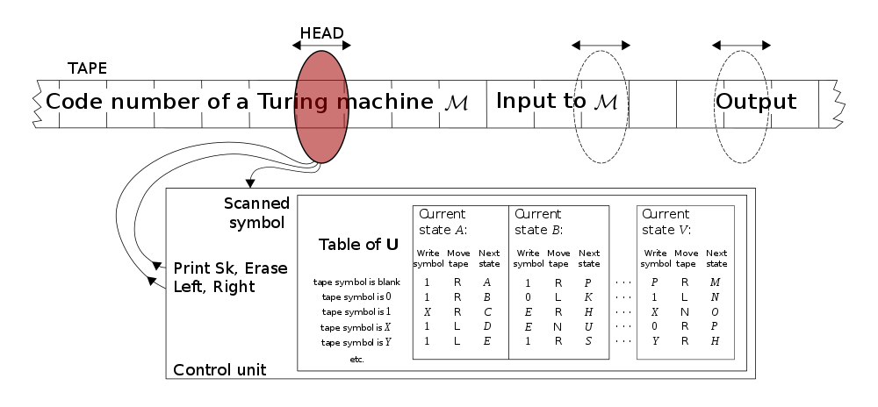
Brief history of AI and ML^{[1,2]}
1930s: Mathematical logic: Can machines do mathematics?
    Alan Turing, British mathematician
    Turing machine
      Mechanization of logic/mathematics
      Foundation for modern computers
    2014 movie: The Imitation Game
      https://www.imdb.com/title/tt2084970/

Slide 6
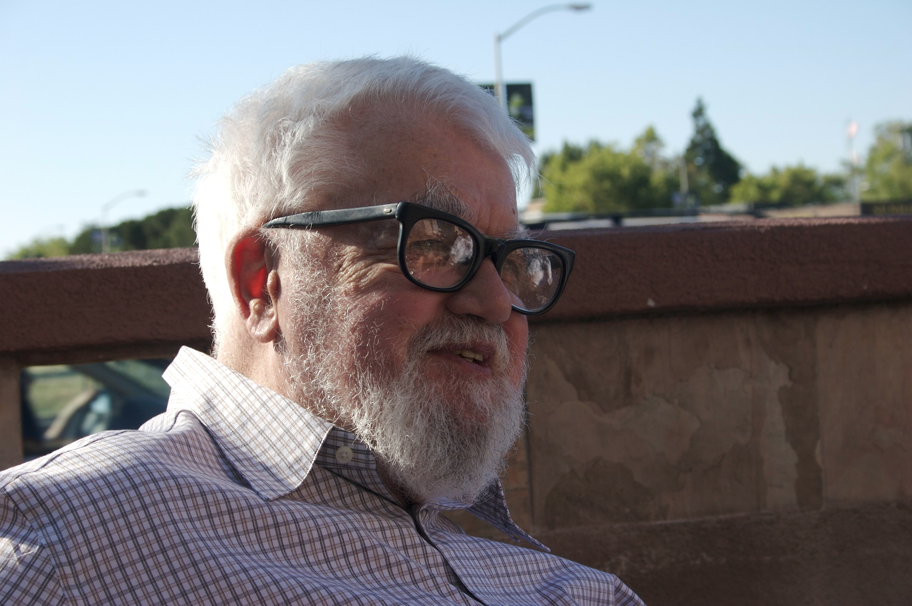
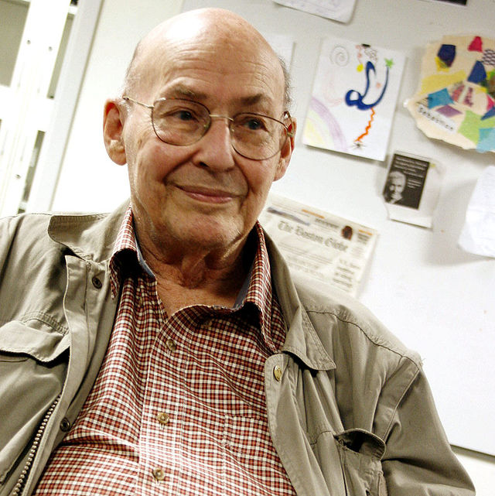
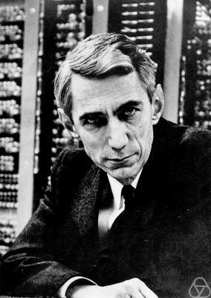
Brief history of AI and ML
  1956, a workshop at Dartmouth College, New Hampshire
    Research proposal by McCarthy, Minsky, Shannon
    Introduced the term artificial intelligence
      “We propose that a 2-month, 10-man study of artificial intelligence be carried out during the summer of 1956 at Dartmouth College in Hanover, New Hampshire. The study is to proceed on the basis of the conjecture that every aspect of learning or any other feature of intelligence can in principle be so precisely described that a machine can be made to simulate it. An attempt will be made to find how to make machines use language, form abstractions and concepts, solve kinds of problems now reserved for humans, and improve themselves. We think that a significant advance can be made in one or more of these problems if a carefully selected group of scientists work on it together for a summer. ”

Slide 7
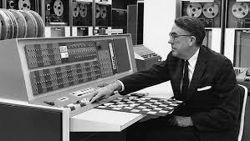
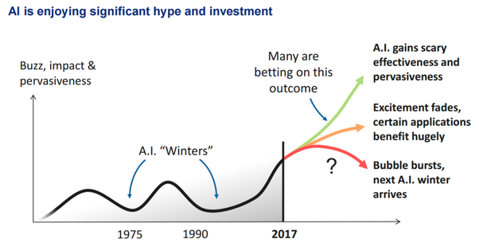
Brief history of AI and ML
  1960s, first successes
    Samuel’s checkers playing program
    Solving algebra problems
    Proving mathematical theorems
  1970s, first AI winter
  1980s, resurgence of interest
    Expert systems (e.g., medical diagnosis)
  1990s, another AI winter
  From 2000s on forward
    Deep neural networks
    Huge interest
    AI as active as it has never been
In a 2017 survey, one in five companies reported they had "incorporated AI in some offerings or processes"

Slide 8
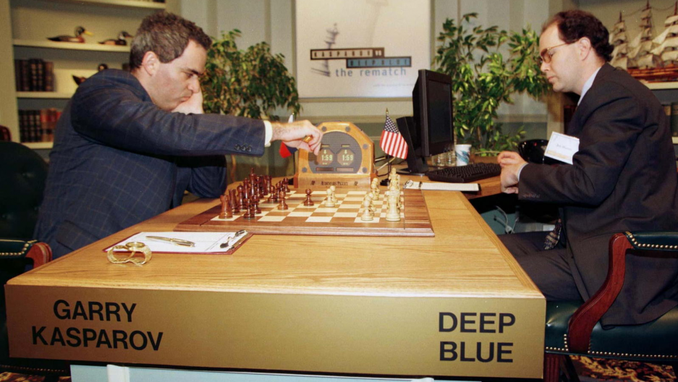
Brief history of AI and ML
    1997: IBM DeepBlue beats Garry Kasparov (score: 3.5 – 2.5)
      World’s 259th most powerful computer
      Traditional AI, with little machine learning
      Analyzes 200 million positions per second
      Today, your laptop can beat a chess grandmaster
      Improvements both in computational power and chess playing software
        Pocket Fritz 4 (running on HTC Touch HD) searches fewer than 20,000 positions per second

Slide 9
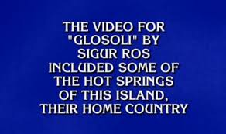
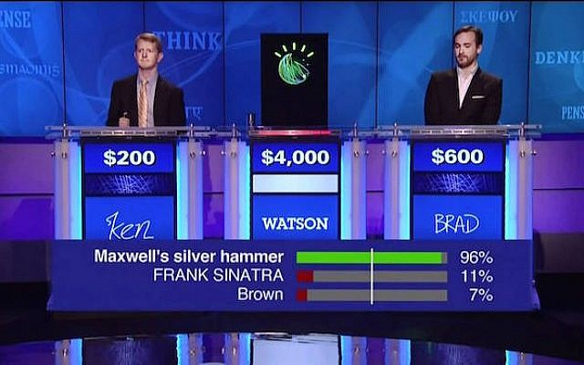
Brief history of AI and ML
    2011: IBM Watson beats humans at Jeopardy
      Quiz show
      Watson
        https://www.youtube.com/watch?v=P18EdAKuC1U
        2,880 POWER7 processor threads and 16 terabytes of RAM
        Uses a combination of machine learning, natural language processing and information retrieval techniques
        Access to 200 million pages of documents

Slide 10

Brief history of AI and ML
    2016: Google AlphaGo beats Go world champion
      Go more difficult than chess
        10⁴⁴ vs 10¹⁷⁰ possible board configurations
      AlphaGo (https://www.alphagomovie.com/)
        1,920 CPUs and 280 GPUs
        Uses supervised learning and reinforcement learning
        Learns from human play and self-play
        AlphaZero: Learned all from self-play. Masters Go, chess, and shogi

Slide 11
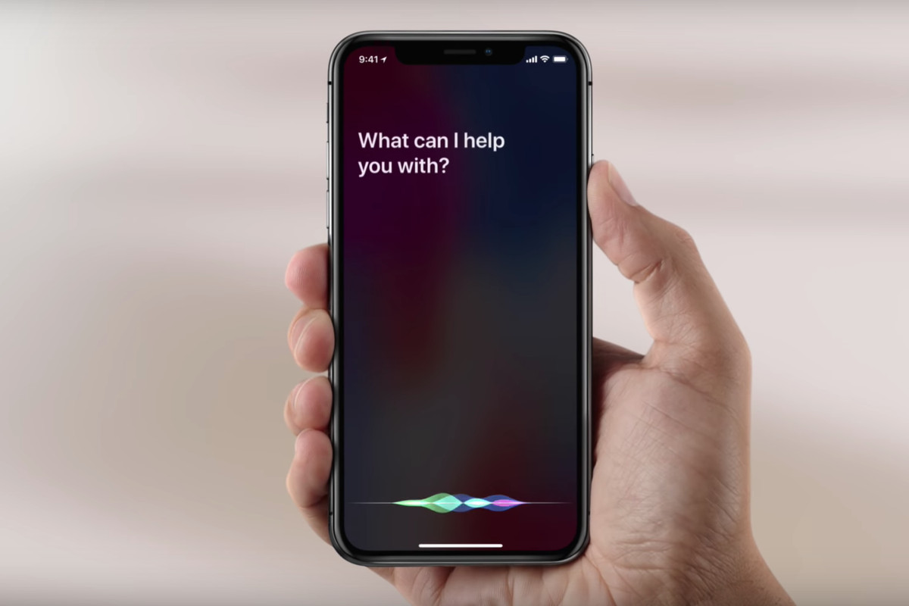
Sample applications

Slide 12
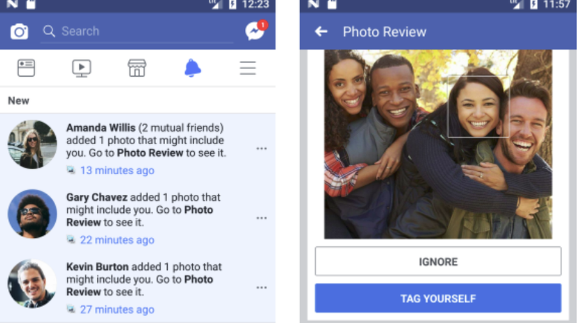
Sample applications
Facebook’s DeepFace, a system that uses neural networks that identifies faces with 97.35% accuracy.^{[4]}

Slide 13
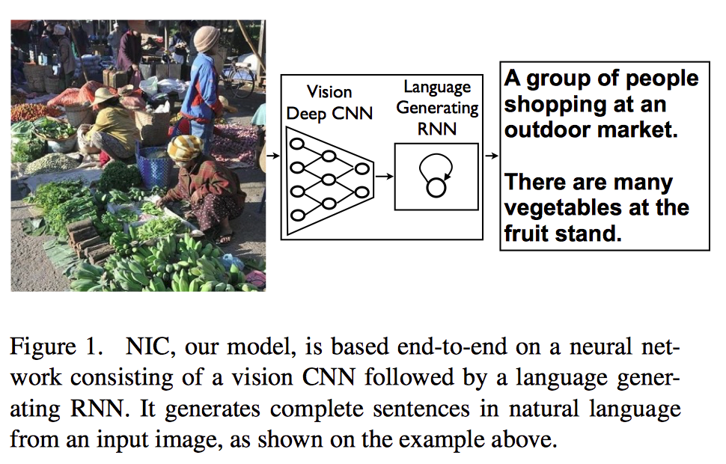
Sample applications^{[5]}

Slide 14
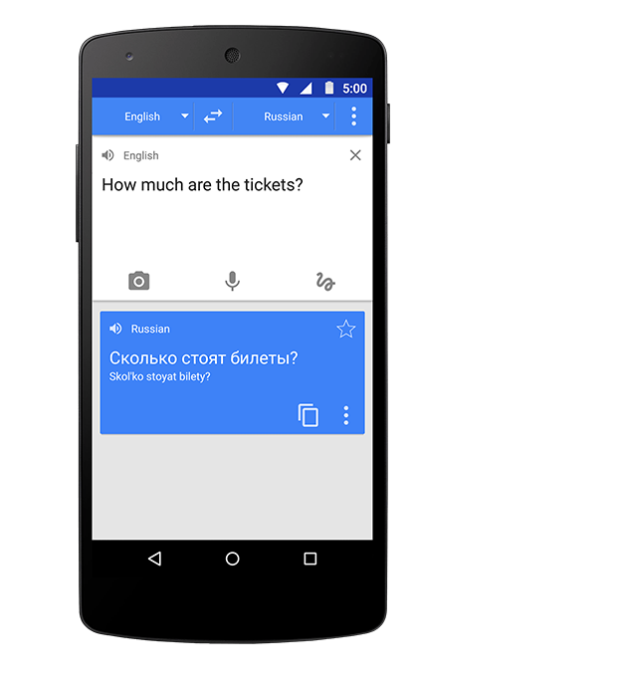
Sample applications
    Youtube automatic captions
    Google translate
    https://youtu.be/oQVQVt5H2QM?t=45

Slide 15
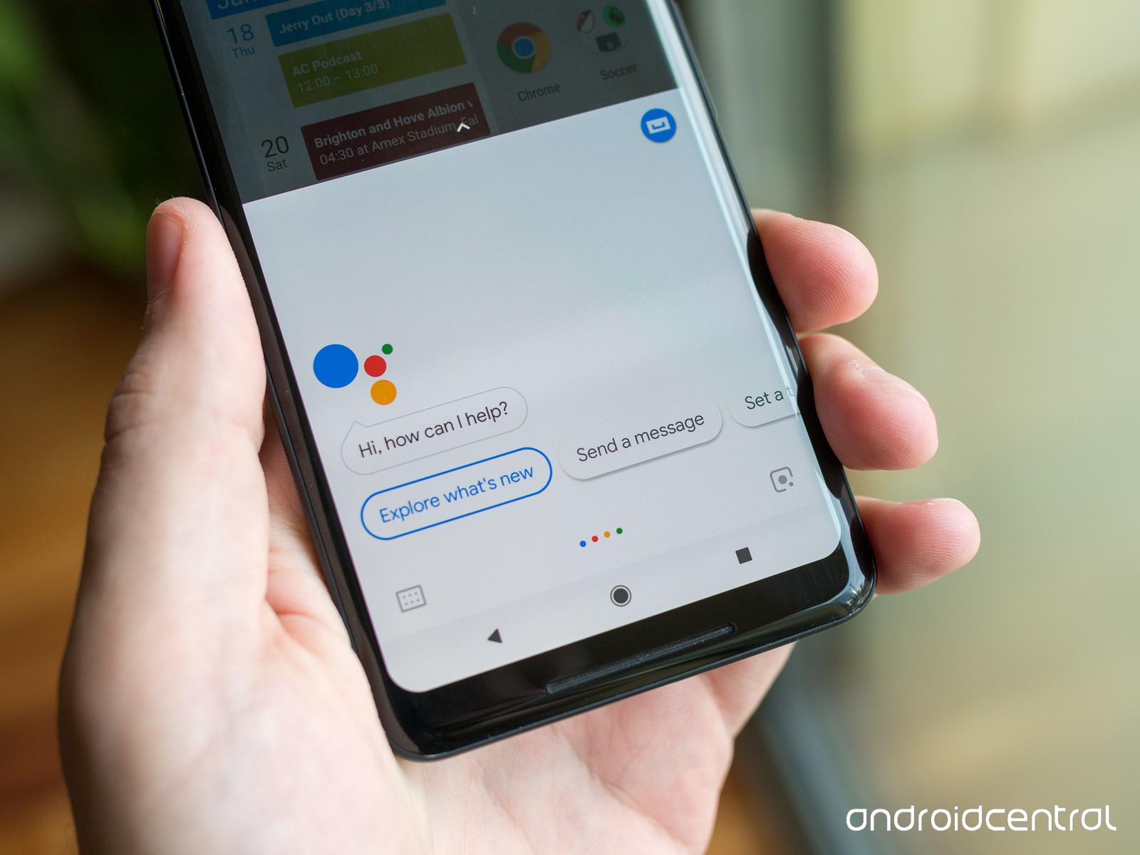
  Google Assistant making a reservation
      https://www.youtube.com/watch?v=-RHG5DFAjp8

Slide 16
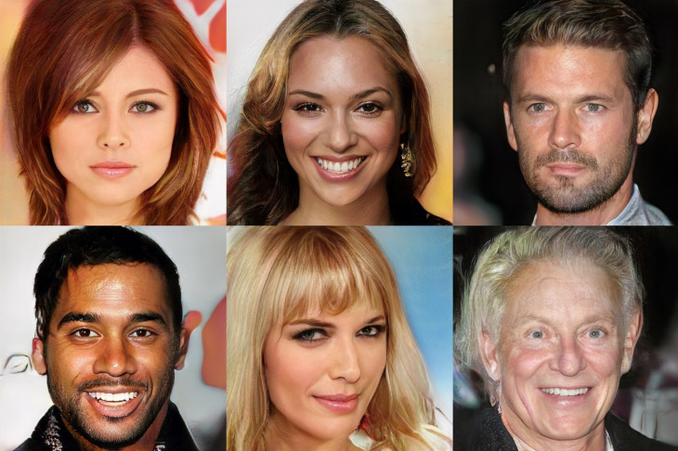
  Dreaming up celebrities^{[6]}
    https://www.youtube.com/watch?v=36lE9tV9vm0

Slide 17
  Can computers fool us?
    DeepFakes
    https://www.youtube.com/watch?v=cQ54GDm1eL0

Slide 18
  Robotics
    https://www.youtube.com/watch?v=hx_bgoTF7bs
    https://www.youtube.com/watch?v=XCLSkFKTWyg
    https://youtu.be/jwSbzNHGflM?t=21

Slide 19
Course outline
4. Unsupervised learning
- Principal components analysis
- Clustering
- Rule extraction/Basket analysis
5. Deep learning
- Neural networks
- Backpropagation algorithm
6. Putting it all together: Poverty prediction from satellite images
- Transfer learning
- Convolutional neural networks
1. Machine learning fundamentals
- Overfitting and underfitting
- Bias variance tradeoff
- Curse of dimensionality
- Cross validation
- No free lunch theorem
2. Supervised learning - Linear models
- Linear regression
- Regularization
- Logistic Regression
- Support vector machines and other supervised learning techniques
3. Supervised learning - Tree based models
- Decision trees
- Random forests

Slide 20
References
[1] https://en.wikipedia.org/wiki/Artificial_intelligence
[2] https://en.wikipedia.org/wiki/Machine_learning
[3] https://en.wikipedia.org/wiki/Data_science
[4] https://en.wikipedia.org/wiki/Timeline_of_machine_learning
[5] Oriol Vinyals, Alexander Toshev, Samy Bengio, Dumitru Erhan: Show and Tell: A Neural Image Caption Generator.
[6] https://research.nvidia.com/publication/2017-10_Progressive-Growing-of

