Slide 1
gifts, reciprocity and cooperation
Marcus Frean
Te Pūnaha Matatini, April 2015

Slide 2
“money allows humans to access cooperative solutions that make everyone better off”
(so if it's a good idea, why don't mice / plants / bacteria do it? (or... do they?!)
gifts
exchange
barter
“obvious”, & yet a bit of a mystery. origins unclear.
lots of properties, but what is crucial? built on “trust” (in... something), ie. built upon plausible predictions
How did they become plausible?
$
$

Slide 3
gifts
exchange
barter
Network of agents with commodities to trade.
Agents need “a bit of everything” to live.
Our agents were also in charge of their production, e.g .could choose to make a little of everything, or a lot of one thing.
$
$

Slide 4
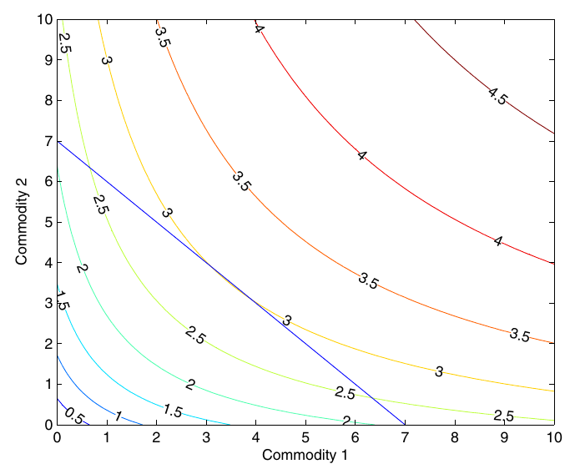
Agents need a little of everything, but can produce a lot (more) of one thing, if they choose to specialise.
This sets up an environment in which it would be worthwhile to conduct trade.

Slide 5
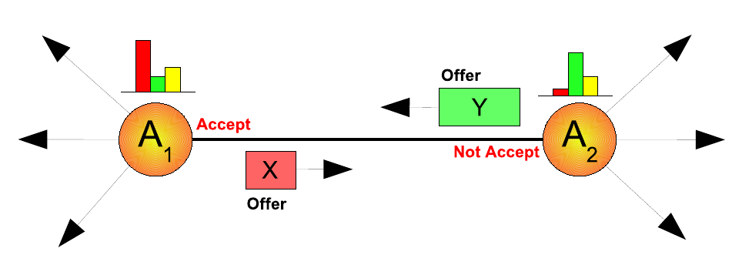
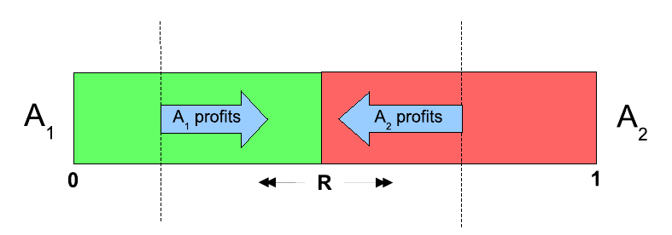
shit happens

Slide 6
gifts
exchange
We saw:
“sensible” policies for bidding
specialisation
emergence of “middle-men”.
Assumes :
the “protocol” of offers and counter-offers
the mechanism for the actual swap exists
barter
$
$

Slide 7
gifts
exchange
.... is a joint cooperative act.
Think of as two “gifts” exchanged simultaneously.
exchange is risky: do you swap your car for the out-of-towner’s truck?
With complex artifacts, the current owner knows more about the gift that the receiver.
& how do we actually do the swap?
barter
$
$

Slide 8
digression - the evolution of cooperation
Iterated Prisoner’s Dilemma → thousands of papers→ Tit-for-tat is general and robust.
All early work implicitly assumed agents acted at the same time. I wrote the first paper (1994) looking at the IPD without perfect synchrony → different forms of TFT survive.
Deja vu: Idealised exchange uses that “synchronous” assumption again!
Asynchronous exchange ~ “reciprocated gifting”
So let’s build a model of conditional gifts...

Slide 9
gifts
Questions:
can something like barter [& money] arise from gifting alone?
what are the critical requirements for barter [& money] to emerge?
(eg. cognitive - “can bacteria do it?”)
what role does network structure play?
exchange
barter
$
$

Slide 10
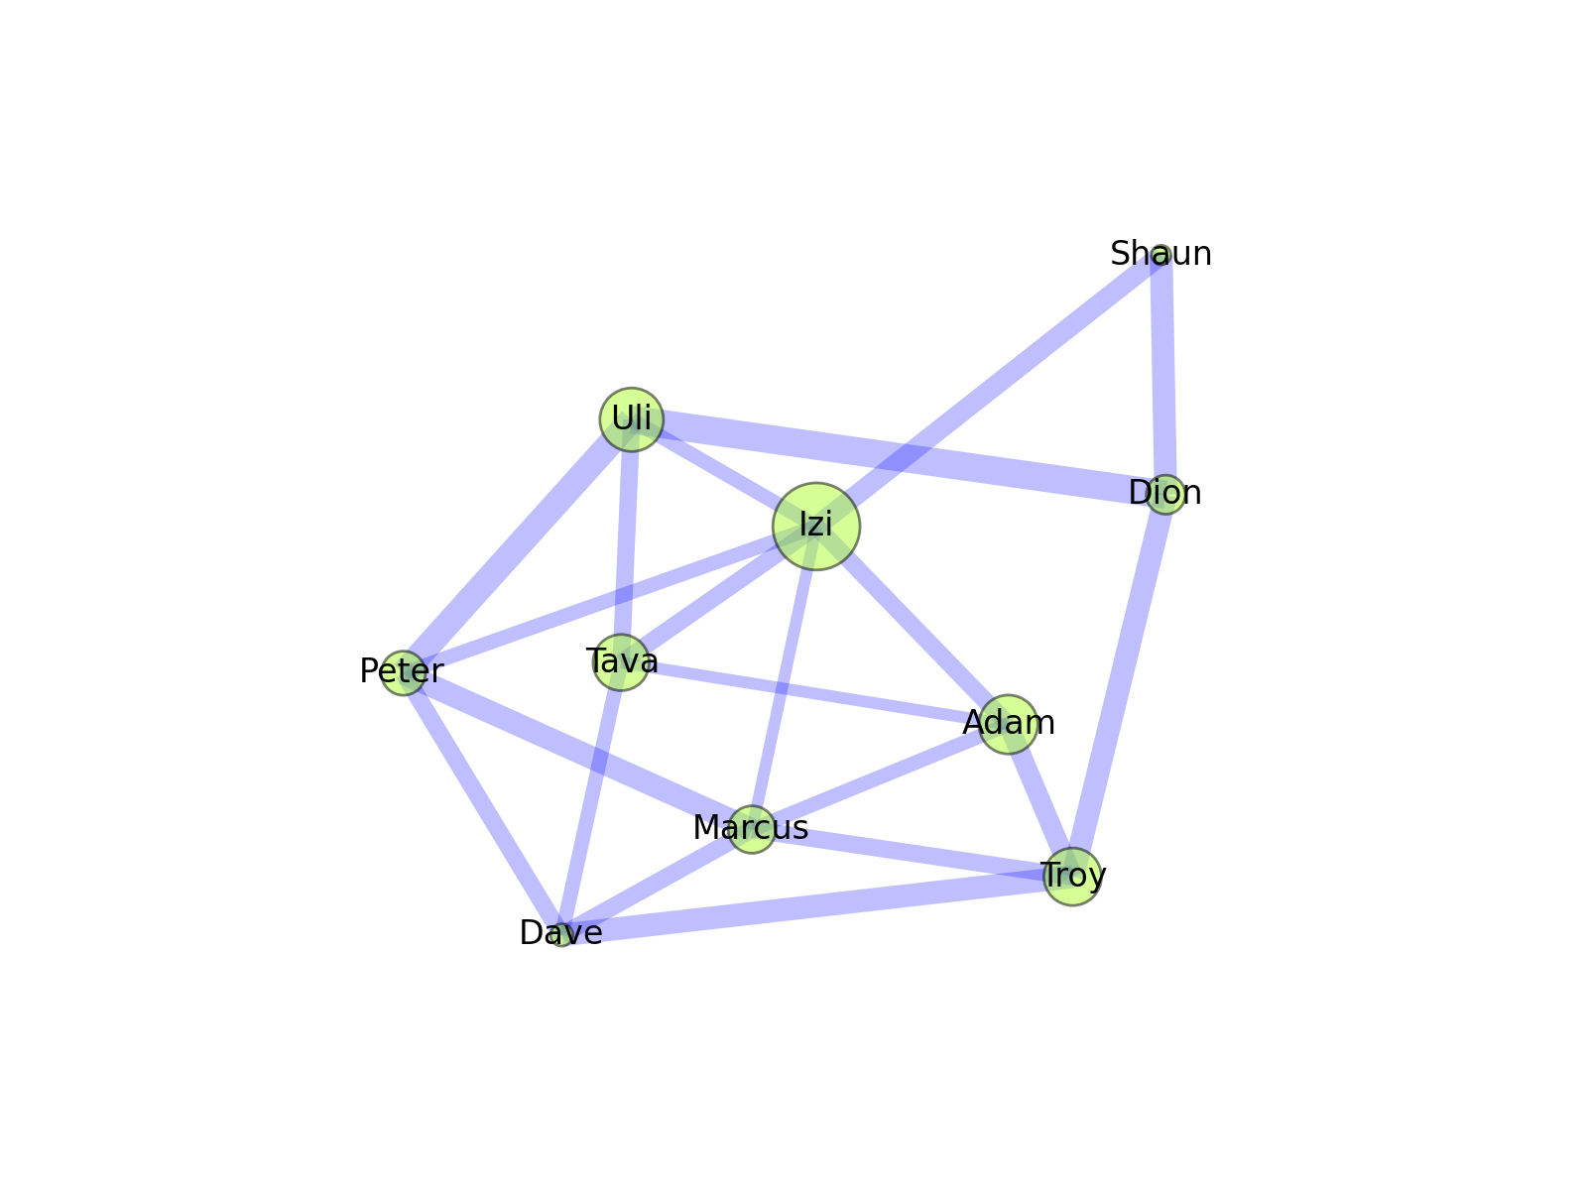
Model 0.1!
network is fixed
agents like to have a bit of everything, but start the season with gaps
gift decision is WHAT to WHOM (or just “pass”)
parameterise decisions with just 3 numbers

Slide 11
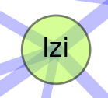
Model 0.1:
we could parameterise decisions with “weights” determining Izi's drive to give commodity X to neighbour i . For example:
controls the willingness of the agent to give versus simple “pass”
determines importance of the loss of utility to be borne
determines importance of prior history: nett perceived “debt”

Slide 12
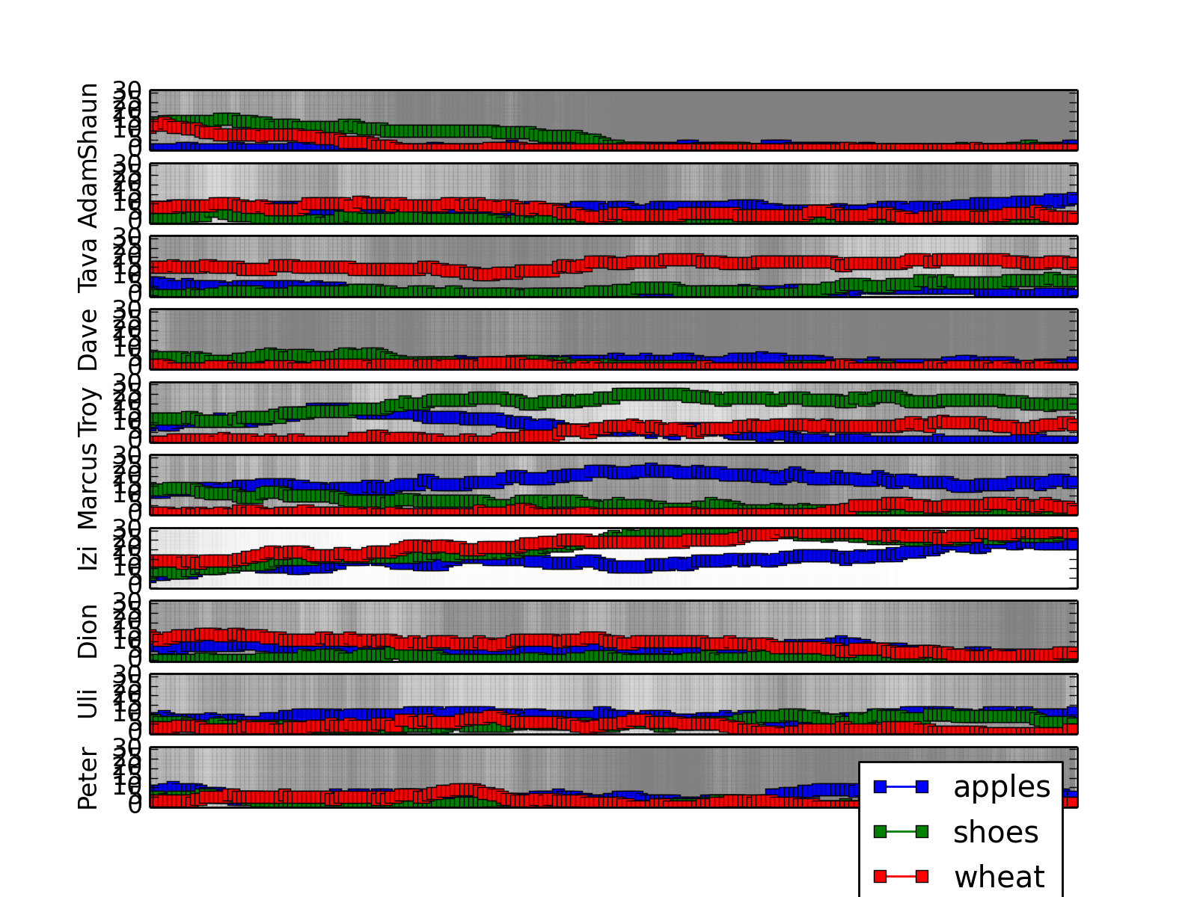

Slide 13
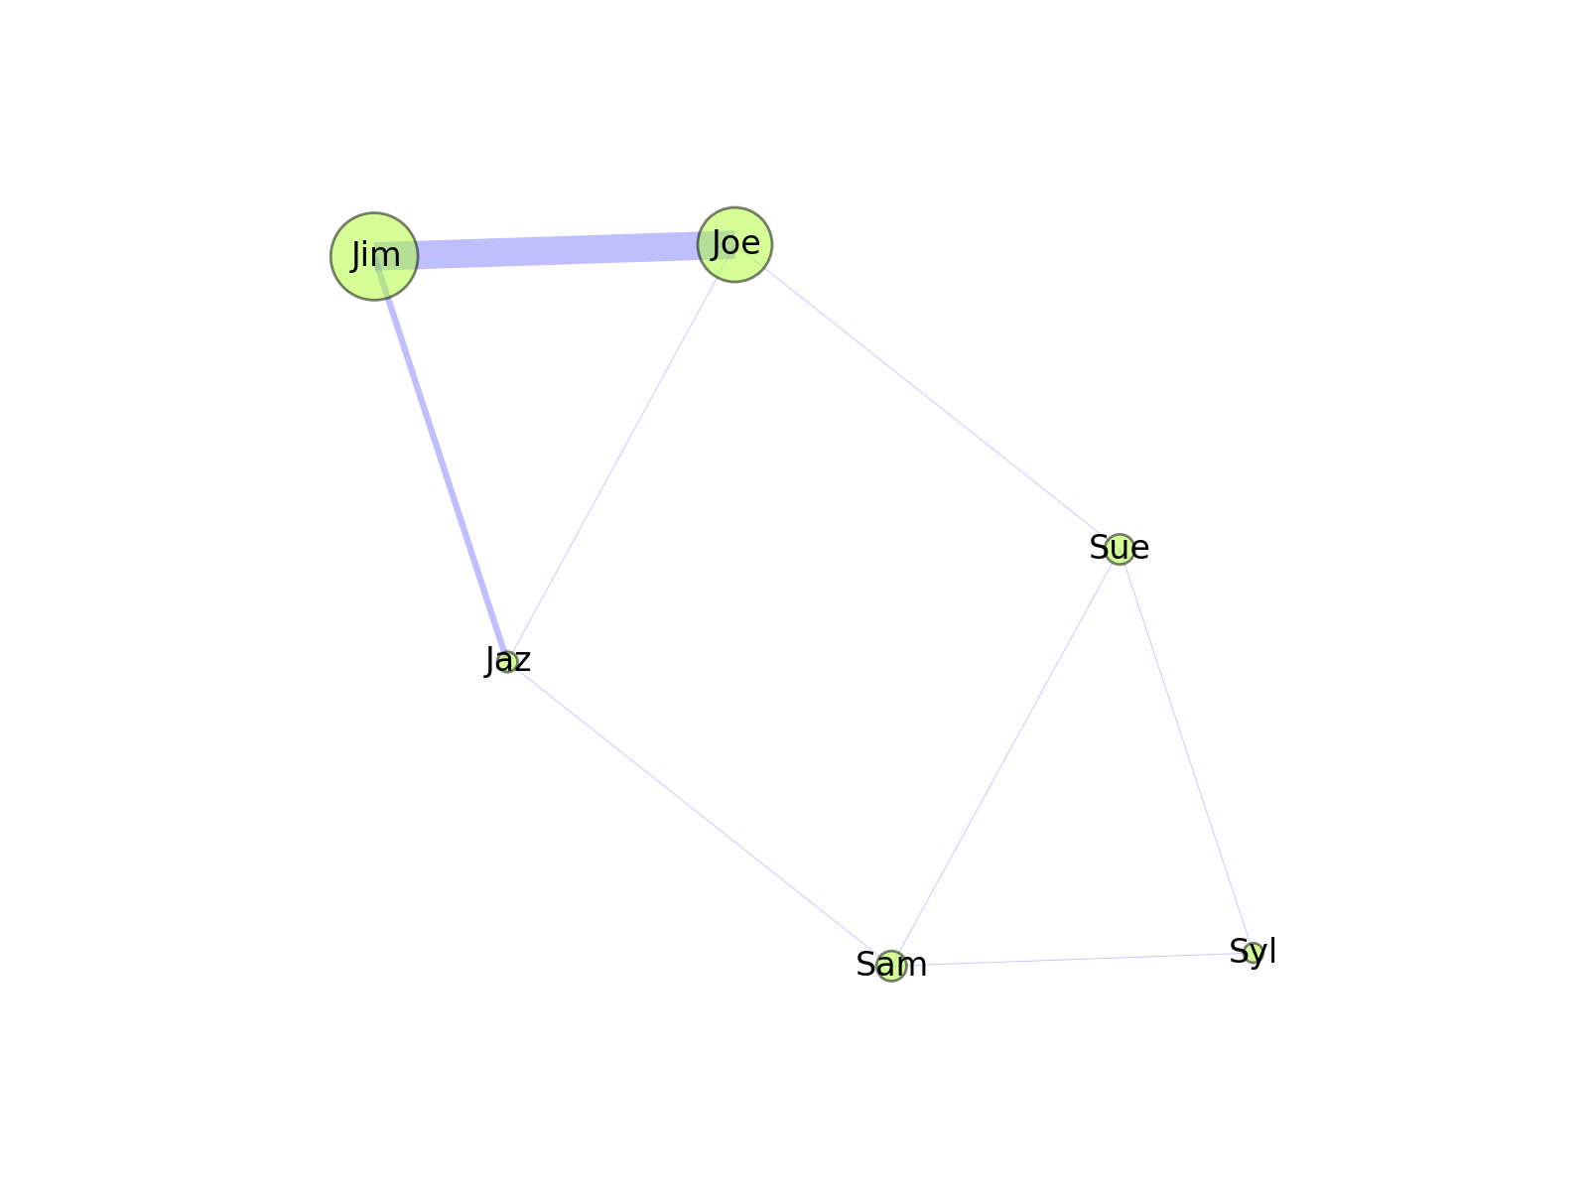
One tribe is TFT, the other are non-cooperators

Slide 14
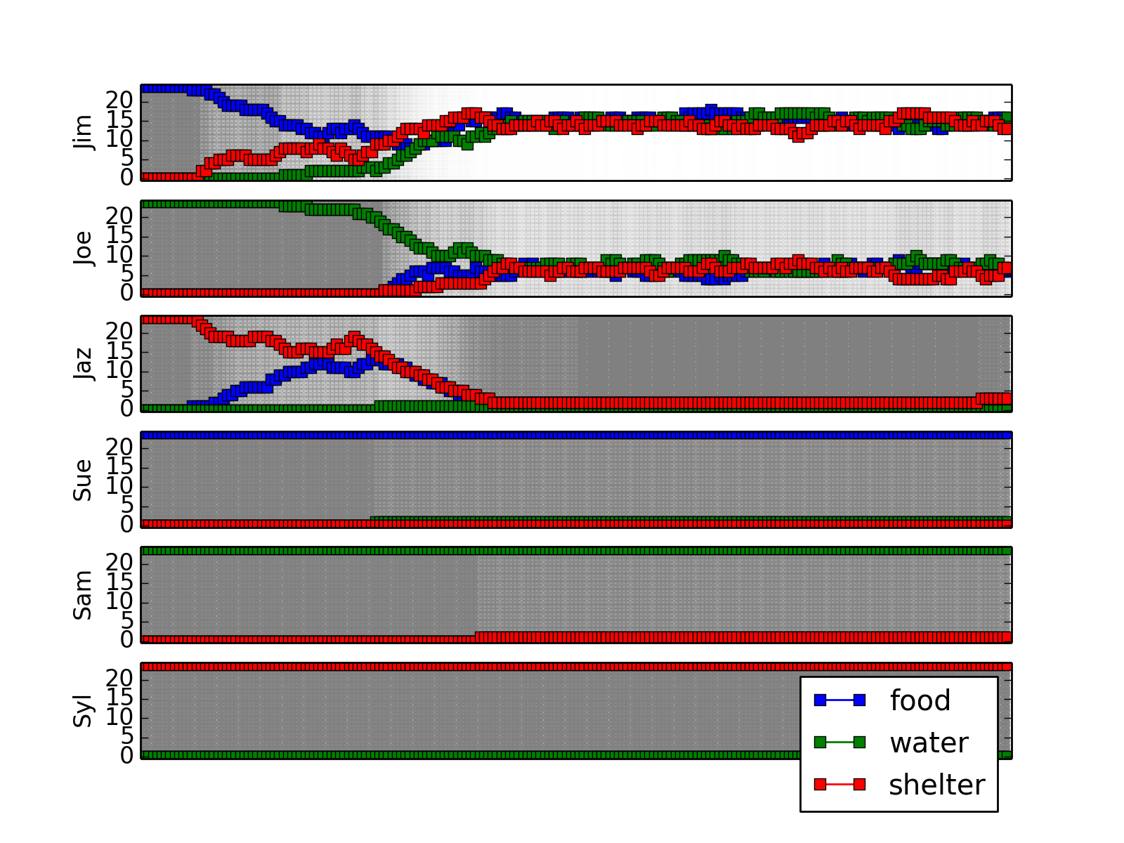
One tribe is TFT, the other are non-cooperators

Slide 15
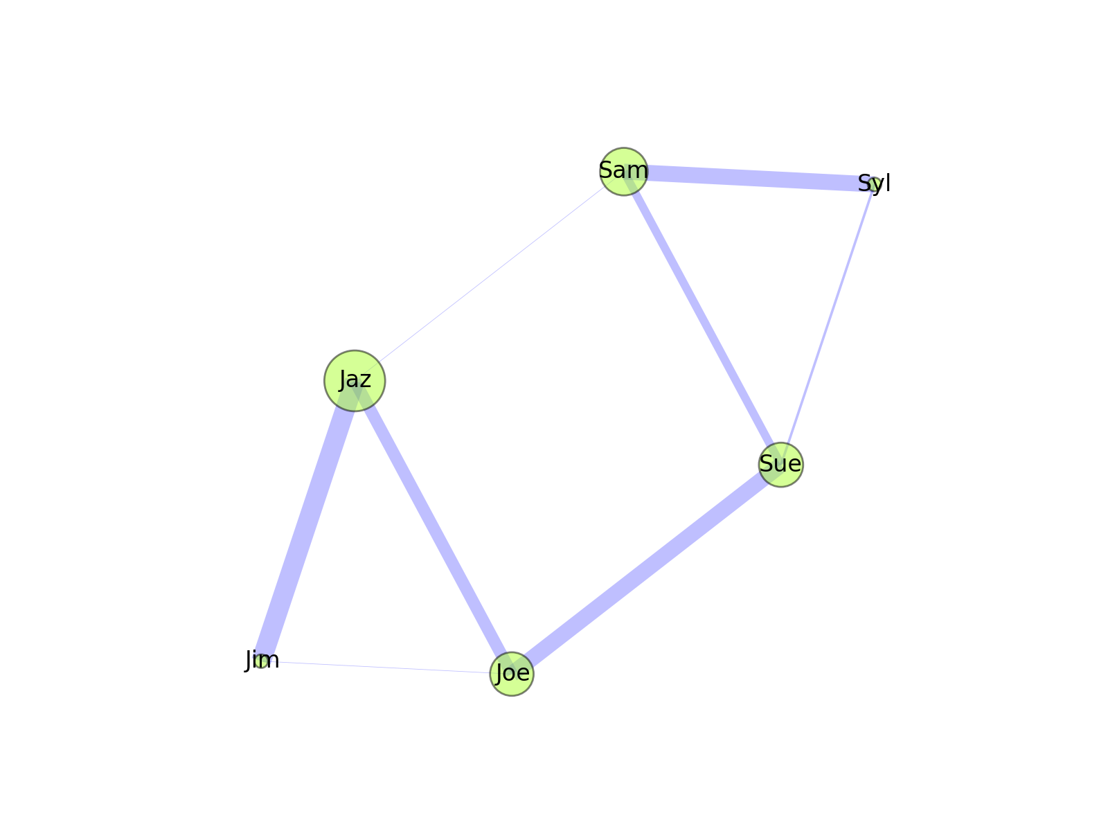
all have perfect memories, and play TFT
we get an “emergent” network, within the network

Slide 16
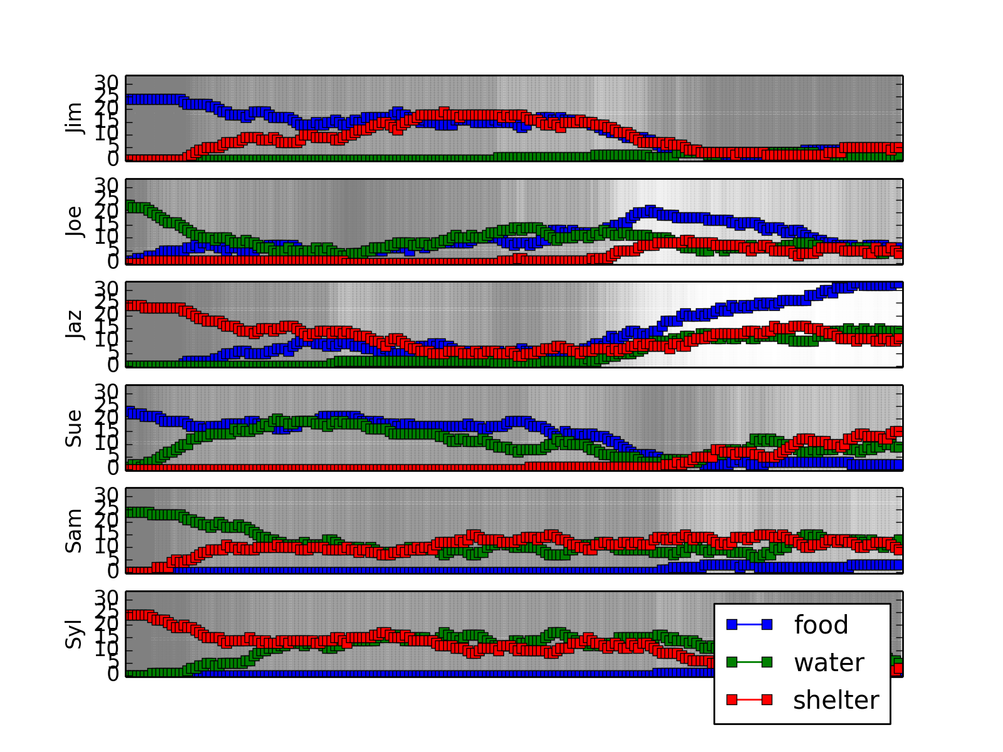
all have perfect memories, and play TFT

Slide 17
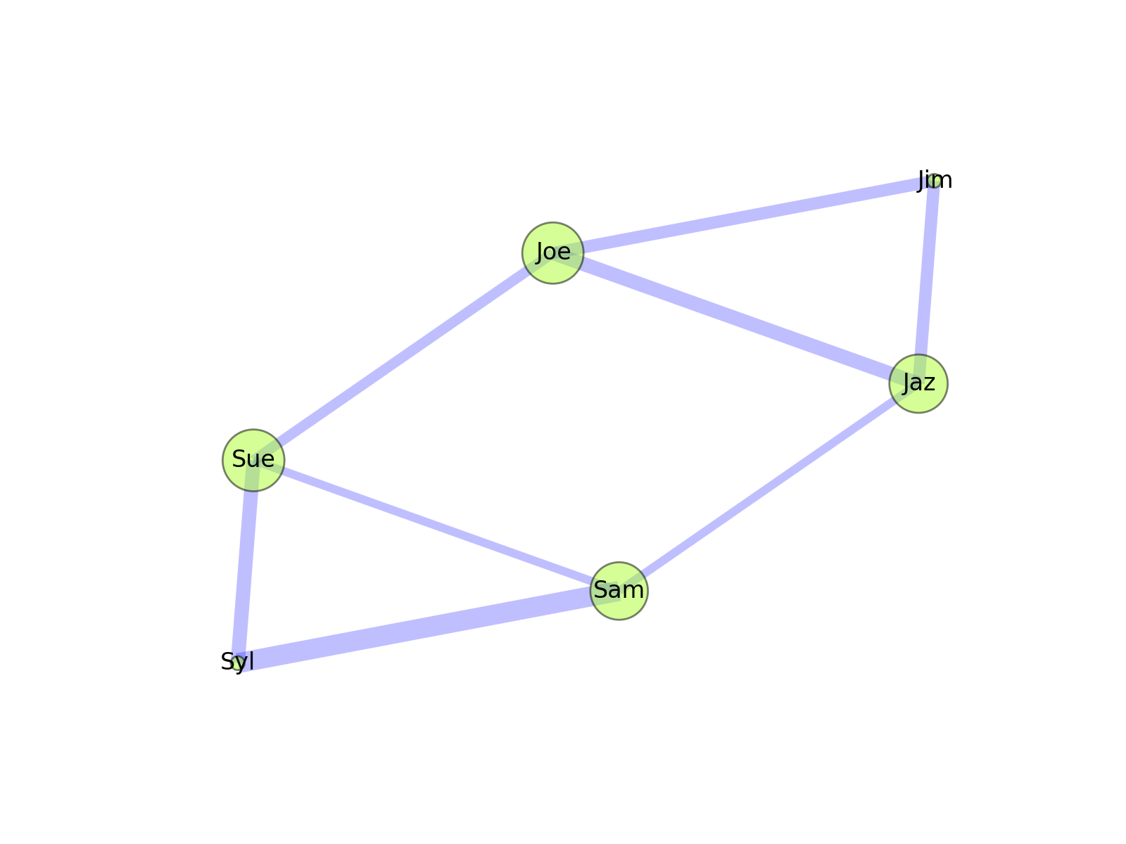
all have BAD memories, and play TFT

Slide 18
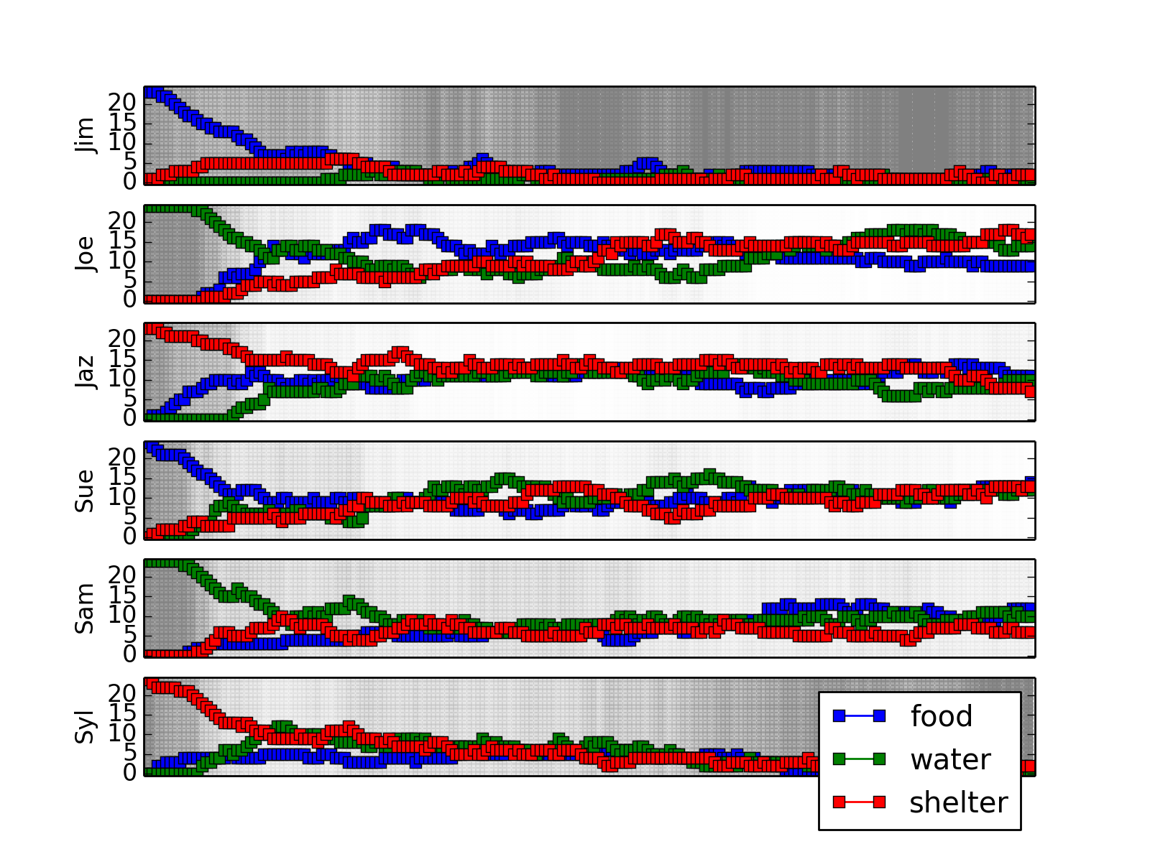
all have BAD memories, and play TFT

Slide 19
gifts
Next:
look at when and how cooperators prosper
flows of “incompressible fluids” → dynamics → stable points (better than stochastic simulation?)
agents could take into account the other’s desires: would empathy emerge? Relationship to money? related to resolving difference between evaluations by self versus other?
reciprocal taking different from gifting?
Project amounts to the generalisation of Prisoners’ Dilemma and TFT to networks
exchange
barter
$
$

