Slide 1
Host manipulation and multiple infections

Slide 2

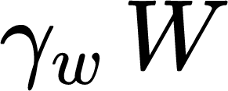
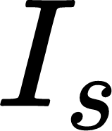
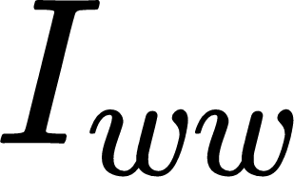
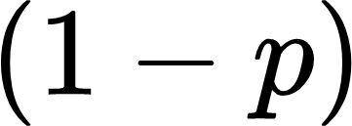

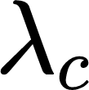
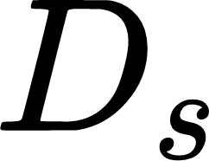
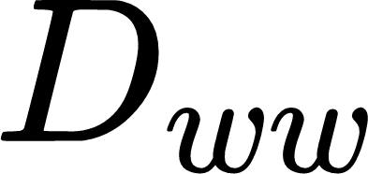
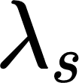
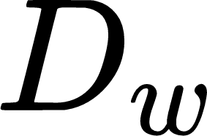





Resident dynamic full model
Multiple infection via cotransmission
with probability p and q
Intermediate host
Multiple infection via sequential transmission
Definitive host
Parasite pool
Force of infection

Slide 3
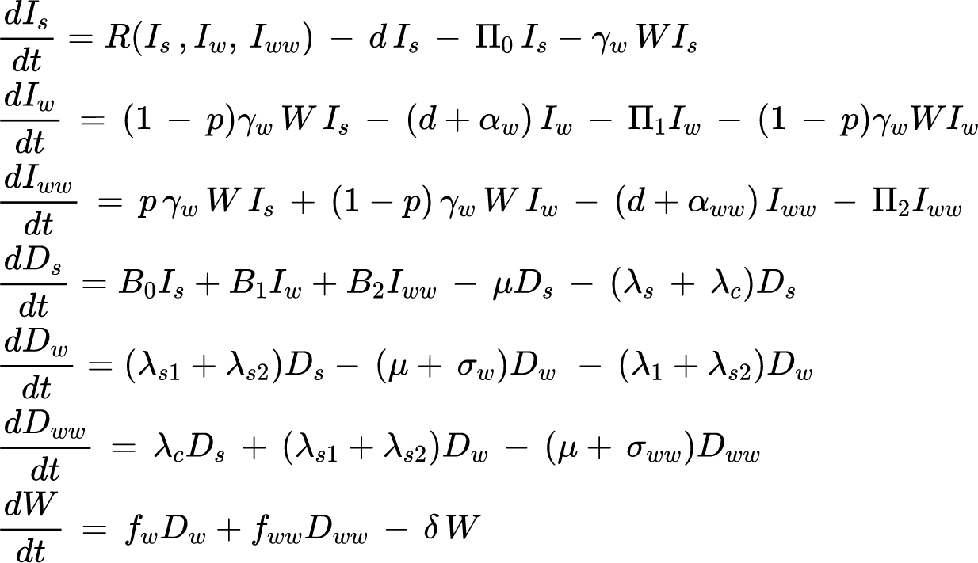










Resident dynamic full model ODEs
Predation rate
Birth rate
Force of infection

Slide 4


Function for predation and birth of definitive hosts
Or

Slide 5
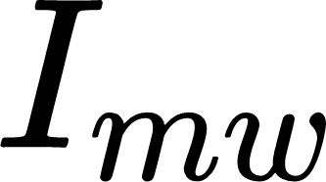

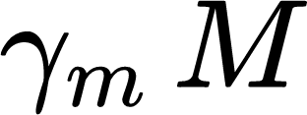
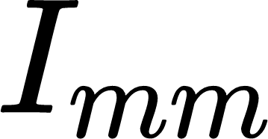
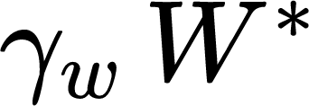
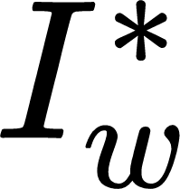

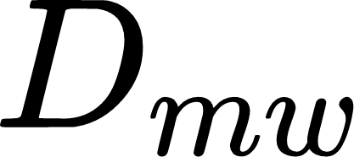




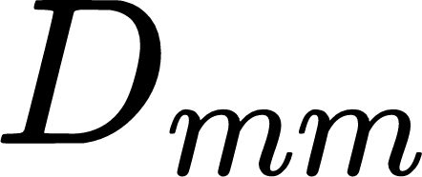
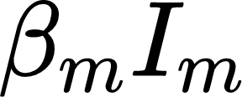
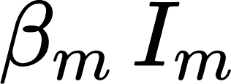
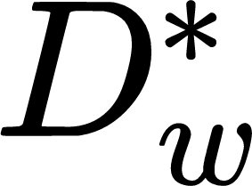
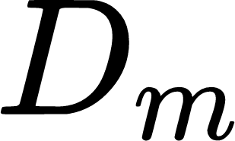
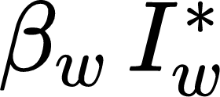
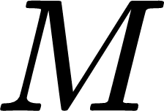
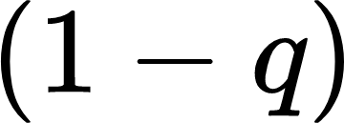

Mutant dynamic full model
Probability of cotransmission
Intermediate host
Definitive host
Parasite pool

Slide 6
Resident dynamic without sequential infection in intermediate host
Multiple infection via cotransmission
with probability p and q
Intermediate host
Multiple infection via sequential transmission
Definitive host
Parasite pool
Force of infection

Slide 7
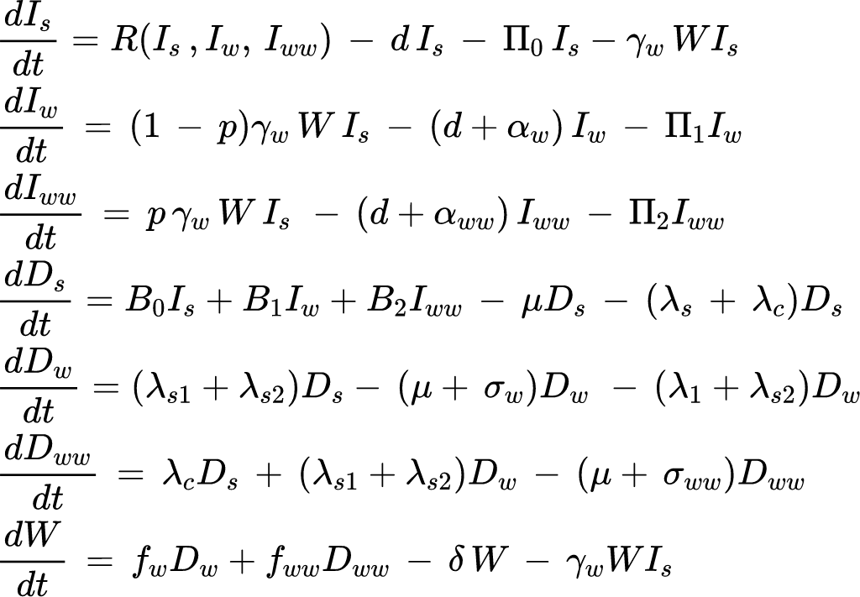
Resident dynamic without sequential infection in intermediate host
Predation rate
Birth rate
Force of infection

Slide 8

Resident dynamic without parasite pool and sequential transmission in intermediate host
Multiple infection via cotransmission
with probability p and q
Intermediate host
Multiple infection via sequential transmission
Definitive host
Force of infection

Slide 9
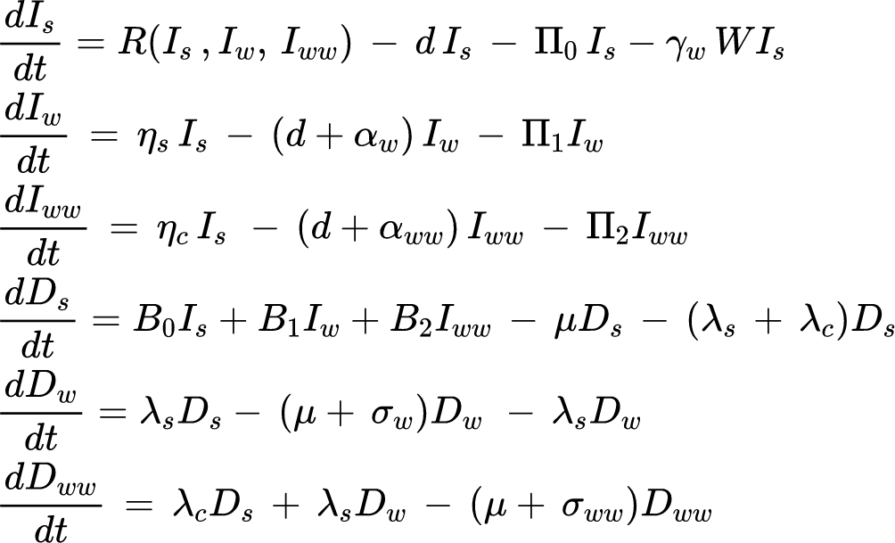
Predation rate
Birth rate
Force of infection of intermediate hosts
Force of infection of definitive hosts

Slide 10


Probability of cotransmission
Intermediate host
Definitive host
Parasite pool

Slide 11
